Slide 1
Core Web API
Controllers, Routing, and HTTP Messages

Slide 2
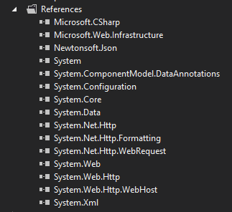
WebAPI – Pieces
NuGet
Microsoft.Net.Http
HttpClient, HttpRequest, HttpResponse
Microsoft.AspNet.WebApi.WebHost
Configuration, Handlers
Microsoft.AspNet.WebApi.Core
Controllers, Filters, ModelBinding
Microsoft.AspNet.WebApi.Client
Formatters

Slide 3
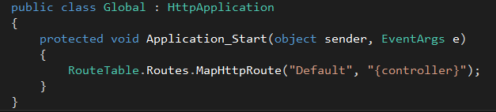
Routing
ASP.NET Hosting can use the System.Web routing engine
MapHttpRoute assigns an HttpControllerRouteHandler

Slide 4
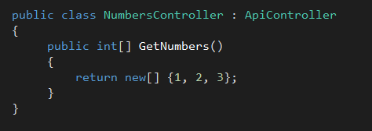
Controllers
Derive from ApiController
URI path maps to controller (default routing)
HTTP method maps to action (default routing)
Public methods only

Slide 5
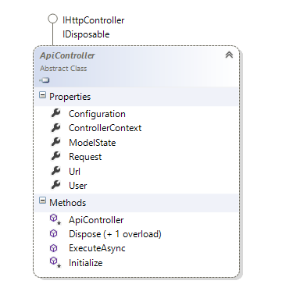
ApiController
Model binding state
Request object
Url helper
Interception methods

Slide 6
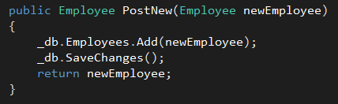
Model Binding
Moves information in a request into CLR objects
Query string, header, or message body
JSON, XML, or form encoded
Validation via attributes or interfaces

Slide 7
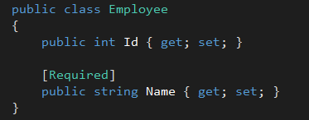
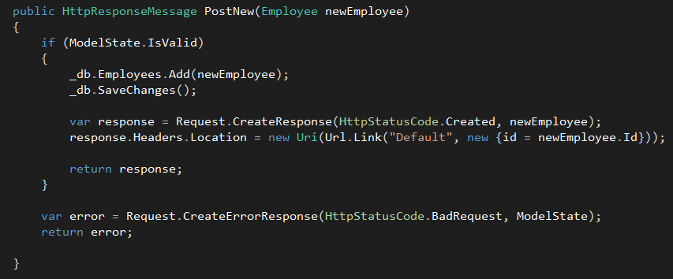
Model State
Side-effect production of model binding
Includes validation errors

Slide 8
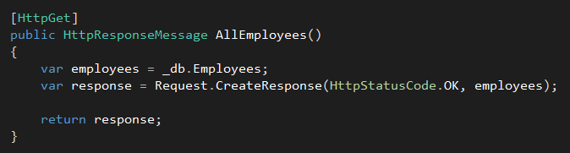
Explicit Routing
HttpGet
HttpPost
HttpPut
HttpDelete

Slide 9
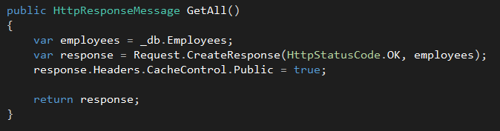
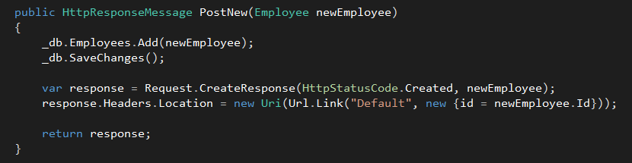
HttpRequestMessage / HttpResponseMessage
Work against the HTTP infrastructure

Slide 10
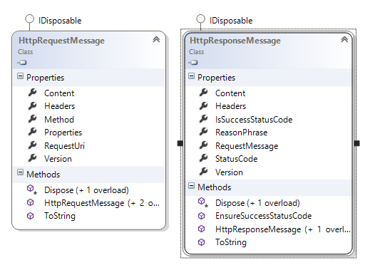
HttpRequestMessage / HttpResponseMessage

Slide 11
Content Negotiation
Important aspect of REST
Based on Accept (client) and Content-Type (client and server) headers
MediaTypeFormatter performs the work
XML, JSON, HTML forms (incoming only)
Can also configure other types using headers, query string, extension

Slide 12
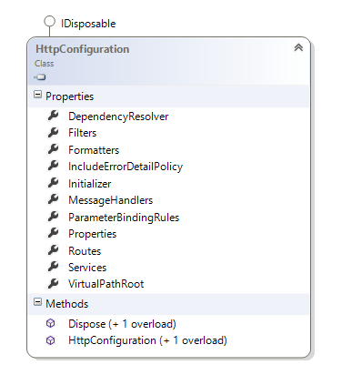
Configuration
GlobalConfiguration.Configuration
Routes
IoC Container
Media formatters
Global filters

Slide 13
Summary
WebAPI embraces HTTP
Conventions for routing provide uniform interface
Model binding moves data between the messages and CLR types

