Slide 1
Models

Slide 2
Overview
What’s a model?
Domain models
View models
Model binding
State management and models

Slide 3
The MVC Model
Controller
Arranged by the controller
Consumed by the view
But what is it?
Model
View
DTOs?
Entities?
Business
Objects?

Slide 4
The Right Model
Could be any of these
Business objects and entities
Make the best model for forms over data
DTOs and view specific models
Work better in a complex application
Isolate business layer from UI
Mix and match to meet application needs
Model
Entities?
DTOs?
Business
Objects?

Slide 5
Model Conventions & Practices
MVC project template creates a Models folder
Using this folder is optional
Models can live anywhere
View are simple
Model contains all the information needed by a view
No complicated logic in the view
Controller actions are small
Rely on business layer to do the heavy lifting
Translates request into instructions for the business layer
Aggregates the model and selects the view

Slide 6
Model Binding
Default model binder maps request values to a CLR type
Inspects form collection and query string
Maps request to primitive action parameters and complex types
public ActionResult Edit(Employee employee)
{
// ...
}
public ActionResult Edit(int id, string name,
DateTime hireDate)
{
// ...
}
public ActionResult Edit(int id, FormCollection collection)
{
// ...
}

Slide 7
Using the FormCollection
Lowest level access to posted values
Can inspect raw values in request
UpdateModel and TryUpdateModel will move values
public ActionResult Create(FormCollection collection)
{
try
{
var employee = new Employee();
var repository = new EmployeeRepository();
UpdateModel(employee);
repository.Add(employee);
return RedirectToAction("Index");
}

Slide 8
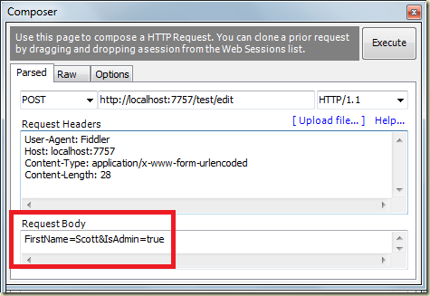
Model Binding Security
Beware of over-posting / mass assignment

Slide 9
White Lists and Black Lists
Lists give you control over what the model binder will move
Include and Exclude parameters
Map properties defined by an interface
var employee = new Employee();
UpdateModel(employee, new string[] { "Title", “HireDate" });
var employee = new Employee();
UpdateModel<IEmployeeBinding>(employee);
public interface IEmployeeBinding
{
string Name { get; set; }
DateTime HireDate { get; set; }
}

Slide 10
Using Parameters
Parameters become required values for the action
Can fail when value not found
Nullable parameters become optional
[AcceptVerbs(HttpVerbs.Post)]
public ActionResult Create(string name, DateTime hireDate)
{
try
{
var employee = new Employee();
employee.Name = name;
employee.HireDate = hireDate;
var repository = new EmployeeRepository();
repository.Add(employee);
...

Slide 11
Model Parameters
ActionInvoker will create and bind new model instance
Use BindAttribute for includes and excludes
public ActionResult Create([Bind(Include="Name, HireDate")]
Employee employee)
{
try
{
if (ModelState.IsValid)
{
var repository = new EmployeeRepository();
repository.Add(employee);
// ...

Slide 12
Model Binding State
ModelState contains byproducts of model binding
Errors and attempted values
ModelState.IsValid
Did the model bind correctly?
HTML helpers use model state
Model state can override view model data
public void IndexAsync(string model)
{
if (ModelState.IsValid)
{
// commit...
return RedirectToAction("Index");
}
return View(model);
}

Slide 13
Custom Model Binders
Useful for custom type conversions
public class DateTimeModelBinder : IModelBinder
{
public object BindModel(ControllerContext controllerContext,
ModelBindingContext bindingContext)
{
...
int year;
if (int.TryParse(result.AttemptedValue, out year))
{
return new DateTime(year, 1, 1);
}
return null;
}
}

Slide 14
Validation with Annotations
Attributes defined in System.ComponentModel.DataAnnotations
Covers common validation patterns
Required
StringLength
Regex
Range
public class LogOnModel
{
[Required]
public string UserName { get; set; }
[Required]
public string Password { get; set; }
public bool RememberMe { get; set; }
}

Slide 15
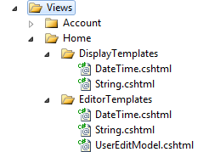
Custom Templates
Use with DisplayFor and EditorFor

Slide 16
Validation Messages
ValidationMessageFor
Display property level validation errors
ValidationSummary
Display model level validation errors
<%: Html.ValidationSummary(true) %>

Slide 17
Custom Validation Annotations
Derive from ValidationAttribute
Override IsValid method (at a minimum)
[AttributeUsage(AttributeTargets.Property)]
public sealed class MinLengthAttribute : ValidationAttribute
{
// …
public override bool IsValid(object value)
{
string valueAsString = value as string;
return (valueAsString != null &&
valueAsString.Length >= _minCharacters);
}
}

Slide 18
Self validating models
IValidatebleObject
Model object must implement a Validate method
public IEnumerable<ValidationResult> Validate(ValidationContext validationContext) { if (EndDate <= StartDate) { yield return new ValidationResult("EndDate must be greater than StartDate"); } }

Slide 19
Summary
Models are application specific
DTO models
Entity models
Model Binders
Move data between HTTP request and model
Custom model binders possible
Use any persistence technology
NHibernate
NoSQL
Entity Framework
Custom DAL

