Slide 1
Startup & Middleware
The HTTP Pipeline

Slide 2
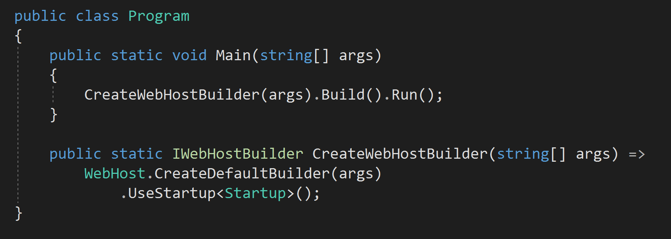
ASP.NET Core Apps Are Executables

Slide 3
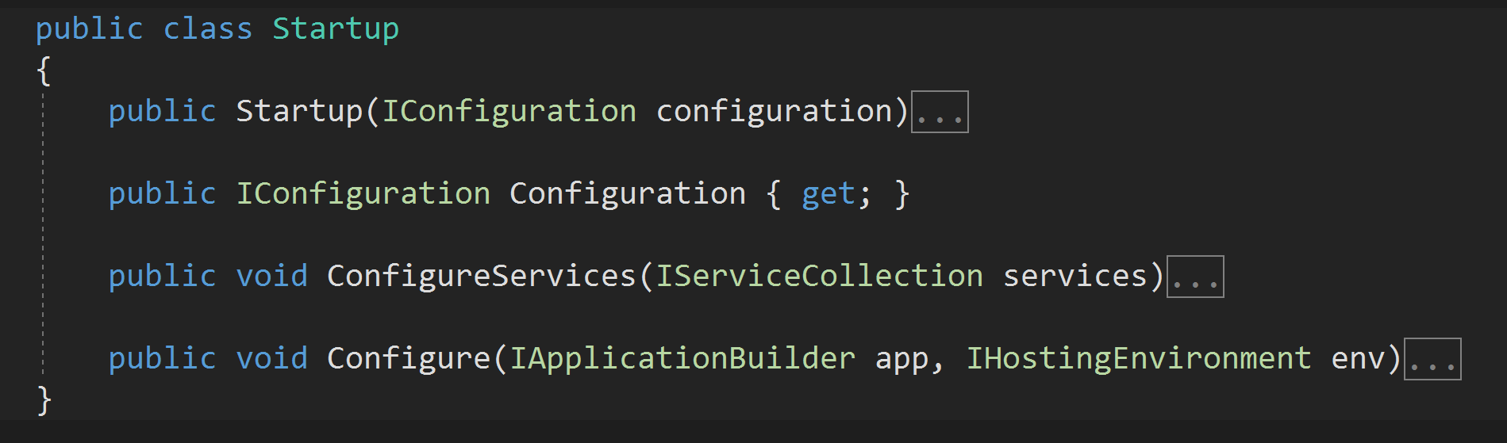
Startup Defines the App

Slide 4



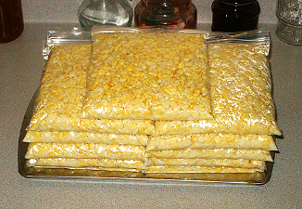


Allen Family Food Processing
Me
next
Mom
next
Dad
return
return

Slide 5
Middleware
POST /corn
POST /corn
POST /corn
Me
next
Mom
next
Dad
return
return
HTTP/1.0 200 OK
<html>
….
</html>
HTTP/1.0 200 OK
<html>
….
</html>
HTTP/1.0 200 OK
<html>
….
</html>

Slide 6
Middleware
Incoming
Request
POST /addmovie
POST /addmovie
POST /addmovie
Logger
next
Authorizer
next
Router
return
return
Response
Created
Outgoing
Response
HTTP/1.0 200 OK
<html>
….
</html>
HTTP/1.0 200 OK
<html>
….
</html>
HTTP/1.0 200 OK
<html>
….
</html>

Slide 7
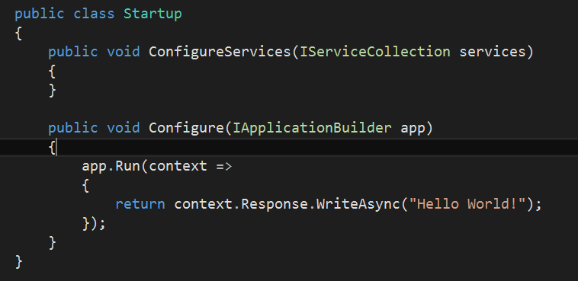
Startup Class
ASP.NET searches for Startup as an entry point
Defines configuration, middleware, services

Slide 8
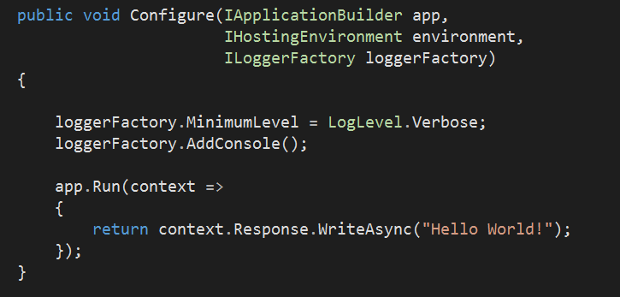
Configure
Injected to Configure method of Startup
Defines how to process HTTP requests
Optional parameters
IHostingEnvironment
ILoggerFactory

Slide 9
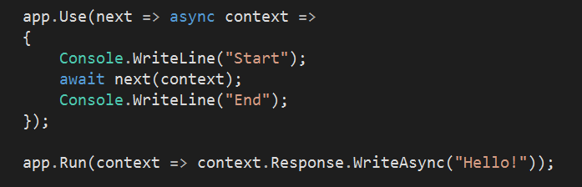
IApplicationBuilder
Use and run middleware

Slide 10
app.Run
Given an HttpContext
No access to more middleware

Slide 11
app.Use
Take a ReqeustDelegate
Return a RequestDelegate

Slide 12
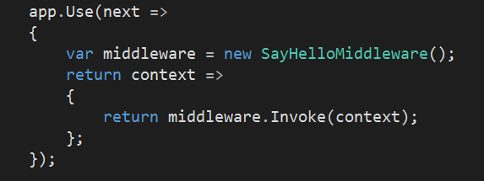

app.UseMiddleware
Encapsulate middleware in a class
Requires constructor and Invoke method

Slide 13
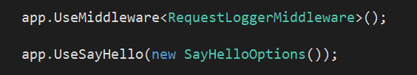
Custom Middleware
Convention is to create custom options and Use methods.

Slide 14
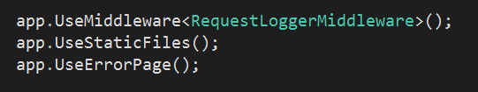
Common Middleware
Static files
Diagnostics
ErrorHandler

Slide 15
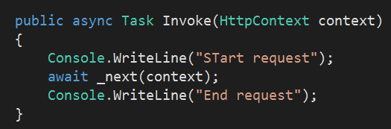
Tips
Order is important
Be careful modifying the response after call to next

Slide 16
Summary
Middleware provides logic for HTTP processing
Middleware
Middleware
Middleware
Server
Host

