Slide 1
The ADO.NET Entity Framework
Part I
Beyond Object Relational Mapping

Slide 2
Overview
Background
Models, Mapping, and Metadata
Entity SQL and LINQ to Entities
Object Services
Compare LINQ to Entities with LINQ to SQL

Slide 3
Impedance Mismatch Redux
Objects | Databases
Built using OOP principles | Built using relational algebra
Use inheritance and aggregation | Requires data normalization
Link with references | Link with foreign keys
Identified by memory location | Identified by primary key
Use data types defined by runtime | Use datatypes defined by database
Can hold data in lists and trees | Can hold data in tuples
Not transactional (today) | Heavily transactional

Slide 4
Entity Framework
The new ADO.NET
Higher level of abstraction than ADO.NET
Introduces the concept of an Entity Data Model
Vision goes beyond traditional ORM tools to provide “data services”
Features
LINQ Provider
Visual Studio designer support
Flexible mapping
Data provider model (to support Oracle, DB2, etc)

Slide 5
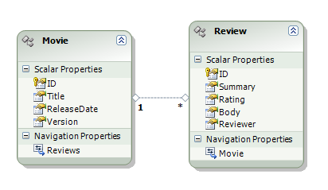
Entity Focus
An Entity is
An object we can persist
An Entity has
An entity key that makes the entity uniquely identifiable
One or more scalar or complex properties
One or more relationships to other entities

Slide 6
Three Approaches To Entities
Schema first approach
Generate the model from a database schema
Model first approach
Generate a schema from the model
Code first approach (EF 4.1)
No mapping files – only C#/VB code
Not "in the box" with 2010 (Easy to install with NuGet)

Slide 7
The Entity Data Model
Conceptual Model
(CSDL)
Entities
Entity Sets
Mapping (MSL)
Storage Model
(SSDL)
Tables
Columns
Relationships

Slide 8
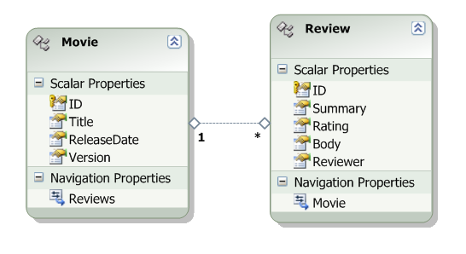
Entity Designer
Create entities and relationships
Define keys, types, nullability

Slide 9
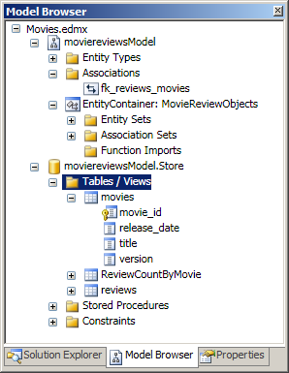
Model Browser
Browse model
GUI can be difficult to navigate
Validate model
Update model from database

Slide 10
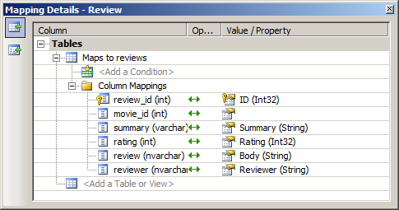
Mapping Details
Map entities across one or more tables
Right-click on entity in design or browser and select “table mapping”

Slide 11
Entity Framework Services
LINQ to
Entities
Object Services
Entity SQL
Entity Client
CSDL
MSL
SSDL
Data
source
ADO.NET Providers

Slide 12
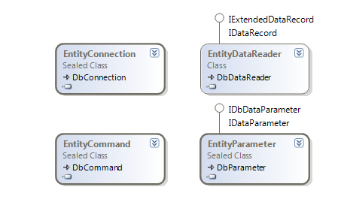
Entity Client
No more database specific constructs in ADO.NET code
Queries sent to client as eSQL (Entity SQL)
Queries run against entity model, not the underlying storage model
Entity client communicates with a database specific provider
Results can be consumed through a DbDataReader

Slide 13
Entity SQL
Structured Query Language for the entity data model
Provider neutral
using(MovieReviewObjects ctx =
new MovieReviewObjects(connectionString))
{
string command = "SELECT VALUE m FROM Movies as m";
var movies = new ObjectQuery<Movie>(command, ctx);
foreach (Movie m in movies)
{
Console.WriteLine(m.Title);
}
}

Slide 14
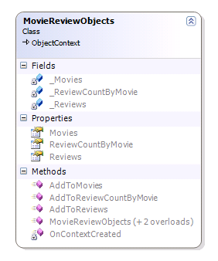
ObjectContext
Gateway to all entities
Relies on mapping and object metadata
Entities live inside Entity Sets
Exposed as ObjectQuery<T> properties on the ObjectContext
ObjectQuery<T> implements IQueryable<T>
Materializes objects instead of returning a data reader

Slide 15
LINQ to Entities
Same standard operators and query syntax
using (MovieReviewObjects context =
new MovieReviewObjects(connectionString)) {
var movies = from m in context.Movies
where m.Reviews.Count > 1
select m;
foreach (var m in movies) {
Console.WriteLine(m.Title);
m.Reviews.Load();
foreach (var r in m.Reviews) {
Console.WriteLine("\t" + r.Summary);
}
}
}

Slide 16
Deferred Loading
Entity Framework does use “lazy loading” for relationships
Turn on/off as ContentOptions
Can also eager load using an Include method on the ObjectContext
foreach (var m in movies) {
Console.WriteLine(m.Title);
m.Reviews.Load();
foreach (var r in m.Reviews) {
Console.WriteLine("\t" + r.Summary);
}
}

Slide 17
Inserting Data
Use AddObject to add any type of entity
Strongly typed ObjectContext includes Add methods for each entity.
using (MovieReviewObjects ctx =
new MovieReviewObjects(connectionString))
{
Movie movie = new Movie()
{
ReleaseDate = new DateTime(2008, 1, 1),
Title = "Revenge of Riverdance"
};
ctx.AddToMovies(movie);
ctx.SaveChanges();
}

Slide 18
Updates
Change tracking service will record any changes to materialized entities
SaveChanges will atomically update all changed entities
using (MovieReviewObjects ctx =
new MovieReviewObjects(connectionString))
{
var movie = (from m in ctx.Movies
where m.Title == "Revenge of Riverdance"
select m).First();
movie.ReleaseDate = movie.ReleaseDate.AddDays(1);
ctx.SaveChanges();
}

Slide 19
Deletes
Use DeleteObject on the object context.
SaveChanges will create one DELETE for each object
using (MovieReviewObjects ctx =
new MovieReviewObjects(connectionString))
{
var movies = from m in ctx.Movies
where m.Title == "Revenge of Riverdance"
select m;
foreach (var m in movies)
{
ctx.DeleteObject(m);
}
ctx.SaveChanges();
}

Slide 20
Compare and Contrast
 | LINQ to SQL | Entity Framework
Advanced Mapping | No | Yes
POCO support | Yes | Yes
Lazy loading | Yes | Yes
Other database support | SQL only | Planned
Full query language | No | eSQL
Actively enhanced | No | Yes

Slide 21
Summary
Entity Data Model is the centerpiece
Broken into three layers
Object Services
Change tracking
LINQ to Entities

