Slide 1
Entity Framework Part II
Identities, Entities, Patterns

Slide 2
Overview
Identity – objects versus rows
Entity lifecycle and the unit of work
Change tracking
Updating associations
Attach and Detach
Concurrency Management

Slide 3
ORMs and Entity Identity
ORM tools want entities to behave with some database semantics
Database enforces identity with primary key values
In ADO.NET – two objects can represent the same row
The result of two successive invocations of a SQL command
This doesn’t make sense from an object viewpoint …

Slide 4
Row Identity
How do objects relate to rows in the database?
Rows in a database table have a unique primary key
What happens if you query for the same movie twice?
Think about the ADO.NET DataSet / SqlReader scenario
MoviesDataTable
MoviesDataTable m1;
MoviesDataTable m2;
MoviesTableAdapter adapter = new MoviesTableAdapter();
m1 = adapter.GetData();
m2 = adapter.GetData();
m1
MoviesDataTable
m2

Slide 5
Object Identity
What happens if you query for the same movie twice?
As CLR programmers we expect see the same object reference, not two unique objects with the same values.
Think about asking a Dictionary<K,T> for an object by unique key
Movie m1;
Movie m2;
using (var ctx = new MovieReviewEntities())
{
m1 = ctx.Movies.Where(movie => movie.ID == 100).First();
m2 = ctx.Movies.Where(movie => movie.ID == 100).First();
Debug.Assert(Object.ReferenceEquals(m1, m2));
}
m1
Movie
m2
Notes:
Question to ask: how does LINQ to SQL provide this magic?

Slide 6
Identity Map Pattern
An Identity Map keeps a record of all objects that have been read from the database in a single business transaction. – Fowler
EF implements an identity map
Called the “object cache”
Retrieved entities are tracked by key value.
Asking for a previously retrieved entity will return the previous object instance
The type of query used to retrieve the entity is not important
Each ObjectContext instance maintains it’s own object cache
Query for the same movie in two different ObjectContexts will return two different objects.
Object cache is part of the ObjectStateManager

Slide 7
Consequences of the Identity Map
Any changes from “outside” are not visible to our current ObjectContext (if we’ve already retrieved an entity)
We want consistency and integrity inside our working context
The only changes we see are local changes
We will revisit concurrency later
Entity Framework cannot update a table with no primary key
No way to ensure uniqueness and integrity of retrieved objects

Slide 8
Unit of work Pattern
Maintains a list of objects affected by a business transaction and coordinates the writing out of changes and the resolution of concurrency problems. – Fowler
ObjectContext is designed to be used in a unit of work
For web apps, a unit of work may represent the processing of a single request
For smart client, a unit of work may be the life of a form
Unit of work may be encapsulated inside a single method
ObjectContext is inexpensive to create
Create as needed
Don’t cache or create a singleton
Not thread safe

Slide 9
Entity Lifecycle
Object becomes an entity when ObjectContext becomes aware of the object
Beginning of the lifecycle
Can happen when object is retrieved from database
Can also insert new objects and attach existing objects
Lifecycle ends when ObjectContext no longer needed
Context and object eligible for garbage collection

Slide 10
Change Tracking
ObjectContext uses an internal change tracking service
Service records changes to all known entities
ObjectContext uses list of changes to generate SQL command
How does the ObjectContext know what changed?
IEntityWithChangeTracker
IEntityChangeTracker

Slide 11
Updating Associations
Changing an object’s relationship requires some work
Object needs to change it’s parent reference
Object needs to be removed from the original parent’s collection
Object needs to be added to it’s new parent’s collection
All this work is managed by the framework
Just move the entities, or reassign the parent properties
var m1 = ctx.Movies.Include("Reviews“).Where(m => m.Reviews.Count > 1)
.First();
var m2 = ctx.Movies.Include("Reviews“).First();
var reviews = m1.Reviews.ToList();
foreach (var review in reviews)
{
m2.Reviews.Add(review);
}
ctx.SaveChanges();

Slide 12
Concurrency Management
Concurrency checks are OFF by default
Control in mapping setting concurrency property to “Fixed” for each property
UPDATE [movies]
SET [release_date] = @p0
WHERE ([movie_id] = @p1)
UPDATE [movies]
SET [release_date] = @p3
WHERE ([movie_id] = @p0) AND
([title] = @p1) AND
([release_date] = @p2)

Slide 13
Concurrency Violations
SaveChanges can throw an exception
OptimisticConcurrencyException
StateEntries property will hold conflicted entities
SubmitChanges is atomic - all changes roll back
ObjectContext left unchanged
Changes can be resubmitted
Entities can be refreshed from database
Use MergeOptions on query

Slide 14
Transactions
Use the promotable TransactionScope from System.Transactions
using (var txn = new TransactionScope())
using (var ctx = new MovieReviewEntities())
{
var movie = ctx.Movies.First();
// do work ...
ctx.SaveChanges();
}

Slide 15
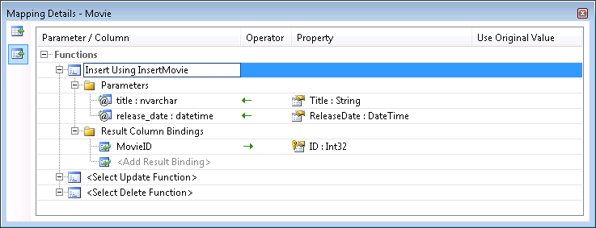
Stored Procedures
Can map Insert, Update, Delete operations to stored procedures
Must map all three operations for model to validate

Slide 16
Detached Entities
Detached entities are entities that “leave” their ObjectContext
Sent over the wire in a web service call
Sent to a client browser
Later the entity can be re-attached
But you have to describe how the entity has changed
No remote change tracking

Slide 17
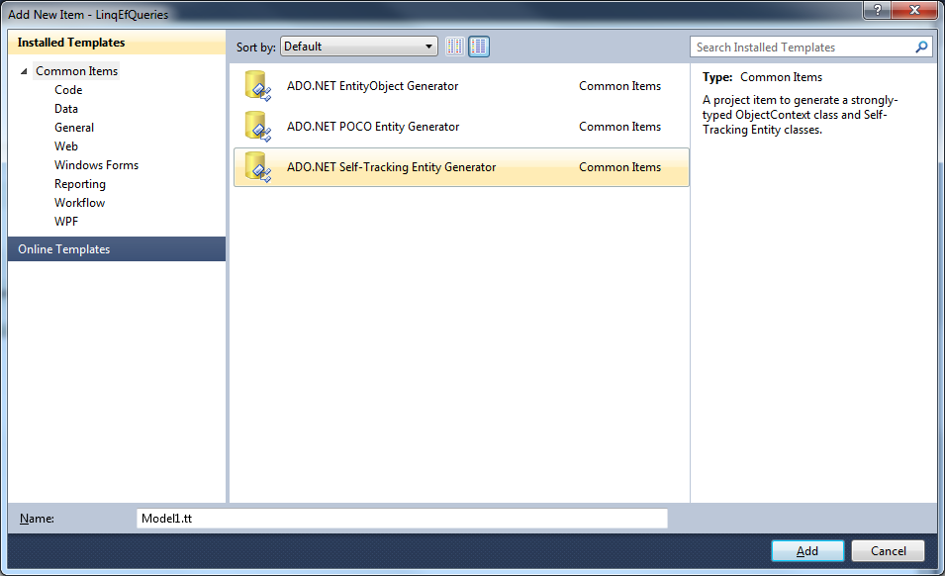
Code Generation

Slide 18
Summary
ObjectContext is the unit of work for Entity Framework
Maintains a change tracking service
Maintains an identity map
EF uses optimistic concurrecy
Concurrency checks off by default
Relationships managed by framework
Think of objects, not database operations

