Slide 1
LINQ in Layered Applications
Choices & Patterns

Slide 2
Topics
Operations:
Lazy
or
Greedy?
Queries:
Composable
or
Predicatable?
Abstractions:
Build
or
Borrow?
Session Scope:
Local
Or
Open?
Testing:
Mocks
or
Fakes?

Slide 3
IQueryable
What we are talking about applies to most remote LINQ providers
NHibernate
Entity Framework
WCF Data Services Client
We'll use EF in the demos

Slide 4
Abstractions – Build or Borrow?
Repository Pattern
Build custom repositories (like IRepository<T>)
Use a built-in abstraction (like IObjectSet<T>)
Unit of Work Pattern
Build your own unit of work
Use a built-in abstraction (ISession, ObjectContext)

Slide 5
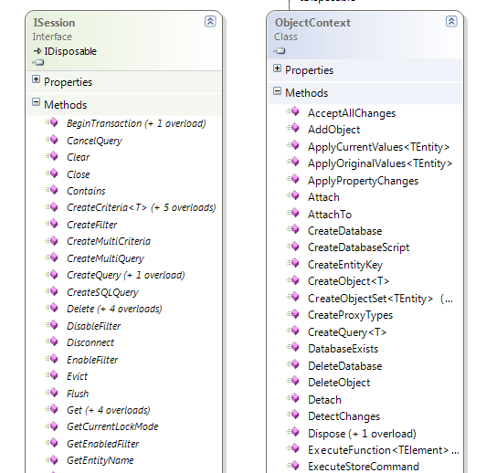
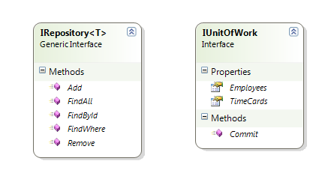
Pros and Cons

Slide 6
Fully Composable Queries?
There are two worlds in LINQ
Both are lazy by default
IQueryable<T>
IEnumerable<T>

Slide 7
Pros and Cons
IQueryable Pros
Allows a LINQ provider to take a holistic view of a query
Generated queries are as efficient as possible
Cons
Universe of possible queries isn't as predictable
Easier to miss an index

Slide 8
Queries – What are They?
What does a query produce?
A concrete list?
A data structure for future execution?
public IQueryable<T> FindWhere(Expression<Func<T, bool>> predicate) {
return _objectSet.Where(predicate);
}

Slide 9
Stopping Deferred Execution
Use one of the "greedy" operators
ToList, ToArray, ToDictionary
Produce a concrete type
Sum, First, Single, Count
public IList<T> FindWhere(Expression<Func<T, bool>> predicate) {
return _objectSet.Where(predicate).ToList();
}

Slide 10
Deferred Execution
Pros
We might not need the result
Cons
It doesn't fail fast
It might execute more than once!

Slide 11
Testing – Mocks or Fakes?
Test doubles for IEnumerable and IQueryable are easy
For fakes use AsQueryable operator
IRepository<T>, IUnitOfWork, ISession are easy, too
ObjectContext – not so much

Slide 12
Pros and Cons
Fakes
Pros: state testing all the way
Cons: test data can be cumbersom
Mocks
Pros: can test state or interaction and fewer fakes to write
Cons: will still need test data in most scenarios, end result might be more code
Other alternatives
Embedded databases
Note: you still need integration tests
Some LINQ queries only work against objects ….

Slide 13
Context/Session Scope
Contexts and Sessions are IDisposable (and often transactional)
Local to a method?
Local to a HTTP request or form?

Slide 14
Managing Contexts
Keeping context local to a method
Cons: No deferred execution, no lazy loading, no work done outside the method (or is that a pro?)
Pros: Easy to see the scope of a unit of work
Keeping a context per request or per form
Cons: Need a way to manage the context
Pros: No worries on closing a session too early

Slide 15
Summary
LINQ offers a powerful abstraction
Easy to implement the Repository and Unit of Work design patterns
In most cases just delegate to ORM framework
Easy to test with fakes or mocks
Tradeoffs around performance and predictability

