Slide 1

Routing
<ngView>

Slide 2
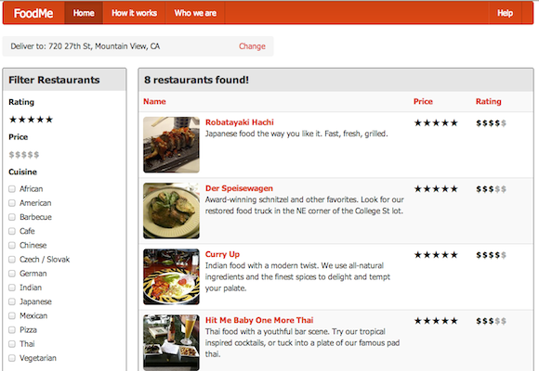
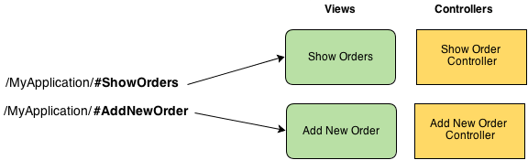
Why Routing?
As applications grow in complexity, easier to use multiple templates
Need to provide deep linking, bookmarks, history support

Slide 3
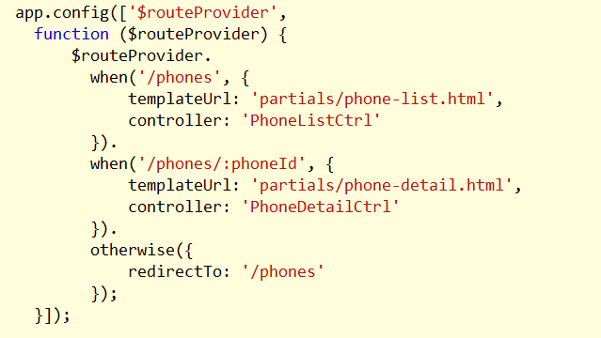
$routeProvider
From the ngRoute module (angular-route.js)
when
otherwise

Slide 4
Path
Can contain named groups (:id)
Will be store in $routeParams
Can use greedy groups
/color/:color/largecode/:largecode*\/edit

Slide 5
More $routeProvider
Controller is optional (can specify in the template)
Specify template or templateUrl
Can use resolve function to wait on promises

Slide 6
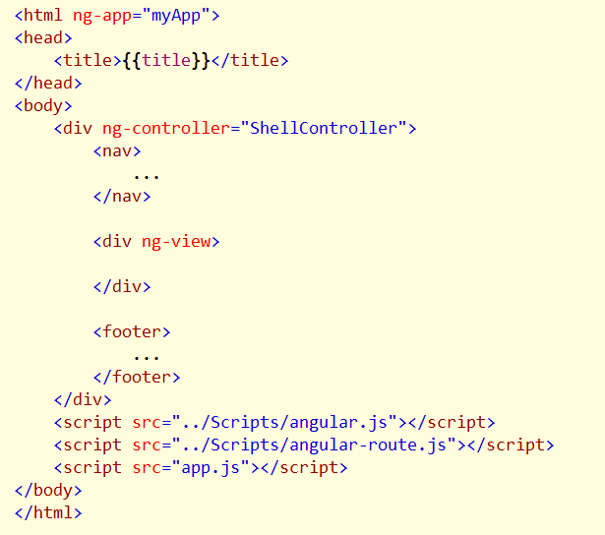
ngView
Includes rendered template of current route

Slide 7
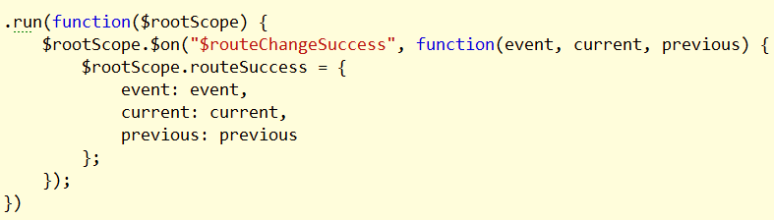
Routing Events
$routeChangeError
$routeChangeStart
$routeChangeSuccess
$routeUpdate
Also: $locationChangeStart

Slide 8
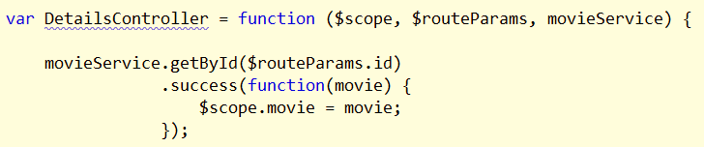
Route Parameters
Can get to parameters using $routeParams

Slide 9

HTML 5 Routing
Remove # from URL
Requires server side configuration

Slide 10
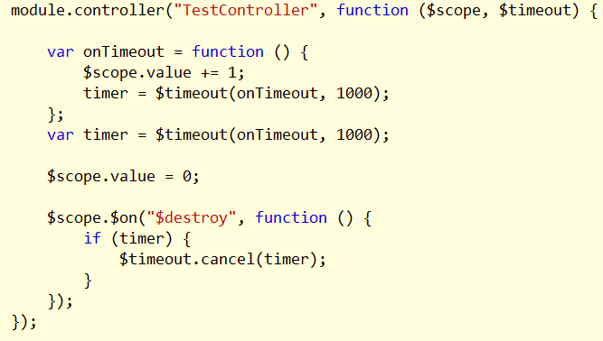
Routing and Controller Lifetimes
Controllers and $scope are recreated on each navigation
But, services are forever

Slide 11
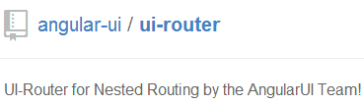
ui-router
More granular (in-view) routing
State manager
Ui-view directive

Slide 12
Summary
Routing gives you the ability to decompose an application
Maintain history, enables deep linking

