Slide 1
Cloud Automation

Slide 2















Account
Subscription
Resource Group
Resource Group
Resource Group
Resource Providers
Resource Manager

Slide 3
Subscription Principles
Subscriptions are…
Administrative security boundary
Support RBAC delegation
A billing unit
Logical limit of scale
First container that you create
Considerations
Subscriptions do not cost anything
Each subscription has its own admins, although a single account can be an admin in multiple subscriptions
Are global
Notes:
Initially a subscription was the administrative security boundary of Microsoft Azure. With the advent of Azure Resource Management (ARM) environment, a subscription now has two administrative models. Service Management and Azure Resource Management. With ARM the subscription is no longer needed as an administrative boundary. ARM provides a more granular Roles Based Access Control (RBAC) model for assigning administrative rights at the resource level. RBAC is currently being released in stages, 32 new roles have been released and user defined roles is coming in a future release. There will be some complexity during the coexistence of the service management and resource management environments and will need to be carefully considered.
A subscription additionally forms the billing unit. Services charges are accrued to the subscription currently, as part of the new Azure Resource Management model it will be possible to roll up costs to a resource group. A standard naming convention for Azure resource object types can be used to manage billing across projects teams, business units, or other desired view.
A logical limit of scale by which resources can be allocated, these limits include both hard and soft caps of various resource types (like 10,000 compute cores /subscription) and are changing as capacity and capabilities are updated within Azure. Scalability will continue to be a function of subscriptions and therefore is a key element to understand how the Subscription strategy will account for growth as consumption increases.

Slide 4
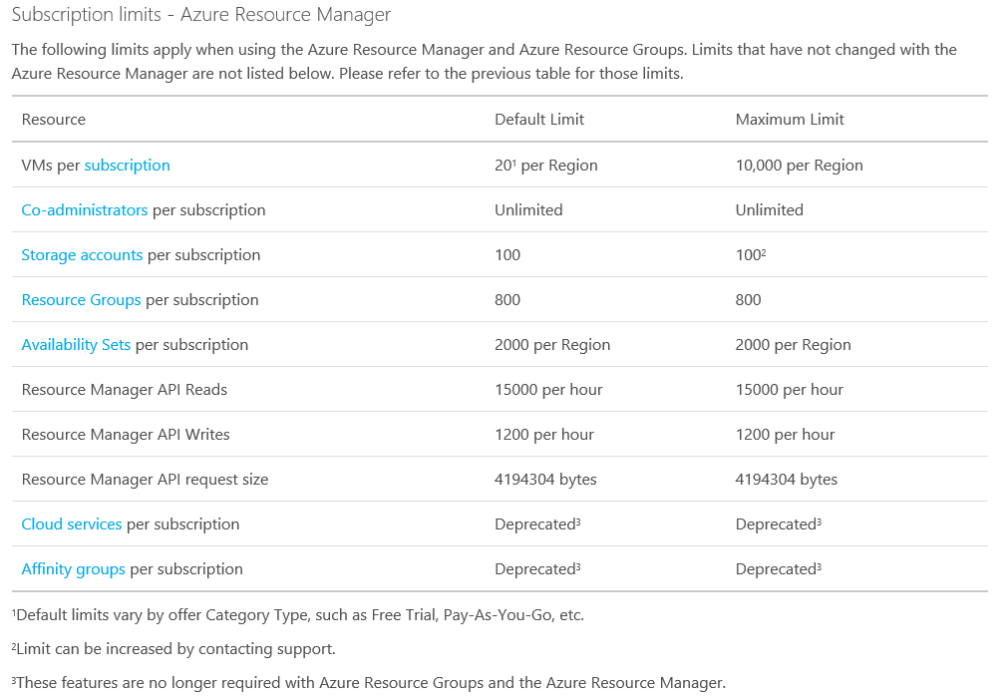
Azure Subscription Limits
http://azure.microsoft.com/en-us/documentation/articles/azure-subscription-service-limits/

Slide 5
Azure Governance Layers
Functional
Business Division
Geographic
Functional
Enterprise
Enterprise
Enterprise
Enterprise
Departments
[optional]
Finance
Marketing
Auto
Aerospace
North America
Europe
Accounts
Joe Smith
Jane Doe
Lin Chi
Adi Krishnan
Ted Bear
Grace Ma
Subscriptions
Project 1 Dev
Project 1 Test
Production Web Sites
Application 1
Application 2
Application 3
Project 1
Project 2
Project 3
Notes:
The Azure governance layers, roles, portals etc.. provide the technical means that can be used in different ways. Some customer prefer to use functional differentiation, others business division based or geographical or even a combination.

Slide 6
Resource Groups
Tightly coupled containers of multiple resources of similar or different types
Every resource *must* exist in one and only one resource group
Resource groups can span regions
Nesting of Resource Groups not supported
Only Subscription Owners can create resource groups
RESOU
R
CE G
R
OUP

Slide 7
Azure Resource Manager
Describe
Deploy
Control
RESOURCE
GROUP
Azure Resource Manager
Azure Resource Manager
App
Database
Compute
Network
Storage
MICROSOFT AZURE STACK
MICROSOFT AZURE

Slide 8
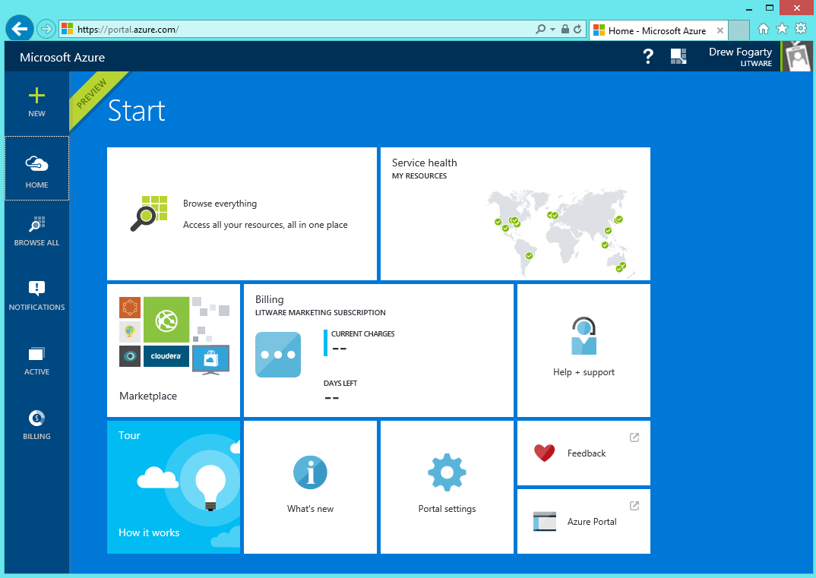
Least Privilege as a Model
Goal
Users can do the tasks their job requires
But no more than that
Best practices
Use the portal and ARM API
Assign the right role
Use resource groups

Slide 9
Role Based Access Control
Users
Authentication
& Authorization
Groups
Azure Resources in Resource Groups
Service Principals
Azure Active Directory
Azure Subscription

Slide 10
Role Based Access Control

Slide 11
Roles for Azure subscription resources
Three primary roles:
Owner, Contributor, Reader
Permissions on all Azure resources
30+ resource-specific roles
Website contributor, Virtual machine contributor, etc.
Permissions scoped to resources and actions typically required by customers
Will add more as new Azure resources come online
Custom roles
Allows customers to take existing actions and create a custom RBAC role
Role must be loaded into each subscription
https://azure.microsoft.com/en-us/documentation/articles/role-based-access-built-in-roles/

Slide 12
Resource Locks
Accidents happen. Resource locks help prevent them :)
Resource locks allow administrators to create policies which prevent write actions or prevent accidental deletion.

Slide 13
Azure Resource Manager Policies: Key Concepts
Polices are a default allow system
Policies are described via Policy Definitions
Policy definitions can be created to restrict the actions that can be performed or require the actions to meet a scenario before they can be performed
Policies are applied via Policy Assignments

Slide 14
Azure Resource Manager Policies: Scenarios
Chargeback: Require departmental tags
Geo Compliance: Ensure resource locations
Service Curation: Select your service catalog
Convention: Enforce naming

Slide 15
Policy Versus RBAC
Designed to work together
User must get past RBAC restrictions first
Policy can restrict the actions you can perform in addition to RBAC rights

Slide 16
Policy Definition Language: Basic Structure
{
"if": {
<condition> | <logical operator>
},
"then": {
"effect": "deny | audit"
}
}
{
"if": {
<condition> | <logical operator>
},
"then": {
"effect": "deny | audit"
}
}

Slide 17
Policy Definition Language: Putting it Together
{
"if": {
"not": {
"field": "location",
"in": ["northeurope", "westeurope"]
}
},
"then": {
"effect": "deny"
}
}
{

Slide 18
Azure Management Platform: Under the Hood
Unified Management Portal
Scripting, PowerShell, CLI
3rd Party Tools
Application management pivots
through UI, API, PowerShell, CLI:
Deploy/Provision
Upgrade/Version
Configure
Monitor/Diagnose
Billing/Subscription
Marketplace
Website
Cloud Service
…
3rd party extension
Unified Management REST
Proxy, Batching & Security
Application Manager
Billing
Monitoring
Marketplace
Web Site
Cloud Service
IaaS
Networking
SQL Azure
3rd Party Service
…

Slide 19
Power of Repeatability
SQL-A
Azure Templates can:
Ensure Idempotency
Simplify Orchestration
Simplify Roll-back
Provide Cross-Resource Configuration and Update Support
Azure Templates are:
Source file, checked-in
Specifies resources and dependencies (VMs, WebSites, DBs) and connections (config, LB sets)
Parametized input/output
Website
[SQL CONFIG] VM (2x)
DEPENDS ON SQL
DEPENDS ON SQL
SQL - A
Website
Virtual
Machines
SQL
C
ONFIG

Slide 20
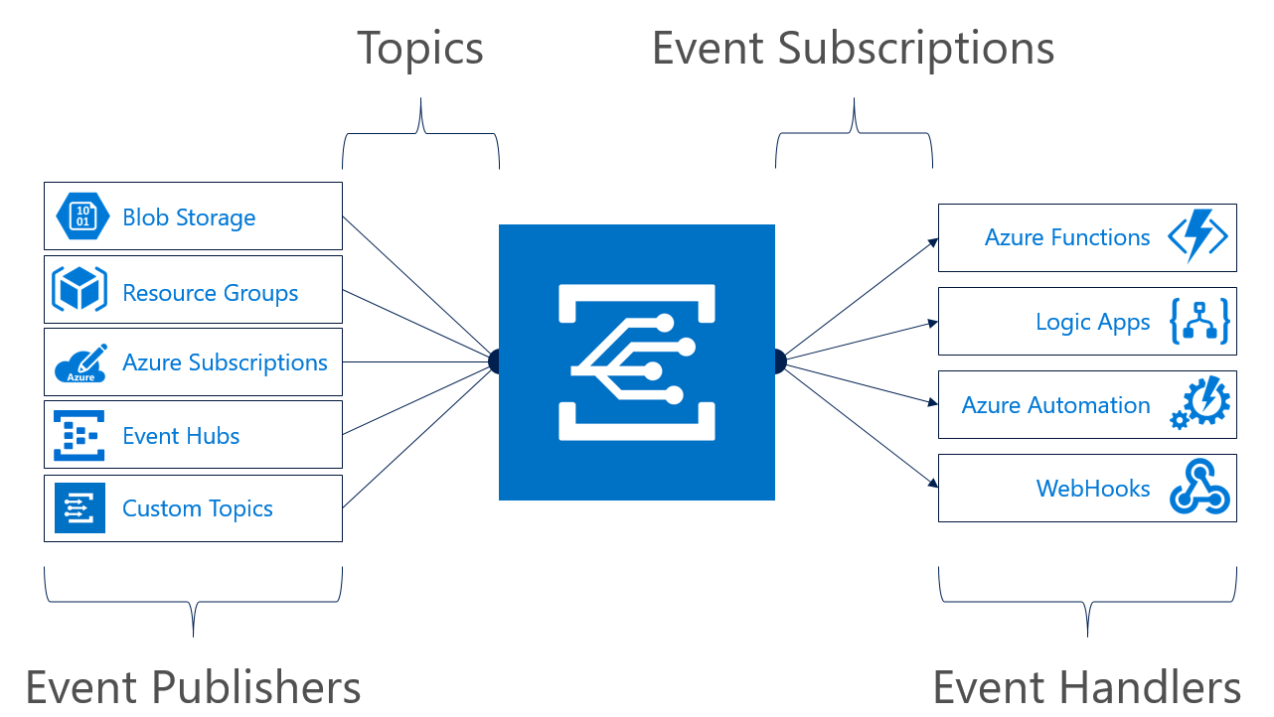
Event Grid

Slide 21
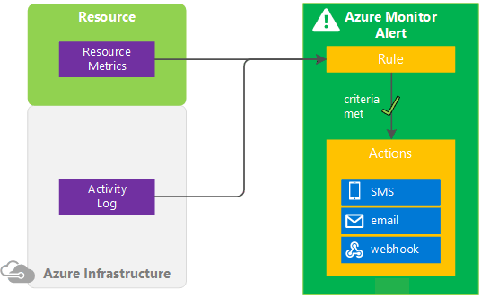
Azure Monitor Overview

