Slide 1

Components in Angular 1.5
<ng-outlet>

Slide 2
module.controller
module.component
module.directive

Slide 3
module.controller
module.component
module.directive

Slide 4
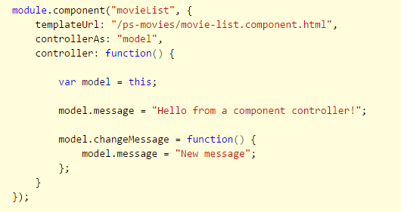
Component Controllers

Slide 5
Components and Directives
module.controller
<div ng-controller=“MovieListController">
</div>
module.directive
<movie-list>
</movie-list>
module.component

Slide 6
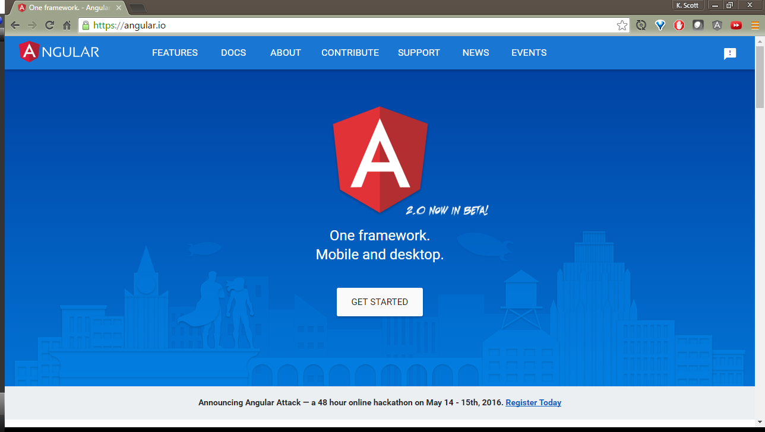

Slide 7
Why Components
Aligned with Angular 2
Can use new component based router
More features, like nested routes

Slide 8
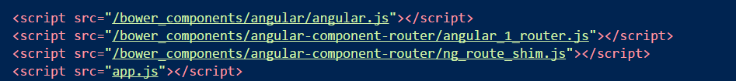
Setup
Install angular-component-router
Built from Angular2 TypeScript source

Slide 9
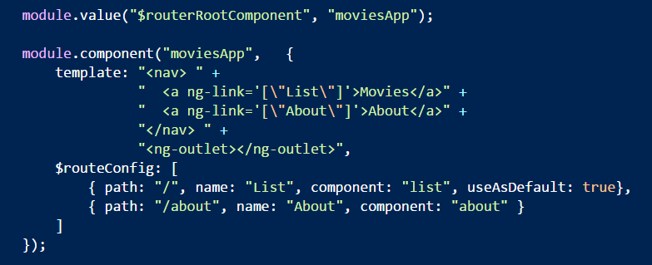
App Level Component

Slide 10
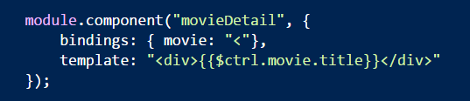
Child Components
Can have their own route configuration

Slide 11
Routing
http://server/app#/home
<ng-view>
</ng-view>
home.html
about.html

Slide 12
Routing
http://server/app#/home
<ng-view>
</ng-view>
home.html
about.html

Slide 13
Routing
http://server/app#/about
<ng-view>
</ng-view>
home.html
about.html

Slide 14
Routing
http://server/app#/home
<ng-view>
</ng-view>
home.html
app-home
about.html
app-about

Slide 15
Routing
http://server/app#/home
<ng-view>
</ng-view>
home.html
app-home
about.html
app-about

Slide 16
Component Router
Components are
Native
Angular 2
Compatible
Lifecycle
Hooks
Nested Routing
Link Generation

Slide 17
Lifecycle Hooks
$canActivate
$routerOnActivate
$routerCanDeactivate
$routerOnDeactivate
$routerCanReuse

Slide 18
Three Compositional Techniques
App
…
<ng-outlet />
…
MovieList
Child
…
<ng-outlet />
…
Accordion
Grandchild
…
<ng-outlet />
…
Bindings
Panel
Panel
MovieRating

Slide 19
Summary
Components should be more compatible with Angular 2

