Slide 1
ASP.NET MVC & Mobile Devices

Slide 2
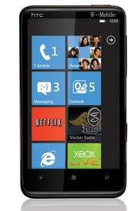
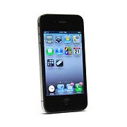
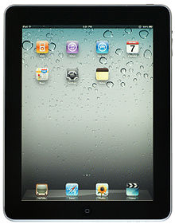
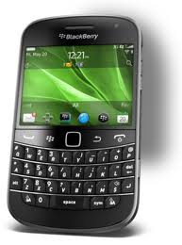
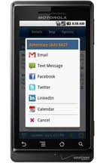



Slide 3
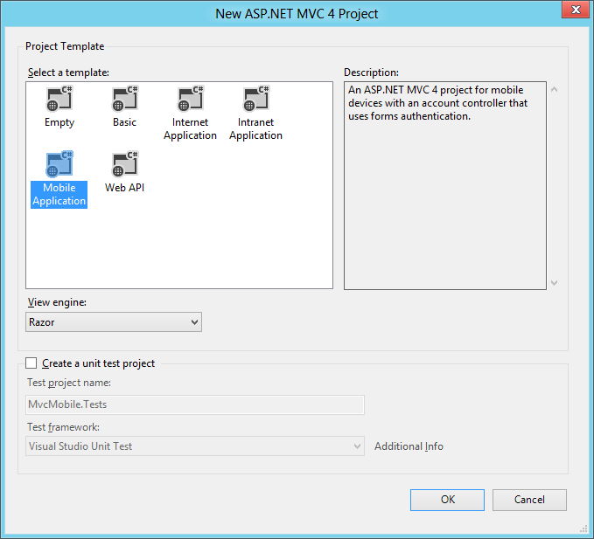
Mobile Project Template

Slide 4
Display Modes
View rendered depends on browser making the request
Applies to layout, content, and partial views
Index.mobile.cshtml
true
Controller
IsMobile?
Index
false
Index.cshtml

Slide 5
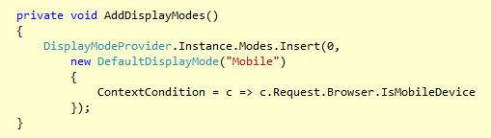
DisplayModeProvider
Holds registered IDisplayMode collection
Runtime will query each display mode for opportunity to override view

Slide 6
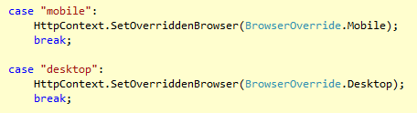
Browser Overriding
Override the user agent for a given user session
Useful for “View The Mobile Version” type links

Slide 7
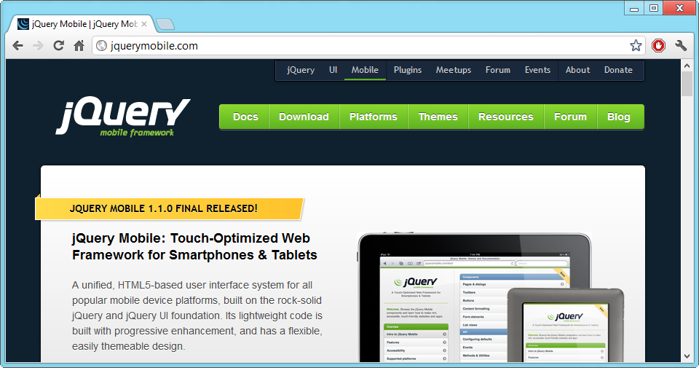

Slide 8
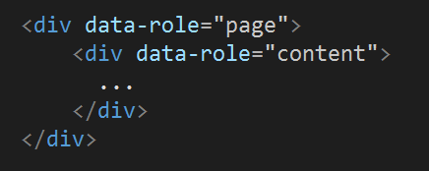
Working with Pages
Pages (and other widgets) identified by data-role

Slide 9
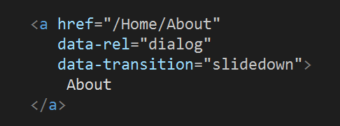
Dialogs
Dialogs are pages with a data-rel=“dialog”

Slide 10

Navigation
Default link and submit behavior is asynch
Impacts script and DOM structures

Slide 11
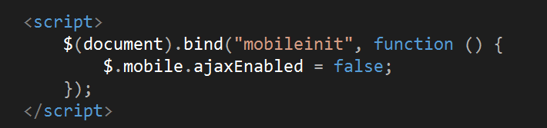
Stopping asynch links
Uses data-ajax=false
Or turn off globally

Slide 12
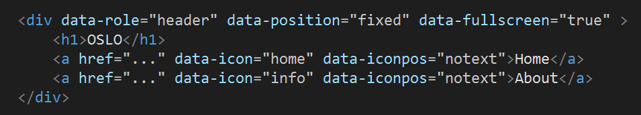
Toolbars
Headers and footers
Will turn links into buttons
Can position as fixed or inline

Slide 13
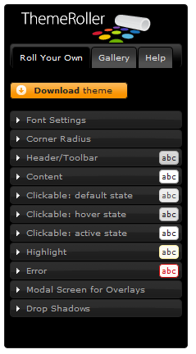
Themes
5 color swatches in every theme
Use data-theme to override
a, b, c, d, e
Build your own at themeroller.com
All driven by CSS

Slide 14
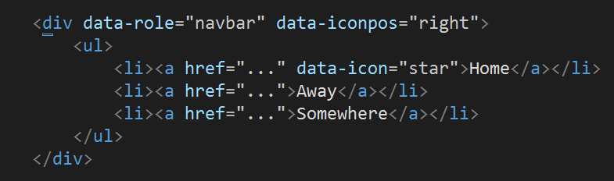
Navbars
Buttons in a header bar

Slide 15
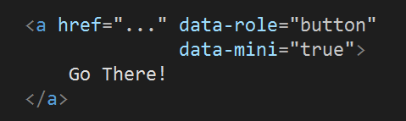
Buttons
Automatic for form inputs and header links
Use data-role=“button” elsewhere
And data-role=“inline” to prevent expansion

Slide 16
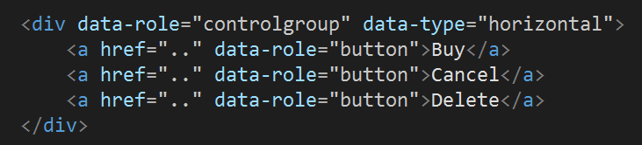
Control Groups
Put together a collection of buttons

Slide 17
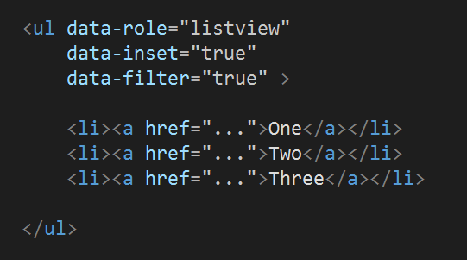
Listviews
Can nest, number, divide, and filter

Slide 18
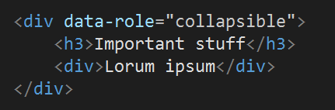
Collapsible & Collapsible Sets
Accordion type control
Will nest

Slide 19
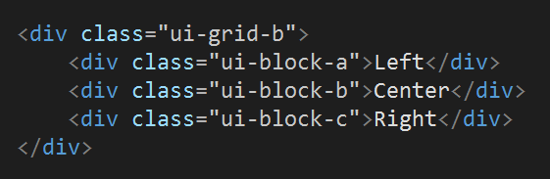
Grids
Simple a, b, c, d (2,3,4,5 column) grid system

Slide 20
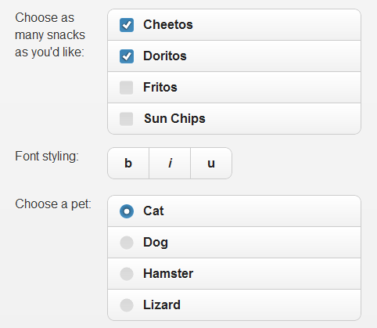
Form Elements
Inputs, labels, buttons all enhanced

Slide 21
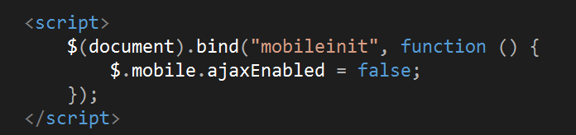
Scripting
Scripts inside of head tag only loaded in first request
Remember asynch navigation?
$(document).ready is useless
Use mobileinit event to configure defaults

Slide 22
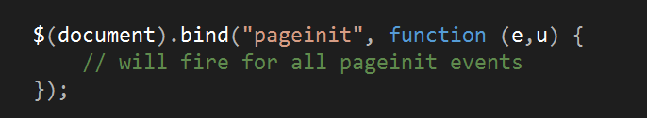
Events
pageinit
pagebeforeload / pageload / pageloadfailed
pagebeforechange / pagechange / pagechangefailed
pagebeforeshow / pagebeforehide / pageshow
pagebeforecreate / pagecreate / pageinit
pageremove

Slide 23
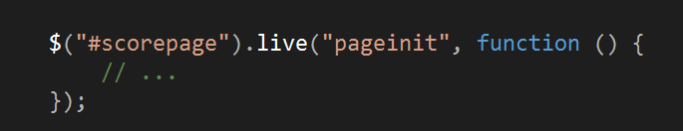
Working With Single Page
Use live (jquery < 1.7) or on (jquery > 1.7) and select page by id

Slide 24
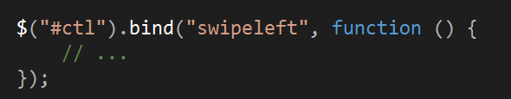
Swipe events / Utilities
Swipeleft and swiperight
Change and load pages

Slide 25
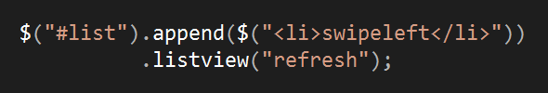
Programmatic Widgets
Typically want to create or refresh

Slide 26
Summary
Questions?
scott@OdeToCode.com

