Slide 1
Core Web API
Controllers, Routing, and HTTP Messages

Slide 2
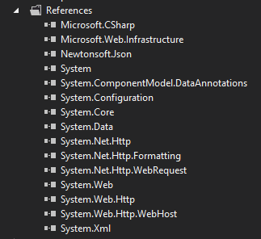
WebAPI – Pieces
NuGet
Microsoft.Net.Http
HttpClient, HttpRequest, HttpResponse
Microsoft.AspNet.WebApi.WebHost
Configuration, Handlers
Microsoft.AspNet.WebApi.Core
Controllers, Filters, ModelBinding
Microsoft.AspNet.WebApi.Client
Formatters

Slide 3
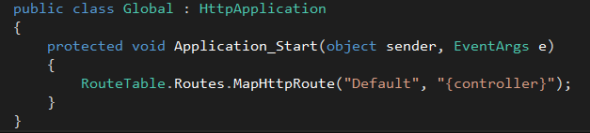
Routing
ASP.NET Hosting can use the System.Web routing engine
MapHttpRoute assigns an HttpControllerRouteHandler

Slide 4
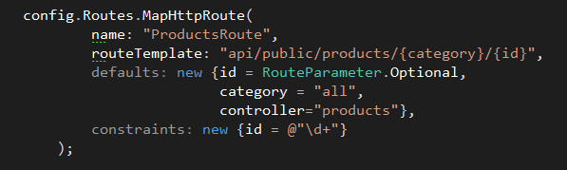
Routes
Matched in the order they appear
Can have defaults and constraints
Two special template placeholders are {controller} and {action}

Slide 5
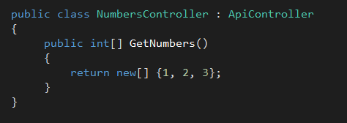
Controllers
Derive from ApiController
URI path maps to controller (default routing)
HTTP method maps to action (default routing)
Public methods only

Slide 6
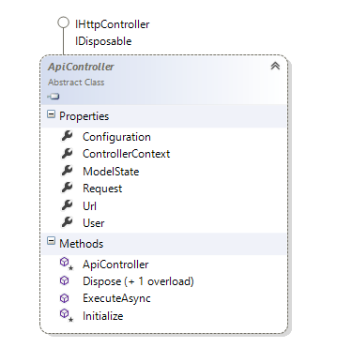
ApiController
Model binding state
Request object
Url helper
Interception methods

Slide 7
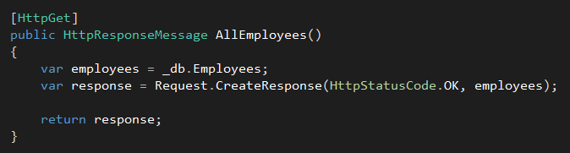
Explicit Routing
HttpGet
HttpPost
HttpPut
HttpDelete

Slide 8
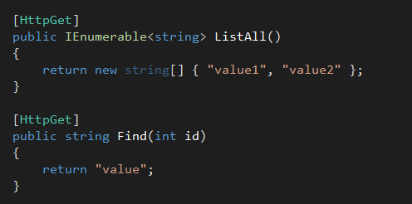
Action Selection
Selects the action with the most parameter matches

Slide 9
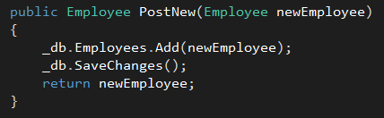
Model Binding
Moves information in a request into CLR objects
Query string, header, or message body
JSON, XML, or form encoded
Validation via attributes or interfaces

Slide 10

Model Binding Defaults
Primitive types come from the query string
Complex types come from the request body

Slide 11
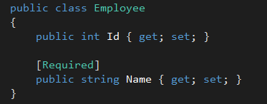
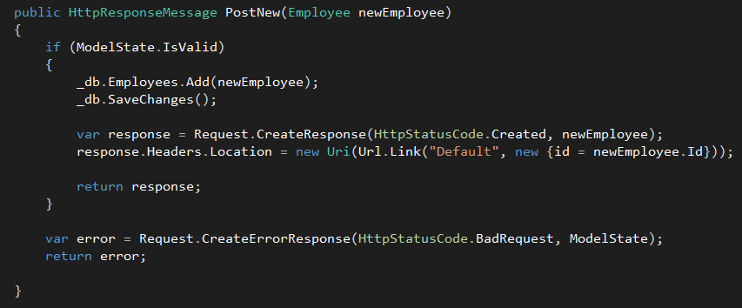
Model State
Side-effect production of model binding
Includes validation errors

Slide 12
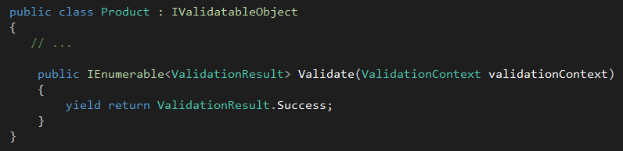
Model Validation
Data annotation attributes
Custom annotations
IValidatableObject

Slide 13
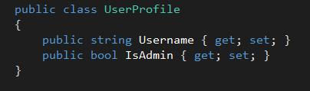
Beware of Over Posting Attacks

Slide 14
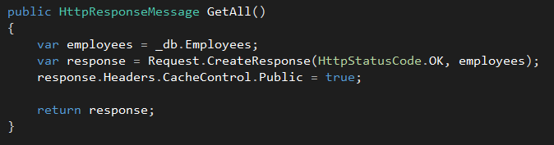
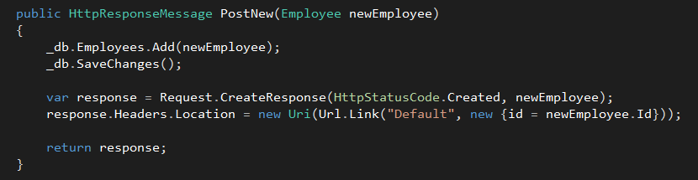
HttpRequestMessage / HttpResponseMessage
Work against the HTTP infrastructure

Slide 15
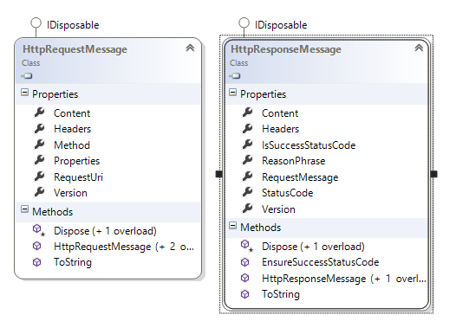
HttpRequestMessage / HttpResponseMessage

Slide 16
Content Negotiation
Important aspect of REST
Based on Accept (client) and Content-Type (client and server) headers
MediaTypeFormatter performs the work
XML, JSON, HTML forms (incoming only)
Can also configure other types using headers, query string, extension

Slide 17

Conneg - JSON
Uses JsonMediaTypeFormatter
Json.NET behind the scenes
Can use DataContractJsonSerializer instead

Slide 18
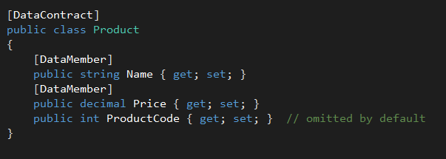
Json.NET
Serializes all public properties by default
Including read-only properties
Use [JsonIgnore] to skip a property
Respects [DataContract] attributes
Only serializes [DataMember] properties

Slide 19
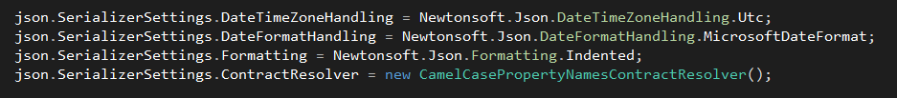
Json.NET Options
Dates use ISO 8601 format by default (dates are hard)
Instead of UNIX ticks, \/Date(…)\/, etc.

Slide 20
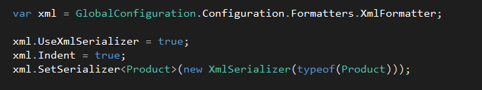
XmlMediaTypeFormatter
Uses DataContractSerializer for XML generation
Can use XmlSerializer instead (better to match existing schemas)
Public read/write properties serialized by default

Slide 21
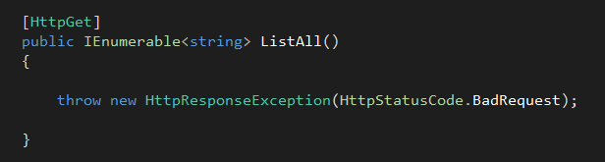
Errors
Can throw HttpResponseException
Or use Request.CreateErrorResponse
Or return HttpResonseMessage with error status

Slide 22
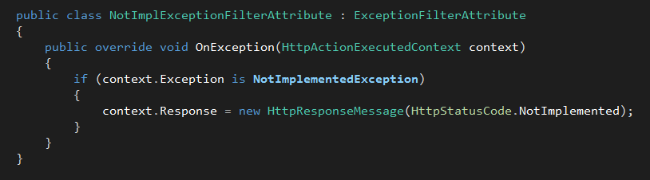
Exception Filters
For unhandled exceptions
Exception: not for HttpResponseException
Can transform exceptions to HTTP status codes
Registered globally, per-action, or per-controller

Slide 23
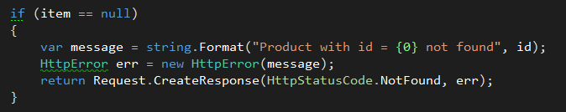
HttpError
Provides an object to serialize error information into response
Same as using Request.CreateErrorResponse

Slide 24
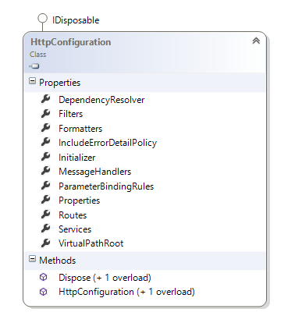
Configuration
GlobalConfiguration.Configuration
Routes
IoC Container
Media formatters
Global filters

Slide 25
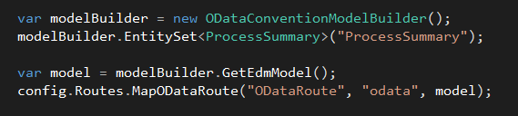

WebAPI and OData
Open Data Protocol (www.odata.org)
Use ODataController or EntitySetController as a base class
Different formatting (AtomPub+XML, JSON) and action selection

Slide 26
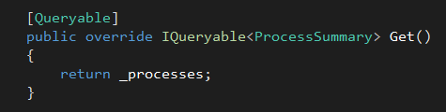

Query Options
Options | Description
$filter | Filter the results on Boolean condition
$inlinecount | Include count of entities
$orderby | Sort the results
$skip | Skip N results
$take | Return only N results

Slide 27
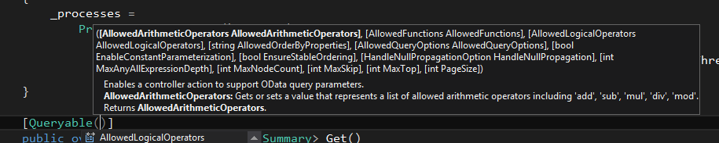
Limiting Query Options
Use the QueryableAttribute, ODataOptions, or Queryable subclass

Slide 28
Odata CRUD
Override Create, Update, and Patch

Slide 29
Summary
WebAPI embraces HTTP
Conventions for routing provide uniform interface
Model binding moves data between the messages and CLR types

