Slide 1

Modules, Services, Controllers
Abstractions For Applications

Slide 2
Why Modules?
Isolate code
Manage dependencies
ng
ng-animate
ui-bootstrap
ngRoute

Slide 3
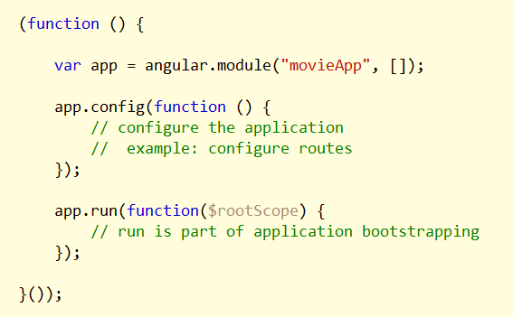
Modules
Separate code by vertical feature or responsibility
Start with an application module
Modules have dependencies
Must describe dependencies to AngularJS

Slide 4
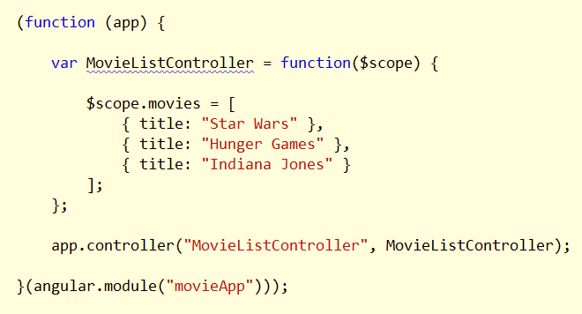
Controllers
One component type you can add to a module

Slide 5
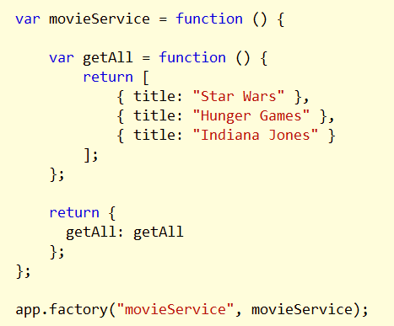
Services
Handle non-view related logic
Server communication, for example
Program to an interface, not an implementation
Testable
Many built in services
$http
$window
$document

Slide 6

Web APIs and $http
$http is a service wrapping XmlHttpRequest
Flexible
Methods for common verbs
Supports transformers and custom headers

Slide 7
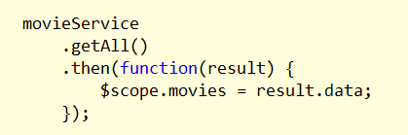
Promises
Async functions return promises
Promise will be resolved or rejected
Use then and finally to execute code when complete

Slide 8
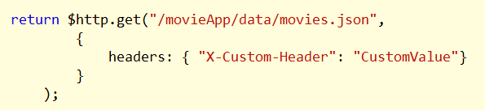
HTTP Headers
Use config parameter for local headers
Use defaults object for global headers
Can use $http or the $httpProvider

Slide 9
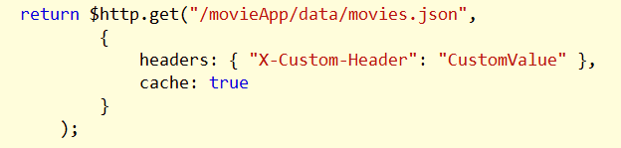
Http Caching
One approach: add cache parameter to config object

Slide 10
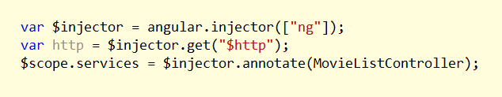
$injector
Creates objects, loads modules, injects dependencies

Slide 11

Annotations
Injector depends on annotations
Components have well known names
Three sources for annotations
Function parameter names (implicit)
$inject property (explicit)
Passed at point of registration (explicit)

Slide 12
Minification
Must use explicit annotations when minifying
Or use an Angular aware minifier

Slide 13
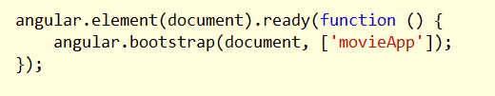
Bootstrapping
Implicit bootstrapping uses ng-app directive
Explicit bootstrapping uses code

Slide 14

Module Config
Execute configuration code
Providers only
**no services injected**
Bootstrap
Configure
Run

Slide 15
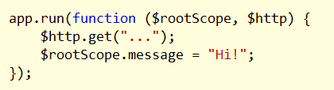
Module Run
Execute code to initialize module / application
Services only
No providers
Bootstrap
Configure
Run

Slide 16
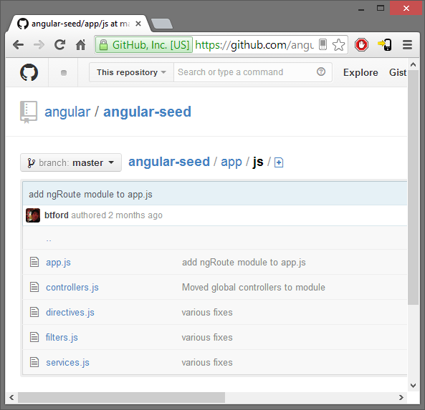
Code Organization
File per abstraction
Folder per abstraction
Folder per feature -> folder per abstraction

Slide 17
Core Angular API
equals
copy
forEach
extend
is*
version
jqLite

Slide 18
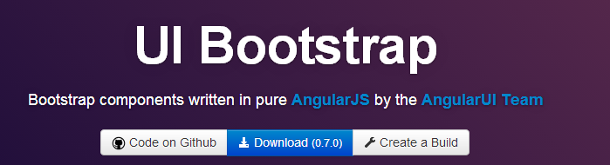
Other Modules
ngMock
ngAnimate
ngCookies
ngRoute
ngResource
uiBootstrap, and more …

Slide 19
Summary
Modules are building blocks
Modules define dependencies
Modules contain one or more components
Controllers
Services
Directives
Filters

