Slide 1

Testing
expect(angular).toBe(testable)

Slide 2
Why?
JavaScript is dynamic
There is no help from a compiler
Other options available (TypeScript)
Testable code is generally well designed
SRP
DIP

Slide 3
How
Angular helps us avoid global state and singletons
Dependency injection
No need for “new” or namespaces
Angular helps with separation of concerns
Controllers don’t manipulate the DOM
Templates don’t contain application logic

Slide 4
Setup
Framework options
Qunit
Jasmine
Mocha
Runner options
Karma
Grunt
Chutzpah (Visual Studio)

Slide 5
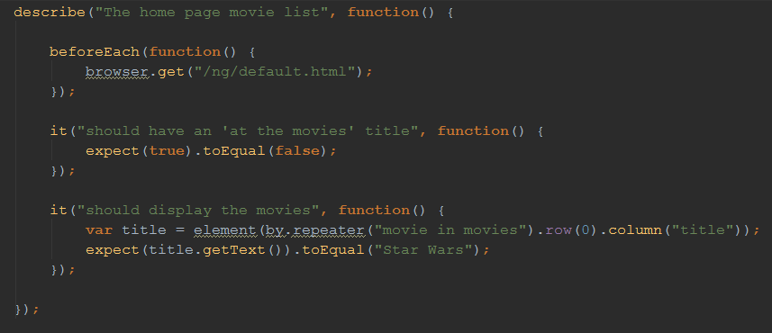
Jasmine

Slide 6
Jasmine Matchers
expect(x).toEqual(y); compares objects or primitives x and y and passes if they are equivalent
expect(x).toBe(y); compares objects or primitives x and y and passes if they are the same object
expect(x).toMatch(pattern); compares x to string or regular expressionpattern and passes if they match
expect(x).toBeDefined(); passes if x is not undefined
expect(x).toBeUndefined(); passes if x is undefined
expect(x).toBeNull(); passes if x is null
expect(x).toBeTruthy(); passes if x evaluates to true
expect(x).toBeFalsy(); passes if x evaluates to false
expect(x).toContain(y); passes if array or string x contains y
expect(x).toBeLessThan(y); passes if x is less than y
expect(x).toBeGreaterThan(y); passes if x is greater than y
expect(function(){fn();}).toThrow(e); passes if function fn throws exception e when executed

Slide 7
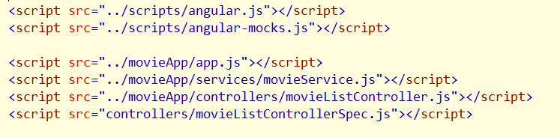
Help
ngMock (angular-mock.js )
Bootstrap modules (module)
Test friendly injector method (inject)
Mock services

Slide 8
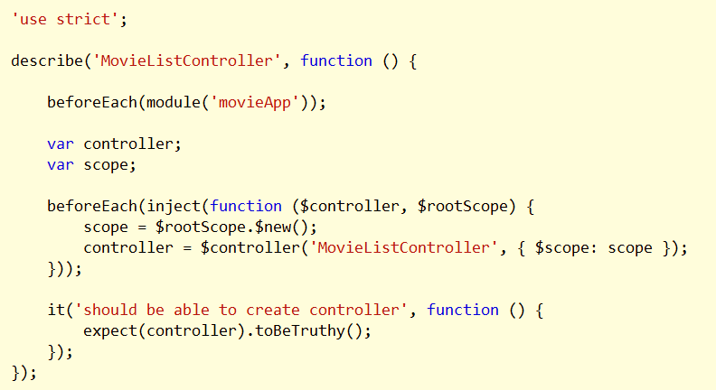
First Spec
Using module and inject to create controller

Slide 9
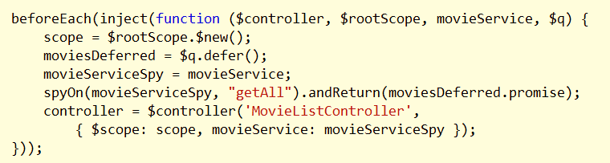
Mocking
Can mock any service
Jasmine provides spies

Slide 10
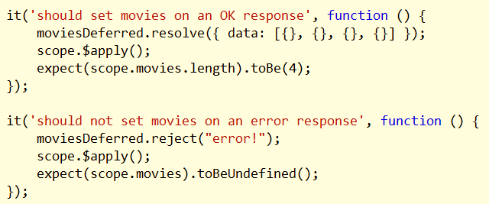
Working With Promises
Often easiest to create promises with $q
Return “controlled” promise from a spy, mock, or fake

Slide 11
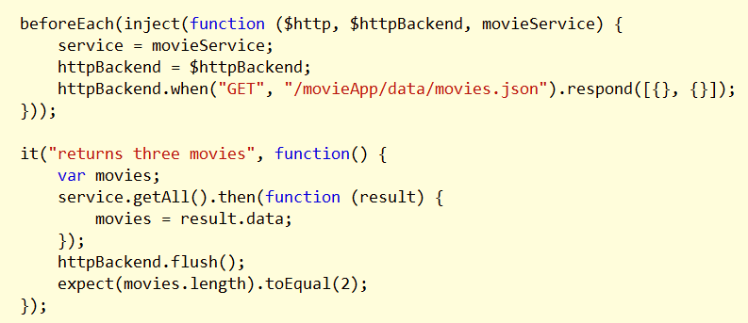
Testing HTTP Interaction
Use $httpBackend

Slide 12
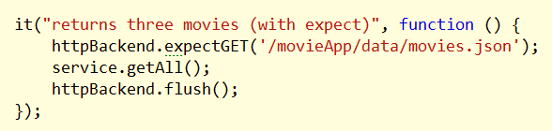
Expectations
Alternate style for $http interaction

Slide 13
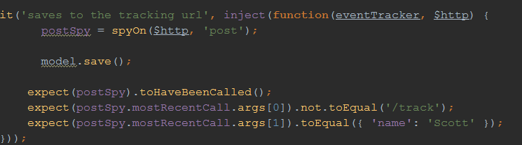
Spies
Jasmine provides an API to make spies

Slide 14

Karma
Continuous test runner
Easy install with npm
Works with Jasmine, Mocha, Qunit
Works with Chrome, IE, Firefox, Phantom

Slide 15

Protractor
Built on Selenium (Java) and WebDriverJS
Test all layers by simulating a user
Uses browser automation

Slide 16

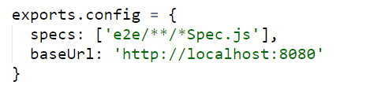
Getting Started
Install protractor with npm
Create protractor.conf.js
Use webdrivermanager to install Selenium and a driver
Requires Java

Slide 17
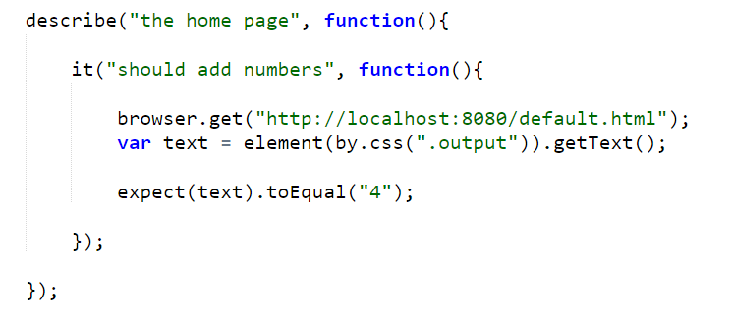
Writing Tests

Slide 18
Locators
by.binding(‘move.title’)
by.model(‘movie.title’)
by.repeater(‘movie in movies’).row(1)
by.options(‘c for c in categories’)
Also css, id, tag

Slide 19
Summary
Testability is a goal
Many options for frameworks, runners, and workflows

