Slide 1

Animations and UI
ngAnimate + Bootstrap

Slide 2

ngAnimate
From angular-animate.js
Supports CSS transition, CSS keyframe, and JavaScript animations
Uses $animate and $animateProvider

Slide 3
Built-In Animations
Directive | Supported Animations
ngRepeat | enter, leave, and move
ngView | enter and leave
ngInclude | enter and leave
ngSwitch | enter and leave
ngIf | enter and leave
ngClass or {{class}} | add and remove
ngShow & ngHide | add and remove (the ng-hide class value)

Slide 4
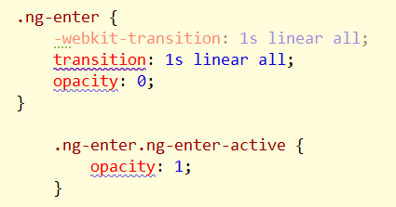
A Touch of CSS
Built in animations use a pair of classes for animations
Classes managed by $animate
Just need to provide the CSS definitions

Slide 5
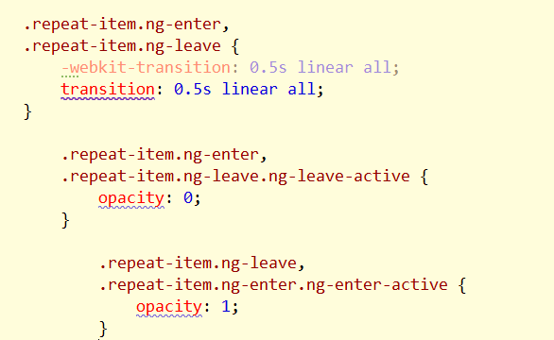
CSS Classes
Event class is added first (ng-enter)
Active class is added second (ng-enter-active)
Both classes removed when animation complete
Can also create custom animations in JavaScript

Slide 6
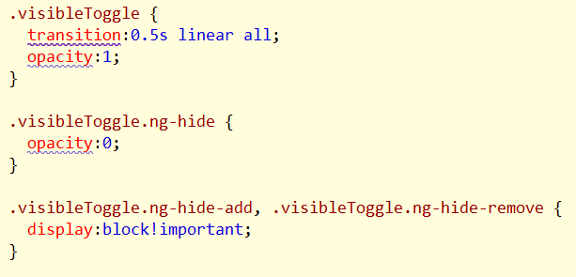
Hide and Show
Remember to use !important

Slide 7
Samples
http://plnkr.co/edit/SZljRItnL986V821M7Ck?p=preview
(ngRepeat)
http://plnkr.co/edit/bY70b3f3PpegDtpTWiKc?p=preview
(ngView)
http://plnkr.co/edit/is0Icl9XsVkdQ3HTAJHZ?p=preview
($animate in custom directive)

Slide 8

UI Bootstrap
No dependencies
Only Bootstrap.css and Angular required
No jQuery, no bootstrap.js

Slide 9
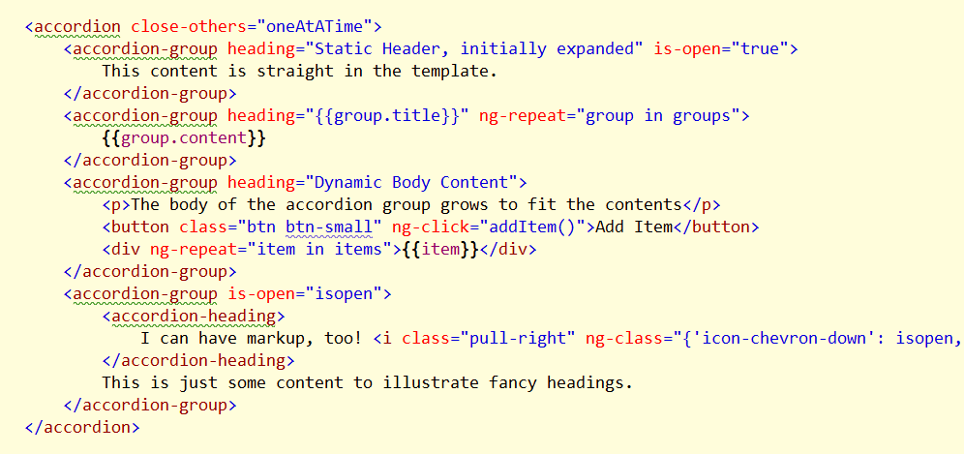
Accordion
http://plnkr.co/edit/MHDqQ5QyrsSDVRky9HF1?p=preview

Slide 10

Alert
http://plnkr.co/edit/H1ogebRPirOAAPQ4kQFe?p=preview

Slide 11
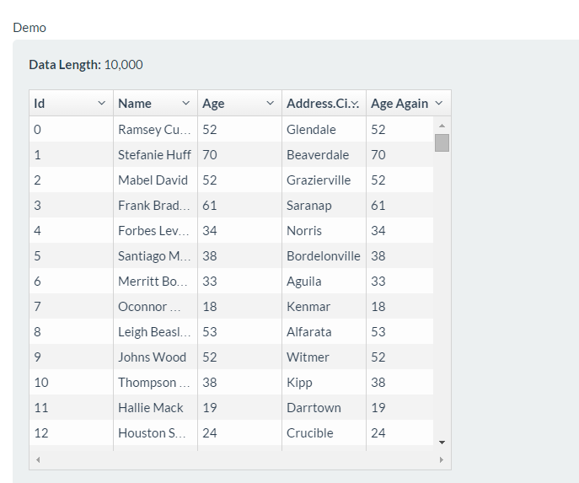
UI Grid

Slide 12

Infinite Scroll

Slide 13
Summary
Animations are built into ngAnimate
Third party modules provide additional directives and services
http://ngmodules.org/popular
UI Bootstrap
ngTable
ngUpload
uiRouter

