Slide 1

Views, Forms, $Scope
{{ binding }}

Slide 2
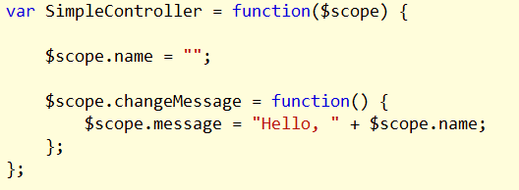
Scopes and Views
$scope provides data to a view
$scope is an execution context

Slide 3


Binding Expressions
Evaluated against $scope
Forgiving
No control flow

Slide 4
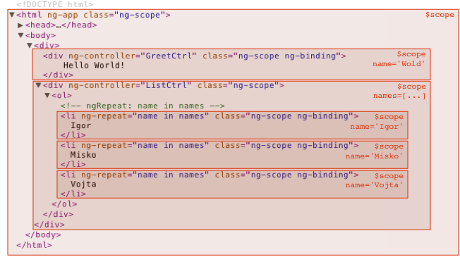
Scope Inheritance
Scope objects use prototypal inheritance
$rootScope is the top object

Slide 5
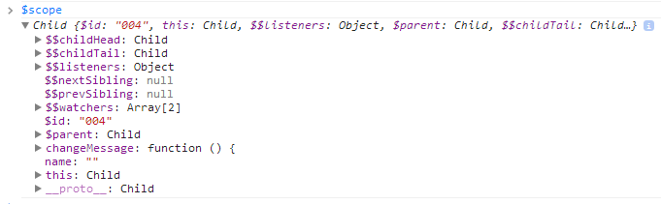
$scope and the DOM
$scope mimics the DOM
Attached to elements in the tree

Slide 6
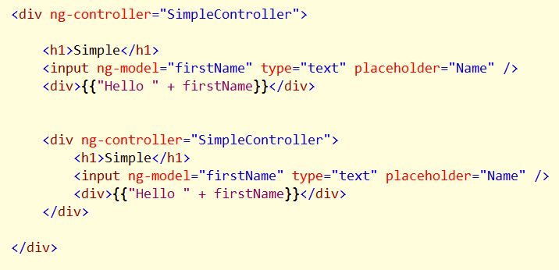
Inheritance Implications
Child $scope can read parent properties
Can override parent properties, too
Makes sharing easy
Beware of unwanted side effects

Slide 7
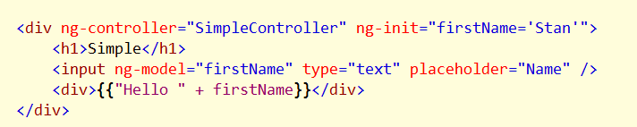
ngInit
Evaluate an expression against the scope

Slide 8
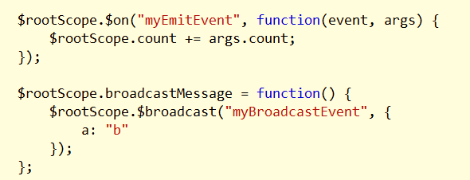
Scope Communication
Emit and broadcast

Slide 9
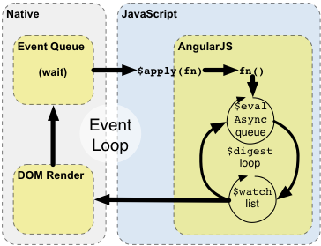
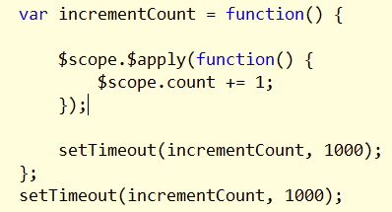
Apply and Digest
Models are plain objects
Changes detected using snapshot change detection
Model mutation not seen until $apply called

Slide 10
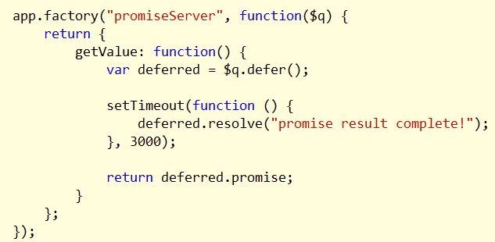
Other $apply considerations
Don’t call apply during an apply
Promises technically don’t resolve until there is a digest

Slide 11

$watch
$watch provides the ability to listen for changes
Beware of digest iterations

Slide 12
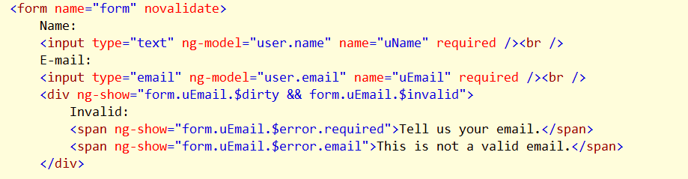
Working With Forms
FormController can attach to named forms
Tracks state and validity
Adds and removes CSS classes to help drive UI
Published into scope when given a name

Slide 13
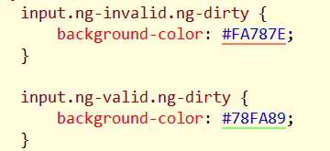
Validation and CSS
FormController adds and removes CSS
ng-valid
ng-invalid
ng-pristine
ng-dirty

Slide 14

Validation
Angular understand HTML5 validation attributes
required
pattern
number
email / url
max / min

Slide 15
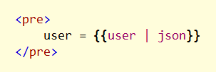
Filters
Formatting and modifying model data
currency
date
filter
json
limitTo
lowercase
number
orderBy
uppercase

Slide 16
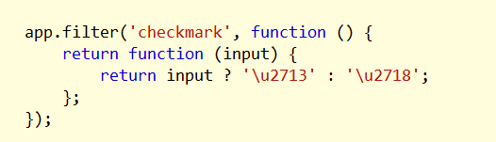
Custom Filters
Take an input parameter, return an output value

Slide 17
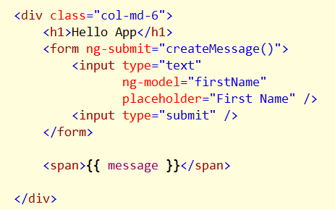
Templates and Views
Templates are declarative specifications for the UI
Directives
Markup
Filters
Views are compiled templates

Slide 18

ngInclude
Allows for partial views
Fetches and compiles an HTML fragment

Slide 19
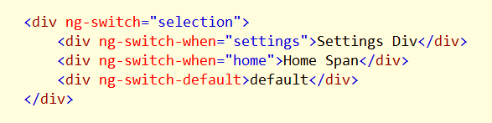
ngSwitch
Swaps DOM structure based on an expression

Slide 20
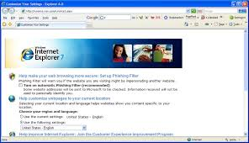
Some Notes For Internet Explorer
Angular currently supports IE8+
For IE < 8
Polyfill JSON.stringify
Beware of custom element tags
Beware of using “finally”

Slide 21
Summary
Scopes and views work together
Scopes form a tree structure in memory
Angular has a digest cycle
FormController helps with validation

