Slide 1
AJAX with ASP.NET MVC

Slide 2
Overview
Ajax Helpers
Ajax & Partial Views
jQuery
JSON Results

Slide 3
Motivations for AJAX
Build a more responsive application
Less wait time
Use less bandwidth
Build a rich interface
Less flicker
More animation
Better feedback
Downsides
Harder to test
Harder to debug
Asynchronous
Requests
JavaScript
DHTML
CSS

Slide 4
Raw Ajax
Tedious and error prone
function getServerTime() {
var xhr = new XMLHttpRequest();
xhr.open("GET", "/Home/ServerTime", true);
xhr.onreadystatechange = function() {
if (xhr.readyState == 4) {
if (xhr.status == "200") {
var timeDiv = document.getElementById("timeDisplay");
timeDiv.innerHTML = xhr.responseText;
}
}
}
xhr.send();
}

Slide 5
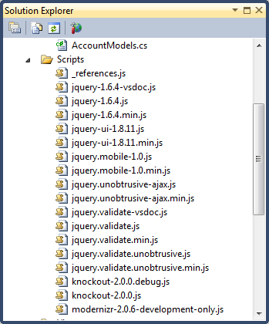
AJAX Infrastructure
jQuery
Functional orientation
Plug-in oriented
CSS Selectors
DOM Manipulation
jQuery Plugins
Authored by Microsoft
Adapt MVC to jQuery

Slide 6
Managing Scripts
Script modes
.min.js, .vsdoc.js, .js
.vsdoc files for development only
Injecting scripts
<script> tags
Url and Content helpers
<script src="../../Scripts/MicrosoftAjax.js" type="text/javascript" />
<link href="../../Content/Site.css" rel="stylesheet" type="text/css" />
<script src="<%= Url.Content("~/Scripts/MicrosoftAjax.js") %>"
type="text/javascript" /> </script>
<link href="<%= Url.Content("~/Content/Site.css") %>" rel="stylesheet"
type="text/css" /></link>

Slide 7
CDNs
Serve scripts from a distributed content delivery network
jQuery
jQuery validate
ASP.NET MVC Scripts
<script src=“http://ajax.googleapis.com/ajax/libs/jquery/1.6.4/jquery.min.js”
type="text/javascript" />
<script src=“http://ajax.aspnetcdn.com/ajax/jQuery/jquery-1.6.4.min.js”
type="text/javascript" />
<script src=“http://code.jquery.com/jquery-1.6.4.min.js”
type="text/javascript" />

Slide 8
Ajax Helpers
Create links and forms that send async requests
<div id="timeDisplay">
<%= Ajax.ActionLink("Click here to set the server time",
"ServerTime",
new AjaxOptions
{
UpdateTargetId="timeDisplay",
HttpMethod="GET", // default
InsertionMode= InsertionMode.Replace, // default
})
%>
</div>

Slide 9
AjaxOptions
Includes events for
OnBegin
OnComplete
OnFailure
OnSuccess
Confirmation prompt
<%= Ajax.ActionLink("Click here to set the server time",
"ServerTime",
new AjaxOptions
{
LoadingElementId="loadingDisplay",
Confirm="Are you sure?",
UpdateTargetId="timeDisplay",
})
%>
<div id="loadingDisplay" style="display:none">
<img src="../../Content/spinner.gif" />
</div>

Slide 10
Partial Page Rendering
Use PartialViewResults in controller actions
if (Request.IsAjaxRequest())
{
return PartialView("MovieTable", movies);
}
return View("Index", movies);
<% using (Ajax.BeginForm("Index", "Movie",
new AjaxOptions { HttpMethod="GET",
UpdateTargetId="movieTable" }))
{ %>
<input type="text" name="q" />
<input type="submit" value="Search" />
<% } %>

Slide 11
Ajax Helpers and Errors
Default behavior is to fail silently
Override default by specifying OnFailure option
function searchFailed(ajaxContext) {
var response = ajaxContext.get_response();
var element = ajaxContext.get_updateTarget();
element.innerHTML = "Error: server returned a " +
response.get_statusCode();
}

Slide 12
Client Validation
Based on model annotations ([Required])
Requires jQuery validation plug-in (provided)
Enabled by default in web.config
Completely unobstrusive!
HTML "data-" attributes
<%
Html.EnableClientValidation(false);
%>

Slide 13
Custom Client Validations
1. Implement IClientValidatable
In attributes or in self-validating models
2. Write a jQuery validation adapter
Maps metadata to validation rules
public IEnumerable<ModelClientValidationRule> GetClientValidationRules( ModelMetadata metadata, ControllerContext context) { var rule = new ModelClientValidationRule(); rule.ErrorMessage = FormatErrorMessage(metadata.GetDisplayName()); rule.ValidationParameters["maxwords"] = MaxWords; rule.ValidationType = "wordcount"; yield return rule; }
jQuery.validator.unobtrusive.adapters.addSingleVal( "wordcount", "maxwords"); jQuery.validator.addMethod("wordcount", function (value, element, maxWords) { if (value) { var wordCount = value.split(' ').length; if (wordCount <= maxWords) { return true; } return false; } return true; });

Slide 14
Remote Validation
Because some validations are impossible on the client-side
Require a database lookup, for example
[Remote("UsernameCheck", ErrorMessage="Invalid username")] public string Username { get; set; }

Slide 15
Beyond the Built-in Helpers
Ajax Helpers cover simple scenarios
Replacing HTML content
Partial page rendering
Other scenarios require some JavaScript coding
Auto-complete textboxes
Client-side validation
Invoking JSON services and actions
Animations

Slide 16
Auto-Complete
jQuery auto-complete plug-in
Included in jQuery UI script
$(function() {
$("#searchBox").autocomplete("/Movie/SearchCandidates",
{ minChars: 3 });
});
public string SearchCandidates(string q, int limit)
{
var ctx = new MoviesContext();
var movies = ctx.MovieSet
.Where(m => m.Title.StartsWith(q))
.OrderByDescending(m => m.ReleaseDate)
.Take(limit)
.Select(m => m.Title);
return String.Join(Environment.NewLine, movies.ToArray());
}

Slide 17
Date Pickers and Other Widgets
Many lightweight jQuery widgets available from jQuery UI
http://jqueryui.com/
Calendar
Accordion
Slider
Dialog
Tab
Progress Bar
$(".create #ReleaseDate").datepicker();

Slide 18
JSON & MVC
JsonResult will serialize objects to JSON
jQuery and ASP.NET AJAX can work with JSON
$.getJSON("/Instructor/InstructorNames", "", function(data) {
$(data).each(function() {
…
});
});
public JsonResult InstructorNames()
{
var repository = new InstructorRepository();
var names =
from i in repository.FindAll()
select new
{
ID = i.ID,
Name = i.Name
};
return Json(names);
}

Slide 19
System.Web.Optimization
Bundling of script and style files
Minification of script and style files
Decrease page load times

Slide 20
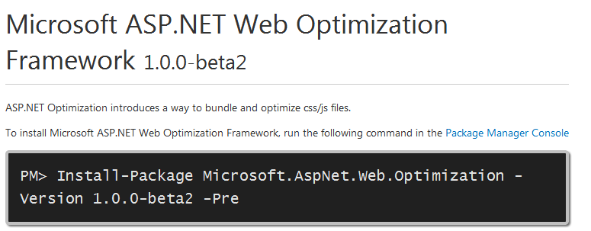
Installation
Use NuGet
install-package Microsoft.AspNet.Web.Optimization

Slide 21
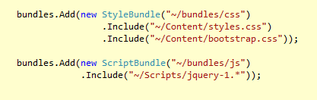
Configuration
Script bundles and style bundles
Add bundles to the global BundleTable object
Specify a virtual path for the bundle
Include files you need in the bundle
Works with wildcards - conventions applied for ignoring doc and debug files

Slide 22
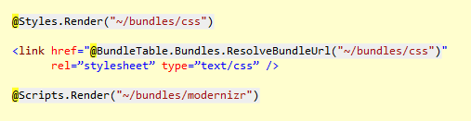
Rendering
Use the Scripts or Styles helpers
Use ResolveBundleUrl for fine-grained control

Slide 23
Summary
ASP.NET MVC has basic AJAX building blocks
AJAX Helpers
Partial Views
Client consumable action results
jQuery
DOM Manipulation
Plugins for any feature
jQuery UI for widgets

