Slide 1

Working with Forms
[(ngModel)]

Slide 2
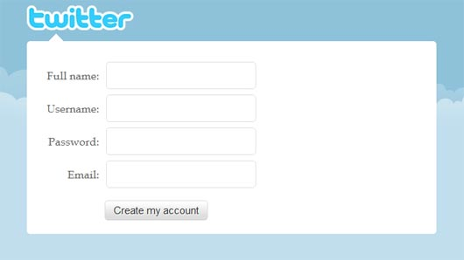
Goals
Accept user input
Enforce validations
Provide visual feedback on form status

Slide 3
Two-Way Or Not Two-Way
Do you like two-way data binding?
Use [(ngModel)]
Do you not like two-way data binding?
Use FormBuilder
<input>
movie.title

Slide 4
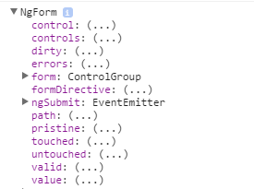

NgForm
NgForm automatically associates with any form element
Provides an API to check status, fetch values
Include FORM_DIRECTIVES on the component

Slide 5

NgControl
Represents a single input field
API can check state and value
Encapsulates validations
Will associate itself with a form ngForm

Slide 6
NgControlGroup
A collection of NgControl objects
Provides state and value for entire collection
Value returns an object of key-value pairs
NgForm provides a control group
And an ngSubmit event

Slide 7
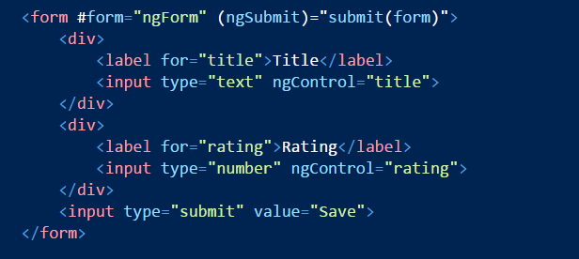
Implicit versus Explicit Forms
Implicit forms are template driven
Use ngForm and ngControl in a template
Explicit forms require some component code
More powerful and gives programmatic access to controls

Slide 8
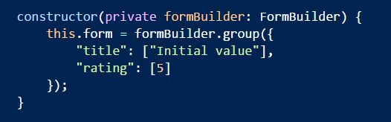
FormBuilder
Injectable service
API for creating control groups with controls
Associate with form using ngFormModel

Slide 9
ngFormModel and ngFormControl
ngForm
ngControl
ngFormModel
ngFormControl
New Control Group
(implicit)
Component FormBuilder
(explicit)

Slide 10
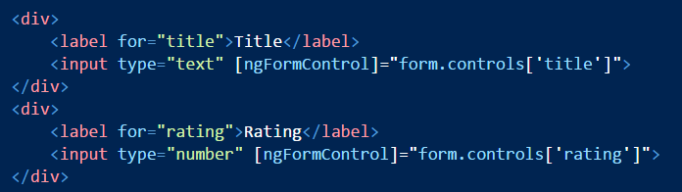
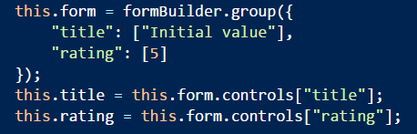
Using ngFormControl
Bind into component form
Can also use instance variables
Easy access from view but requires more code

Slide 11
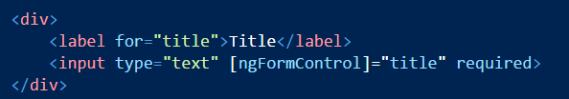

Validations
HTML validation attributes (implicit)
Register validations during form building (explicit)

Slide 12

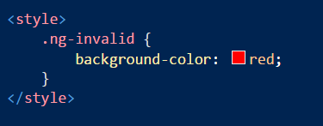
Visual Feedback
Many options
Bind to control or form valid property
Use hasError
Use automatic CSS classes

Slide 13
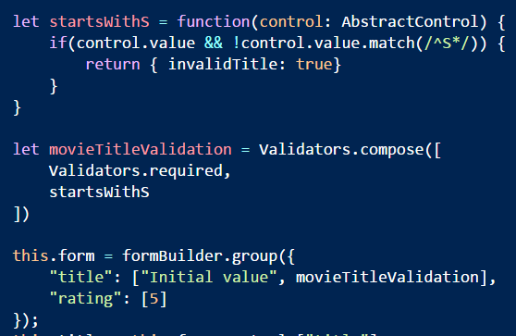
Custom Validations
Functions that take a control reference
Return an object with keys for error flags

Slide 14

Change Subscriptions
Controls and forms have a valueChanged observer

Slide 15

ngModel
Two way data binding
Keep a model in sync with the view

Slide 16
Summary
Forms with Angular 2 provide many features
Flexibility
Testability
Control interaction

