Slide 1

Directives
<slideShow>
<slide>
</slideShow>

Slide 2
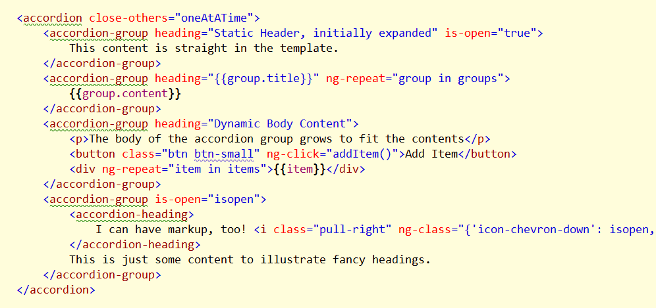
Extending HTML
WebComponents and Shadow DOM coming
Directives bring a glimpse of the future today
Custom elements
More semantic markup

Slide 3
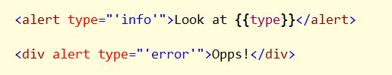
Elements, Classes, Attributes
Many directives will work in any position
Element <accordion>
Attribute <div accordion>
Class <div class=accordion>

Slide 4
Event Directives
ngClick
ngChange (requires ngModel)
ngChecked
ngBlur
ngDblClick
ngKeydown ngKeyup ngKeypress
ngMouse*
ngSubmit

Slide 5
Core Directives
ngApp
ngController
ngForm

Slide 6
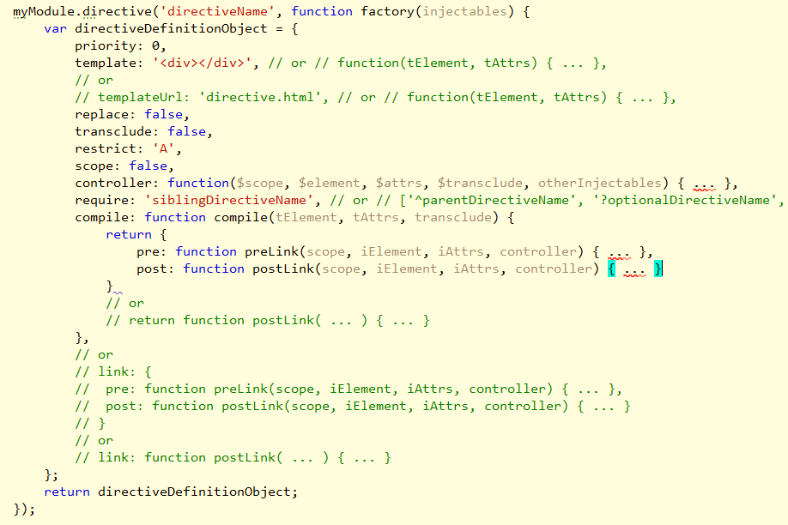
Custom Directives
Use a Directive Definition Object

Slide 7
Names
Best to use a prefix
Avoid clashes with over libraries or future specifications

Slide 8

angular.element
jQuery Lite (or jQuery) API
The 20% of jQuery you use 80% of the time

Slide 9
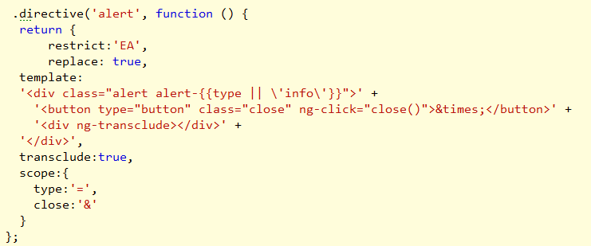
Directive Templates
Will wrap or replace an element with the template contents
Can be local (strings) or remote (templateUrl)

Slide 10
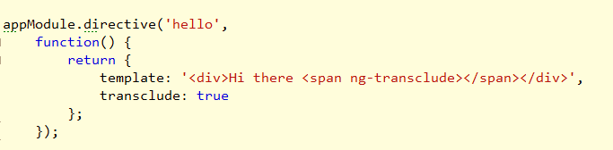
Transclusion
Include original content into template

Slide 11
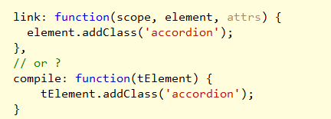
Compile and Link
Compile: transforms the template
Link: Modify data in the view (DOM)

Slide 12
Directives and Scope
Three options
Use existing scope (default)
Create a new inherited scope (scope:true)
Create an isolate scope ( scope: { } )

Slide 13
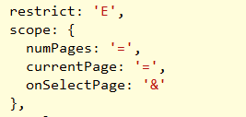
Isolated Scopes
No inherited access to parent scope
Still have $parent property
Isolated scope good for reusable widgets
Don’t want 2 directives sharing same scope

Slide 14
Summary
Directives create custom HTML
Directives manipulate the DOM

