Slide 1
Healthy Habits For AngularJS
K. Scott Allen
@OdeToCode

Slide 2
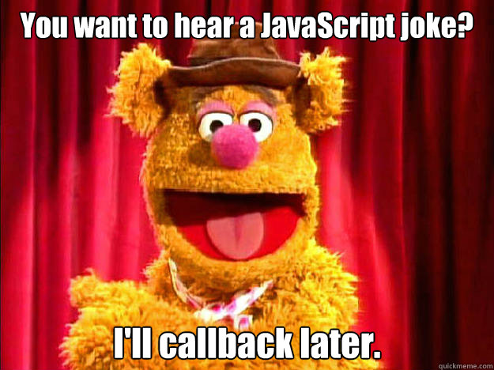

Slide 3
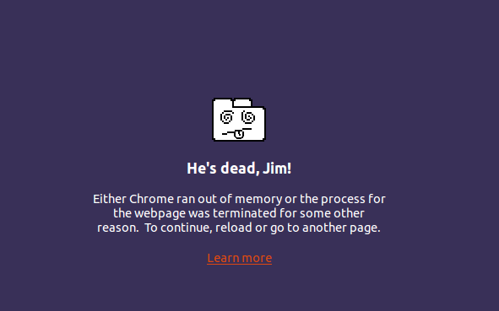

Slide 4
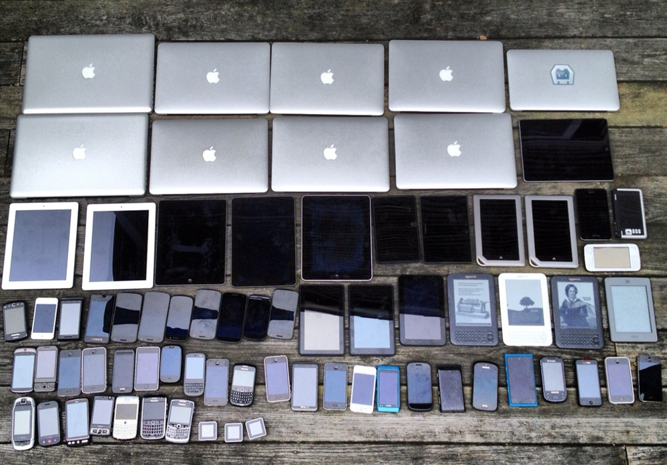

Slide 5


Slide 6
Three Things
Needs
Cautions
Plans

Slide 7

Needs

Slide 8
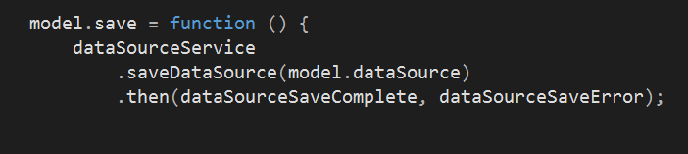
Need: Robust Error Handling

Slide 9
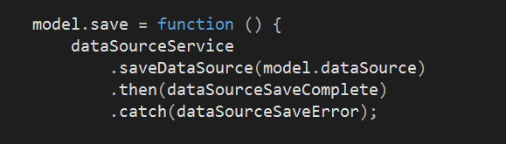
Catch At The Top Of The Chain

Slide 10
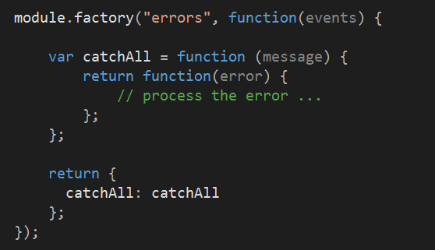
Need: Consistent Error Handling

Slide 11
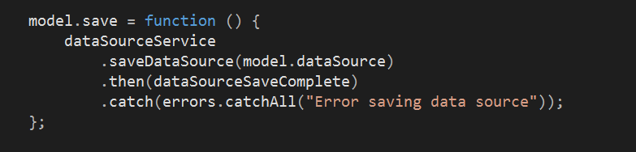
Error Service Usage

Slide 12
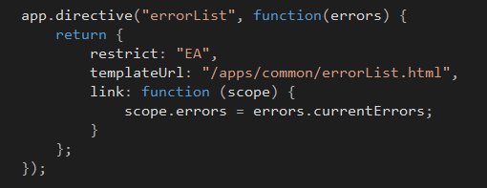
Consistent Display

Slide 13
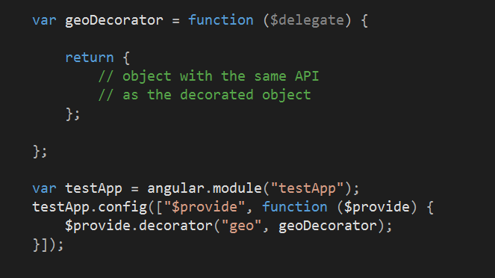
Need: Decorators

Slide 14
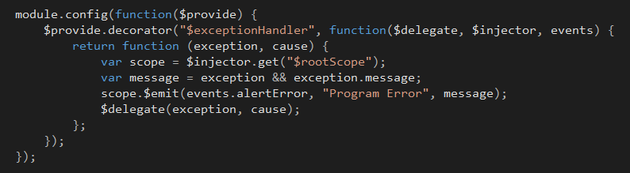
See All The Errors

Slide 15
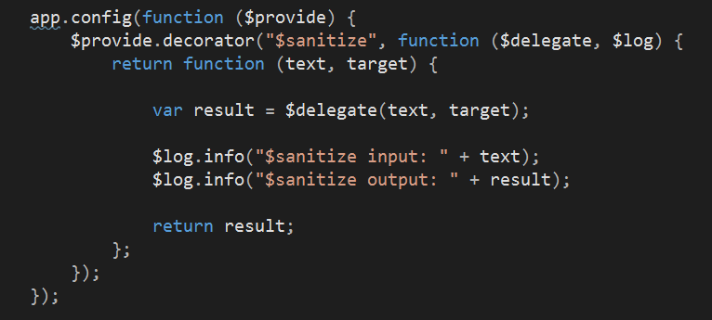
Decorators For Instrumentation

Slide 16
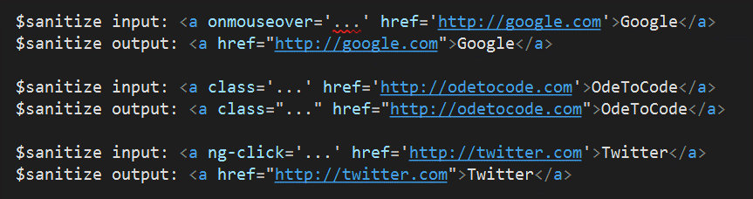
Sanitize Decorator Output

Slide 17
Decorators For Debugging

Slide 18
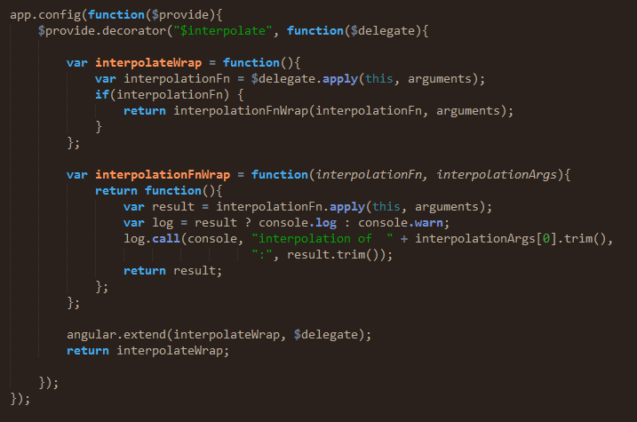
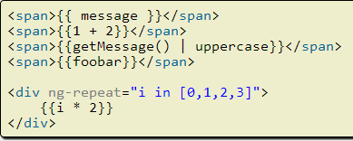
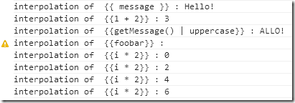

Slide 19
Need: $http Interceptors

Slide 20
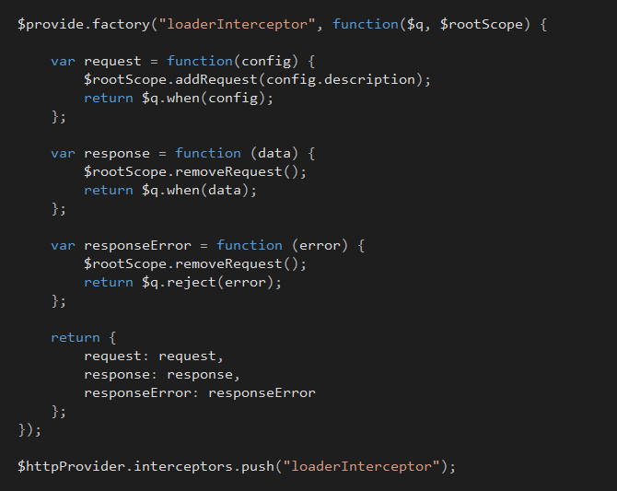

Slide 21
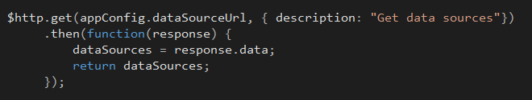
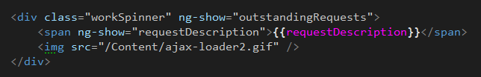

Slide 22
Need: Custom Directives

Slide 23
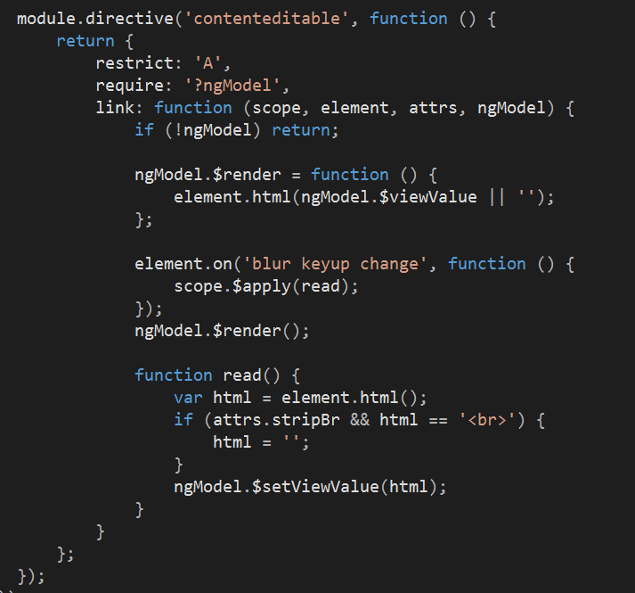

Slide 24
Need: Unit Tests

Slide 25
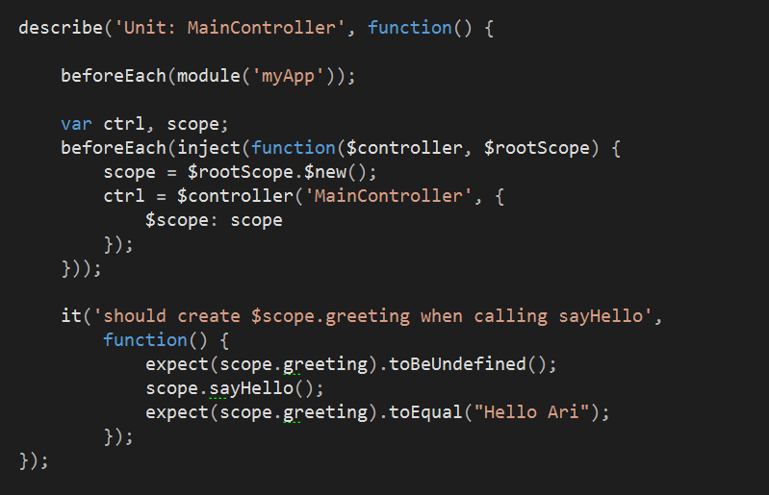

Slide 26
Inject All The Things

Slide 27
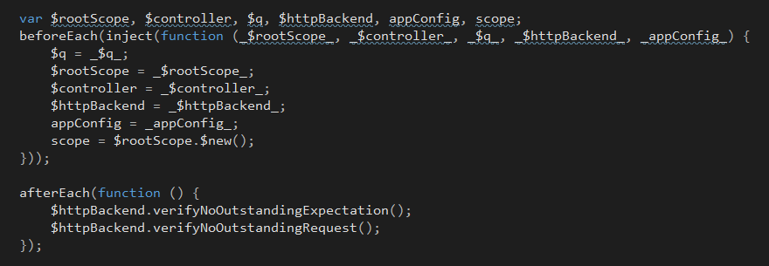

Slide 28
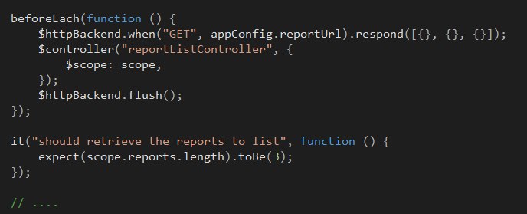

Slide 29
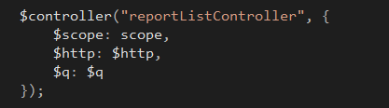

Use $controller With What You Need

Slide 30
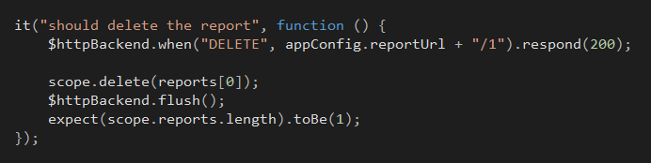
Possibly Redefine The SUT

Slide 31
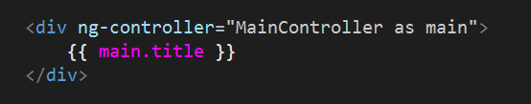
Use Controller As
Explicit in the view
Simplifies tests

Slide 32

Cautions

Slide 33
Avoid: $rootScope Abuse
Let’s store errors
Let’s store loading messages
Let’s store user profile
Let’s store configuration constants

Slide 35
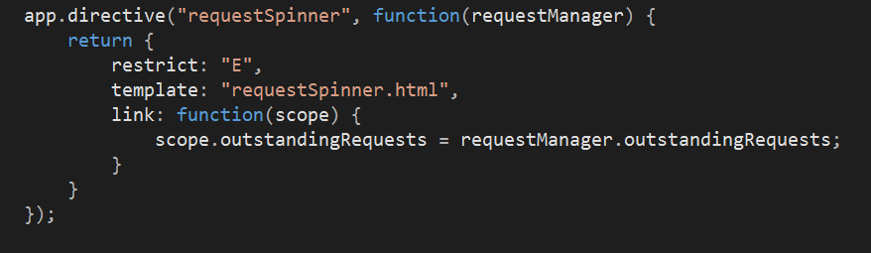

Slide 36
Avoid: Promise Abuse

Slide 37
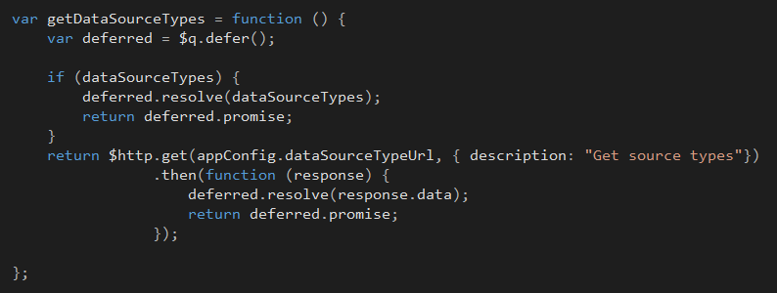
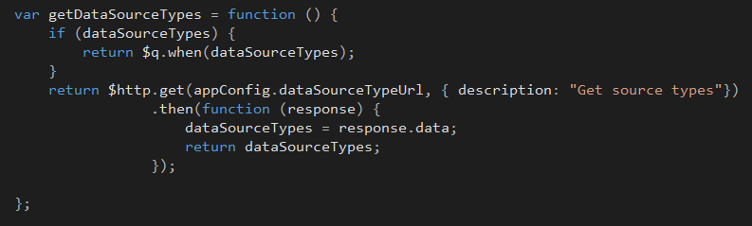

Slide 38
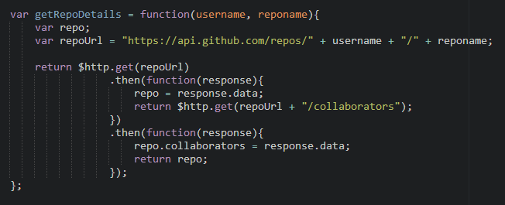
Promises Chain!

Slide 39

Planning

Slide 40
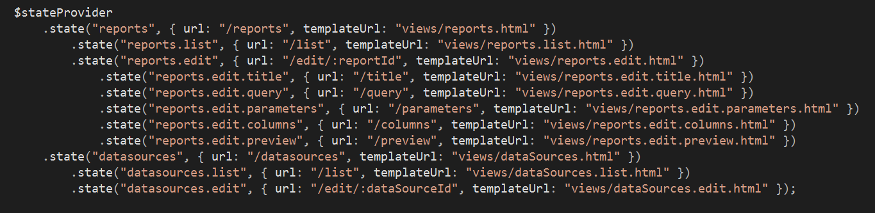
Think About: Your Router
Look at UI-Router

Slide 41
Think About: A Better $http
BreezeJS
Restangular
Caching, configuration, offline…

Slide 42
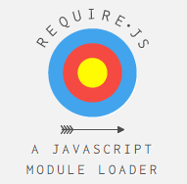
Think About: AMD

Slide 43
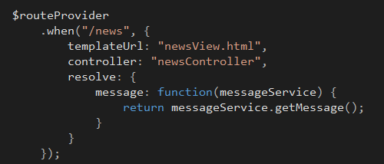

Think About: Resolve

Slide 44
Resolve Pros
View appears with data ready
Easier to stay somewhere is there is an error
Easier to test controllers

Slide 45
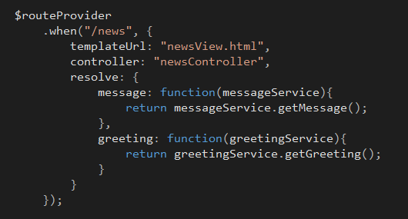
Resolve Everything

Slide 46
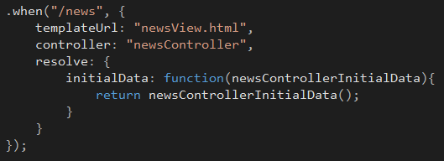
Move Resolve To A Service

Slide 47
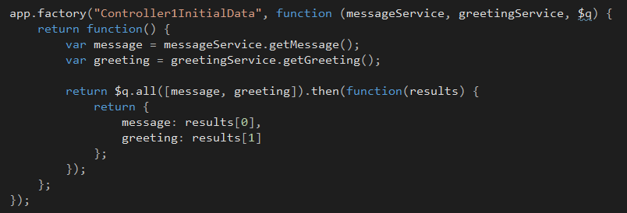

Slide 48
Think About: Basic Abstractions
Controller
Model
Service
Directive
Filter

Slide 49

Think About: Code Standards

Slide 50
Think About: Directory Structure
I like feature based

Slide 51
apps
movieApp
module.js
templates
dashboard
common
specs
js

Slide 52
Summary
Error handling
Decorators, interceptors
Custom directives
Code style and structure

