Slide 1

An Introduction To Angular 2

Slide 2

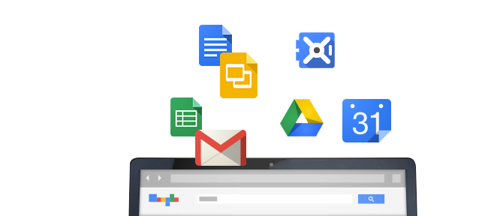
History
Started in 2009 @ Google
Built from experience with large web applications

Slide 3
Concepts and Goals
Separation
of
Concerns
Testability
Extensibility
Forward
Looking

Slide 4
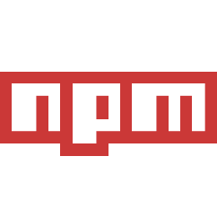

Tools & Languages

Slide 5
Getting Started : Packages
angular 2 – the framework
typescript – the language
systemjs - the module loader
npm init –y
npm install angular2 typescript systemjs --save

Slide 6
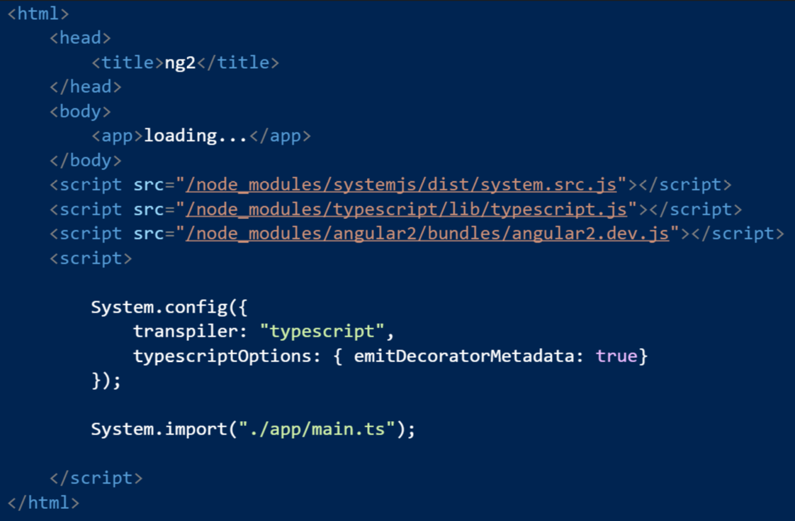
Getting Started: Shell Page

Slide 7
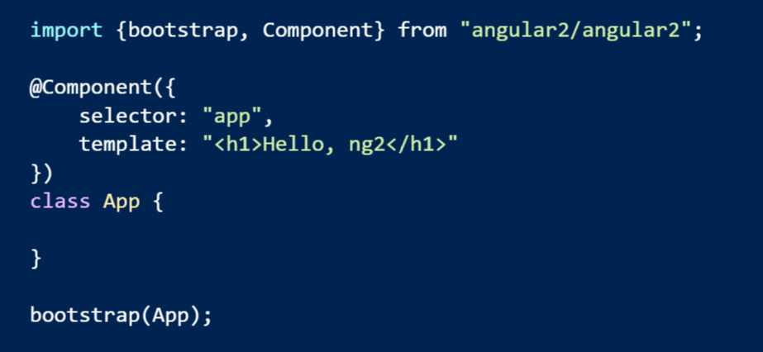
Getting Started: First Script

Slide 8

Other Starting Points
Yeoman generators
generator-angular2
generator-angular2-gulp-webpack
Seed projects
angular2-seed (npm)
ng2-play (github:pkozlowski-opensource)
angular-starter (github:eladrk)

