Slide 1
Testing

Slide 2
Unit Tests
Test a small but functional piece of code
public ActionResult Login(LoginModel model, string returnUrl)
{
// …
}

Slide 3

Testing is about Confidence
Confidence when deploying cod
Confidence when changing code

Slide 4
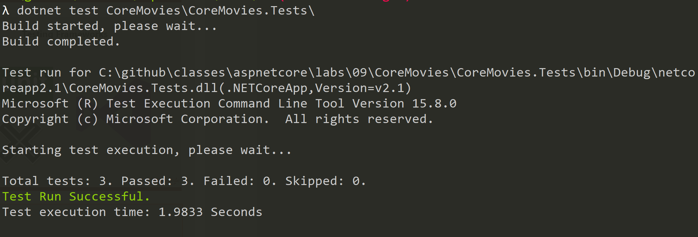
First Class Support

Slide 5



Testing Frameworks

Slide 6
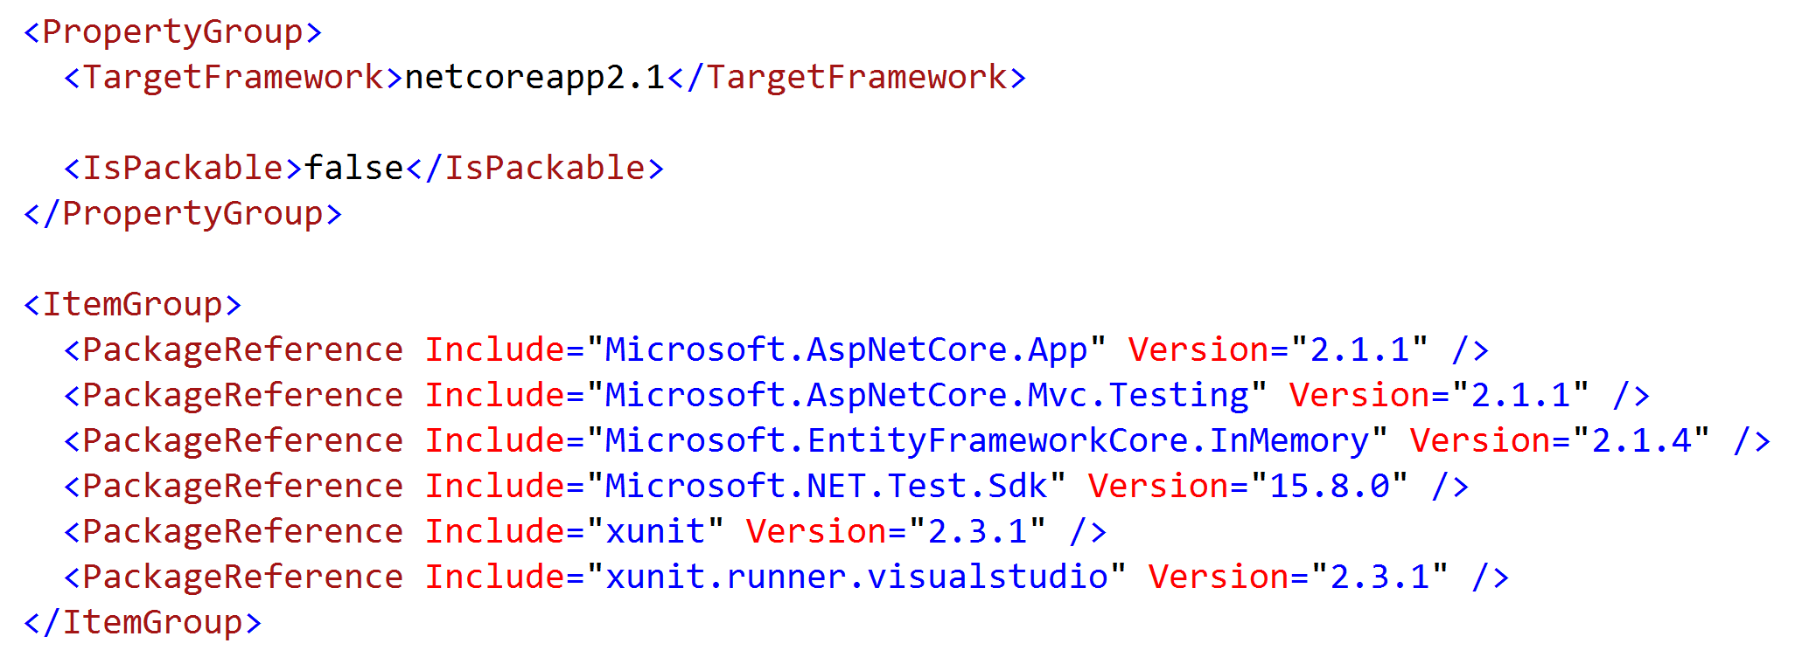
Anatomy of a Test Project

Slide 7
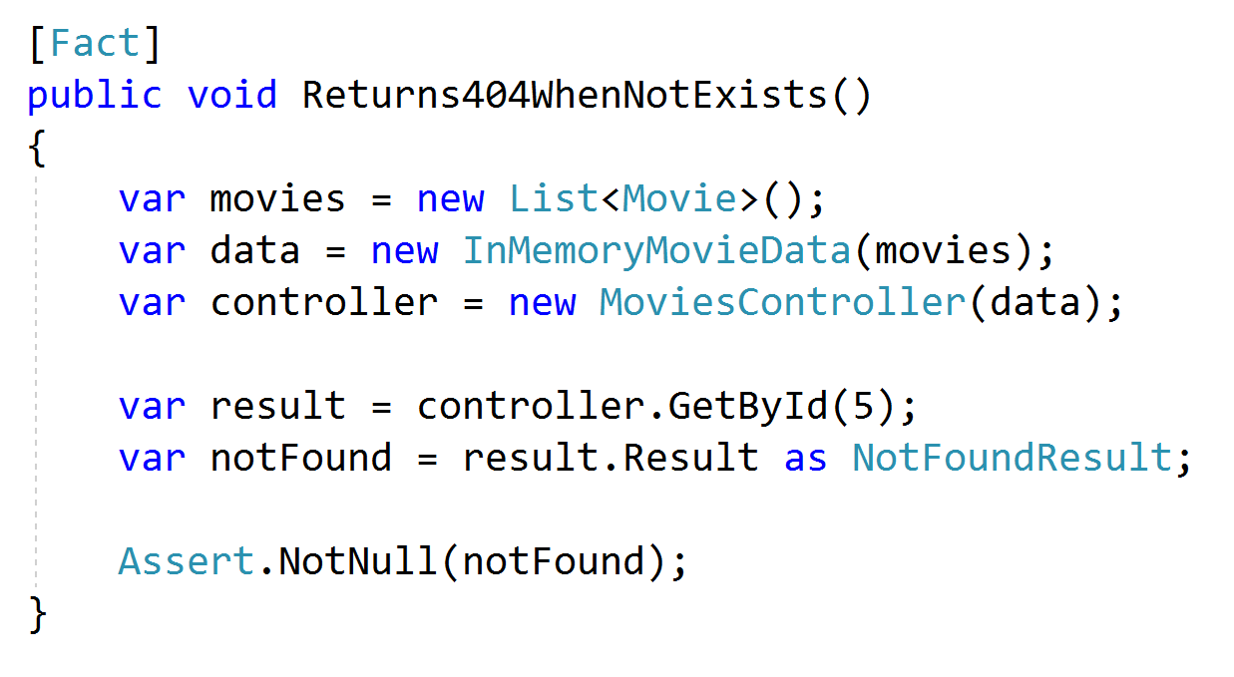
Testing Controllers

Slide 8
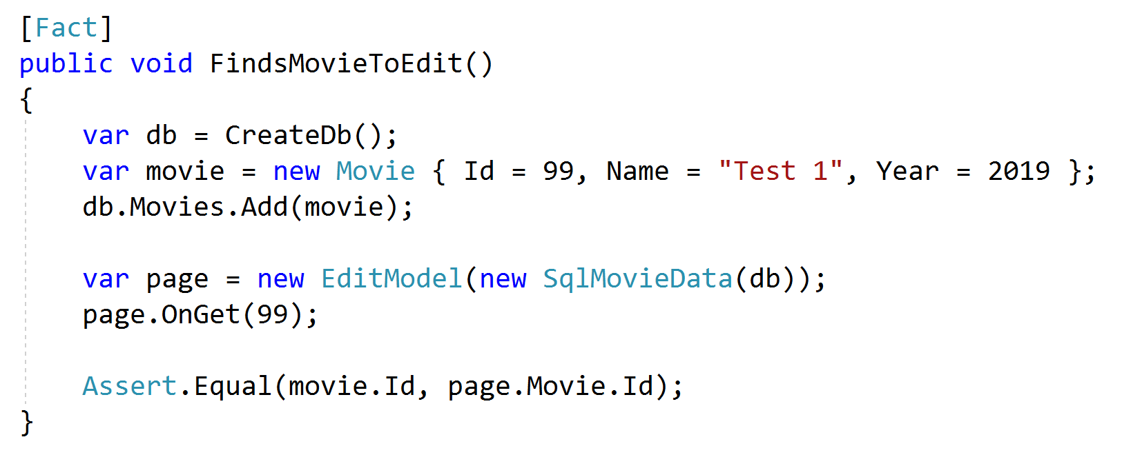
Testing Pages

Slide 9
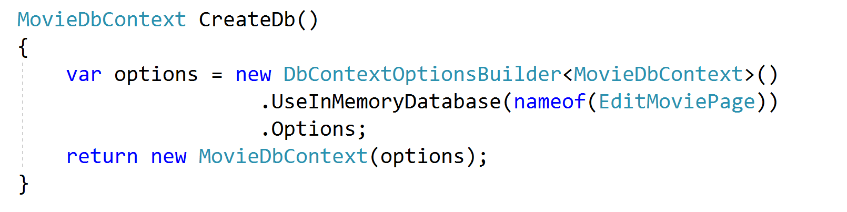
Using In-memory EF

Slide 10
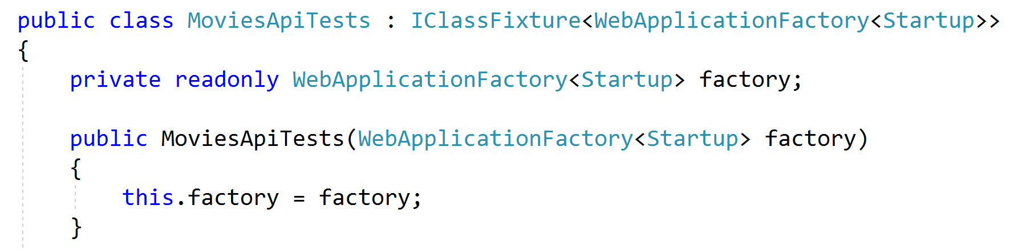
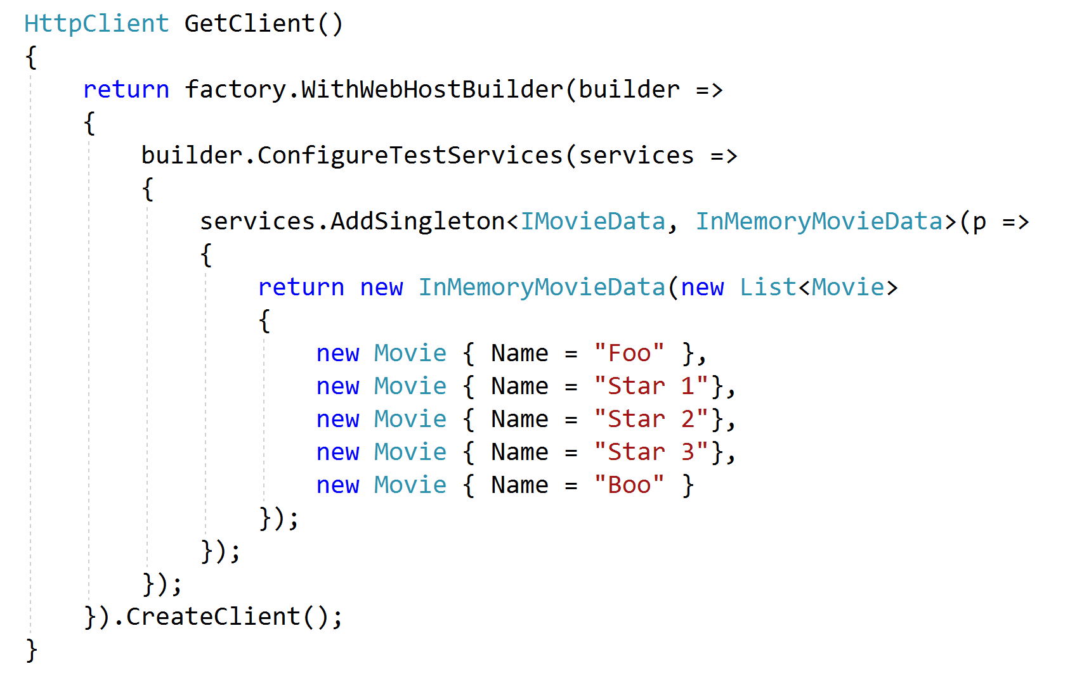
Using WebApplicationFactory

Slide 11
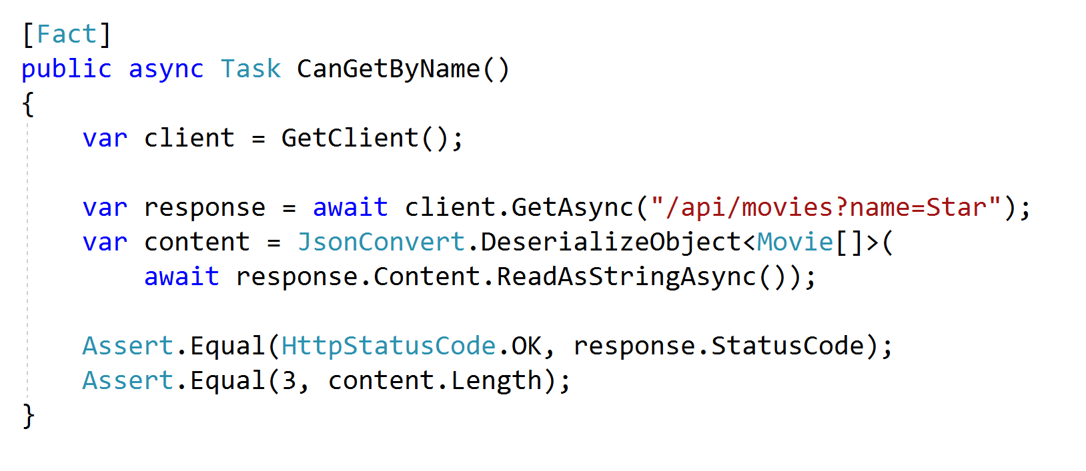
Functional Tests

Slide 12
Summary

