Slide 1
The Evolution of JavaScript (and the features of ES2015) K. Scott Allen

Slide 2
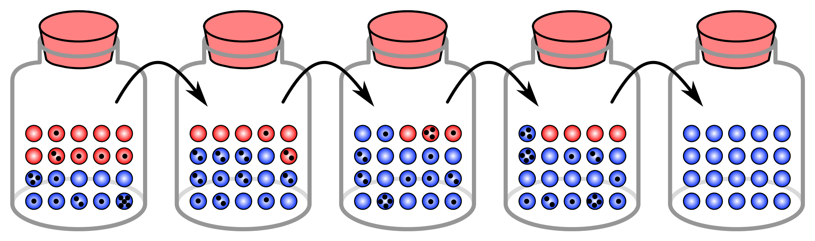

Slide 3
1993
1.0
1999
3.0
2015
6.0
1998
2.0
2009
5.0

Slide 4
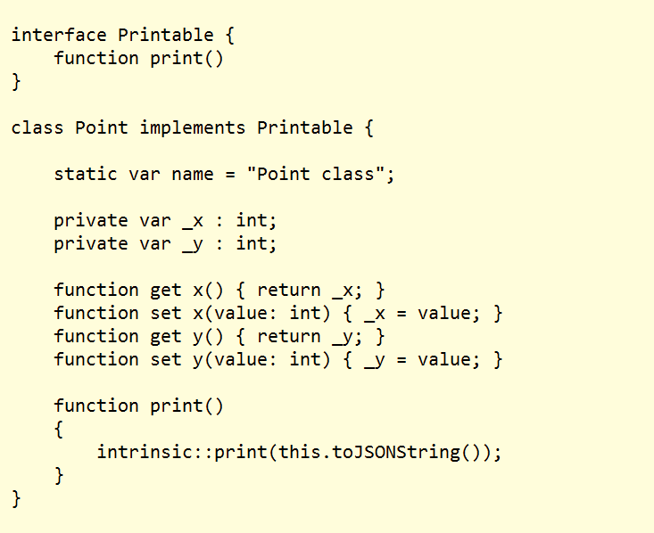
2007

Slide 5
Why The Excitement?
First substantial addition to JavaScript since inception
1993
1.0
1999
3.0
2015
6.0
1998
2.0
2009
5.0

Slide 7
The Old New JavaScript
Apologies to Raymond Chen
Lisp
C#
JavaScript
Python
Ruby

Slide 8
Agenda
What’s New?
How Do I Use It NOW?!?

Slide 9
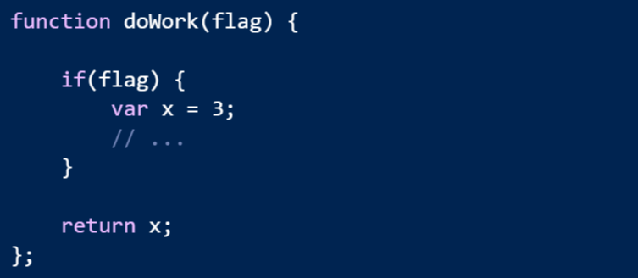
Problem
JavaScript has no block scope

Slide 10
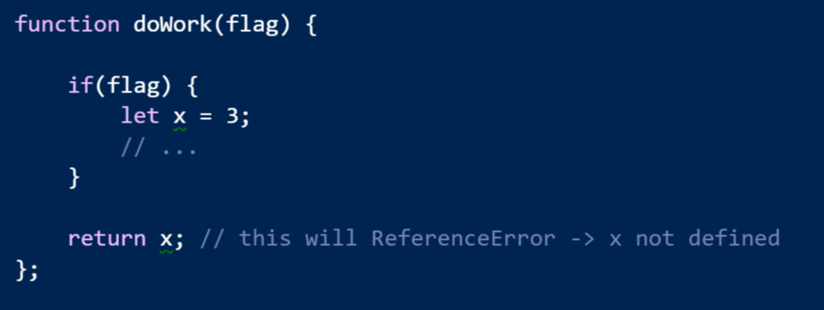
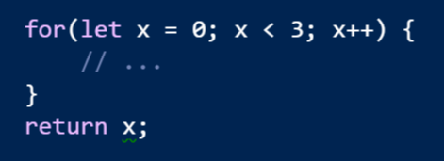
Solution: let

Slide 11
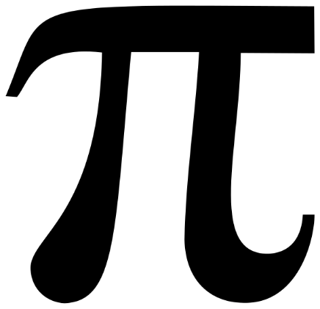
Problem
All variables are mutable
=4

Slide 12
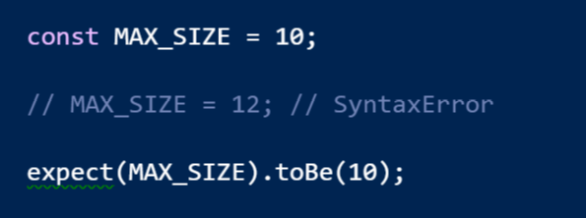
Solution: const

Slide 13
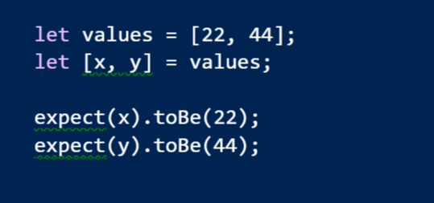
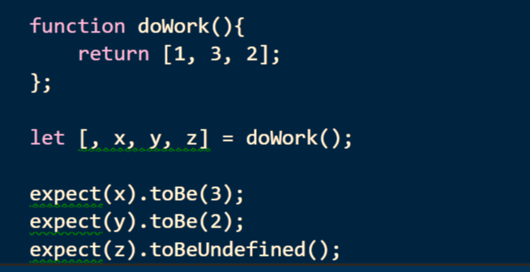
Destructuring
The opposite of constructing is destructing

Slide 14
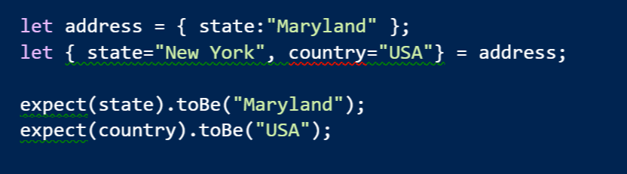
Destructuring Objects

Slide 15
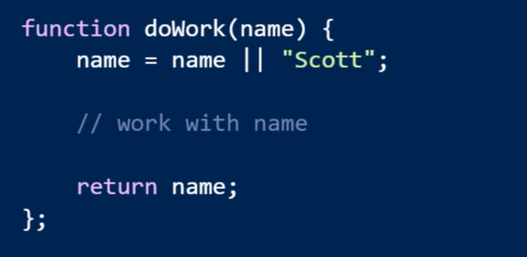
Problem: Default Values
Default are buried in the function code

Slide 16
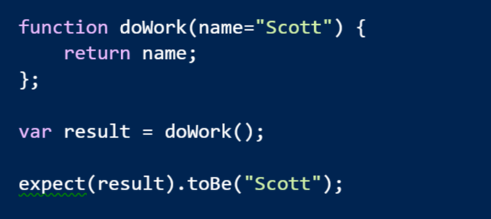
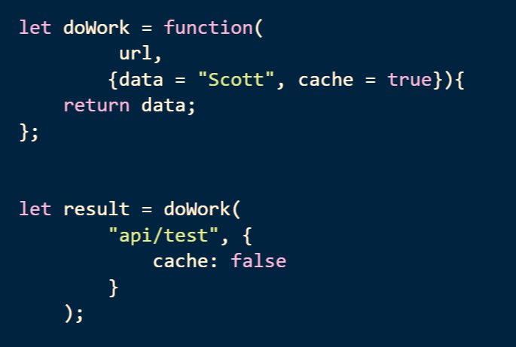
Solution: Default Parameter Values

Slide 17
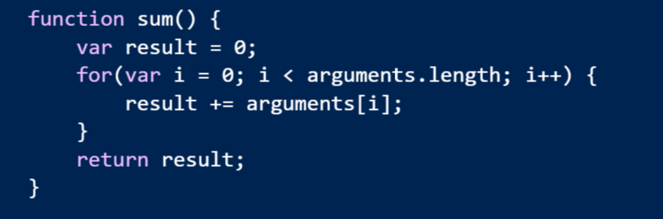
Problem: Variable Number of Arguments
Syntax is not obvious to the consumer

Slide 18
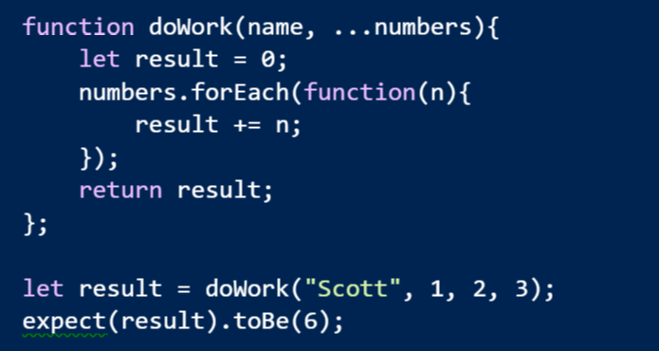
Solution: Rest Parameters
Let the last parameter take the rest of the arguments

Slide 19
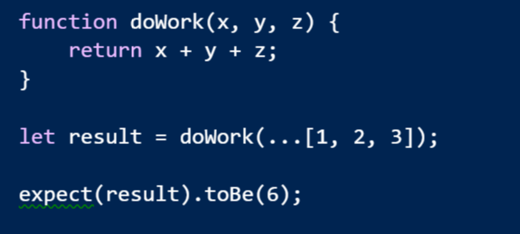
Spread Operator
Spread an array across the parameters

Slide 20
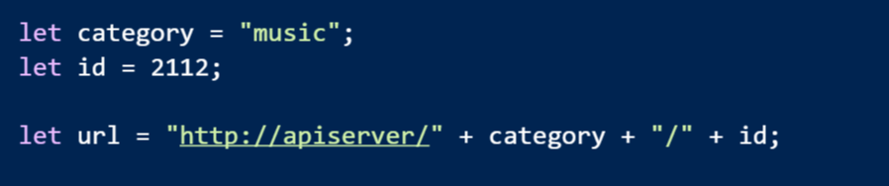
Problem: String Concatenation Is Unpleasant

Slide 21
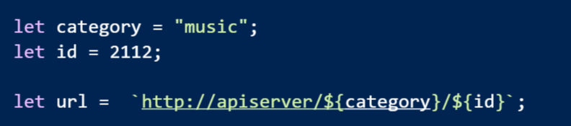
Solution: String Templates

Slide 22
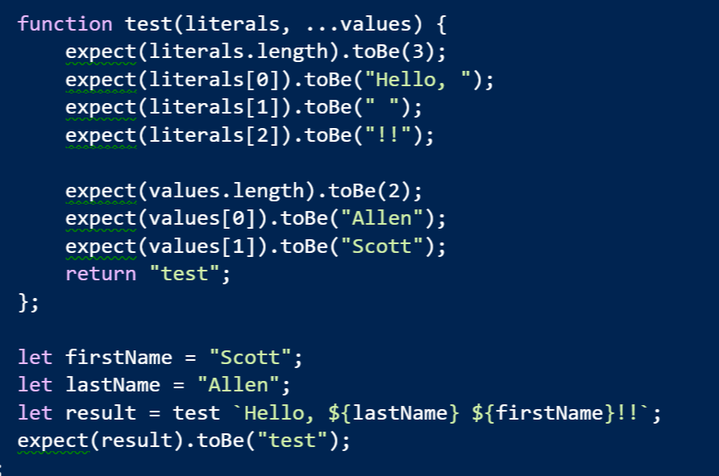
Even Better: Tagged Templates

Slide 23

Syntax Sugar
Even more to come!

Slide 24
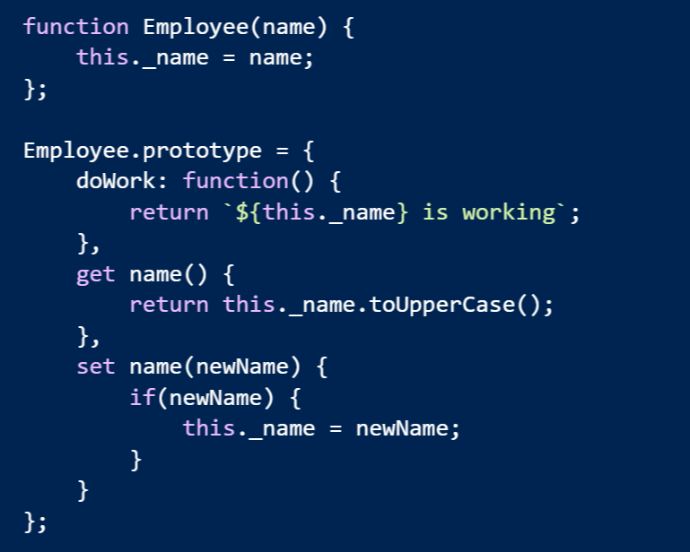
Problem: Simulating OOP

Slide 25
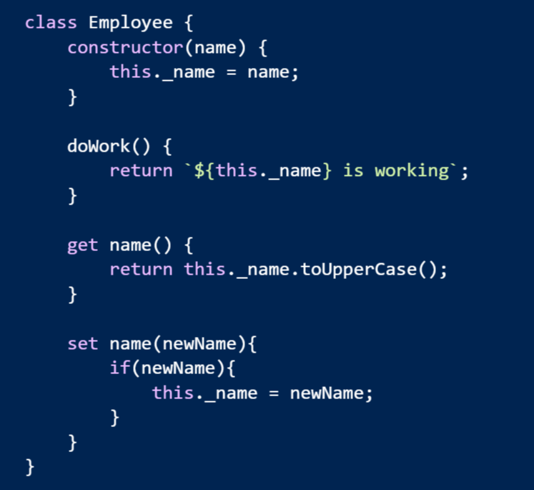
Solution: class Keyword

Slide 26
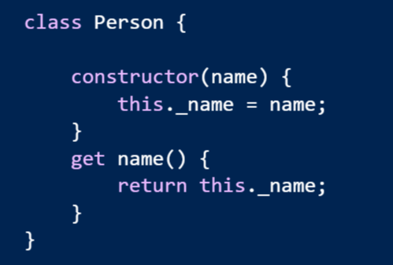
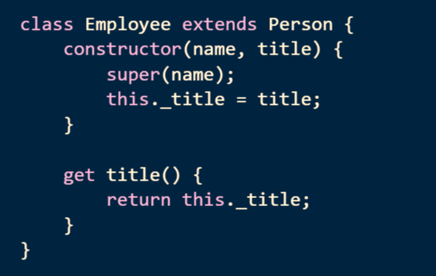
Inheritance

Slide 27
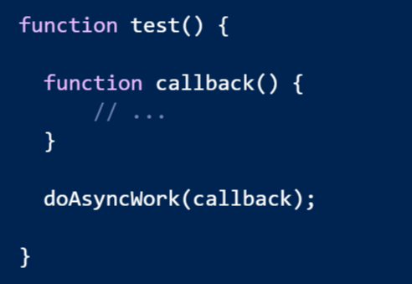
Problem: function is an 8 character word

Slide 28
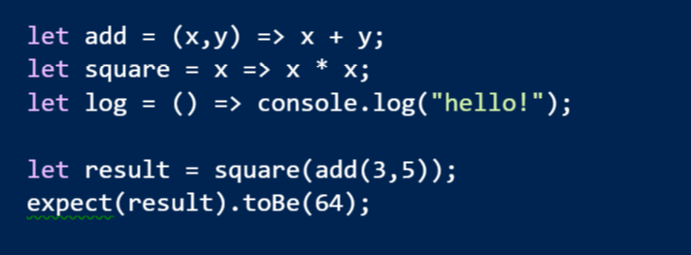
Arrow Functions
Expressive syntax
Familiar to C# developers

Slide 29
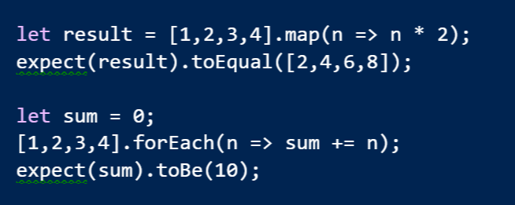
LINQish Arrows

Slide 30
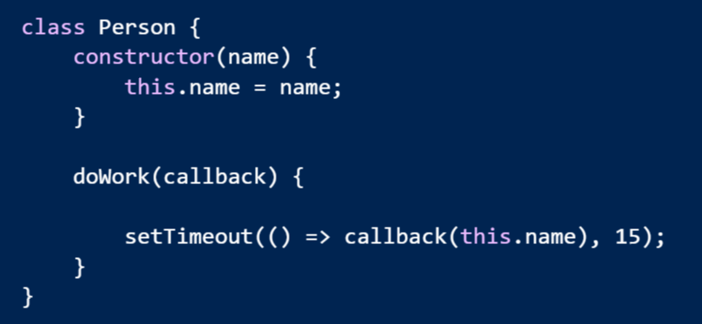
Arrow Functions Lexically Bind this

Slide 31
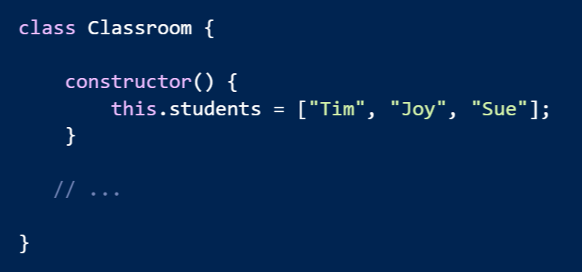
Problem: Encapsulating Collections

Slide 32
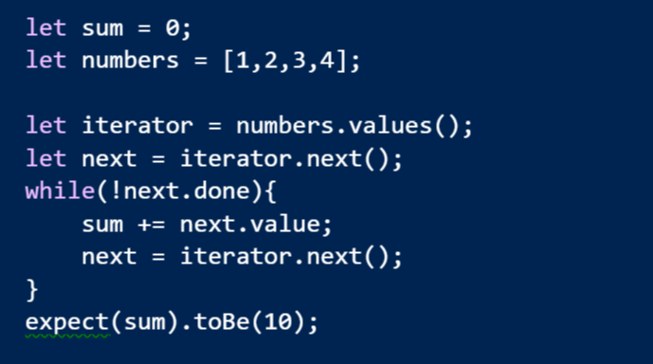
Solution: Iterators and Iterables

Slide 33
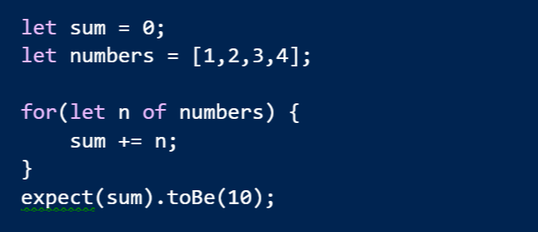
for of

Slide 34
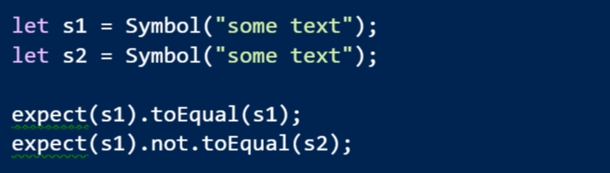
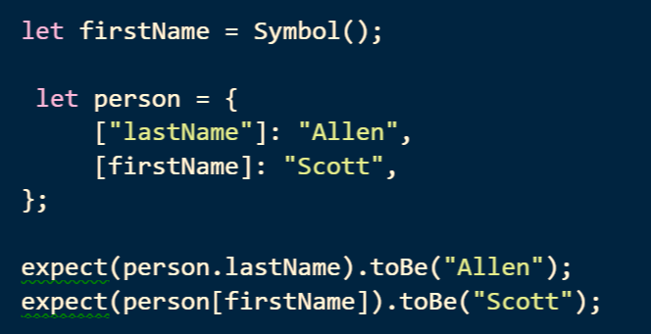
Symbol
A new type where every value is unique and immutable
Can use a symbol as a key into an object

Slide 35
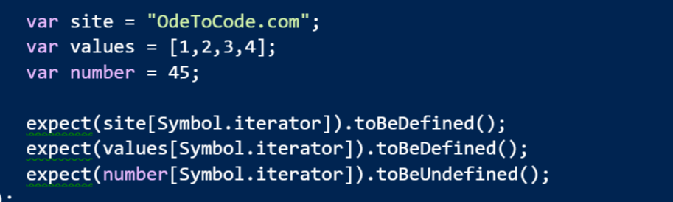
Symbol.iterator
A magic method that makes an object iterable

Slide 36
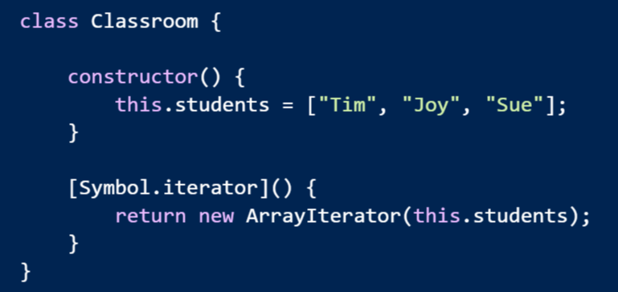
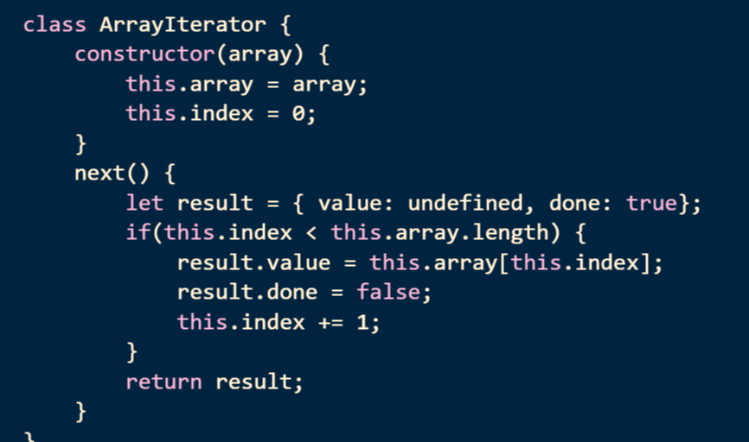
Make Your Own Iterable

Slide 37
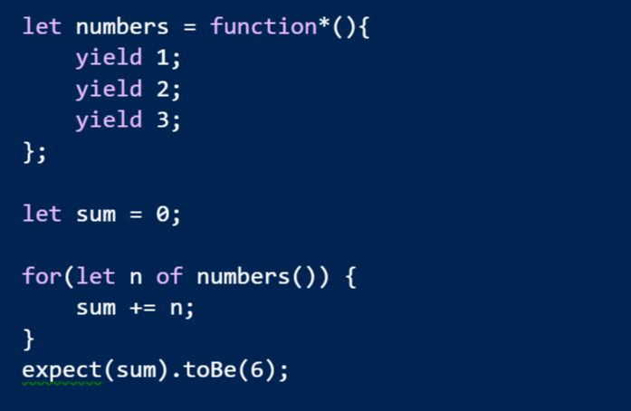
Generators

Slide 38
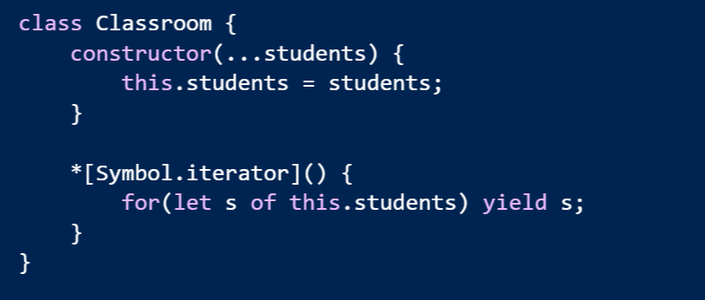
Easy To Make Iterables

Slide 39
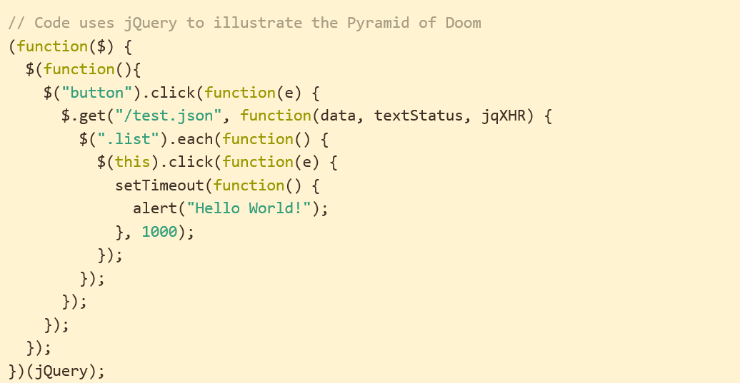
Problem: Async Code
http://tritarget.org/blog/2012/11/28/the-pyramid-of-doom-a-javascript-style-trap/

Slide 40
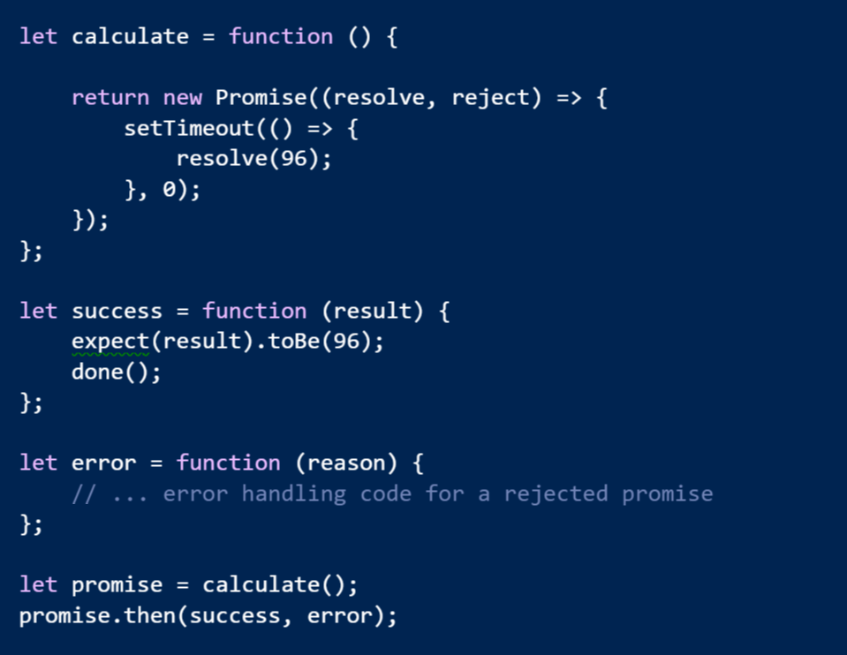
Solution: Promises

Slide 41
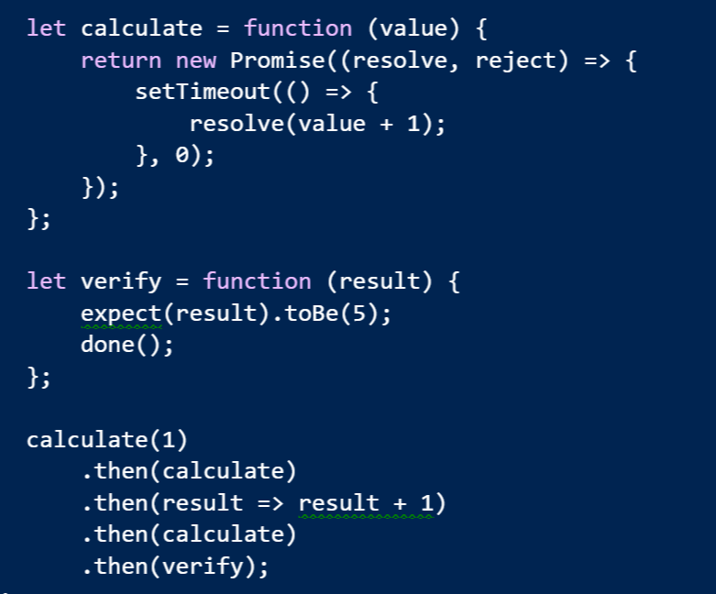
Promises Chain

Slide 42
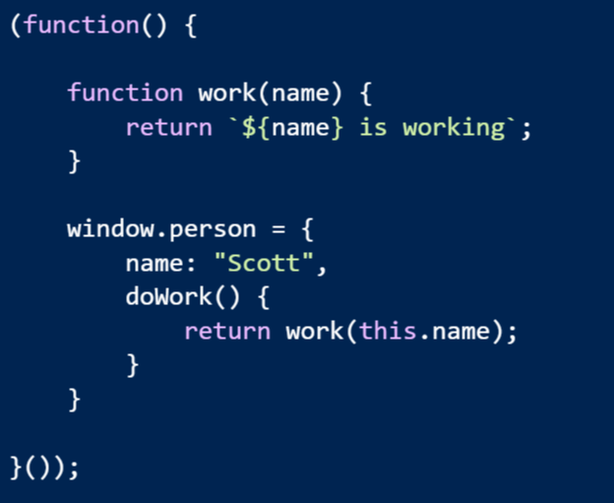
Problem: Modularity & Scope

Slide 43
Problem: Modularity & Scope
Possible solutions
Common JS
Asynchronous Module Definitions
IFFE and Globals
Think about how current libraries are designed
jQuery -> $
Angular -> angular
Lodash -> _

Slide 44
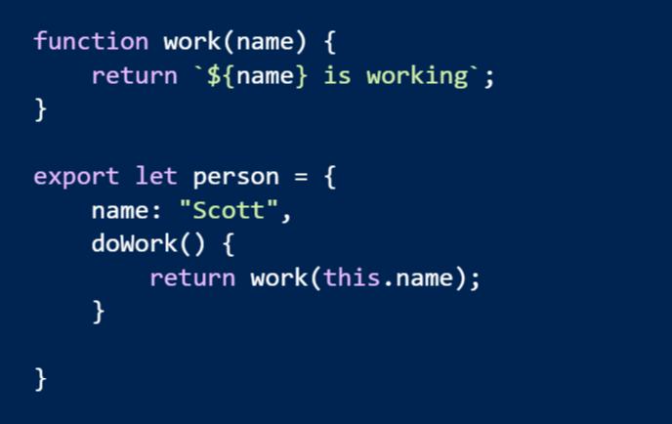
Solution: Real Modules!
Think “module” not “file”

Slide 45
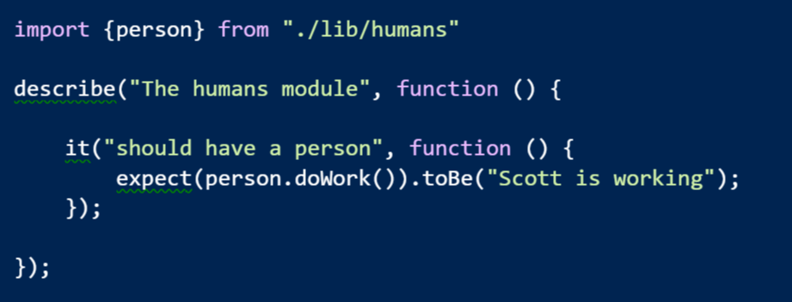
Imports

Slide 46
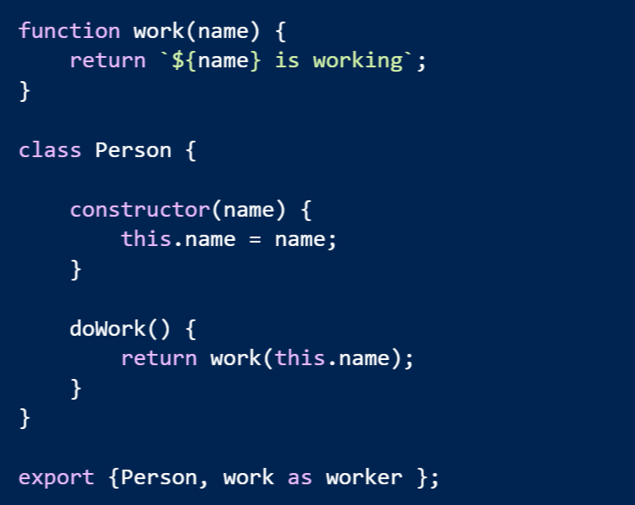
Multiple Exports

Slide 47
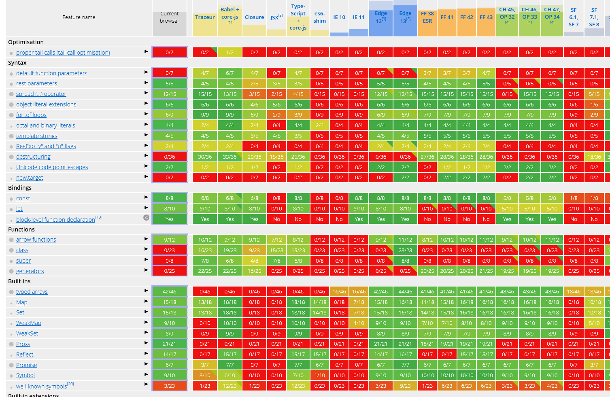
Making It Work
https://kangax.github.io/compat-table/es6/

Slide 48
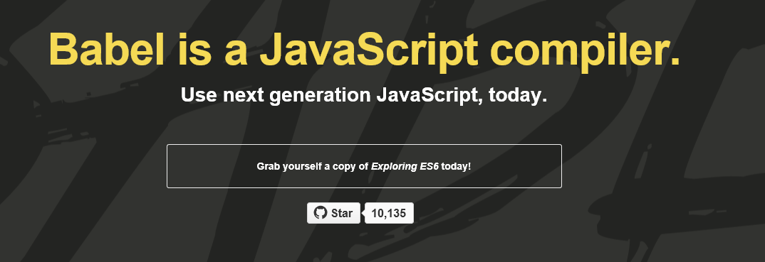
Build Your JavaScript
https://babeljs.io/
Use with Grunt, Gulp, WebPack, JSPM
Many others
Or . . . directly in a browser

Slide 49
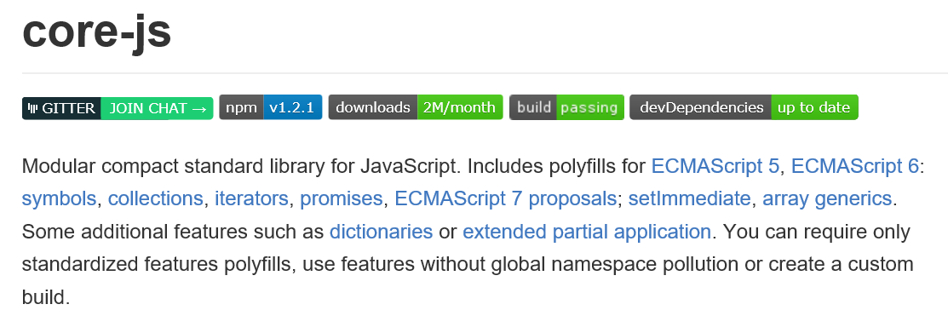
Polyfill Your Browser
Almost automatic with many bundling tools

Slide 50
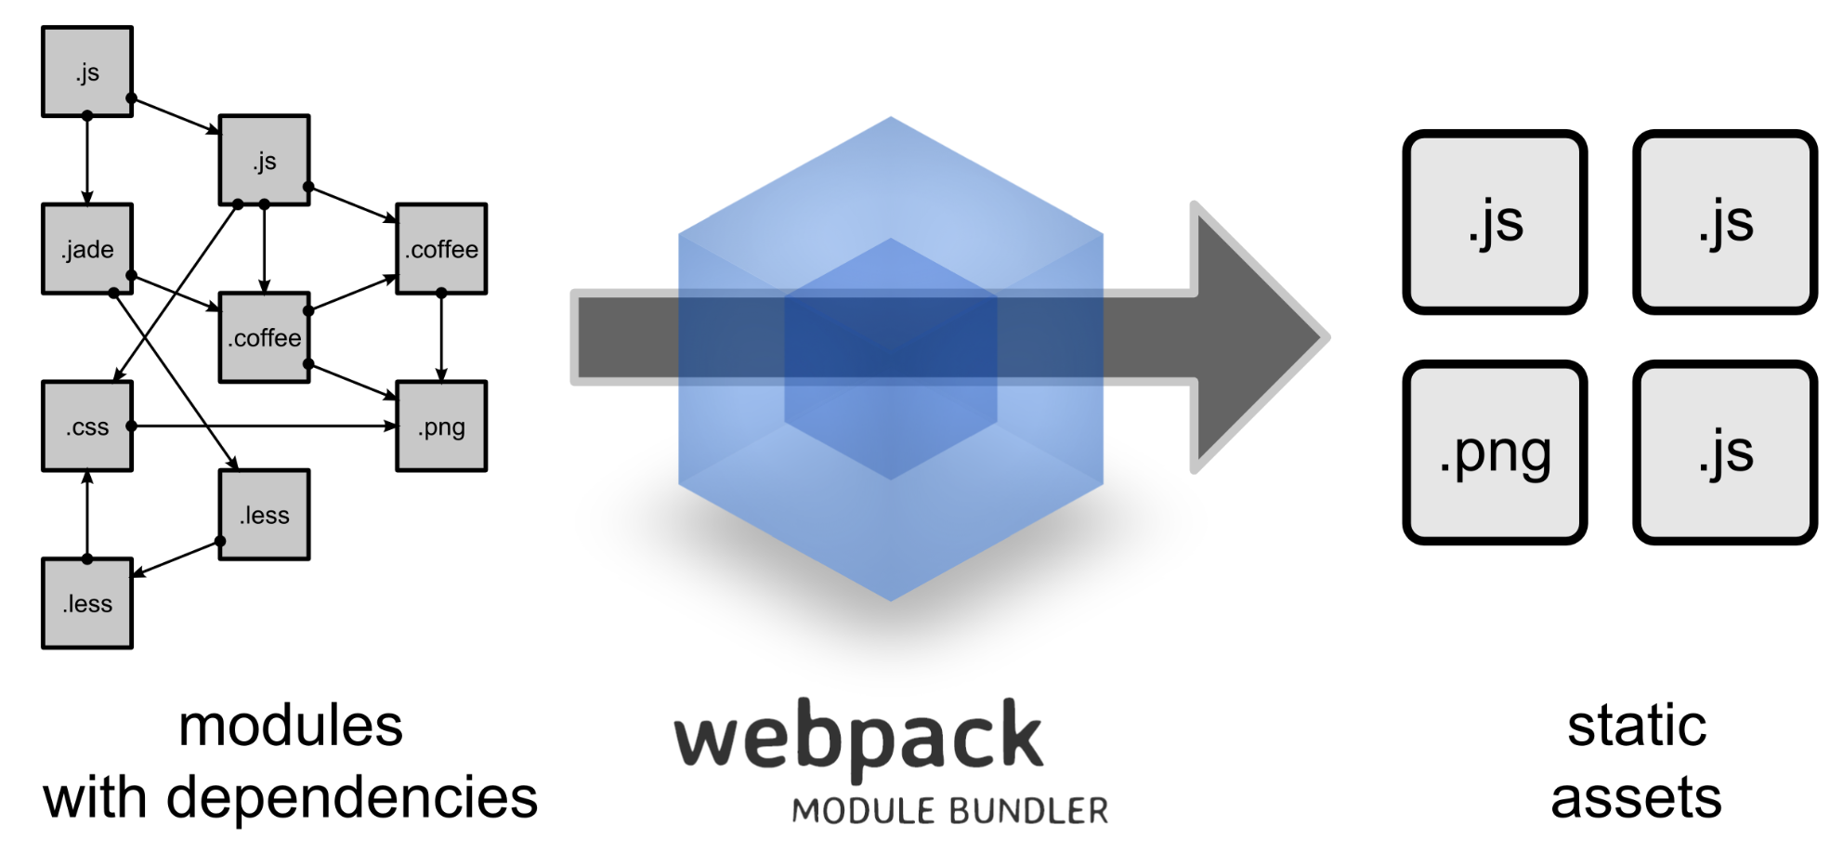
Build Your Modules
http://webpack.github.io/
Bundle them, too

Slide 51
In Conclusion …
Thanks for listening!
scott@OdeToCode.com

