Slide 1
ASP.NET 5
Old patterns on a new framework

Slide 2

The 15 Year Reboot
Major architectural changes
No more System.Web.dll
Cross Platform
Windows, OS/X, Linux
Unified programming model
One framework for UI and APIs
Faster, lighter, and pay as you go
Customize the processing pipeline

Slide 3
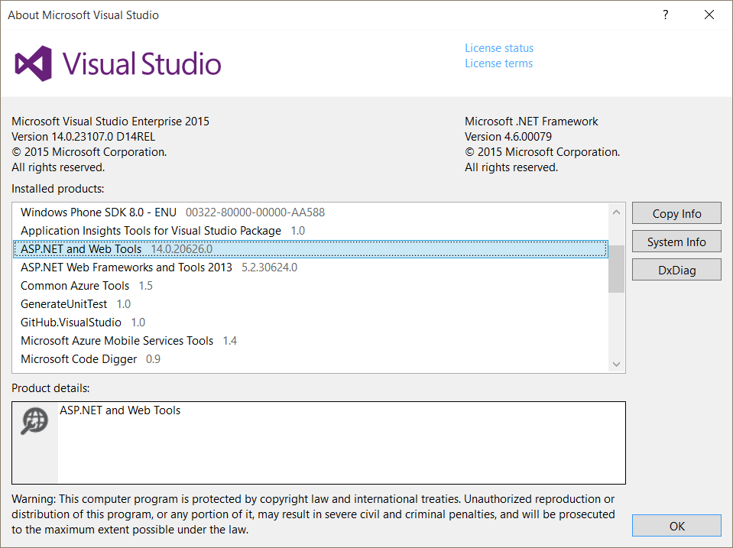
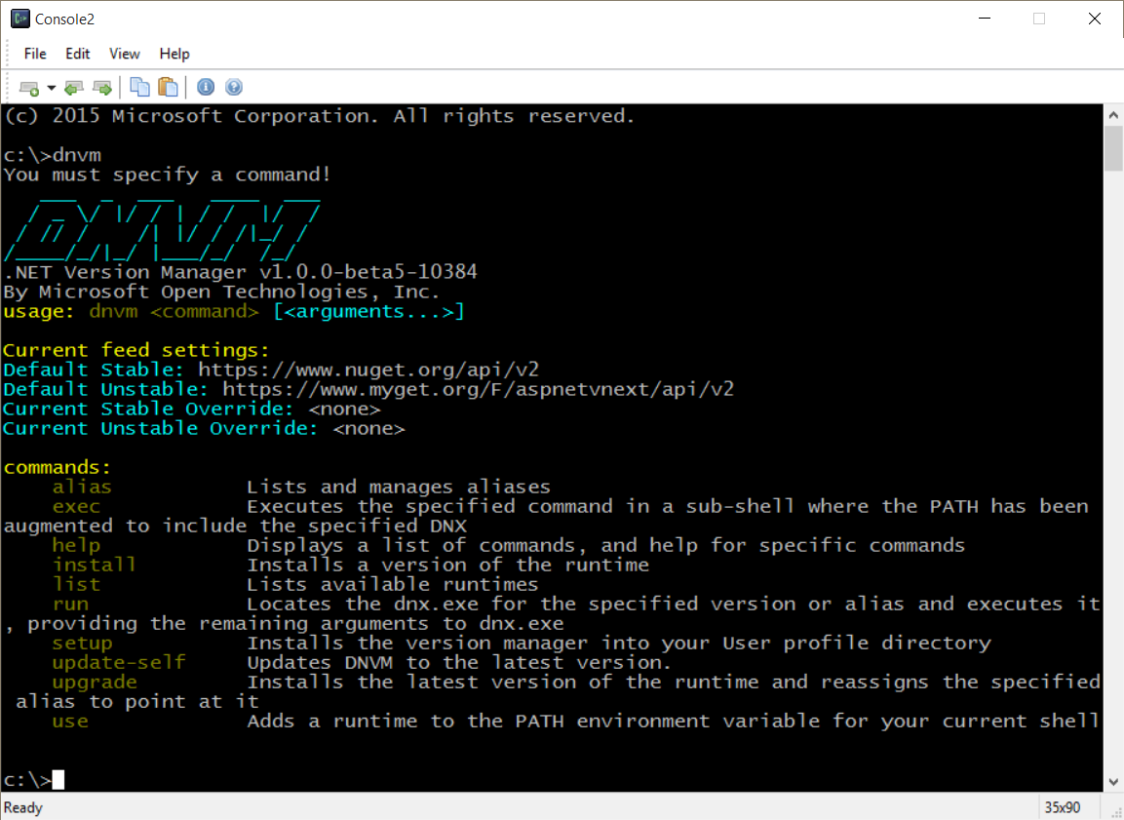
Getting Started
Install with Visual Studio 2015
Install using the .NET Version Manager (dnvm)

Slide 4
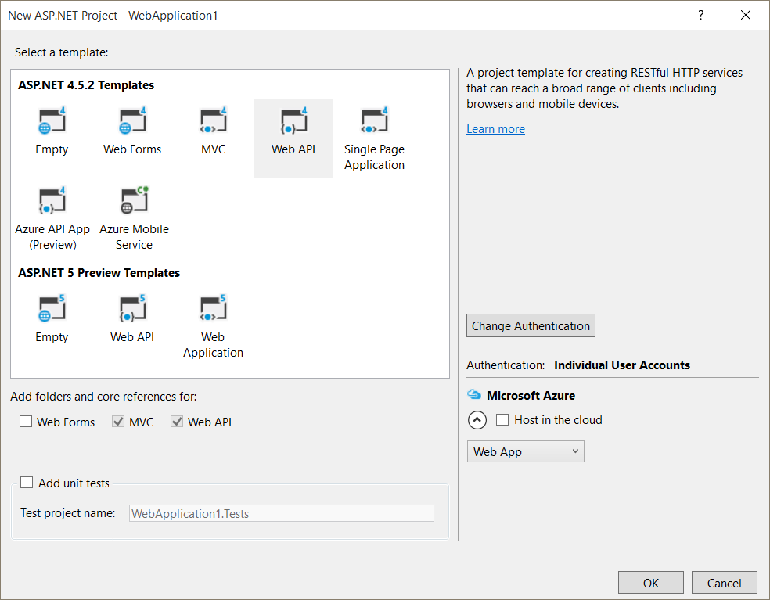
Creating a Web App
Visual Studio offers ASP.NET 5 templates

Slide 5
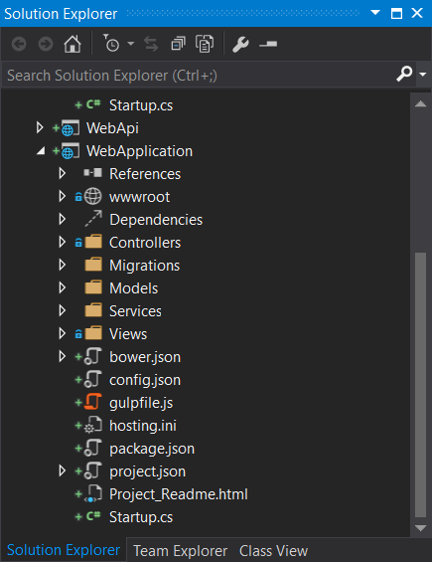
The .xproj file
.xproj file for Visual Studio
No individual files
No assembly references
Enabled tooling, building
File system dictates project contents

Slide 6
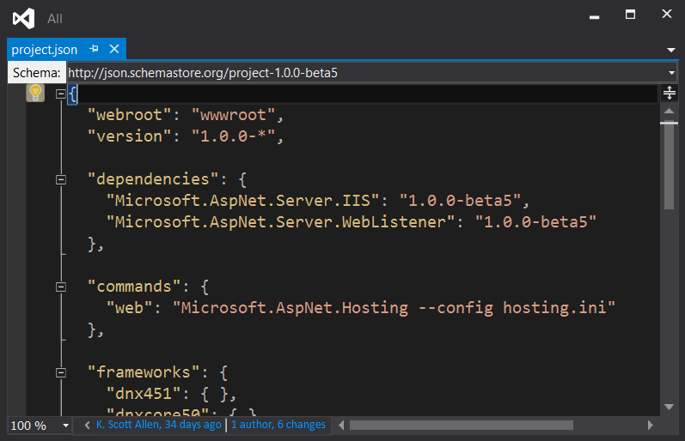
The project.json
project.json is the heart of the project
Defines dependencies (references)
Defines framework
Defines the “build”

Slide 7
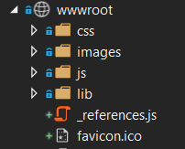
The wwwroot folder
Web site is rooted in wwwroot
Static assets must live in wwwroot
Name is configurable in project.json

Slide 8
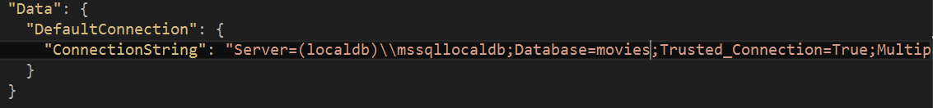
The config.json file
Runtime configuration options include:
JSON files
INI files
Environment variables

