Slide 1
ASP.NET Core Overview
Old patterns on a new framework

Slide 2

The 15 Year Reboot
Major architectural changes
No more System.Web.dll
Cross Platform
Windows, OS/X, Linux
Unified programming model
One framework for UI and APIs
Faster, lighter, and pay as you go
Customize the processing pipeline

Slide 3
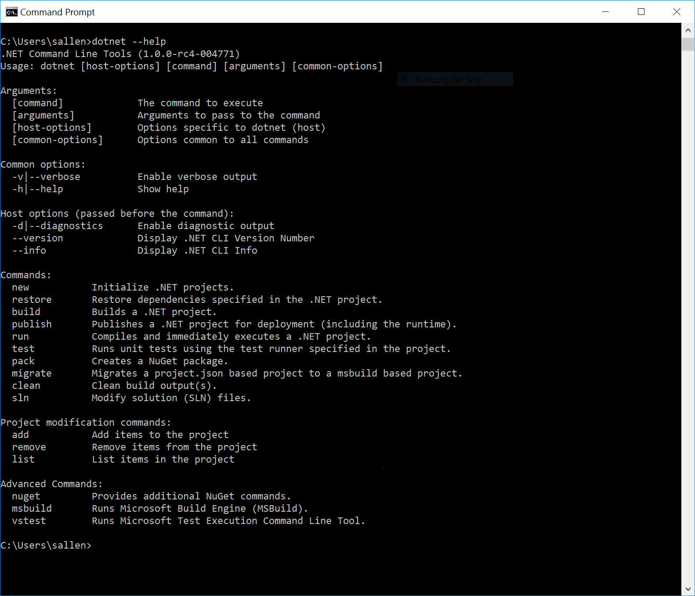
.NET 2016

Slide 4
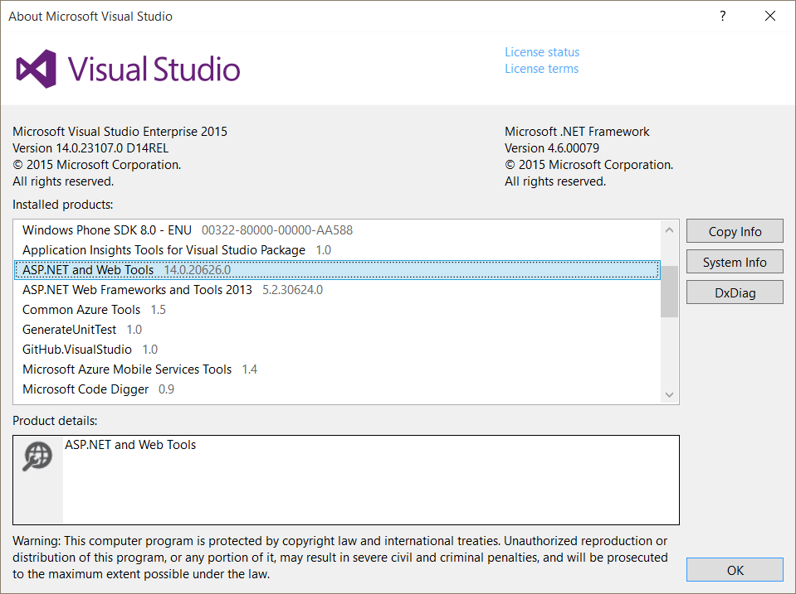
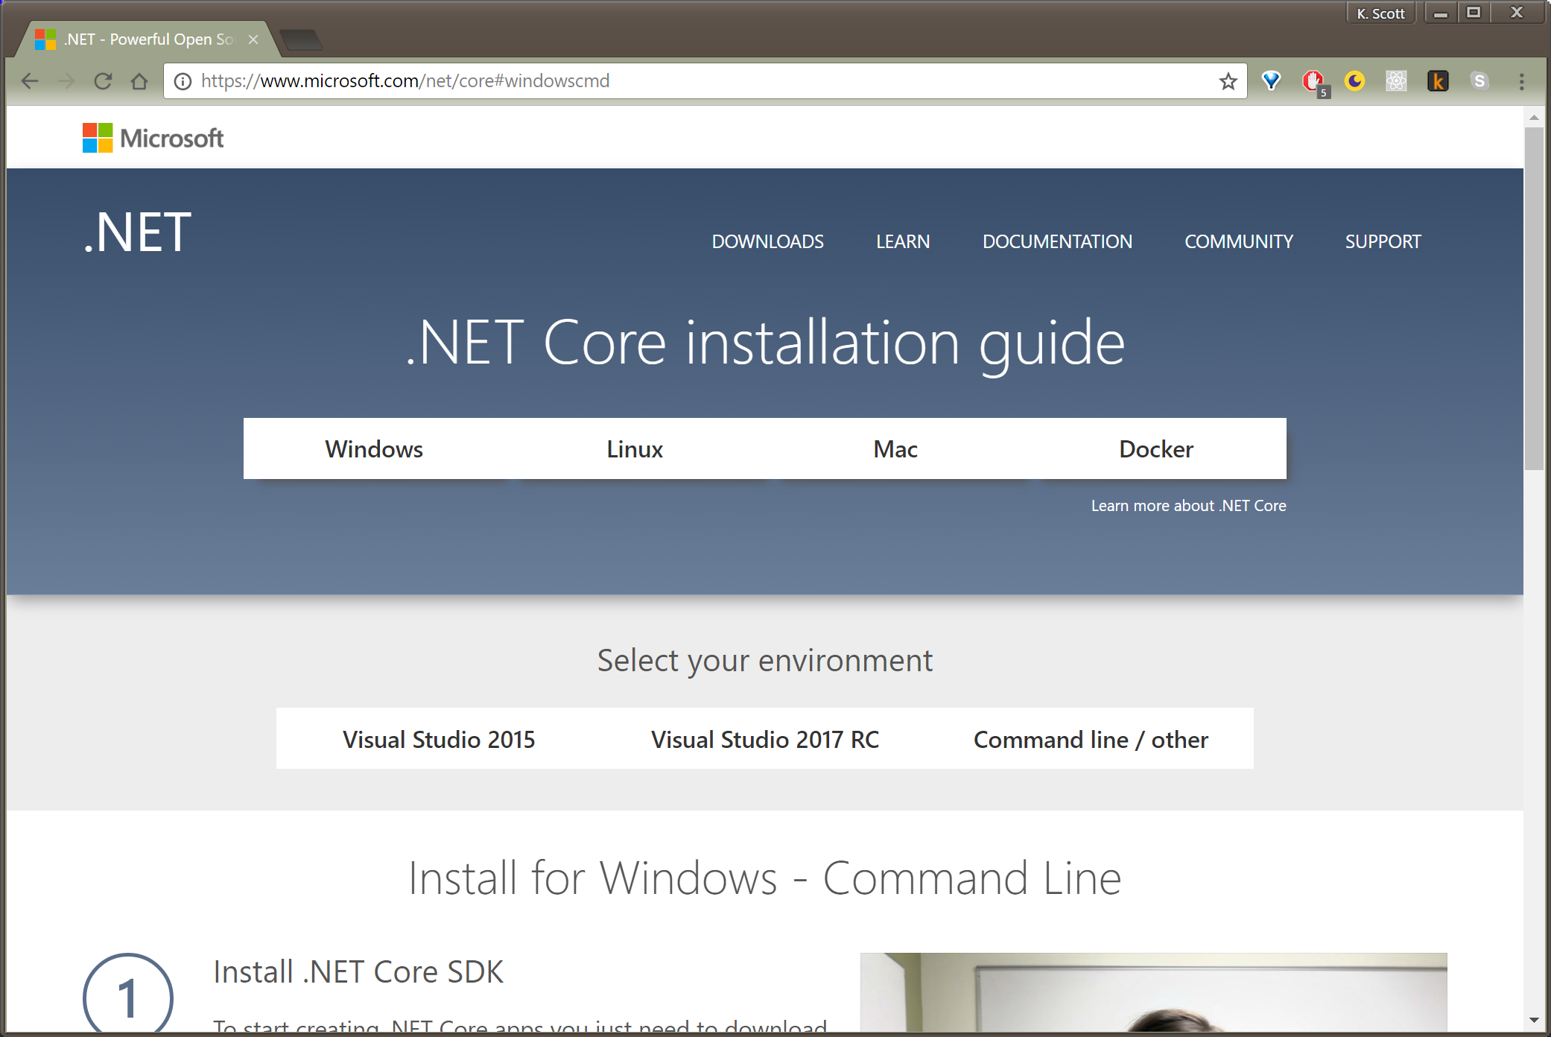
Getting Started
Install with Visual Studio
Install using the .NET Core SDK

Slide 5
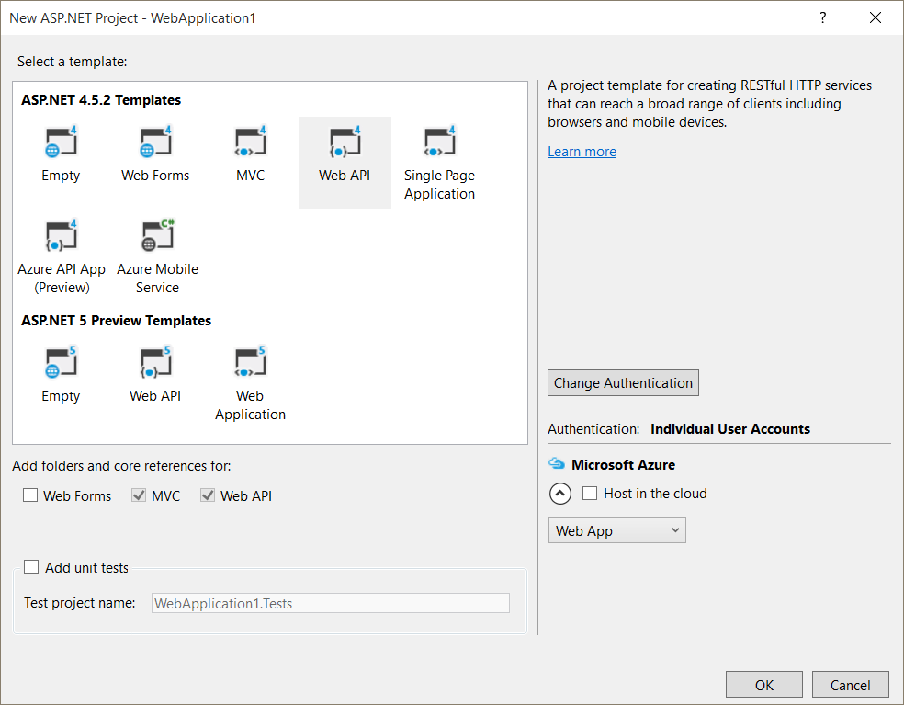
Creating a Web App
Visual Studio offers ASP.NET Core templates

Slide 6
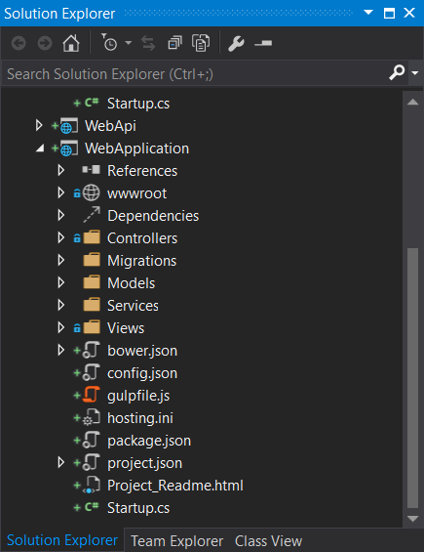
The .csproj file
.csproj file for Visual Studio
No individual files
Enabled tooling, building
File system dictates project contents

Slide 7
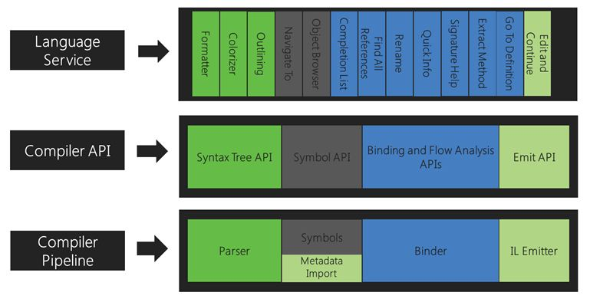
Dynamic Compilation
Roslyn builds assemblies in memory

Slide 8
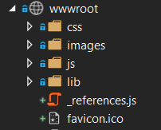
The wwwroot folder
Static assets must live in wwwroot
This behavior is configurable

Slide 9
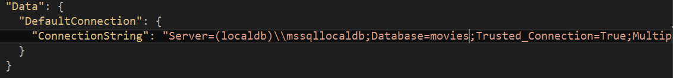
The config.json file
Runtime configuration options include:
JSON files
INI files
Environment variables

Slide 10
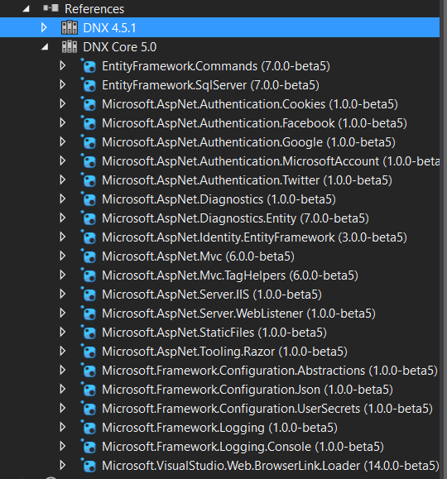
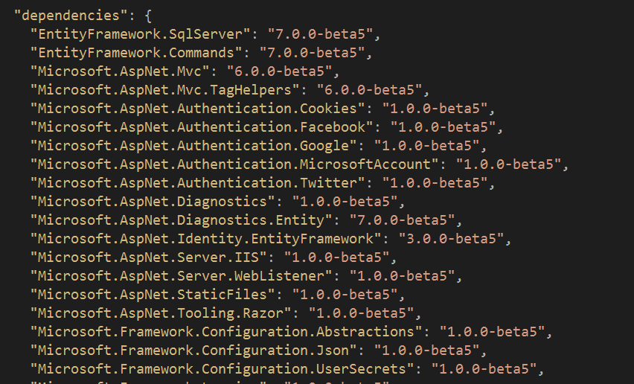
Dependencies
Everything in NuGet

Slide 11
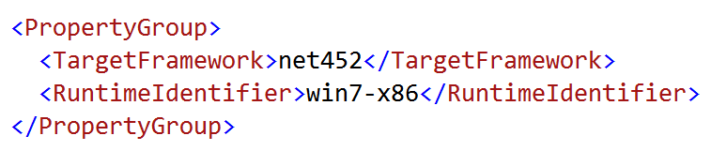
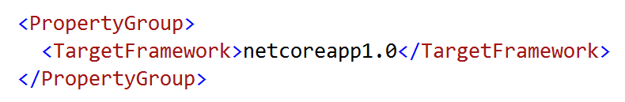
The Runtimes
Full CLR versus the Core CLR
Build against 2 frameworks

Slide 12
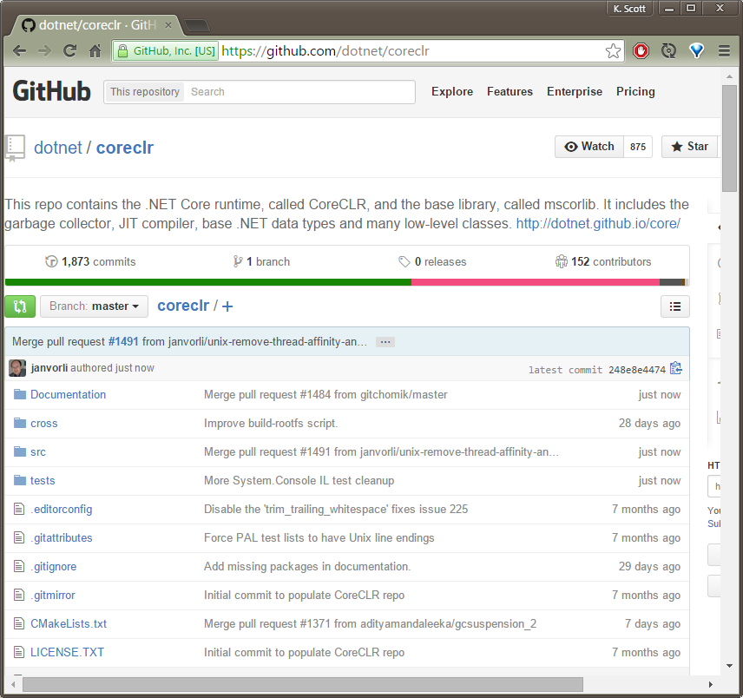
Core CLR
Cross platform
Subset of full CLR

Slide 13
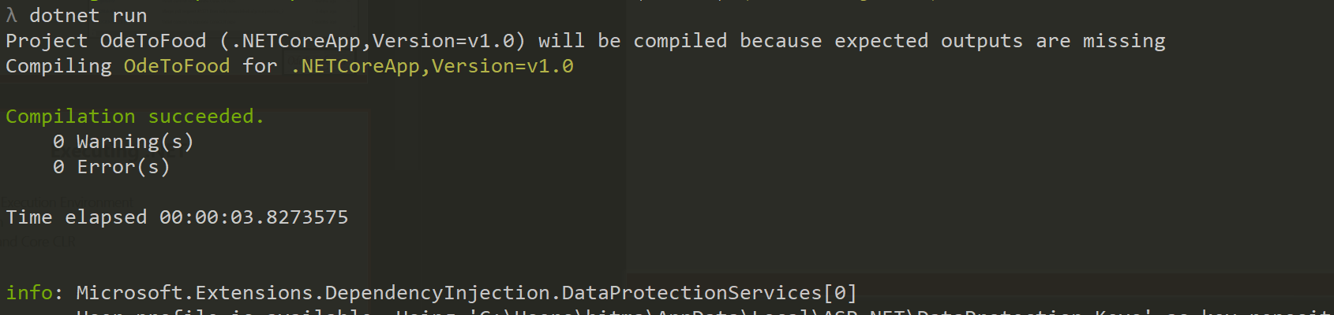
Executing .NET
dotnet - .NET Execution Environment
Cross platform
Host for CLR and Core CLR

Slide 14
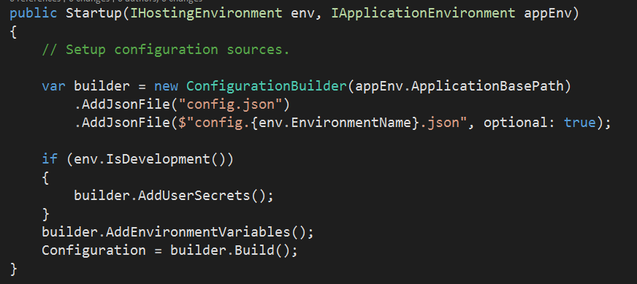
Startup
Entry point for web application
Configure the configuration
Configure the HTTP processing pipeline
Configure services and container

Slide 15
Middleware
Middleware is the HTTP processing pipeline
POST /corn
POST /corn
POST /corn
Me
next
Mom
next
Dad
return
return
HTTP/1.0 200 OK
<html>
….
</html>
HTTP/1.0 200 OK
<html>
….
</html>
HTTP/1.0 200 OK
<html>
….
</html>

Slide 16
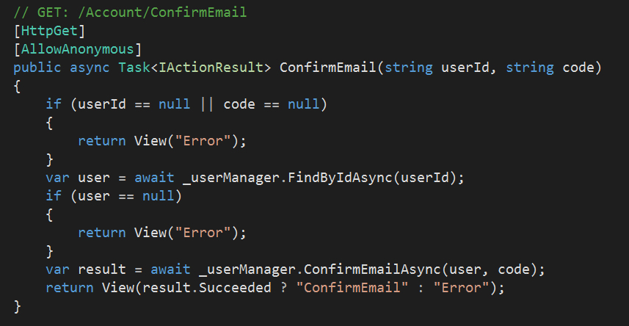
MVC Framework
Includes both HTML and API features

Slide 17
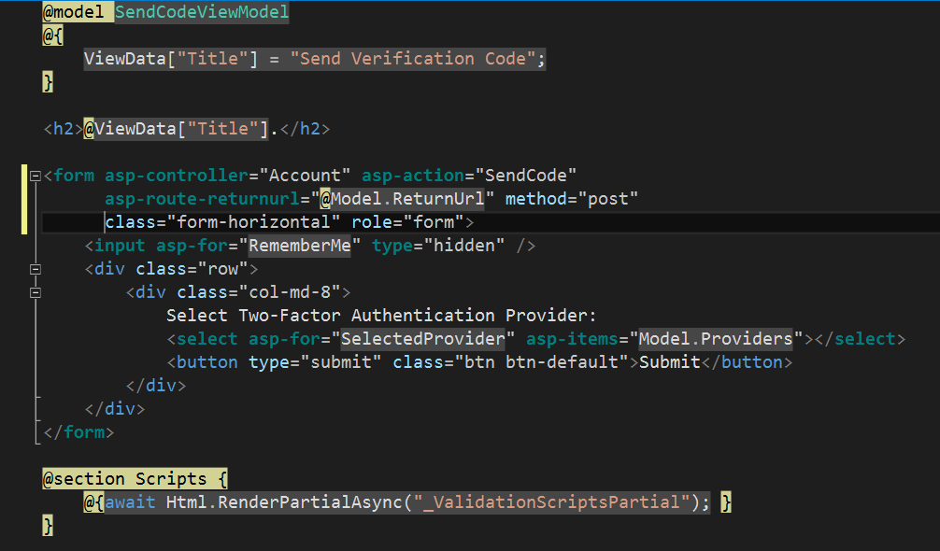
Razor Views

Slide 18

Hosting
IIS / IIS Express
Kestrel

Slide 19
Summary
ASP.NET MVC
Middleware

