Slide 1
MVC 4 – WebAPI
GET Resources
Scott Allen

Slide 2



Web Services
SOAP

Slide 3



HTTP Web Services
HTTP

Slide 4
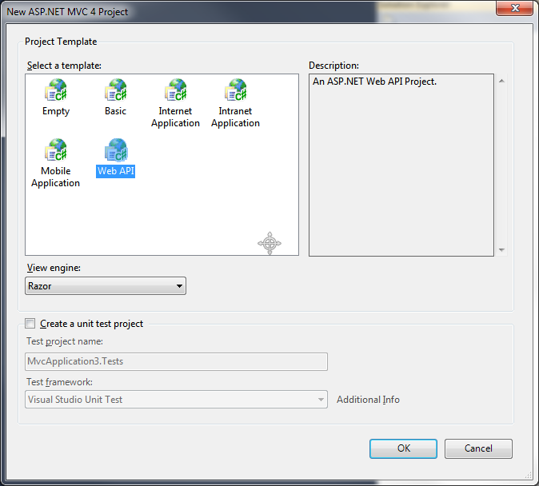
Getting Started
Create a WebAPI project
Create an ASP.NET project
Create any project!
install-package Microsoft.AspNet.WebApi.SelfHost

Slide 5
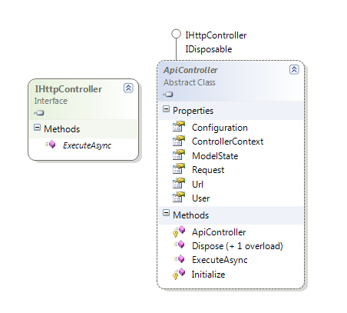
Controllers
WebAPI uses an ApiController base class

Slide 6
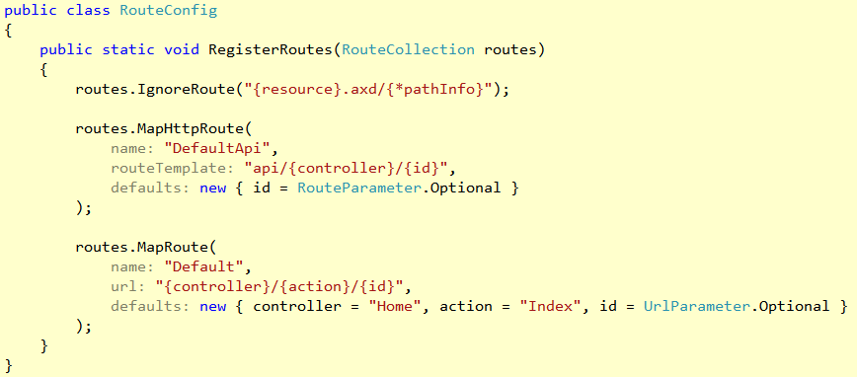
Routing
Routes by HTTP method (GET, POST, PUT, DELETE)
Other methods available via [AcceptVerbs]
Looks at the start of an action name

Slide 7
Content Negotiation
Core mechanism of HTTP
Client specifies desired formats using Accept header
MSFT Resource
image/png
Client
GET /msft Accept: image/png
Text/html

Slide 8
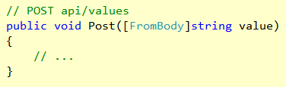
Action Parameters
Primitive types (assumed to not be in message body)
Complex types (assumed to be in the message body)
Only a single model allowed from the message body

Slide 9
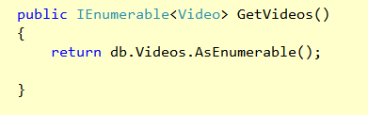

GET Pattern

Slide 10
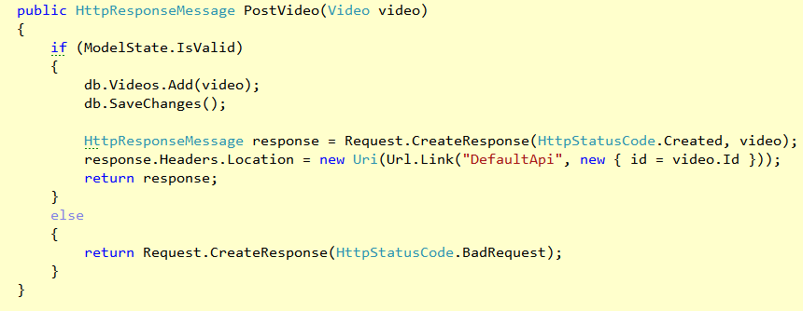
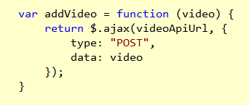
POST Pattern

Slide 11
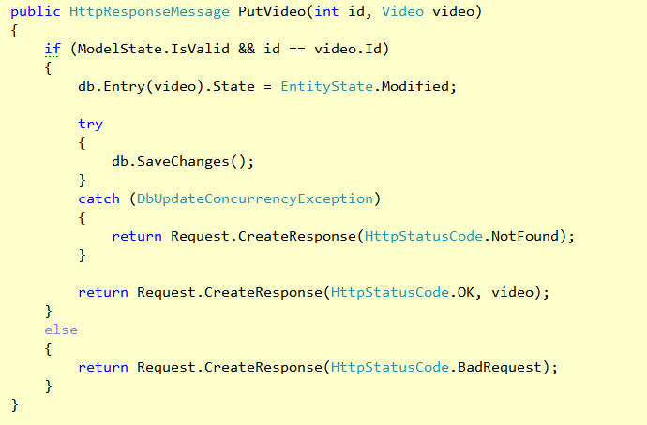
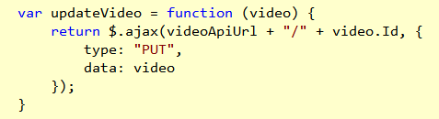
PUT Pattern

Slide 12
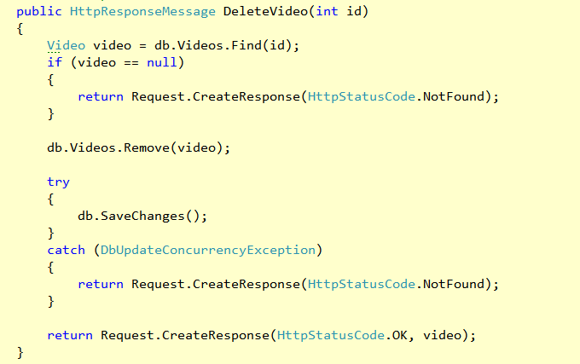
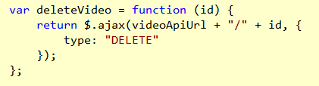
DELETE Pattern

Slide 13
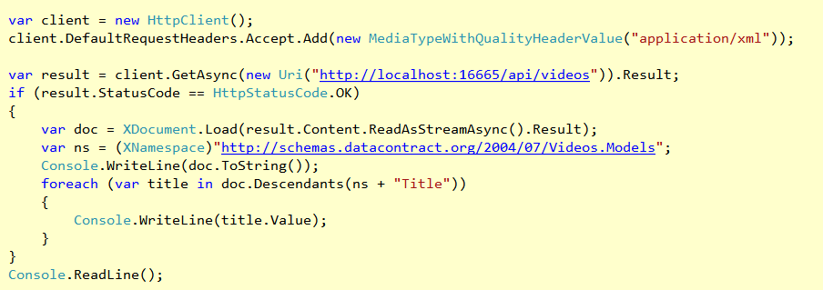
HttpClient

Slide 14
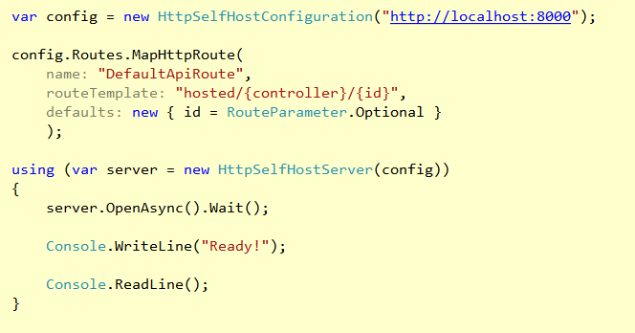
Self Hosting

Slide 15
Summary
WebAPI embraces HTTP
Scalable, interoperable, flexible
Includes client and self hosting capabilities

