Slide 1
Cloud Patterns for Resiliency

Slide 2

High Availability
Disaster Recovery
Notes:
Needs images, ideally have some animation, too

Slide 3




When Disaster Strikes
Blob Storage
Redundant Storage
Virtual Machines
Availability Sets
SQL
Replication
Point in Time Restore
App Services
Geo Distributed

Slide 4
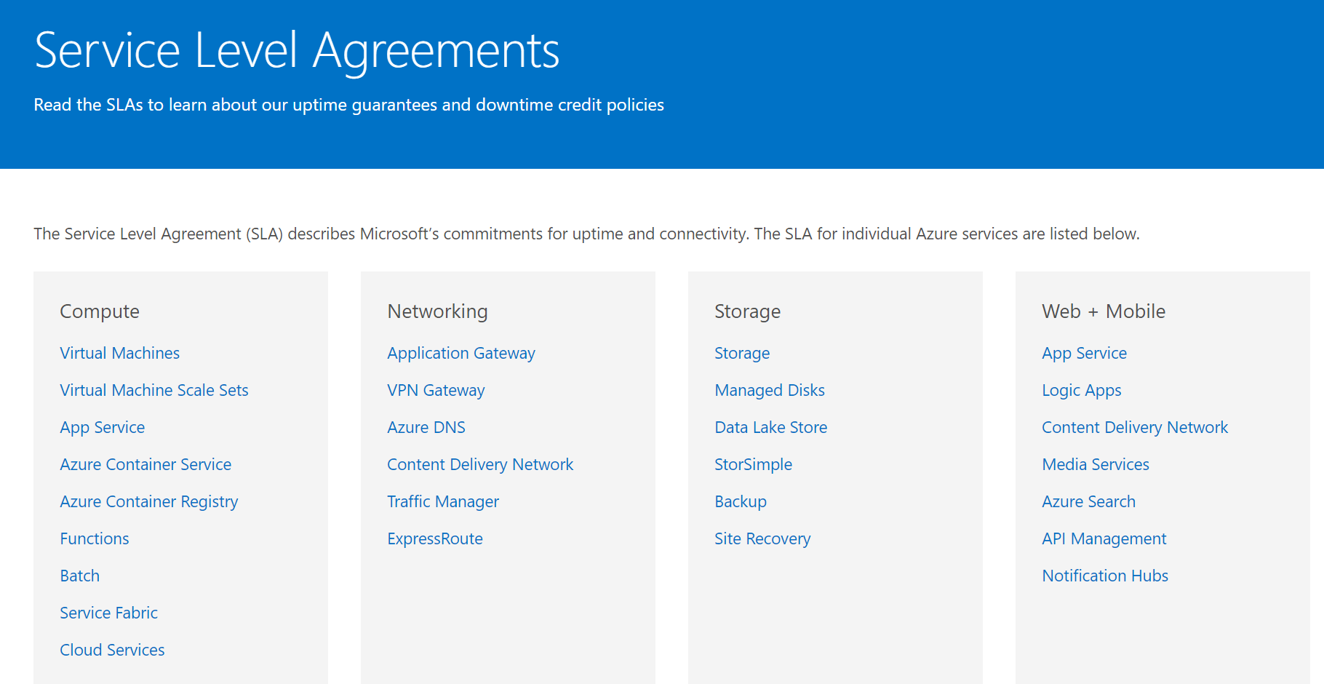

Slide 5
SLA | Downtime/week | Downtime/month | Downtime/year
99% | 1.68 hours | 7.2 hours | 3.65 days
99.9% | 10.1 minutes | 43.2 minutes | 8.76 hours
99.95% | 5 minutes | 21.6 minutes | 4.38 hours
99.99% | 1.01 minutes | 4.32 minutes | 52.56 minutes
99.999% | 6 seconds | 25.9 seconds | 5.26 minutes

Slide 6

Connection Resiliency

Slide 7
Retry Logic
Service | Retry Logic
Azure Storage | In SDK
Azure SQL | In Entity Framework
Service Bus | In SDK
DocumentDB | In SDK
Azure Redis Cache | In SDK

Slide 8
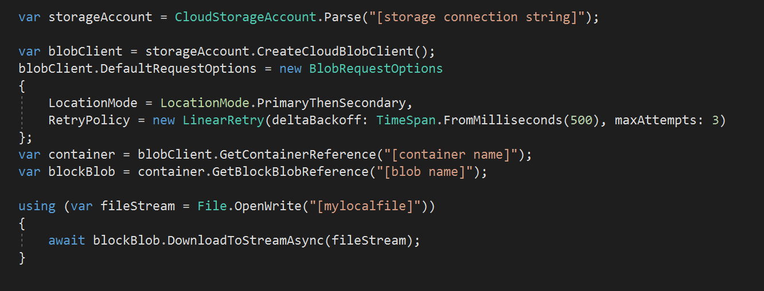
Retry Logic
Service | Retry Logic
Azure Storage | In SDK
Azure SQL | In Entity Framework
Service Bus | In SDK
DocumentDB | In SDK
Azure Redis Cache | In SDK

Slide 9
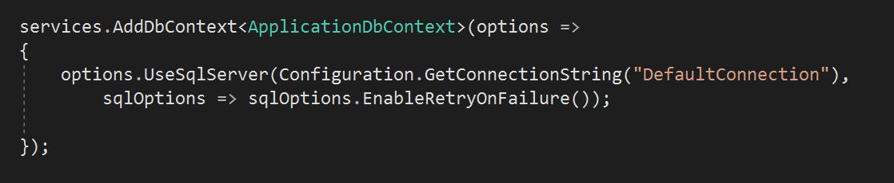
Retry Logic
Service | Retry Logic
Azure Storage | In SDK
Azure SQL | In Entity Framework
Service Bus | In SDK
DocumentDB | In SDK
Azure Redis Cache | In SDK

Slide 10
Retry Logic
Service | Retry Logic
Azure Storage | In SDK
Azure SQL | In Entity Framework
Service Bus | In SDK
DocumentDB | In SDK
Azure Redis Cache | In SDK

Slide 11


Graceful Degradation

Slide 12



Load Balancing
Azure Load Balancer
Azure Application Gateway
Azure Traffic Manager

Slide 13


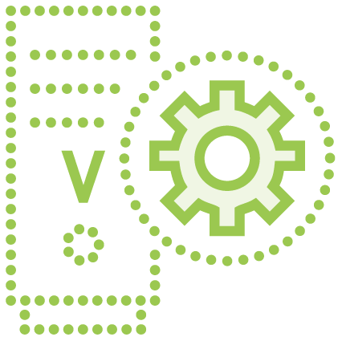
Load Leveling

Slide 14




Service Bus
Topics | Relays | Queues

Slide 15


Automation & Deployment

Slide 16


Testing

Slide 17

Monitoring

Slide 18
Summary

