Slide 1
Cloud Patterns for Scalability

Slide 2

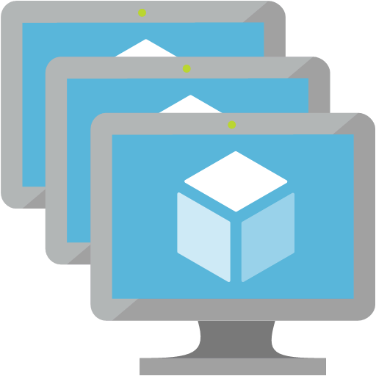

Performance
Scalability

Slide 3












Traffic Manager
Service Bus Queues
Azure
Functions
Customers
CDN
Blob Storage
App Service
Redis Cache
API Gateway
Azure SQL
Application
Insights

Slide 4

Partitioning
Orders
Orders
Orders
Invoices
A | B | C | D | E
A | B | C | D | E
A | B | C
A | B | C
A | D
B | C | E
Horizontal
Partitioning
Functional
Partitioning
Vertical
Partitioning

Slide 5

Azure SQL Sharding
Map
Tenant D
Tenant A
Tenant B
Tenant C

Slide 6




Application Patterns

Slide 7
CAP Theorem
Consistency
CA
CP
Availability
Partition
Tolerance
AP

Slide 8
Traffic Manager
Service Bus Queues
Azure
Functions
Clients
CDN
Blob Storage
App Service
Redis Cache
API Gateway
Azure SQL
Application
Insights

Slide 9
Traffic Manager
Service Bus Queues
Azure
Functions
Clients
CDN
Blob Storage
App Service
Redis Cache
API Gateway
Azure SQL
Application
Insights

Slide 10
Traffic Manager
Service Bus Queues
Azure
Functions
Clients
CDN
Blob Storage
App Service
Redis Cache
API Gateway
Azure SQL
Application
Insights

