Slide 1
Building Web Applications and APIs

Slide 2





Infrastructure as a Service (IaaS)
Platform as a Service (PaaS)
On Premises
Apps
OS
Apps
OS
Apps
OS
Hardware
Hardware
Hardware
You
Azure
Notes:
Showing what you manage versus what azure manages in each scenario. Want to animate in each scenario left to right

Slide 3

The Benefits of PaaS
PaaS is faster
Reason: There’s less work for developers to do
Benefit: Applications can go from idea to availability more quickly
Paas is cheaper
Reason: There’s less admin and management work to do
Benefit: Organizations spend less supporting applications
PaaS is lower risk
Reason: The platform does more, leaving fewer opportunities for error
Benefit: Creating and running applications gets more reliable

Slide 4


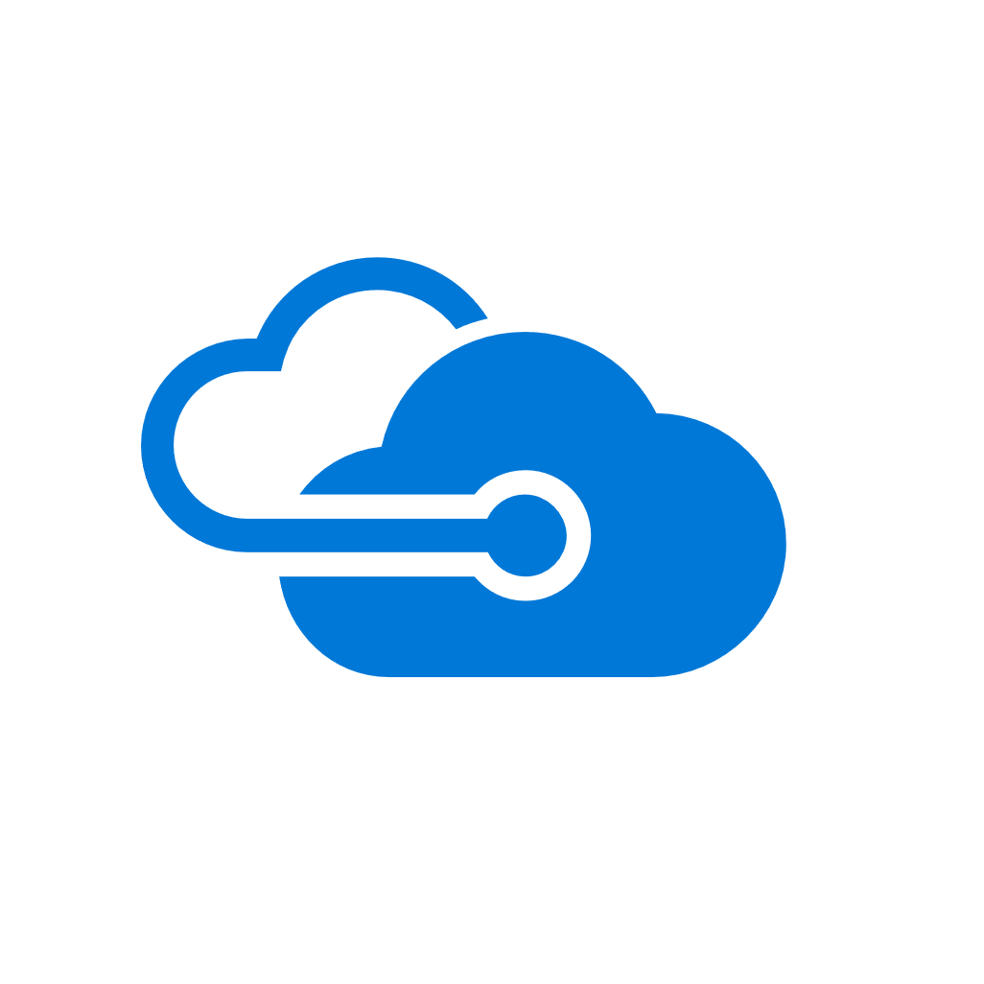



Web Applications
API Applications
Microsoft
Azure
App Services
Mobile Applications
Logic Applications
Notes:
Talk about what app services consists of. Animate in from top left clockwise

Slide 5
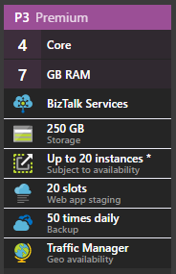
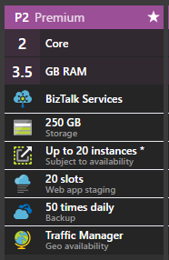

App
App
App Service Plan
App
Notes:
Need to demonstrate that each app gets its own app service
Multiple app services can share a single app plan
Every app plan can scale UP (to a bigger app plan) or OUT (to more instances)
Animations carefully orchestrated to show the concepts I talk about one at a time ☺

Slide 6
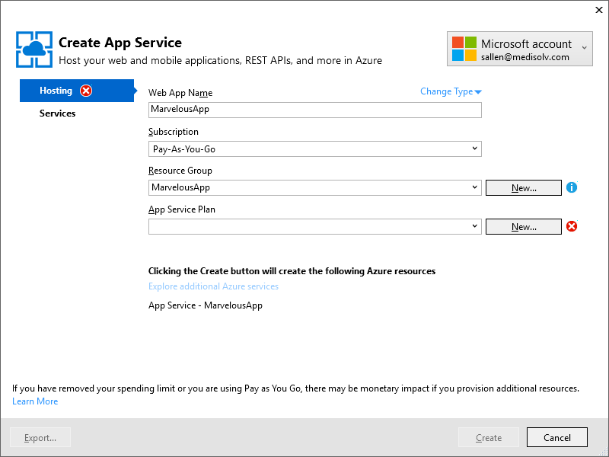

Notes:
At a loss here ☺
I’m going to talk about how I use Visual Studio (icon on the left) to create an app service (window clip in the middle) to put the app into the cloud (icon on the right)
Yes, the window is ugly, but just need something visual for a 30 second discussion

Slide 7
Notes:
At a loss here ☺
I’m going to talk about how I use Visual Studio (icon on the left) to create an app service (window clip in the middle) to put the app into the cloud (icon on the right)
Yes, the window is ugly, but just need something visual for a 30 second discussion

Slide 8
Summary
Notes:
Summary is about 30 – 40 seconds of summarizing

Slide 9
