Slide 1
The Evolution of JavaScript (and the immediate future frameworks) K. Scott Allen

Slide 2
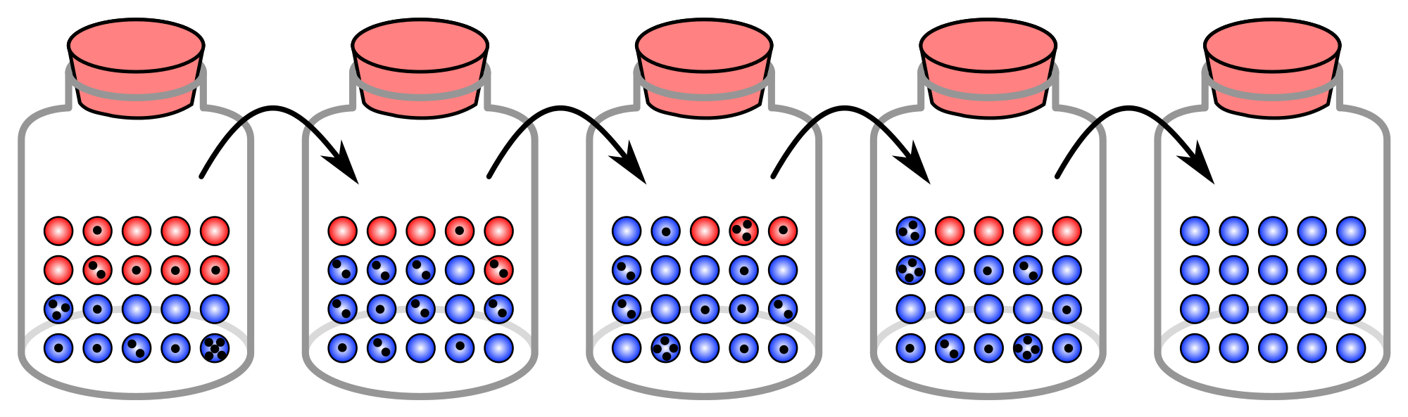

Slide 3
1993
1.0
1999
3.0
2015
6.0
1998
2.0
2009
5.0

Slide 4
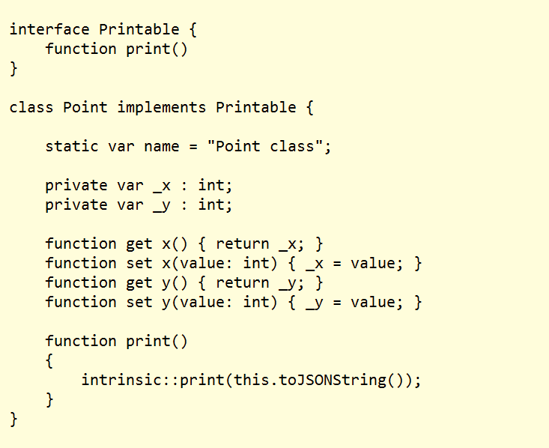
2007

Slide 5
Why The Excitement?
First substantial addition to JavaScript since inception
1993
1.0
1999
3.0
2015
6.0
1998
2.0
2009
5.0

Slide 7
The Old New JavaScript
Apologies to Raymond Chen
Lisp
C#
JavaScript
Python
Ruby

Slide 8
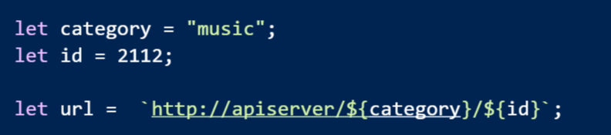
Solution: String Templates

Slide 9
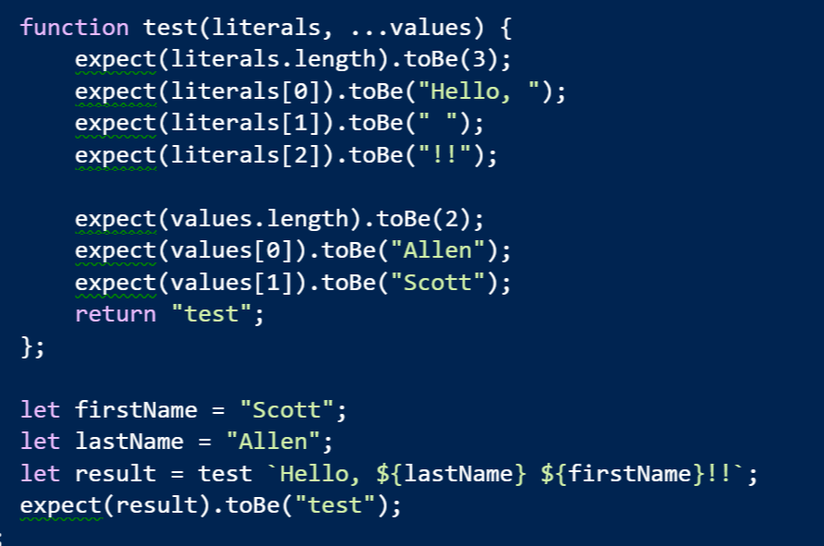
Tagged Templates

Slide 10
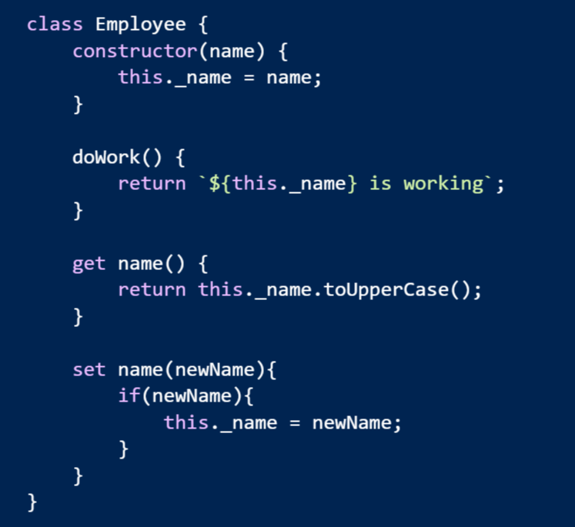
Classes

Slide 11
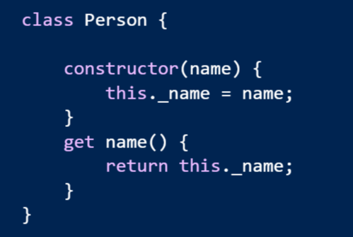
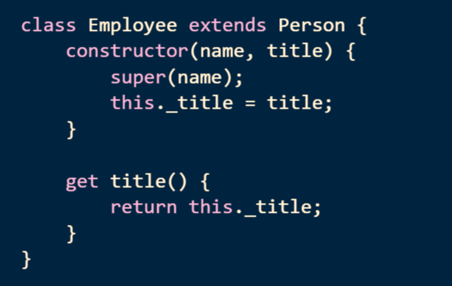
Inheritance

Slide 12
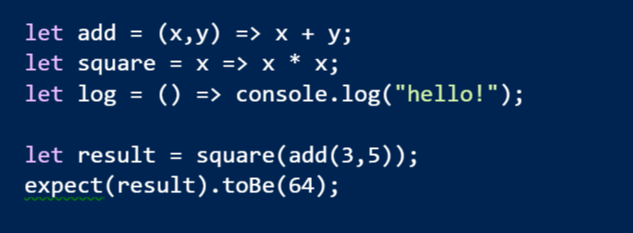
Arrow Functions
Expressive syntax
Familiar to C# developers

Slide 13
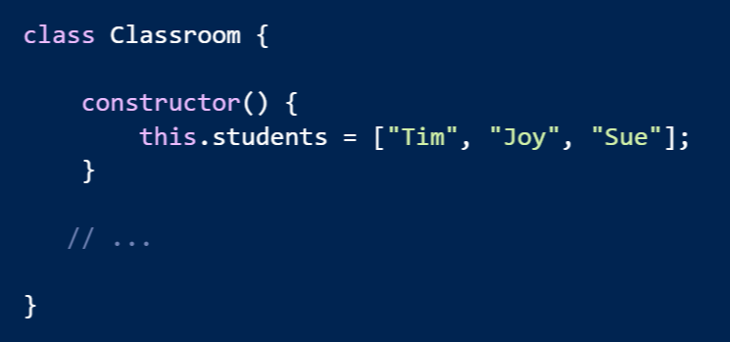
Problem: Encapsulating Collections

Slide 14
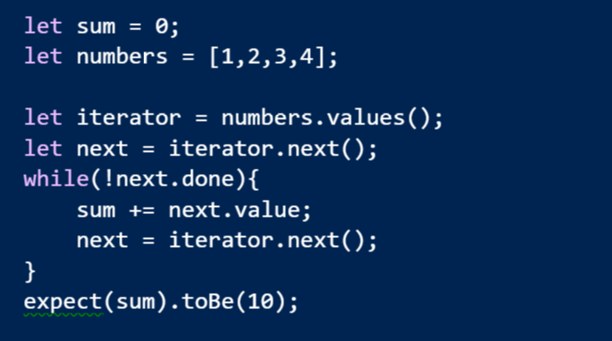
Solution: Iterators and Iterables

Slide 15
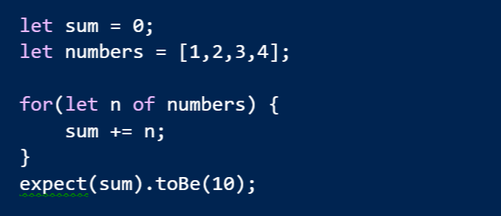
for of

Slide 16
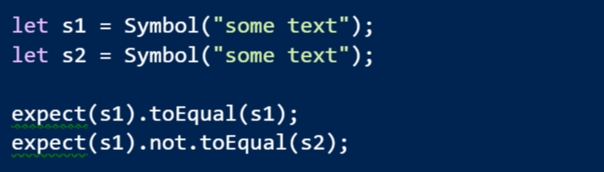
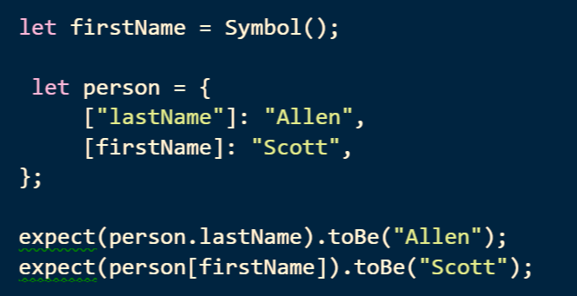
Symbol
A new type where every value is unique and immutable
Can use a symbol as a key into an object

Slide 17
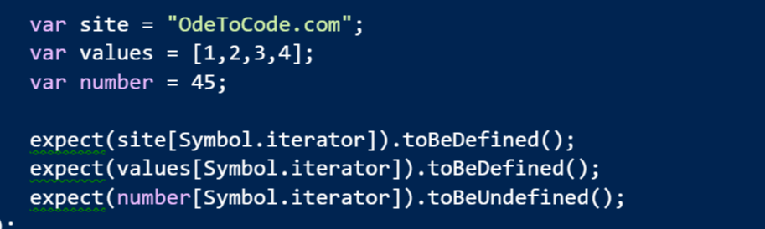
Symbol.iterator
A magic method that makes an object iterable

Slide 18
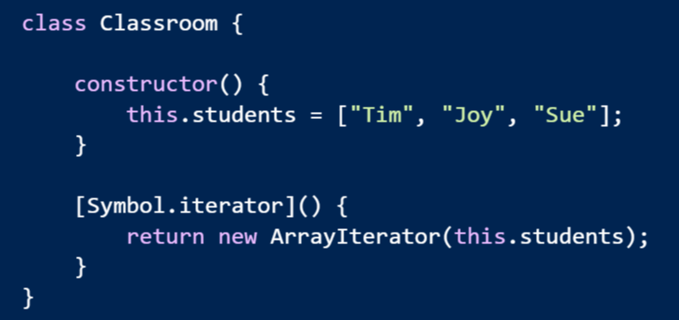
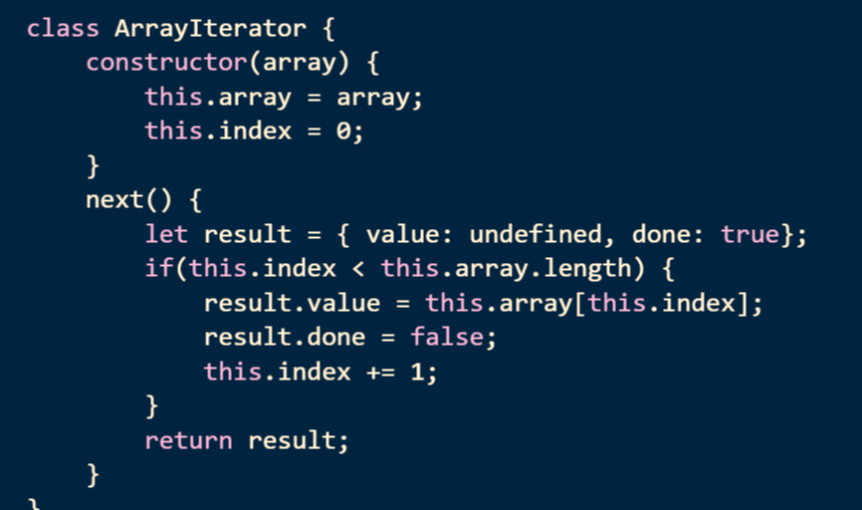
Make Your Own Iterable

Slide 19
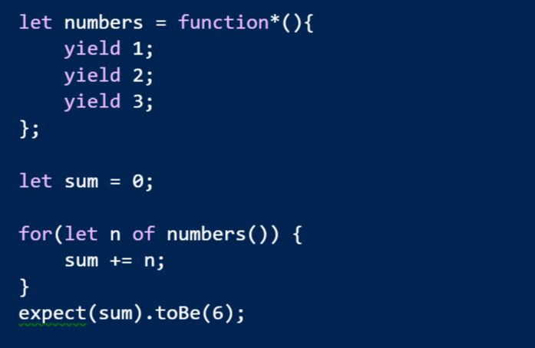
Generators

Slide 20
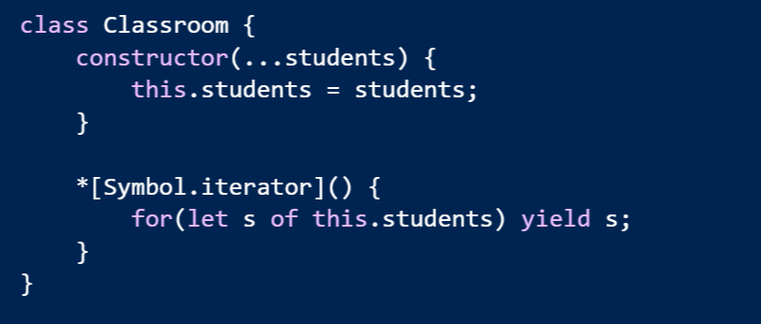
Easy To Make Iterables

Slide 21
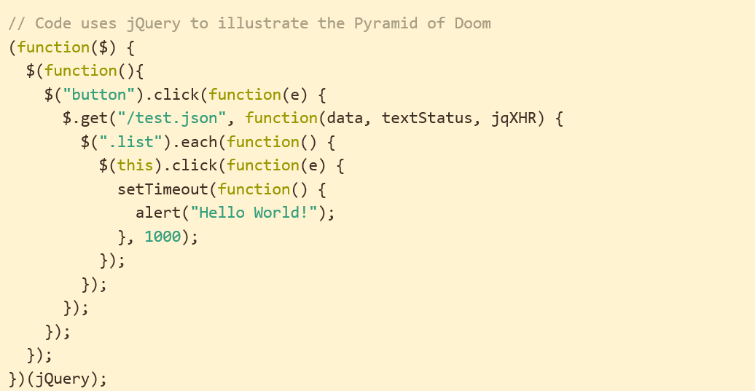
Problem: Async Code
http://tritarget.org/blog/2012/11/28/the-pyramid-of-doom-a-javascript-style-trap/

Slide 22
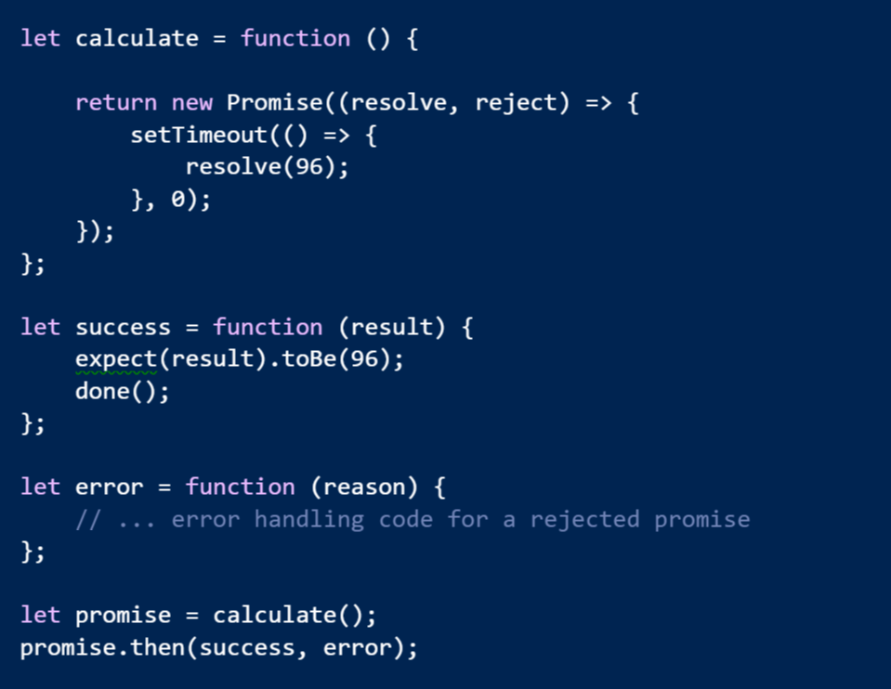
Solution: Promises

Slide 23
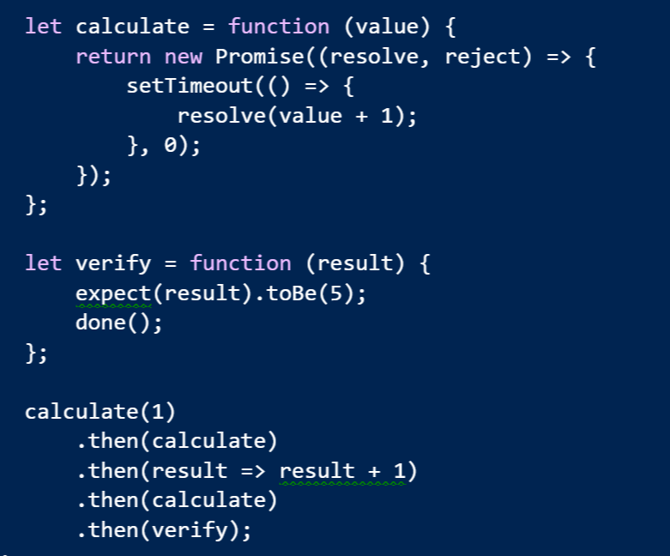
Promises Chain

Slide 24
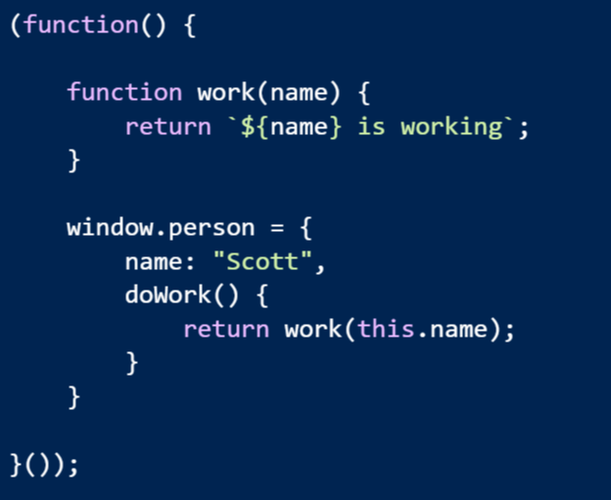
Problem: Modularity & Scope

Slide 25
Problem: Modularity & Scope
Possible solutions
Common JS
Asynchronous Module Definitions
IFFE and Globals
Think about how current libraries are designed
jQuery -> $
Angular -> angular
Lodash -> _

Slide 26
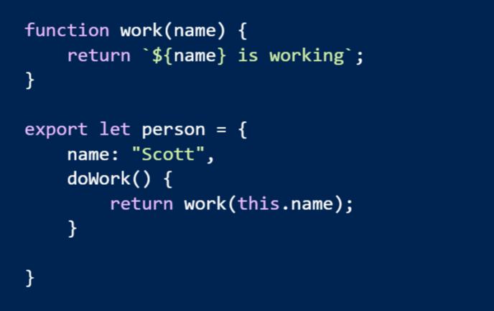
Solution: Real Modules!
Think “module” not “file”

Slide 27
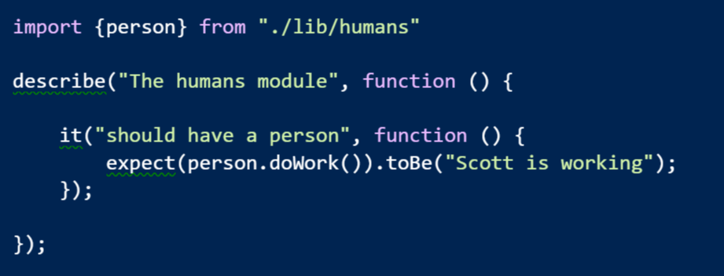
Imports

Slide 28
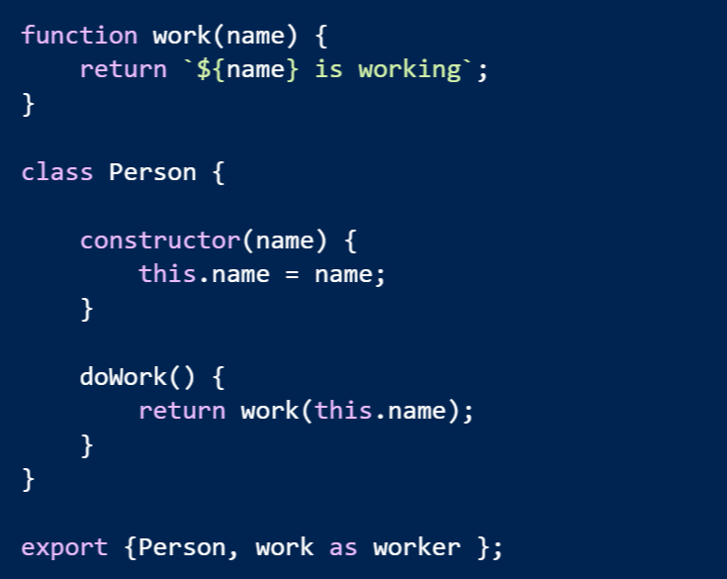
Multiple Exports

Slide 29
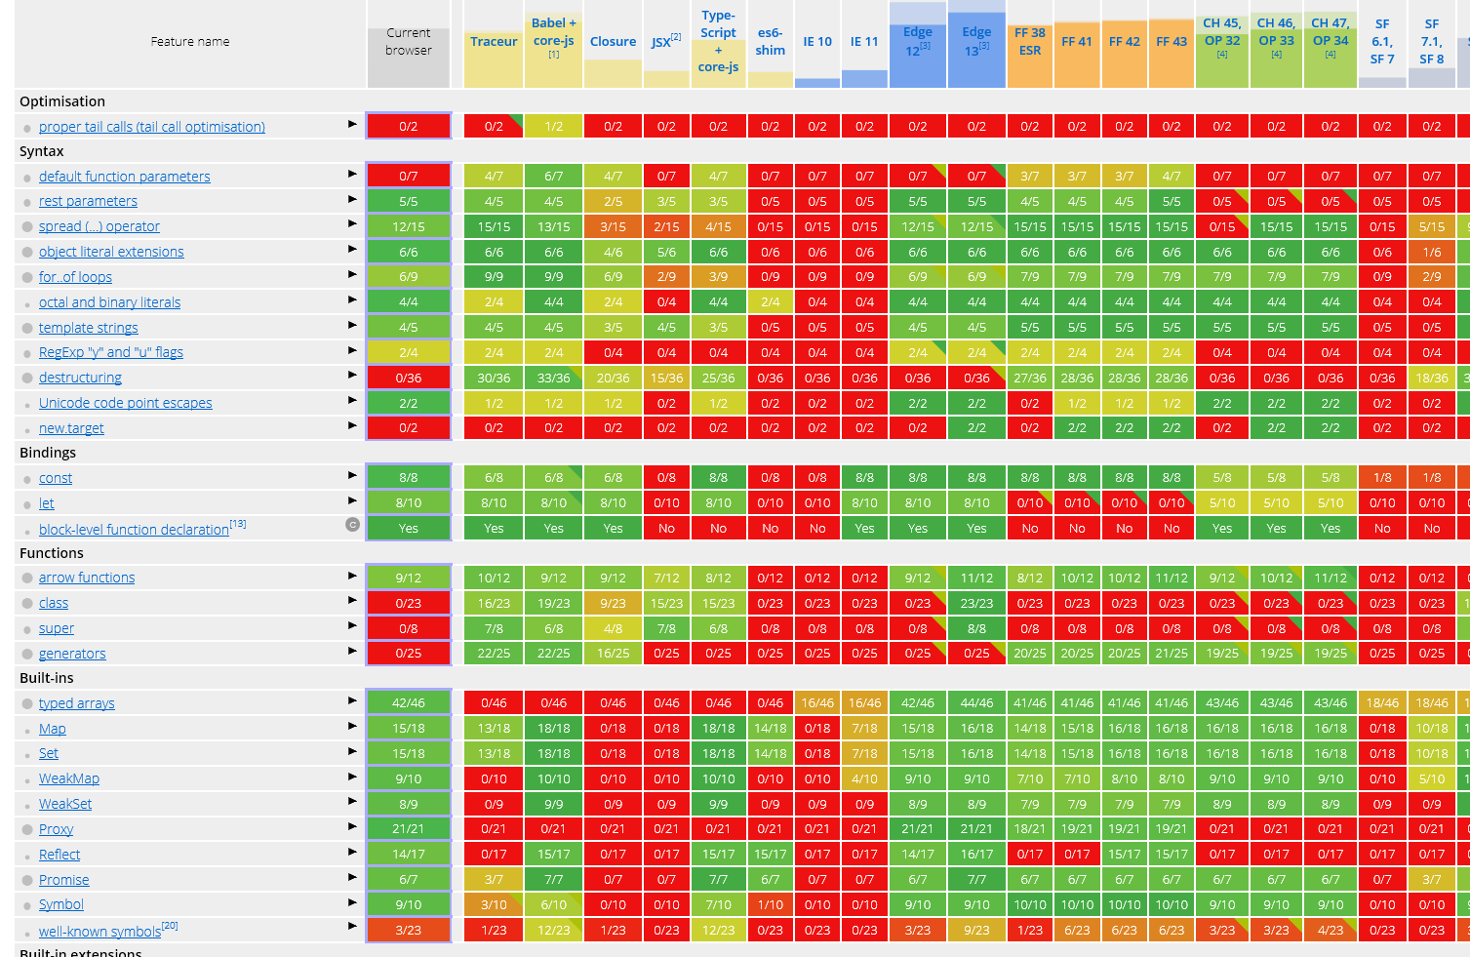
Making It Work
https://kangax.github.io/compat-table/es6/

Slide 30
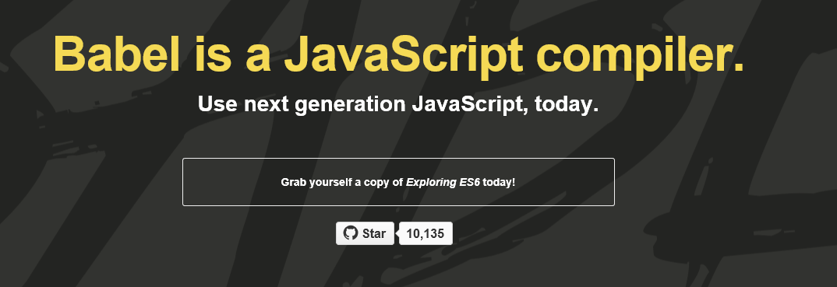
Build Your JavaScript
https://babeljs.io/
Use with Grunt, Gulp, WebPack, JSPM
Many others
Or . . . directly in a browser

Slide 31
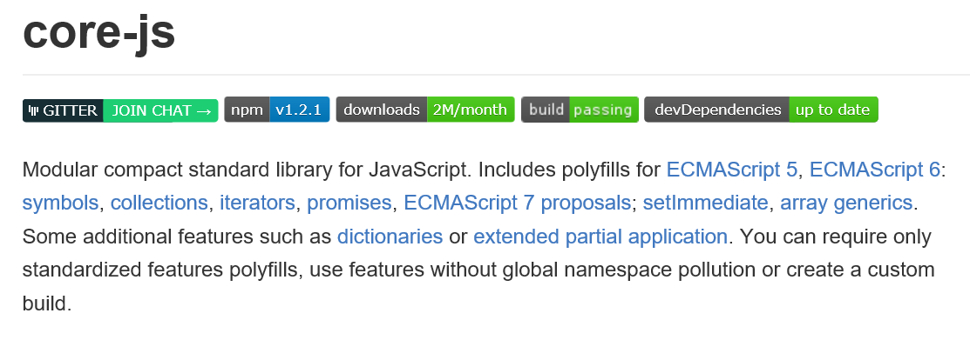
Polyfill Your Browser
Almost automatic with many bundling tools

Slide 32
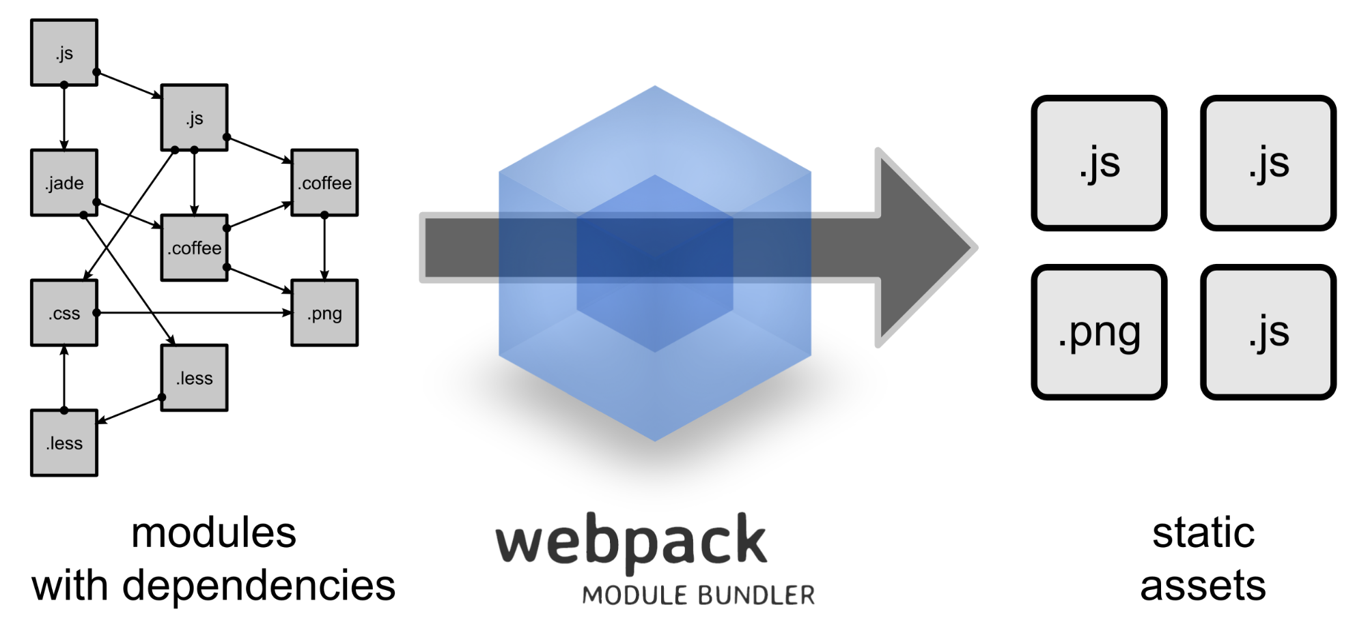
Build Your Modules
http://webpack.github.io/
Bundle them, too

Slide 33


Example: Aurelia

Slide 34

Next Gen
Written with ES 2015 & 2016
Integration with future standards

Slide 35
JavaScript Framework
Aurelia Framework
Application Code
Polyfills

Slide 36




Mobile Desktop and Web

Slide 37
Simple conventions
ViewModel
View
+

Slide 38


Getting Started
Install Node
Install a Git CLI
Getting Started

Slide 39
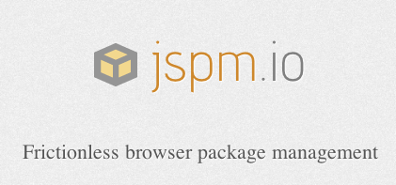
Install JSPM
More than a package manager
Also includes a runtime
System API polyfill
ES6 module loader
Runtime configuration

Slide 40
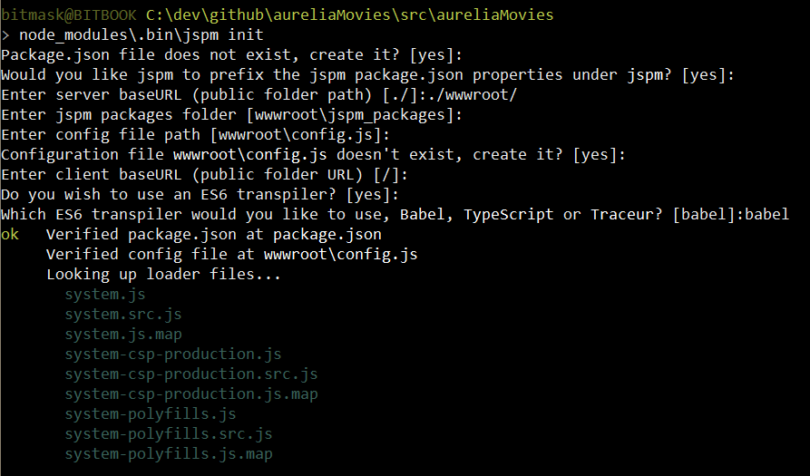
jspm init

Slide 41
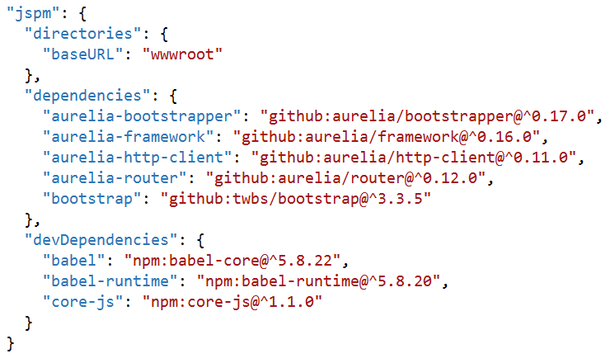
jspm install
Dependencies manages in package.json
You’ll probably want
aurelia-framework
aurelia-bootstrapper
aurelia-router
aurelia-http-client

Slide 42
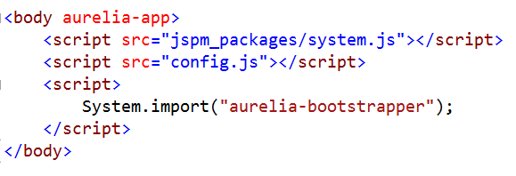
Bootstrap an App
Bring in
SystemJS
Runtime module configuration
Aurelia bootstrapper

Slide 43
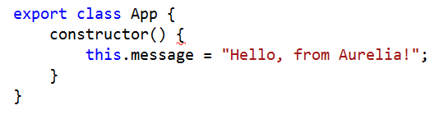
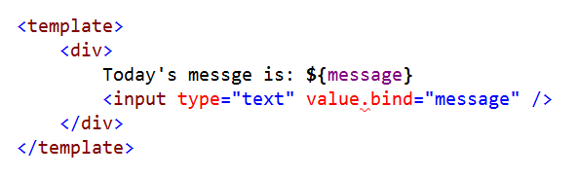
Aurelia Conventions
app.js
+
app.html

Slide 44
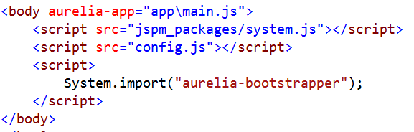
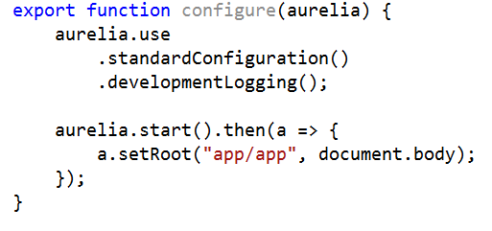
Taking Control
Specify a configure module for aurelia

Slide 45
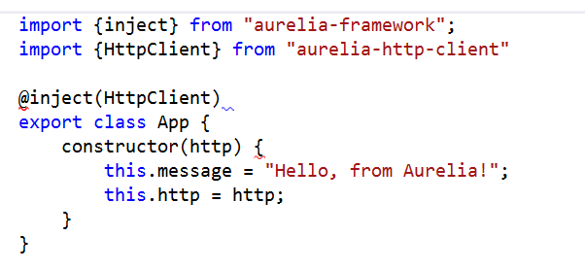
Dependency Injection
Container configured during startup
Can inject using decorators

Slide 46
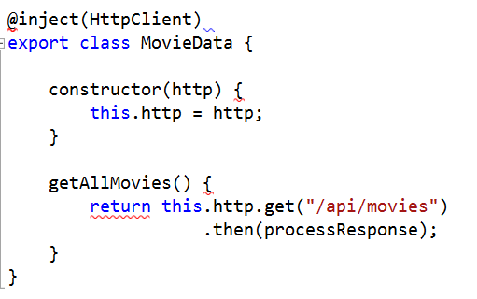
Creating Components
Write plain JavaScript and export
Import or inject where needed

Slide 47
Aurelia – Check It Out
The beta is almost here!
http://aurelia.io
https://gitter.im/Aurelia/Discuss

Slide 48
In Conclusion …
Thanks for listening!
scott@OdeToCode.com

