Slide 1

Components in Angular 1.5
<ng-outlet>

Slide 2
Why Components
Aligned with Angular 2
Can use new component based router
More features, like nested routes
<app>
<list>
<detail>
<about>
<detail>
<detail>

Slide 3
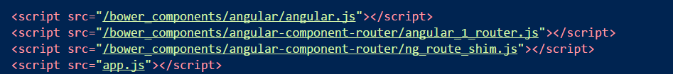
Setup
Install angular-component-router
Built from Angular2 TypeScript source

Slide 4
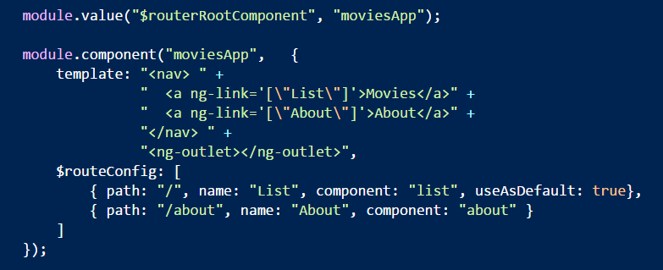
App Level Component

Slide 5
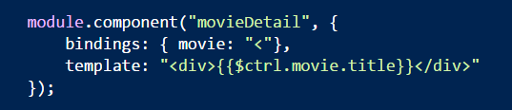
Child Components
Can have their own route configuration

Slide 6
Summary
Components should be more compatible with Angular 2

