Slide 1

Working with Forms
[(ngModel)]

Slide 2
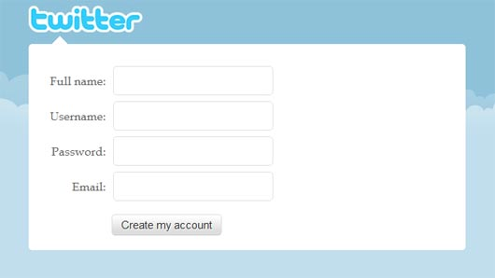
Goals
Accept user input
Enforce validations
Provide visual feedback on form status

Slide 3
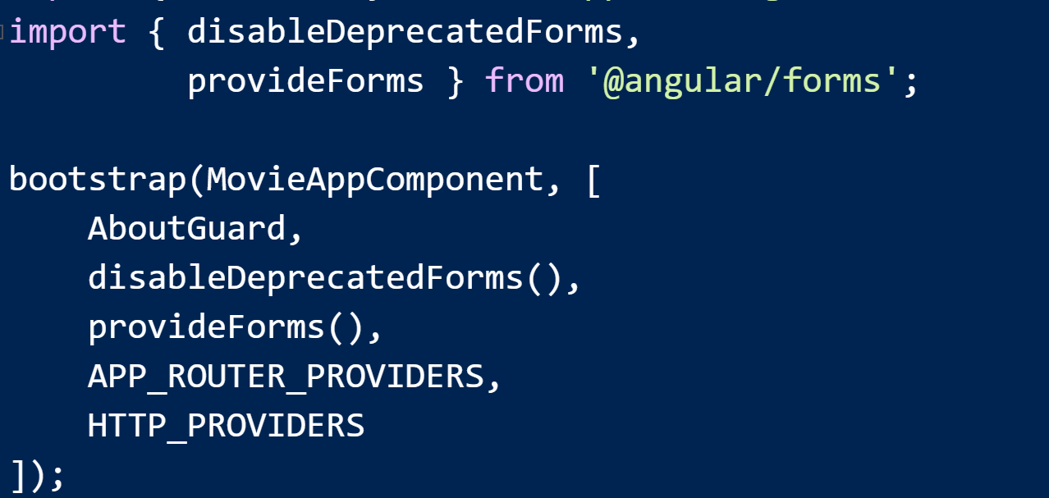
Bootstrapping
Current scenario:
Explicitly disable deprecated forms API
Enable new forms API

Slide 4
Choices
Template Driven Forms
Model Driven Forms

Slide 5
Template Driven Forms
Features 2-way data binding
Template controls validation and model mapping

Slide 6
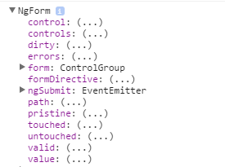
NgForm
NgForm automatically associates with any form element
Provides an API to check status, fetch values
NgModel communicates with NgForm

Slide 7
NgModel & CSS
Angular adds classes to represent the state of an ngModel input

Slide 8
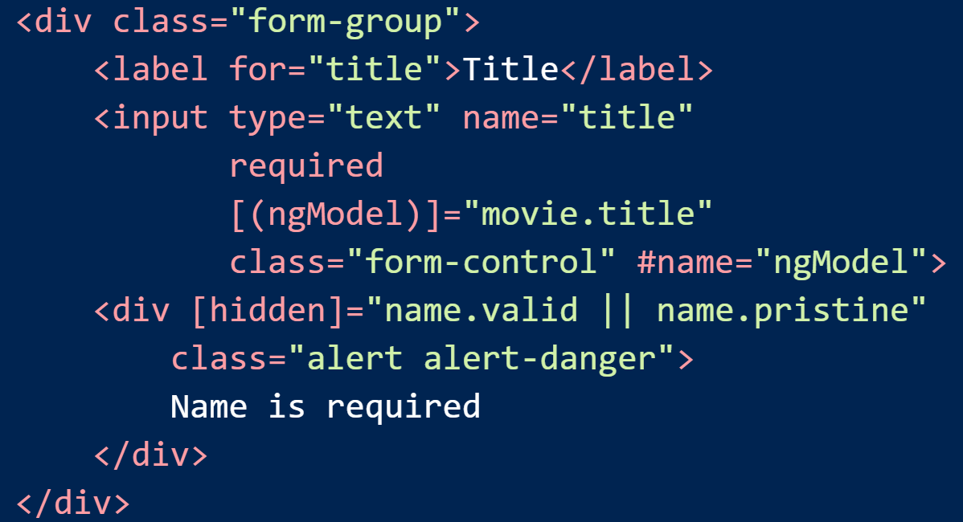
Validations
Use CSS and/or template logic

Slide 9
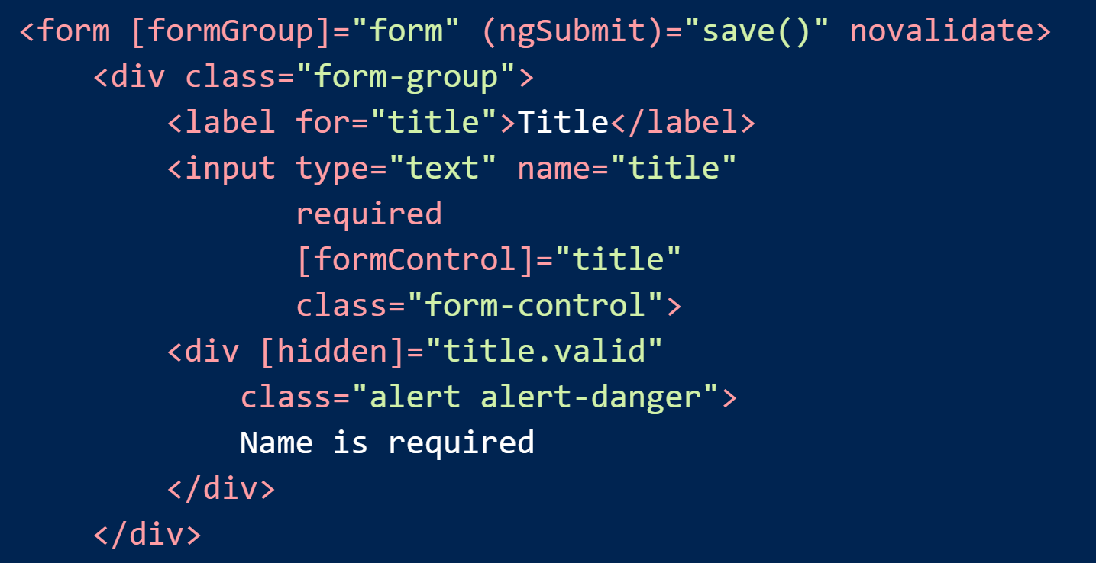
Model Driven Forms
For advanced scenarios
Requires explicit data shuffling

Slide 10
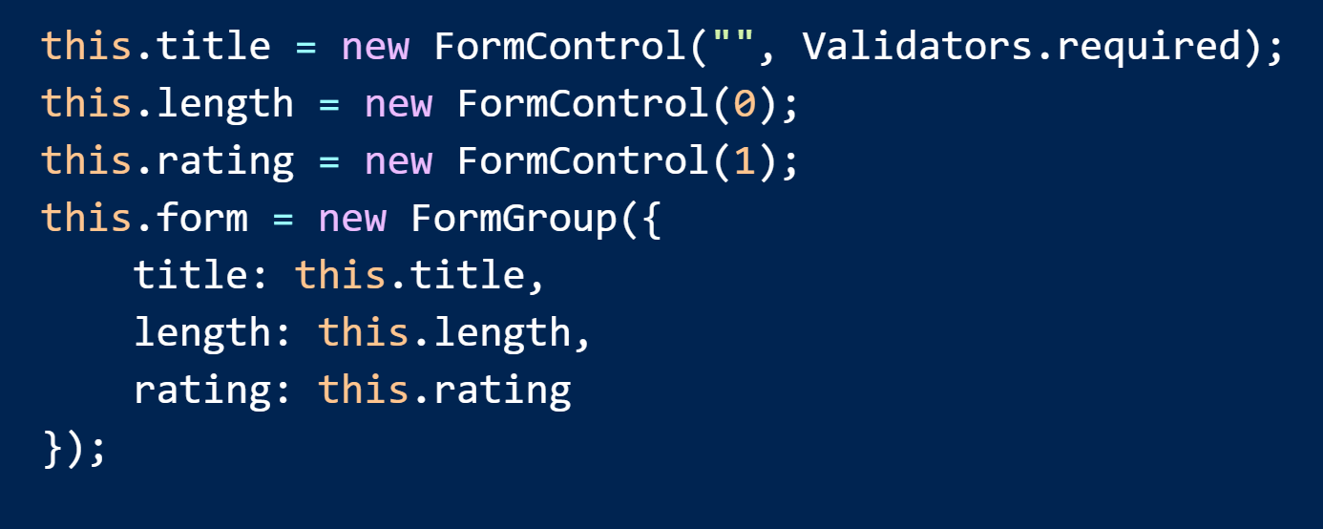
Controls In The Component

Slide 11
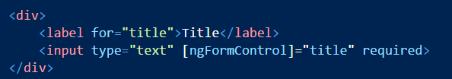

Validations
HTML validation attributes (implicit)
Register validations during form building (explicit)

Slide 12
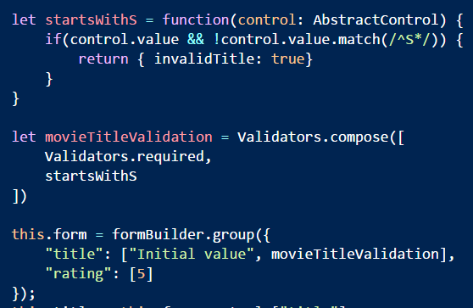
Custom Validations
Functions that take a control reference
Return an object with keys for error flags

Slide 13

Change Subscriptions
Controls and forms have a valueChanges observer

Slide 14
Summary
Forms with Angular 2 provide many features
Flexibility
Testability
Control interaction

