Slide 1
SignalR

Slide 2
Why SignalR?
Real time apps with frequent updates from the server
Collaborative apps
Notifications for long-running tasks

Slide 3
Transports
WebSockets
Server-Sent Events (SSE)
Long-polling

Slide 4
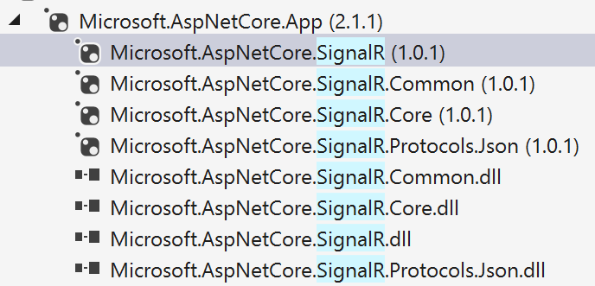
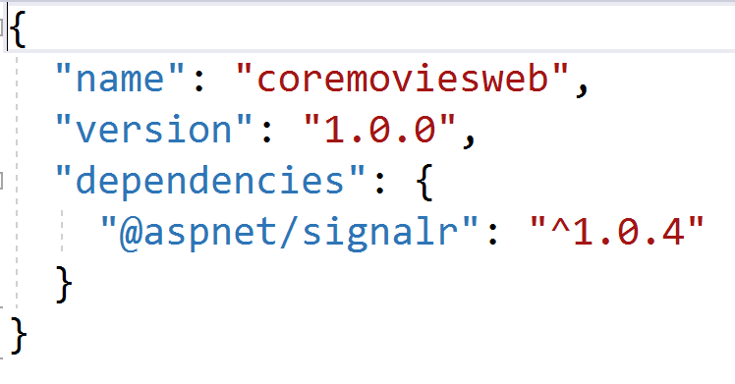
Install

Slide 5
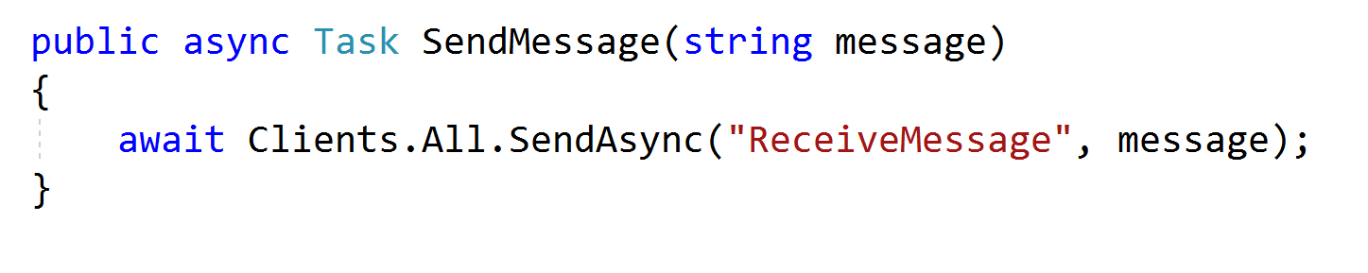
Hubs
Hubs live on the server
Client can invoke methods on the hub
A hub can invoke methods on the client

Slide 6
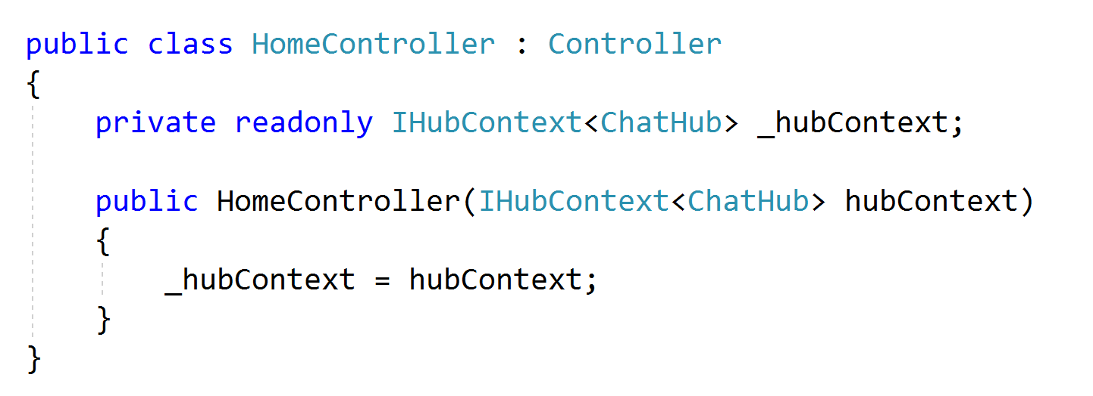
Hub Access
Access a hub from anywhere using dependency injection

Slide 7
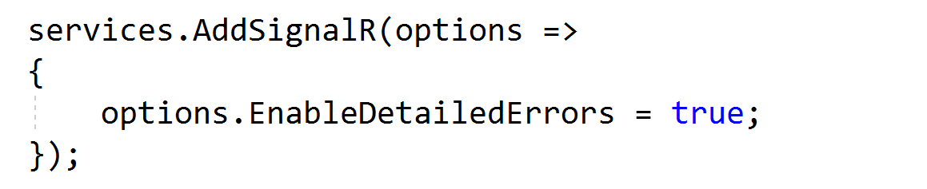
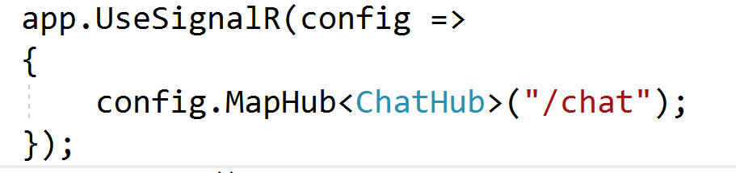
Configuration

Slide 8
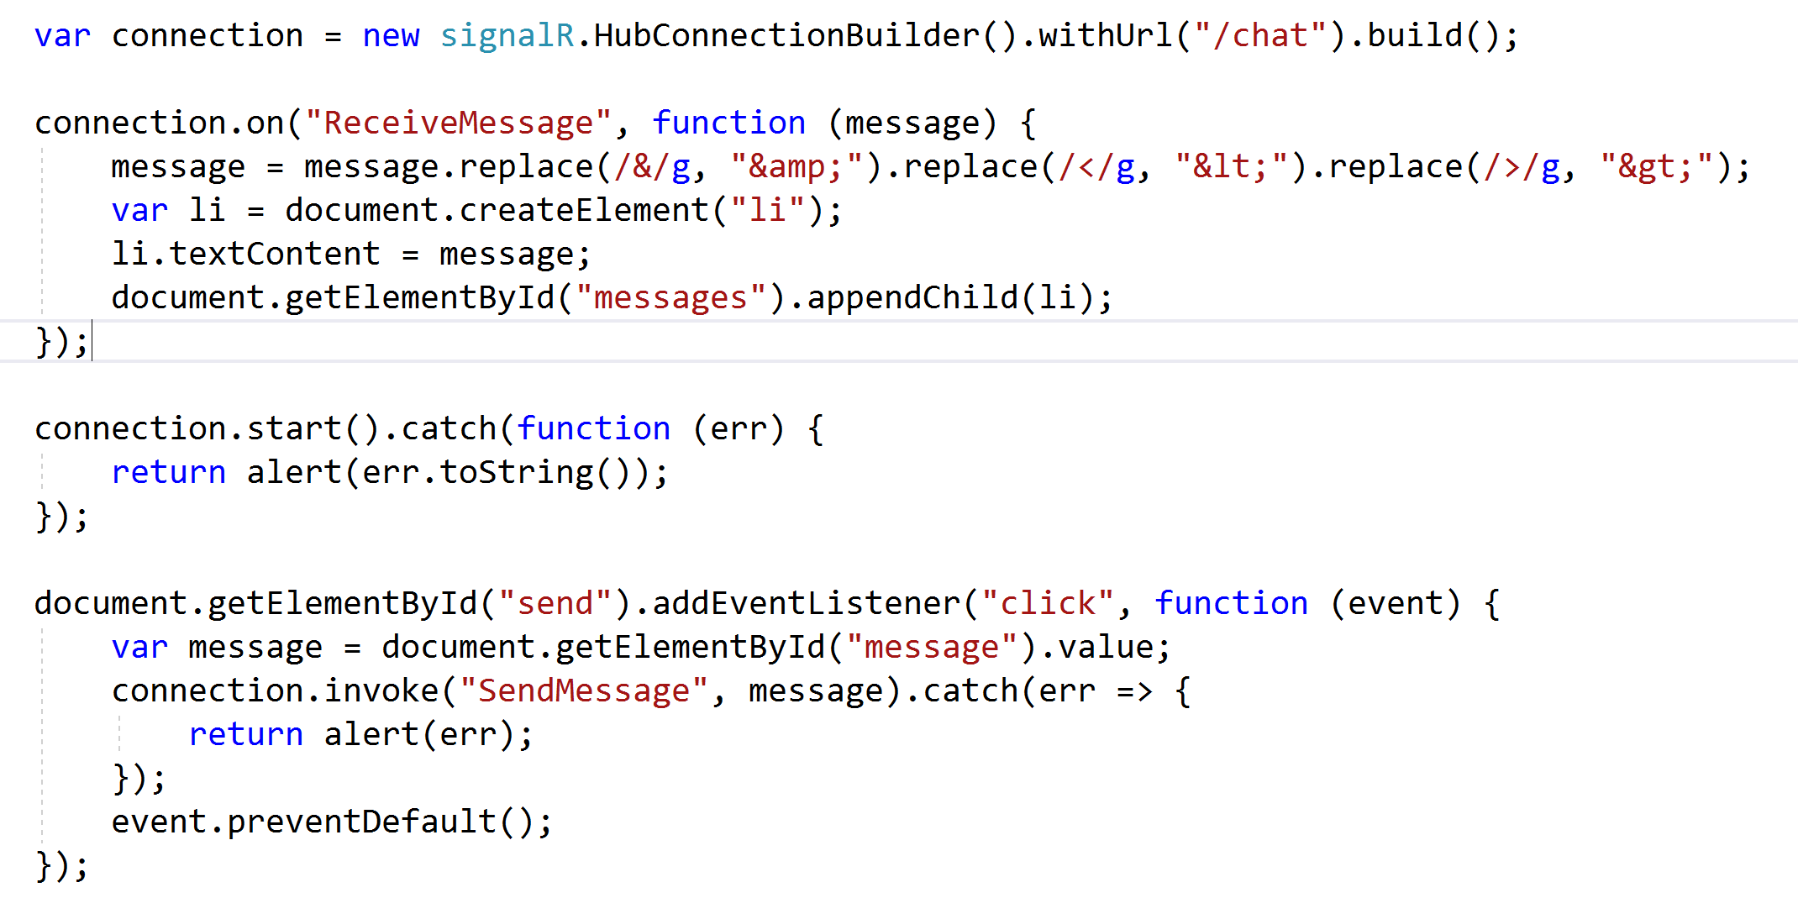
Client Code

Slide 9
Summary

