Slide 1
Configuration and Services
JSON and Injection

Slide 2
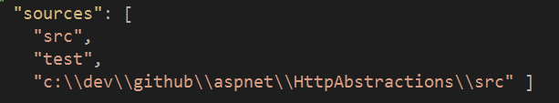
global.json
Projects indicates which folders have source code
Control DNX version used by VS
Add sources for debugging!

Slide 3
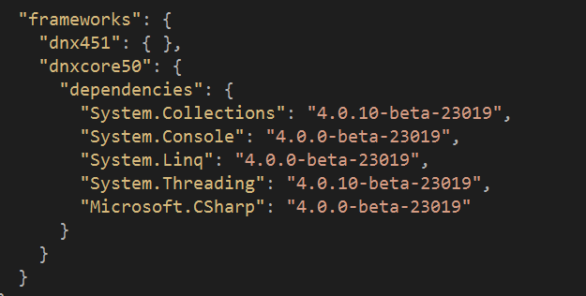
project.json
Dependencies
Supported runtimes
Commands
Publishing information
Scripts

Slide 4
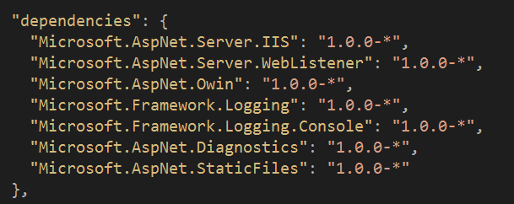
Dependencies
Can allow versions to float
Only top level dependencies required
Lock file can override dependency resolution

Slide 5
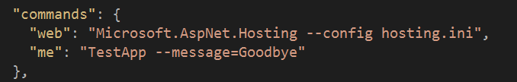
Commands
Defines entry points for DNX

Slide 6
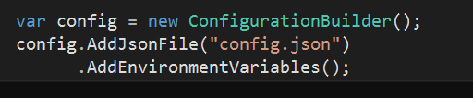
Runtime Configuration
Instantiate Configuration class in Startup
Add sources via extension methods
JSON
INI
Environment variables
XML
Command line

Slide 7

Configuration Is Key => Value
Drill into hierarchy using :

Slide 8
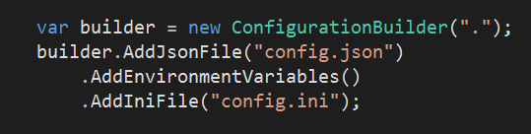
Configuration Sources Override
Last entry wins

Slide 9
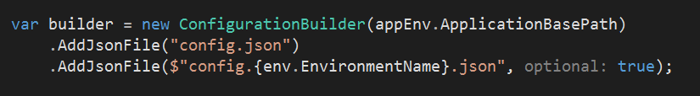
Using the Environment
Add files with names corresponding to environment

Slide 10
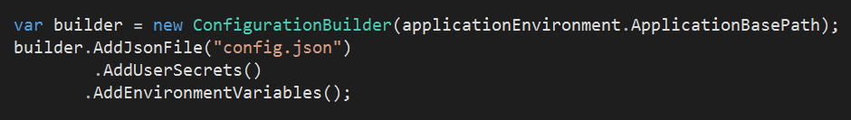
User Secrets
Secrets stored in user home directory
Manage from Visual Studio or user-secrets CLI
Allows protected configuration outside of source control

Slide 11
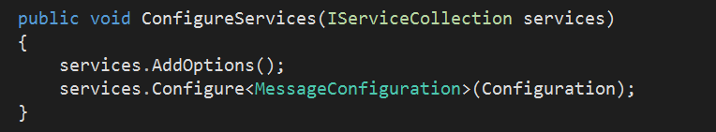
Configuration In The Application
Inject IOption<T> instances

Slide 12
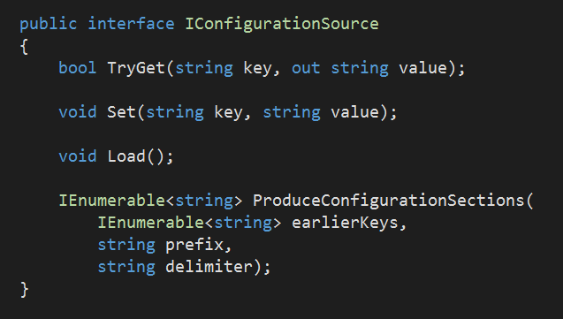
Custom Configuration Providers
Implement IConfigurationSource
Load, Set, TryGet
Or, inherit from ConfigurationSource

Slide 13
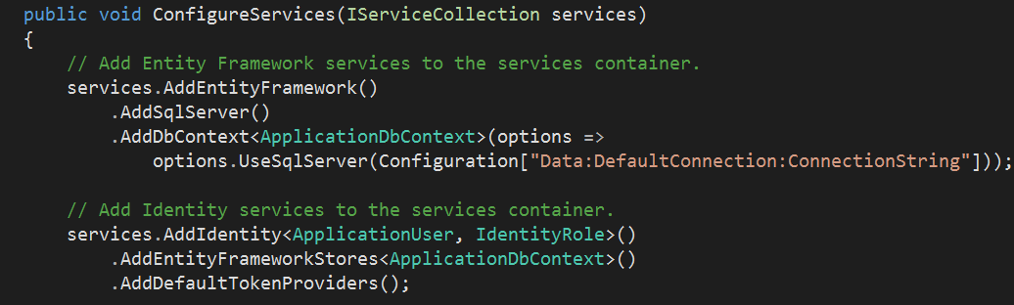
Dependency Injection
Single, simple container out of the box (BYOC)
DI all the way down

Slide 14
IServiceProvider
Abstraction for systemwide container
Implementation supports lifestyles:
Instance
Transient
Singleton
Scoped

Slide 15
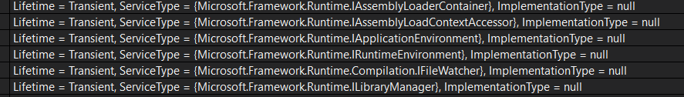
Summary
Configuration and DI work together
Many options for flexibility and extensibility

