Slide 1

The New Dragons in JavaScript K. Scott Allen @OdeToCode
Notes:
Hi everyone, my name is Scott, and this talk is about the new dragons of JavaScript. This is not a negative talk where I bash JavaScript features. Instead, I’m trying to express my feelings as I’ve worked with the new language features for over a year now.

Slide 2
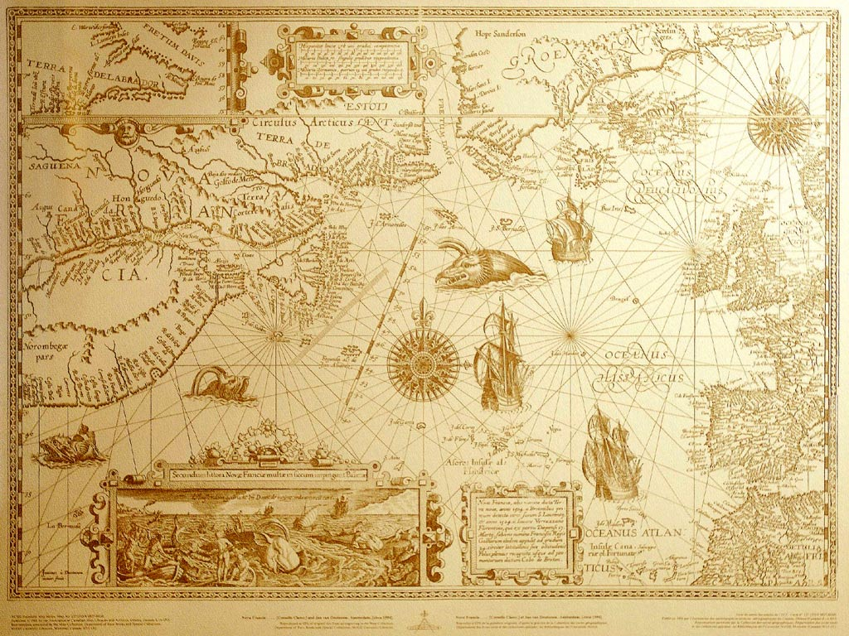
Notes:
… were drawn on the unexplored and uncharted areas of a map. When you truly embrace the es2015 features of JavaScript you’ll often

Slide 3
Arrow
Functions
Notes:
So to get started, and give you a feel for what this talk is all about, let’s start with a simple topic. Arrow functions. How hard can they be, right? They look just like lambda expressions in C# and many of us have been using and abusing those for years.

Slide 4
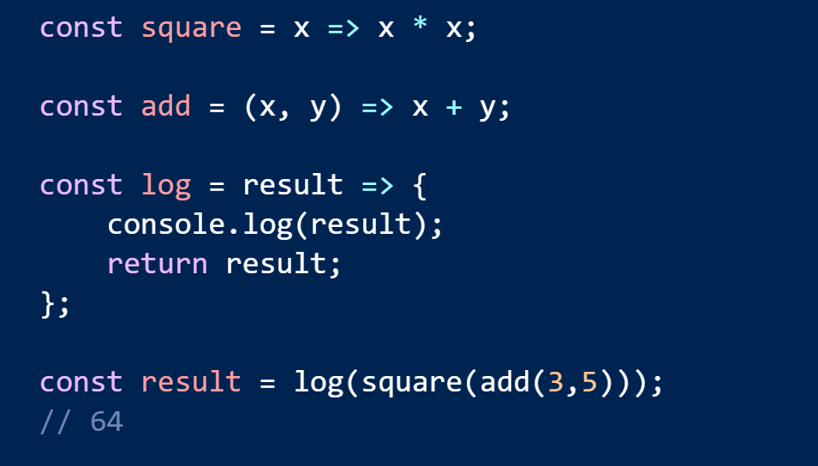
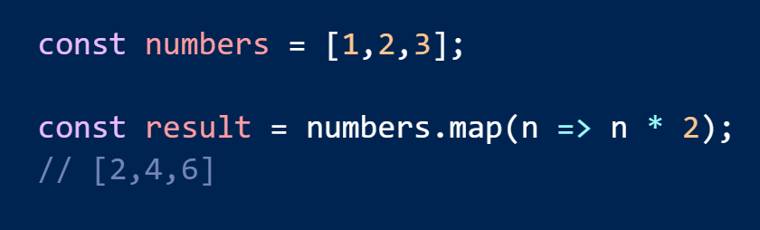
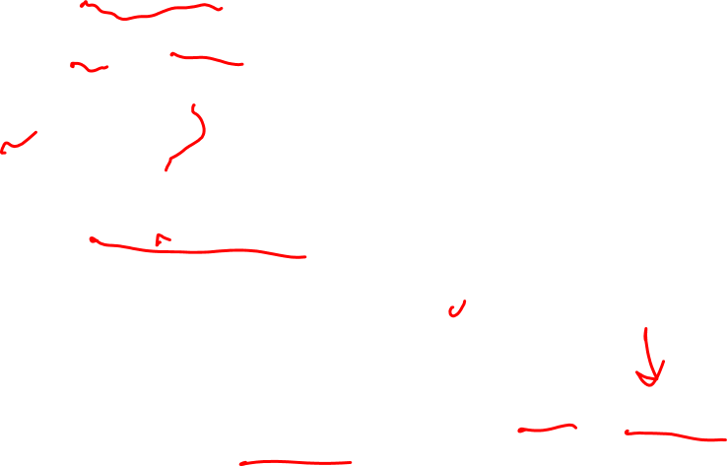
Arrow Syntax

Slide 5
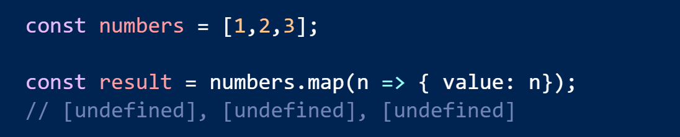
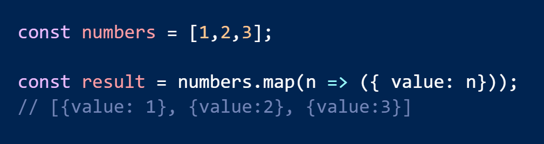
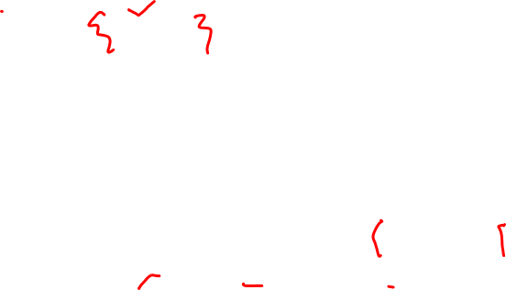
Return An Object Literal

Slide 6
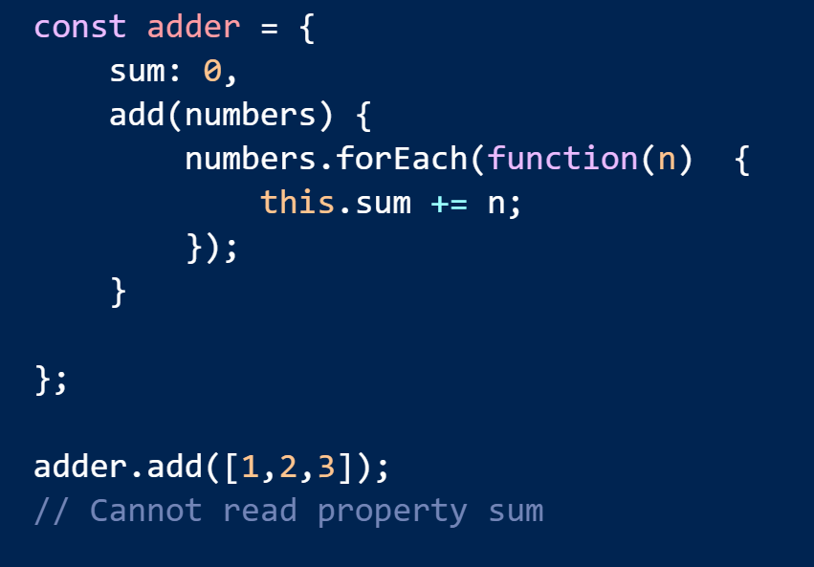
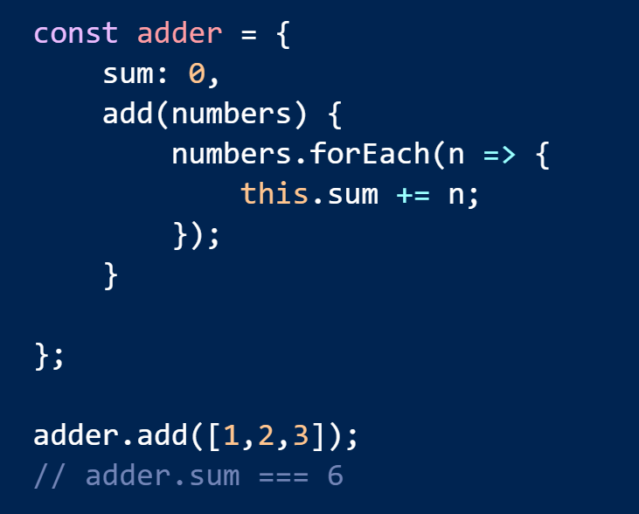

Lexical this Reference

Slide 7
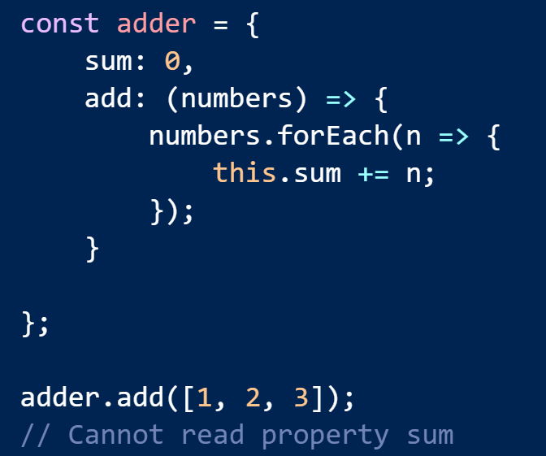
Too Many Arrows

Slide 8
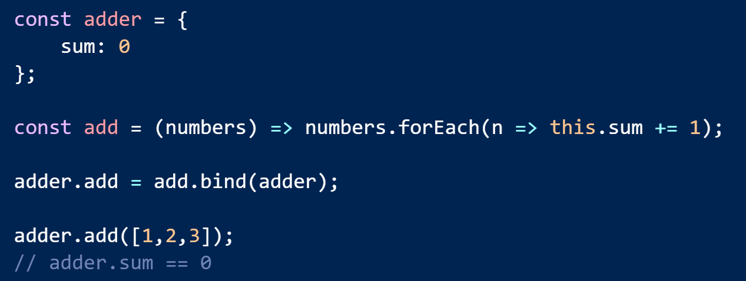
Cannot re-bind with bind, apply, or call

Slide 9
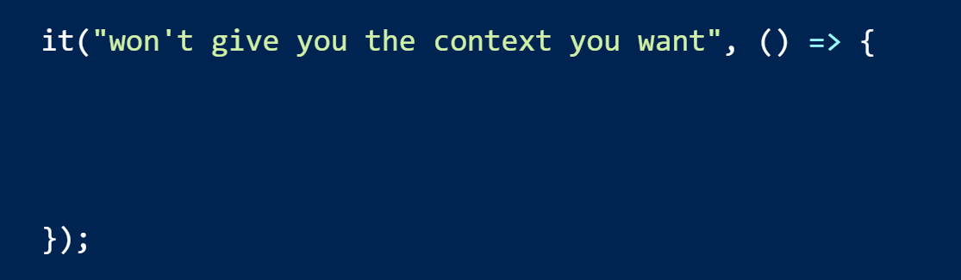
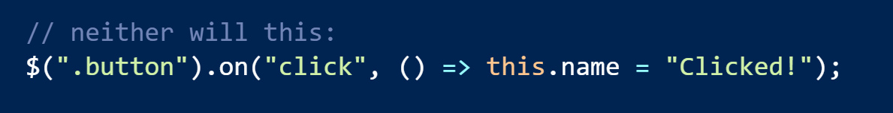
Careful with Legacy Libraries

Slide 10
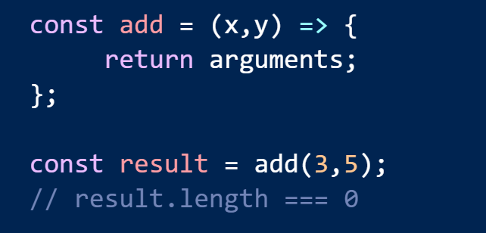
Also, no implicit arguments

Slide 11
Arrow
Functions
Template
Literals
Notes:
So to get started, and give you a feel for what this talk is all about, let’s start with a simple topic. Arrow functions. How hard can they be, right? They look just like lambda expressions in C# and many of us have been using and abusing those for years.

Slide 12
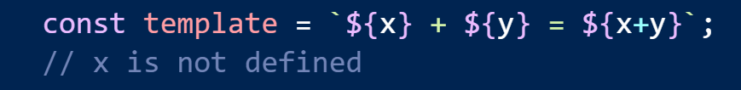
They Aren’t Reusable …

Slide 13
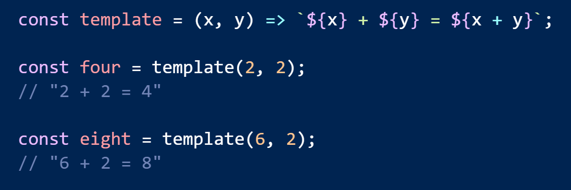
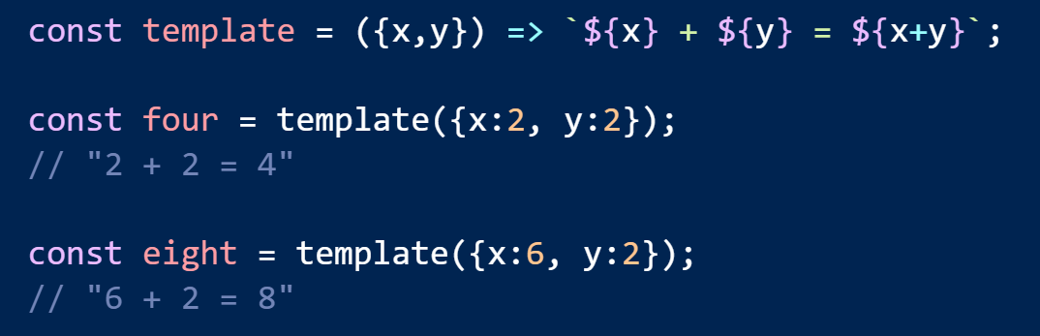
… Unless You Wrap Them

Slide 14
Arrow
Functions
Template
Literals
Crazy Syntax
Notes:
So to get started, and give you a feel for what this talk is all about, let’s start with a simple topic. Arrow functions. How hard can they be, right? They look just like lambda expressions in C# and many of us have been using and abusing those for years.

Slide 15
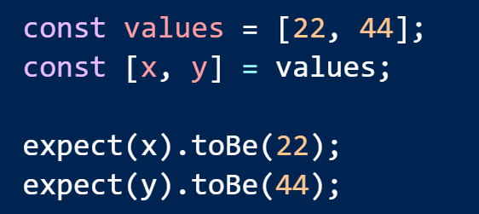
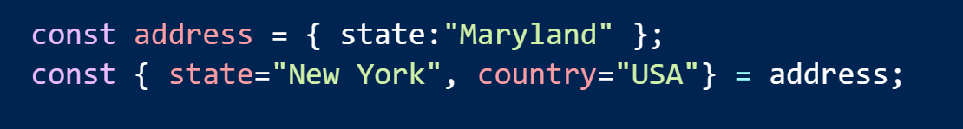
Destructuring

Slide 16
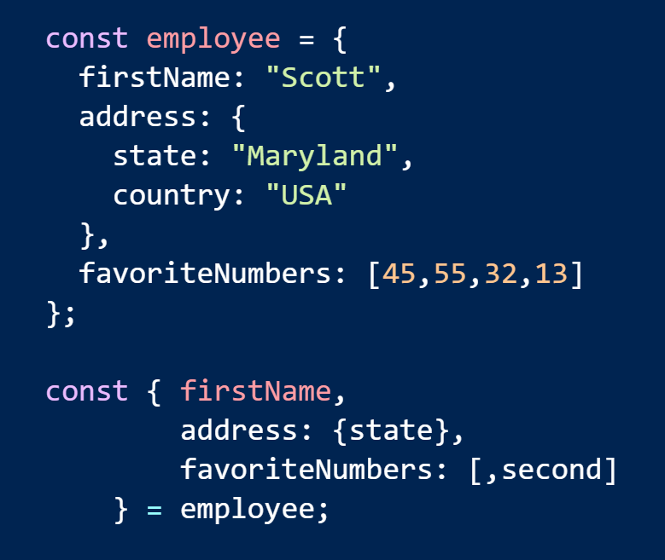
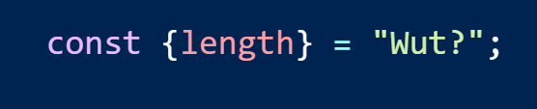
Readable?

Slide 17
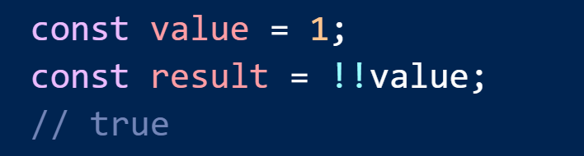
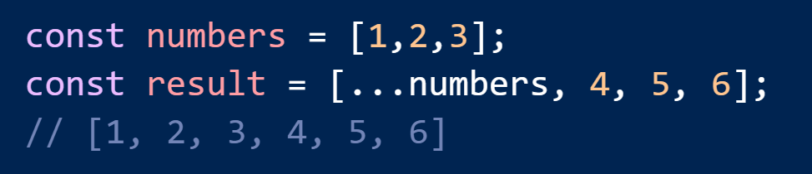
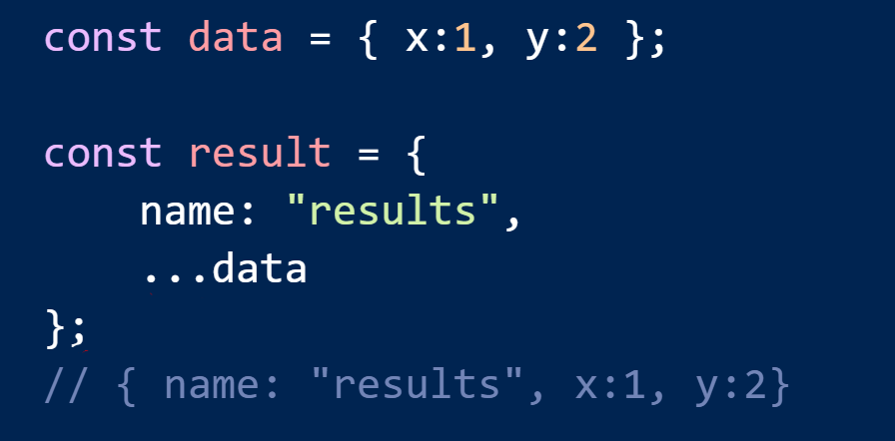
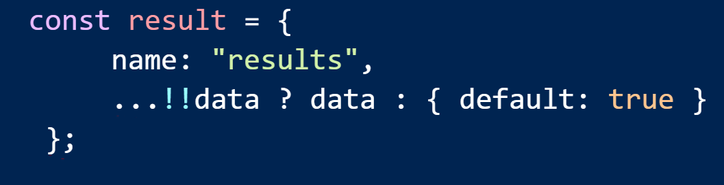
Crazy Operators

Slide 18
const
Arrow
Functions
Template
Literals
Crazy Syntax
Notes:
So to get started, and give you a feel for what this talk is all about, let’s start with a simple topic. Arrow functions. How hard can they be, right? They look just like lambda expressions in C# and many of us have been using and abusing those for years.

Slide 19
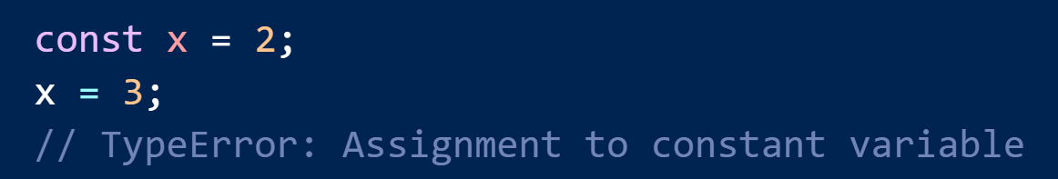
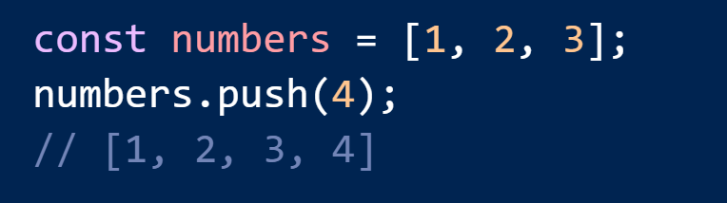
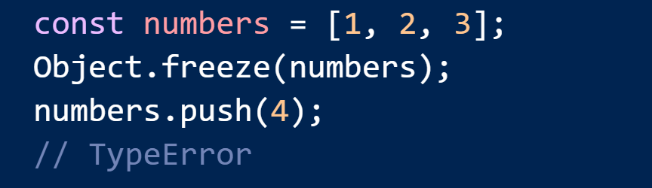
const means no more assignments

Slide 20
Collections
const
Arrow
Functions
Template
Literals
Crazy Syntax
Notes:
So to get started, and give you a feel for what this talk is all about, let’s start with a simple topic. Arrow functions. How hard can they be, right? They look just like lambda expressions in C# and many of us have been using and abusing those for years.

Slide 21
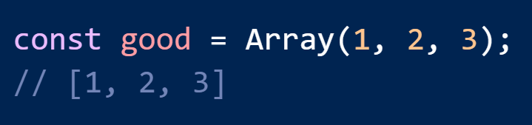
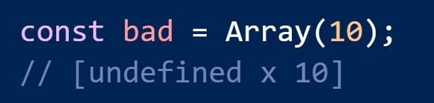
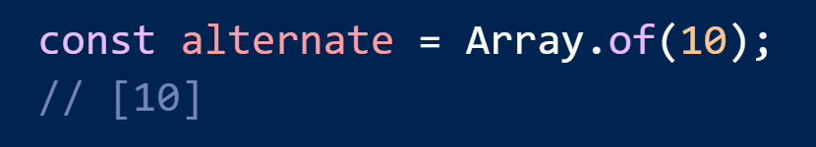
Creating Arrays

Slide 22
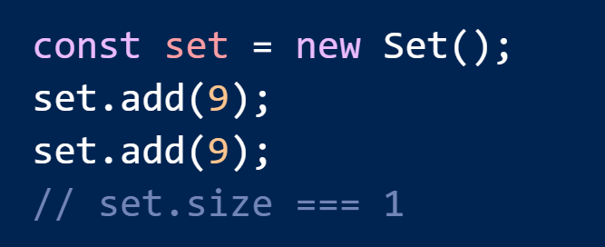
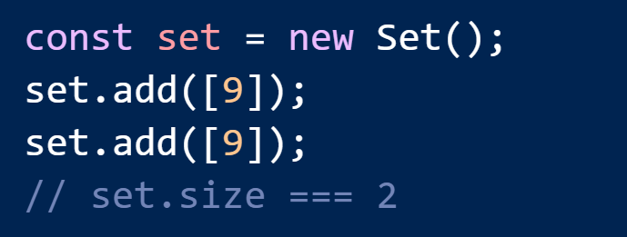
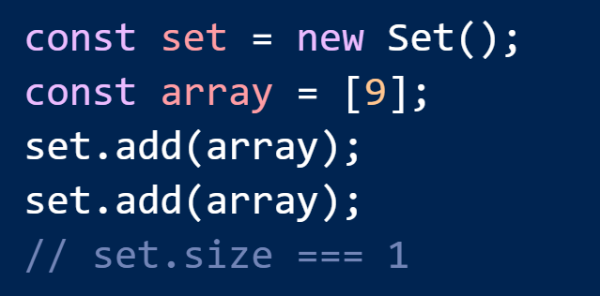
Sets Are Shallow

Slide 23


Literal Notation For Map/Set? No

Slide 24
Collections
const
Arrow
Functions
Classes
Template
Literals
Crazy Syntax
Notes:
So to get started, and give you a feel for what this talk is all about, let’s start with a simple topic. Arrow functions. How hard can they be, right? They look just like lambda expressions in C# and many of us have been using and abusing those for years.

Slide 25
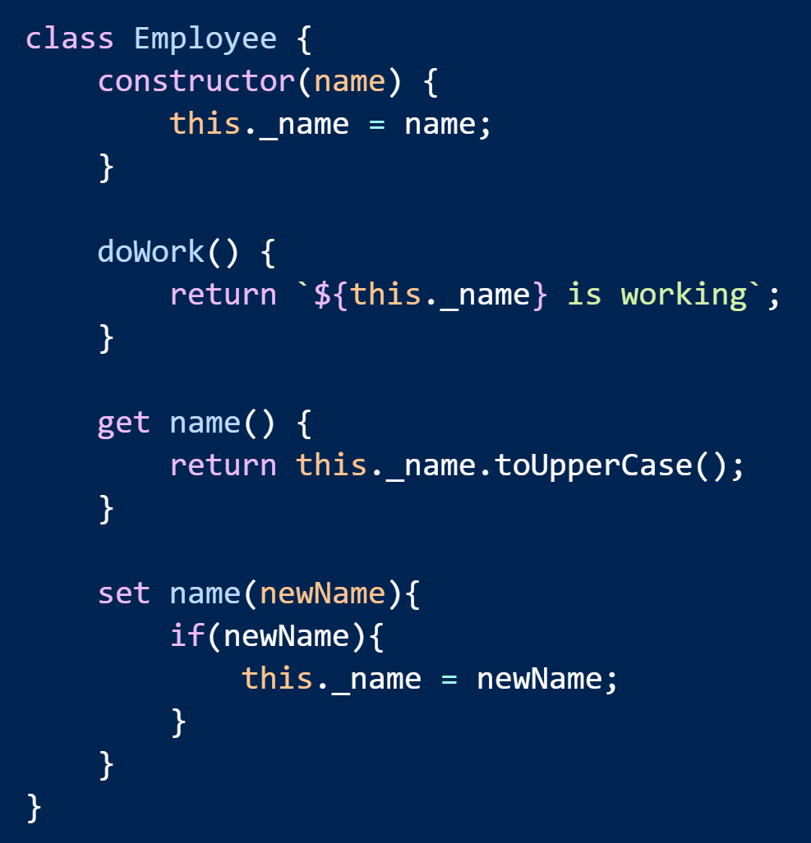
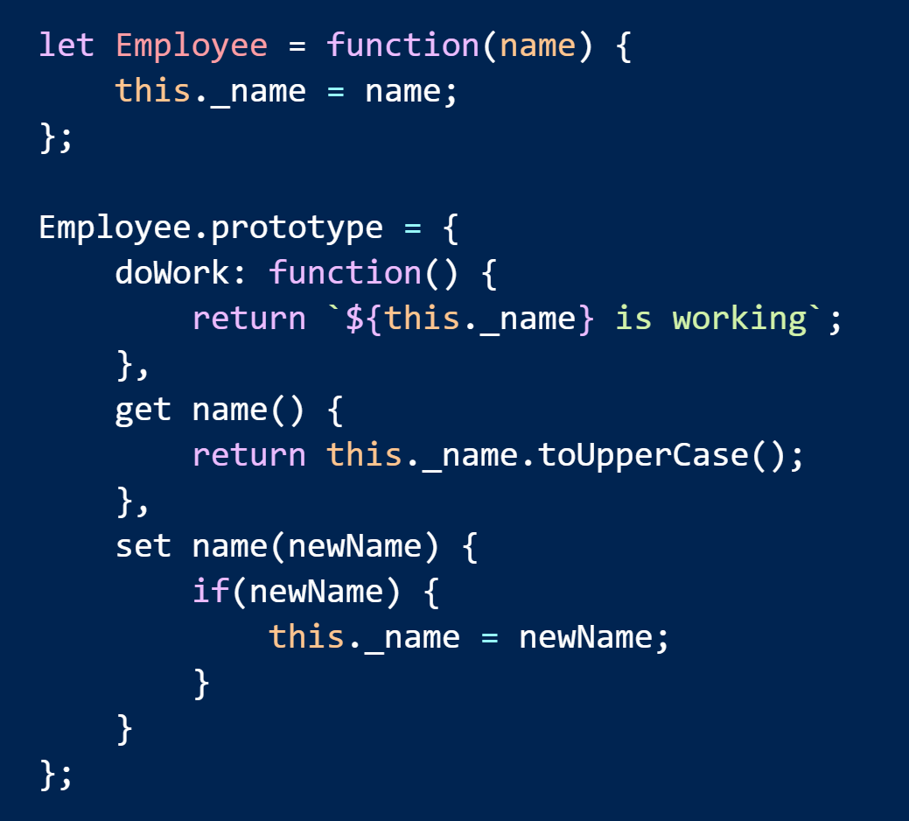
Classes are Mostly Sugar

Slide 26
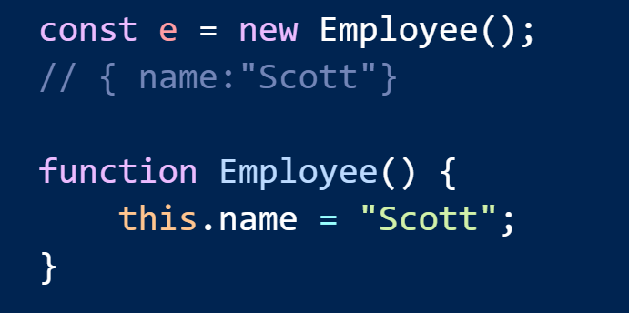
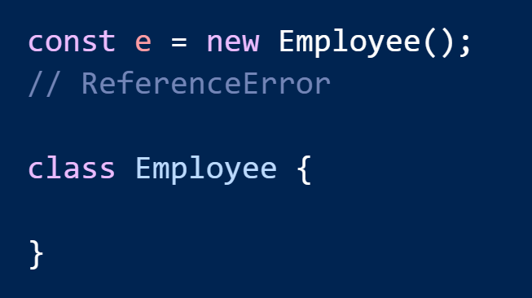
Hoisting

Slide 27
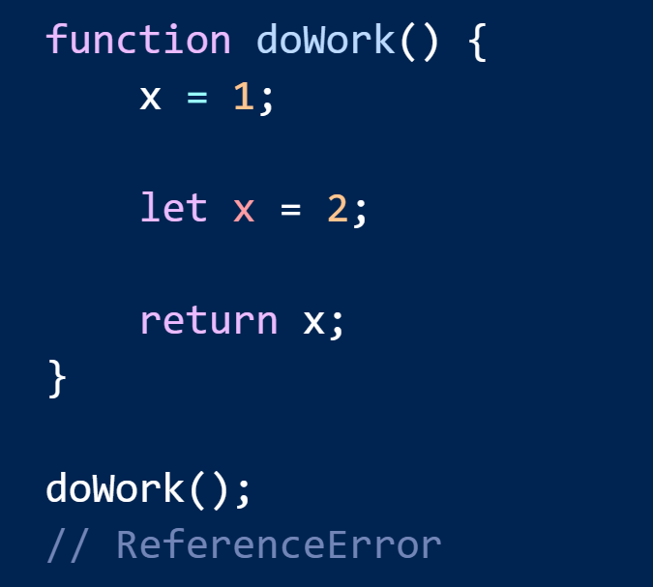
The TDZ

Slide 28
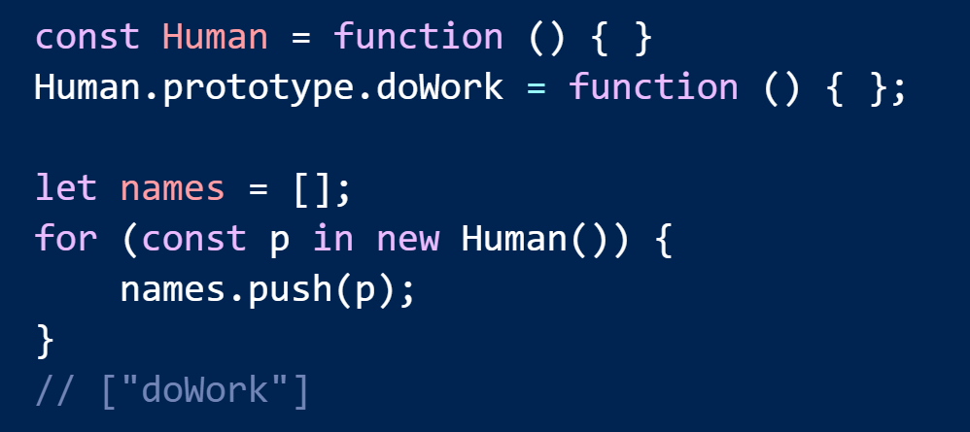
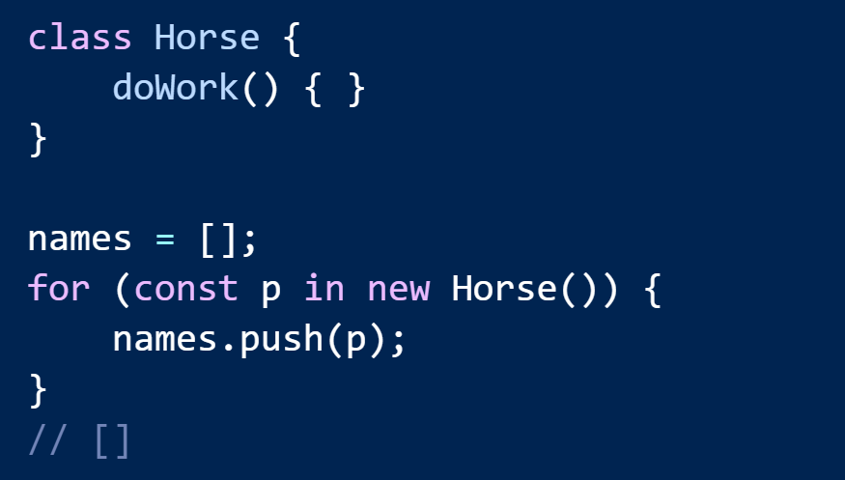
Reflective Introspection

Slide 29
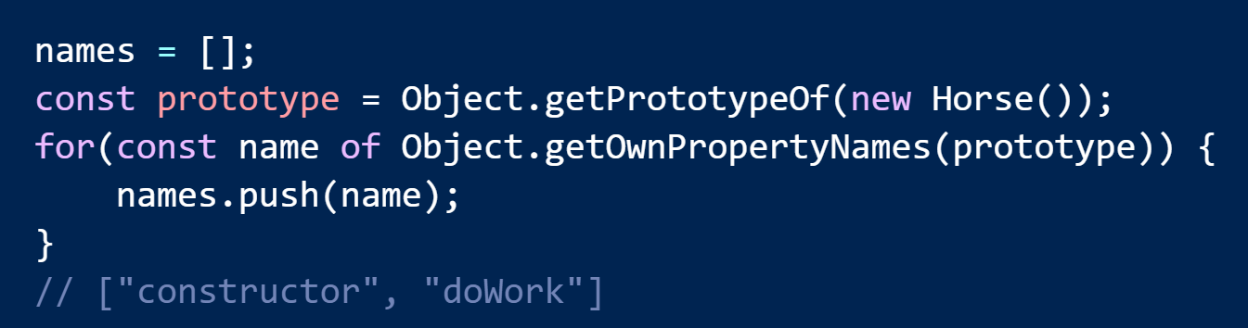
Introspection Part II

Slide 30
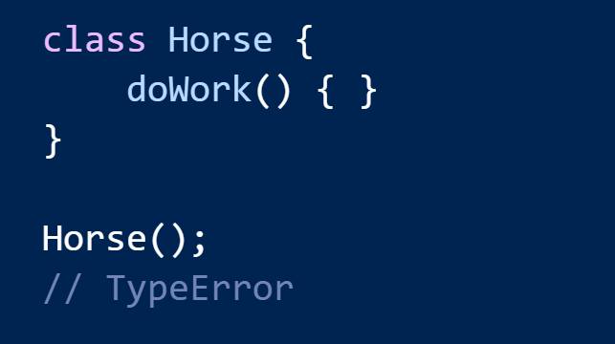
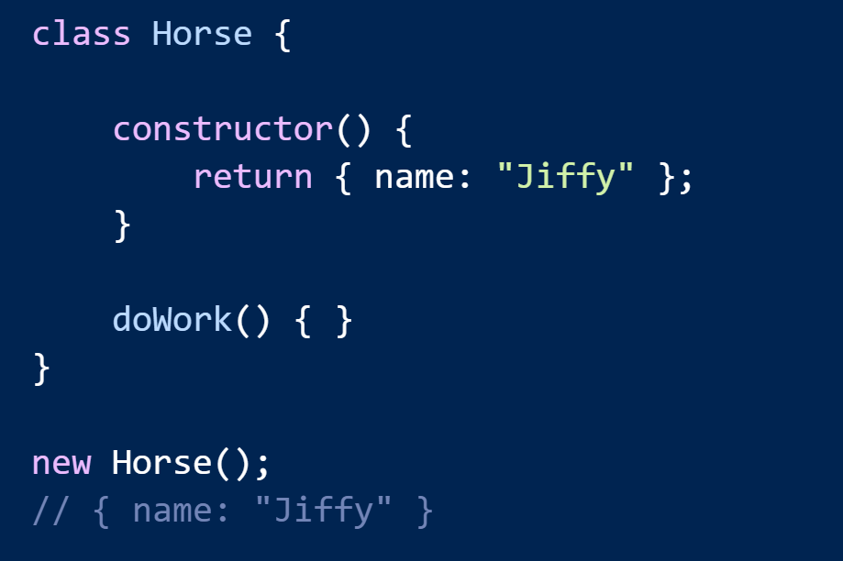
new is Required

Slide 31
Collections
const
Arrow
Functions
Classes
Template
Literals
Crazy Syntax
Modules
Notes:
So to get started, and give you a feel for what this talk is all about, let’s start with a simple topic. Arrow functions. How hard can they be, right? They look just like lambda expressions in C# and many of us have been using and abusing those for years.

Slide 32

When the gods wish to punish us
they answer our prayers.
Oscar Wilde

Slide 33
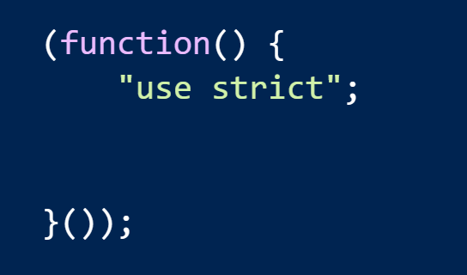
No More Strict IIFEs

Slide 34
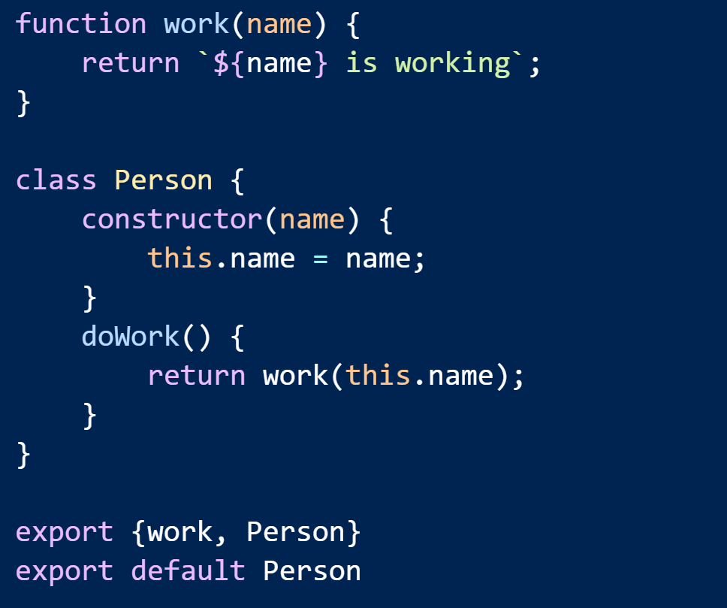
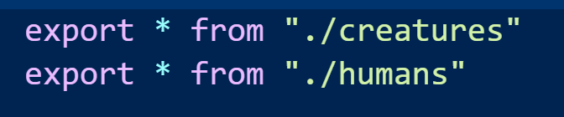
Exports

Slide 35
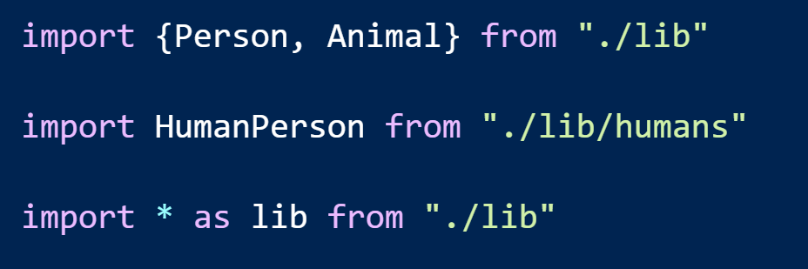
Imports

Slide 36
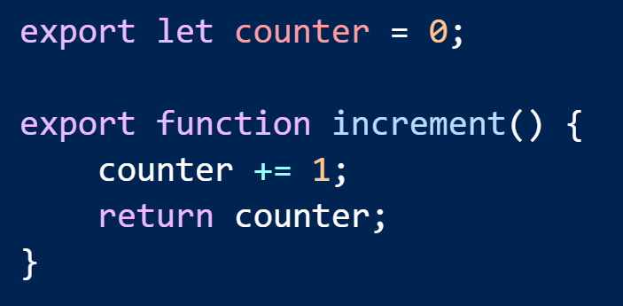
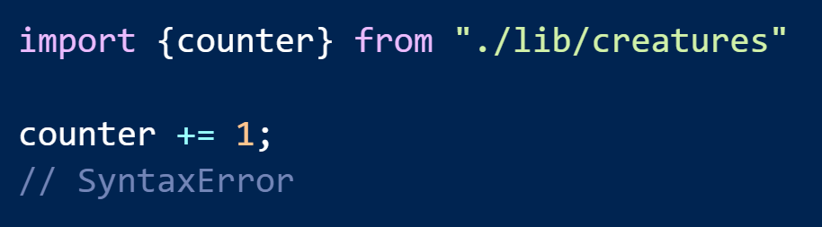

Immutable Bindings

Slide 37


Bindings Are Live

Slide 38

Default Value of this

Slide 39

Import Everything

Slide 40

Modules are static

Slide 41


Modules Don’t Work In The Browser
Syntax
Behavior

Slide 42


SystemJs

Slide 43
Problems
Changing
Standards
Performance

Slide 44


WebPack

Slide 45

Problems

Slide 46
What About Library / Framework Authors?
Compile to UMD?
Add
Polyfills?

Slide 47

Tooling

Slide 48
The End
Scott Allen
scott@OdeToCode.com
@OdeToCode
http://odetocode.com
http://pluralsight.com/

