Slide 1
Middleware
The HTTP Pipeline in ASP.NET 5

Slide 2
Architecture
Web Framework
Web Server

Slide 3
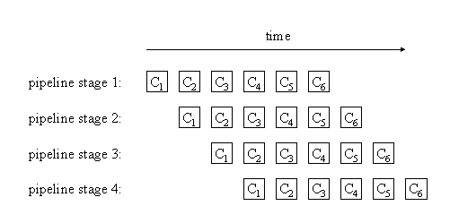
Processing HTTP Messages

Slide 4
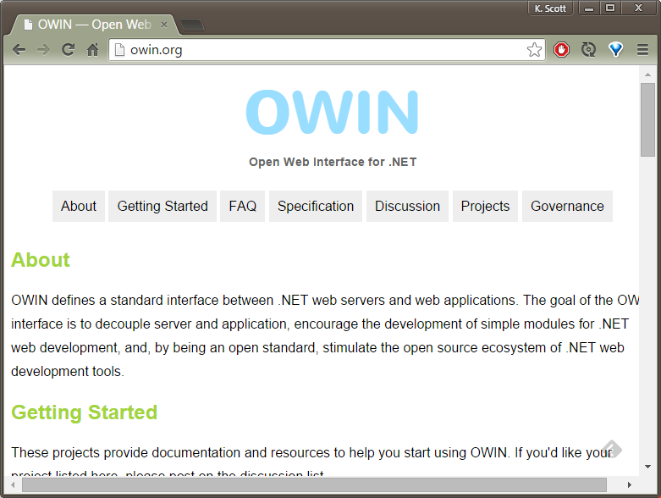
OWIN

Slide 5
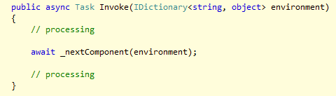
The AppFunc
Context
Async

Slide 6
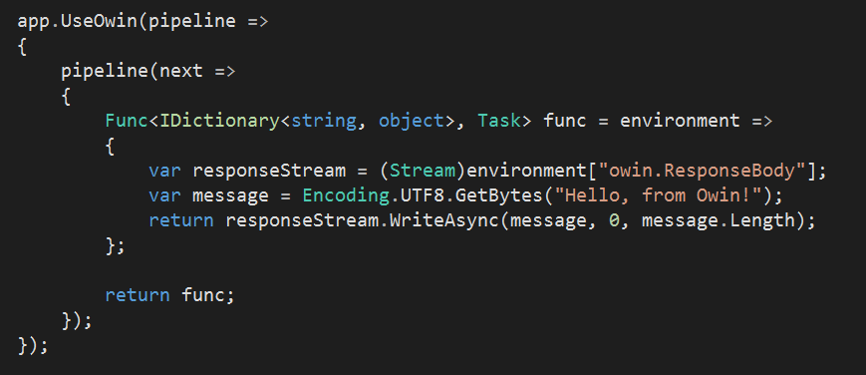
OWIN and ASP.NET 5
OWIN Middleware supported by Microsoft.AspNet.Owin

Slide 7
Middleware
Middleware
MVC
Or …?
Middleware
Middleware
Server
Host

Slide 8
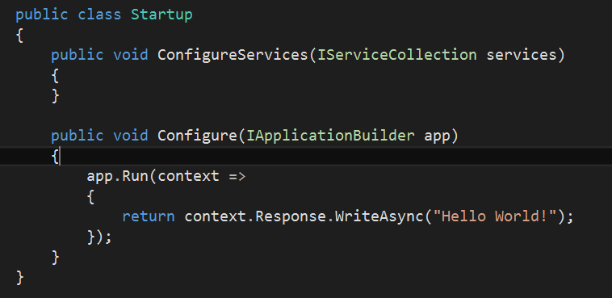
Startup Class
ASP.NET searches for Startup as an entry point
Defines configuration, middleware, services

Slide 9
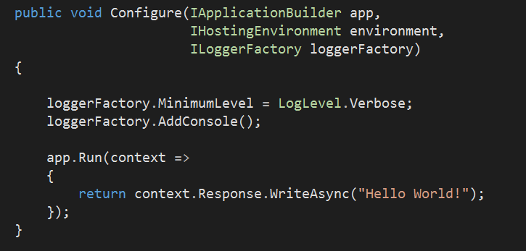
Configure
Injected to Configure method of Startup
Defines how to process HTTP requests
Optional parameters
IHostingEnvironment
ILoggerFactory

Slide 10
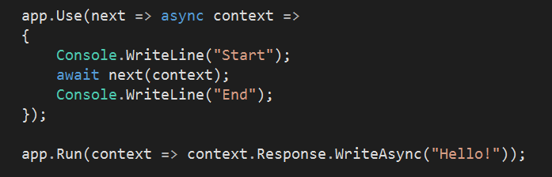
IApplicationBuilder
Use and run middleware

Slide 11
app.Run
Given an HttpContext
No access to more middleware

Slide 12
app.Use
Take a ReqeustDelegate
Return a RequestDelegate

Slide 13
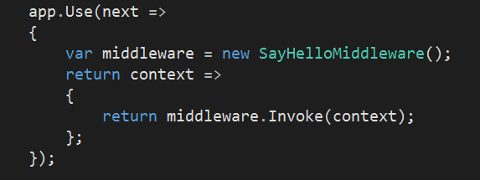

app.UseMiddleware
Encapsulate middleware in a class
Requires constructor and Invoke method

Slide 14
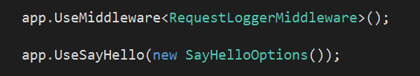
Custom Middleware
Convention is to create custom options and Use methods.

Slide 15
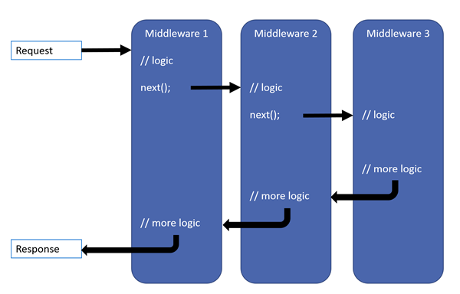
Middleware Pipelines

Slide 16
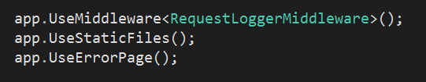
Common Middleware
Static files
Diagnostics
BrowserLink
ErrorHandler

Slide 17
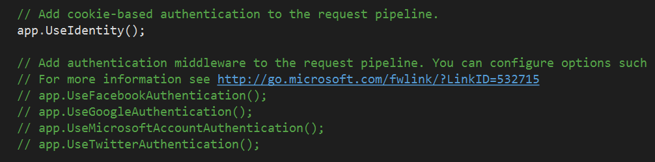
Other Middleware
ASP.NET MVC
Identity
Authentication providers
CORS
Session

Slide 18
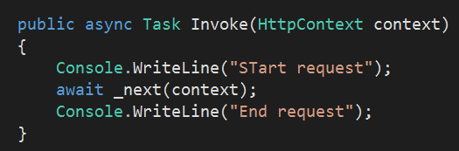
Tips
Order is important
Be careful modifying the response after call to next

Slide 19
Summary
Middleware provides logic for HTTP processing
Middleware
Middleware
Middleware
Server
Host

