Slide 1
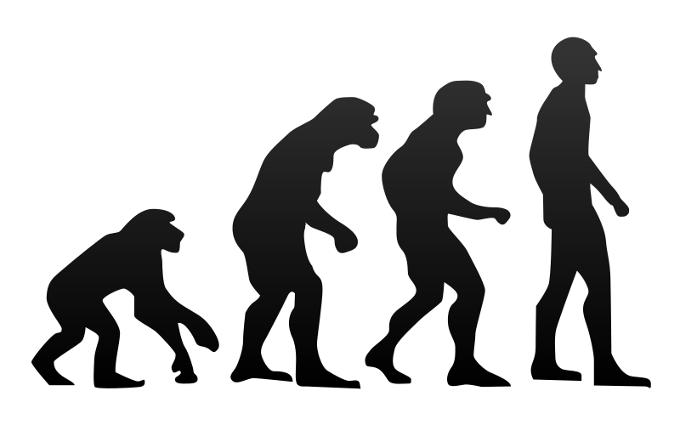
Evolution of the Entity Framework
K. Scott Allen
@OdeToCode

