Slide 1

Components in Angular 1.5
<ng-outlet>

Slide 2
module.controller
module.component
module.directive

Slide 3
Why Components?
Clean and simple API
Aligned with
Angular 2
Practical defaults
Component
Routing

Slide 4
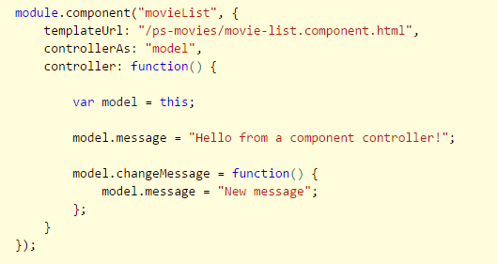
The Essence of Components
Creates a custom element
Consists of template and controller
Uses controllerAs and isolated scope

Slide 5
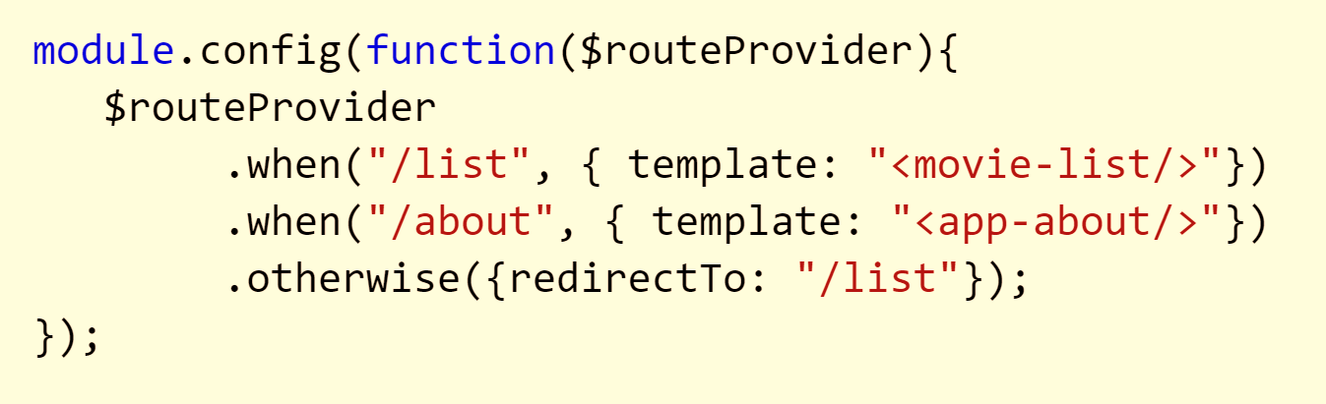
Routing
Swap templates in and out of the DOM
Features map to URLs

Slide 6
Component Router
Components are
Native
Angular 2
Compatible
Lifecycle
Hooks
Nested Routing
Link Generation

Slide 7
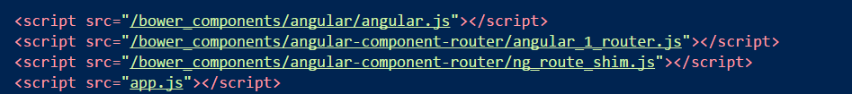
Setup
Install angular-component-router
Built from Angular2 TypeScript source

Slide 8
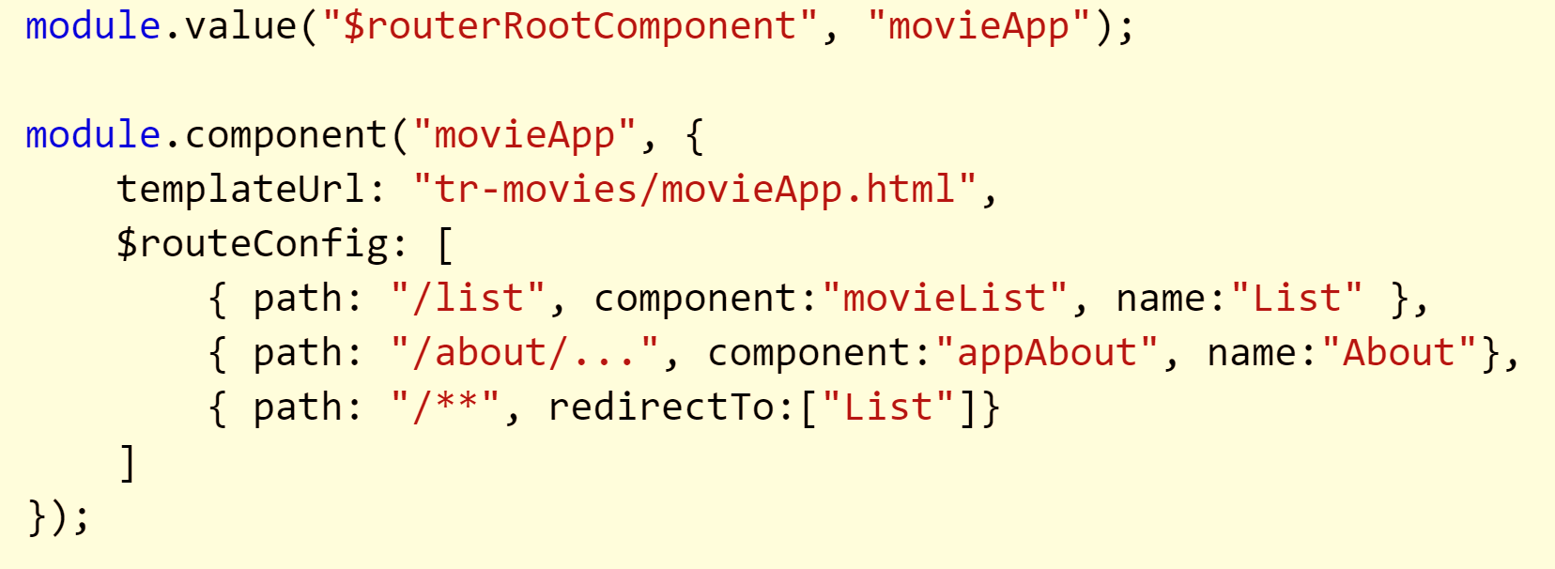
App Level Component

Slide 9
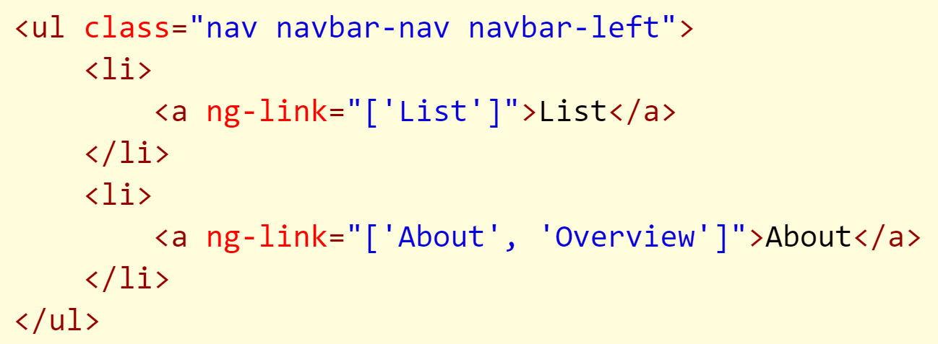
ng-link
Generate links using route names and paramters

Slide 10
Component Lifecycle
Event | Description
$onInit | After construction and bindings initialized
$onChanges | Called when bindings are updated
$onDestroy | Called when associated $scope destroyed
$postLink | Similar to directive link function

Slide 11
Lifecycle Hooks
Event | Description
$canActivate | Return Boolean or promise – can the component activate?
$routerOnActivate | After a successful navigation
$routerCanDeactivate | Can component be removed?
$routerOnDeactivate | Just before destruction
$routerCanReuse | Reuse or recreate a component

Slide 12
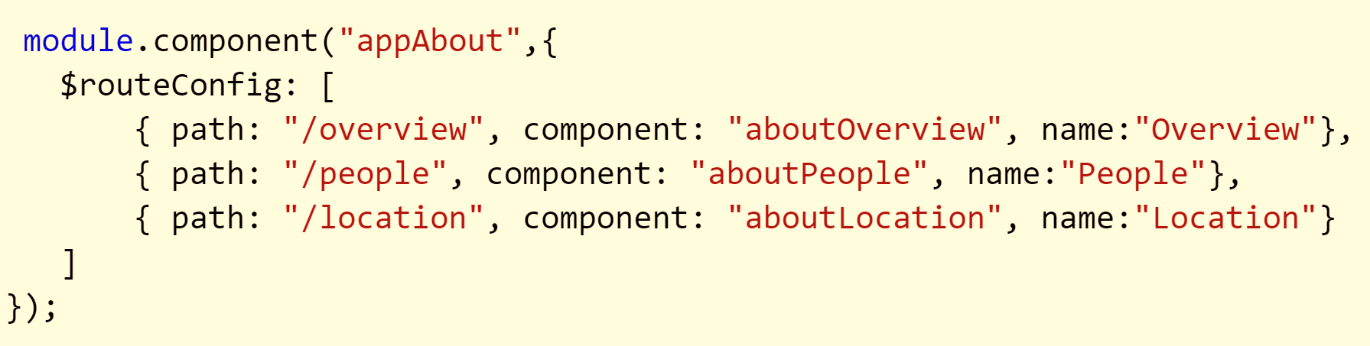
Child Components

Slide 13
Three Compositional Techniques
App
…
<ng-outlet />
…
MovieList
Child
…
<ng-outlet />
…
Accordion
Grandchild
…
<ng-outlet />
…
Bindings
Panel
Panel
MovieRating

Slide 14
Summary
Components should be more compatible with Angular 2

