Slide 1
ASP.NET MVC
V is for View

Slide 2
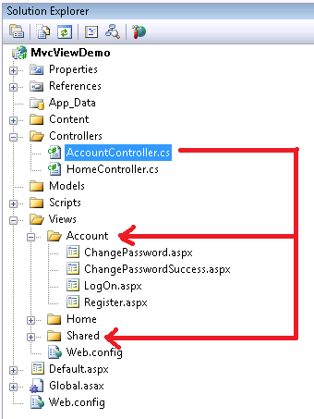
View Conventions
Every controller has a default view directory
Default view is the name of the action
ViewResult can override the default view name
Shared views for all controllers
ASP.NET will look here after the default
// extension not required ...
return View("Error");

Slide 3
Razor Templates
Template
Data
Generated
Output
+
=

Slide 4
Intermingling
C#
HTML
<ul> @foreach (var movie in Model) { <li> <a href="/home/details/@movie.ID">@movie.Title</a> </li> } </ul>
Email: scott-allen@pluralsight.com Twitter: @@OdeToCode

Slide 5
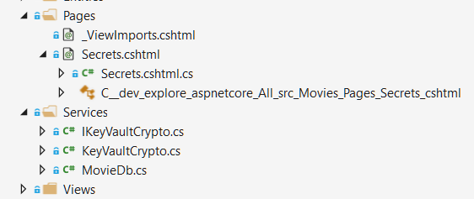
Razor Pages
Live in a Pages folder by default
Razor code + C# code
Has DI, model binding, tag helpers, and all other MVC features

Slide 6
Layout with Razor
Layout views are “master pages” for razor
Use inherited methods to specify content areas
RenderBody
RenderSection
<!DOCTYPE html> <html> <head> <title>@ViewBag.Title</title> <script src="@Url.Content("~/Scripts/jquery-1.4.4.min.js")"
type="text/javascript"></script> </head> <body> @RenderBody() </body> </html>

Slide 7
_ViewStart
Code inside _ViewStart.cshtml executes before every view renders
Hierarchical (subfolders override parent)
@{ Layout = "~/Views/Shared/_Layout.cshtml"; }

Slide 8

_ViewImports
Add namespaces and tag helpers

Slide 9

Views and Dependency Injection
Use @inject

Slide 10
HTML Helpers
Html is a property of the ViewPage base class
Many HTML helpers replaced with tag helpers
@using (Html.BeginForm()) { @Html.ValidationSummary(true) <div class="editor-label"> @Html.LabelFor(model => model.FirstName) </div> <div class="editor-field"> @Html.EditorFor(model => model.FirstName) @Html.ValidationMessageFor(model => model.FirstName) </div>

Slide 11
Partials
Partial views render portions of a page
Reuse pieces of a view
@foreach (var item in Model) { @await Html.RenderPartialAsync("_movieRecord", item) }
@model Movie <tr> <td> @Html.ActionLink("Edit", "Edit", new { id = this.Model.ID }) | @Html.ActionLink("Details", "Details", new { id = Model.ID }) </td> <td> @Model.Title </td> </tr>

Slide 12
TagHelpers
A better HTML helper
Opt-in (required @addTagHelper support)
Forms, links, inputs
Caching, environment, and more

Slide 13
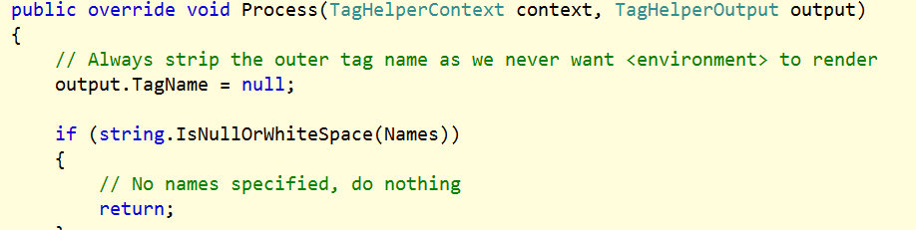
Custom Tag Helper

Slide 14
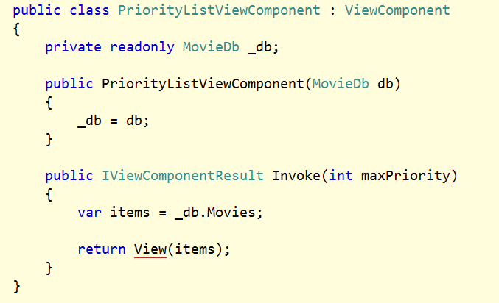
View Components
Child controller renders part of a page
View lives in Components folder

Slide 15
Templated Helpers
Builds UI based on metadata
@Html.Display("JoinedOn")
@Html.DisplayFor(m => m.JoinedOn)
@Html.DisplayForModel()
@Html.Editor("JoinedOn")
@Html.EditorFor(model => model.JoinedOn)
@Html.EditorForModel()

Slide 16
Data Annotations
Gives additional metadata for templates
public class UserEditModel { [ScaffoldColumn(false)] public int ID { get; set; } [DisplayFormat(NullDisplayText="No name")] public string Name { get; set; } [DisplayName("Joined")] [DisplayFormat(DataFormatString="{0:d}")] public DateTime JoinedOn { get; set; } }

Slide 17
Display / Edit Annotations
Attribute | Description
DisplayColumn | Specify the property of a model class for simple text display.
HiddenInput | Render value in a hidden input (when editing).
UIHint | Specify the name of the template to use for rendering.
DataType | Common templates (email, password, URL, currency)
ReadOnly | Specify a read-only property (for model binding).
DisplayFormat | Format strings and null display text
ScaffoldColumn | Turn off display and edit capabilities
DisplayName | Friendly name for labels
Required | Specify required properties (for model binding).

Slide 18


Security
Html.Encode
Helps to avoid XSS attacks
Not encoding user input makes you particularly vulnerable
AntiForgeryToken
Helps to avoids CSRF attacks
Requires a ValidateAntiForgeryToken attribute on controller action
EVIL.com
GET evil.aspx
<form action=“http://you.com/editprofile.aspx”>
…
YOU.com
POST editprofile.aspx

Slide 19
Model Binding
Default model binder maps request values to a CLR type
[FromBody] [FromQuery] [FromHeader] [FromRoute] …
public ActionResult Edit(Employee employee)
{
// ...
}
public ActionResult Edit(int id, string name,
DateTime hireDate)
{
// ...
}

Slide 20
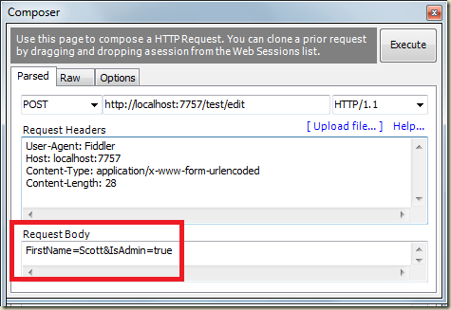
Model Binding Security
Beware of over-posting / mass assignment

Slide 21
Model Binding State
ModelState contains byproducts of model binding
Errors and attempted values
ModelState.IsValid
Did the model bind correctly?
HTML helpers use model state
Model state can override view model data
public void IndexAsync(string model)
{
if (ModelState.IsValid)
{
// commit...
return RedirectToAction("Index");
}
return View(model);
}

Slide 22
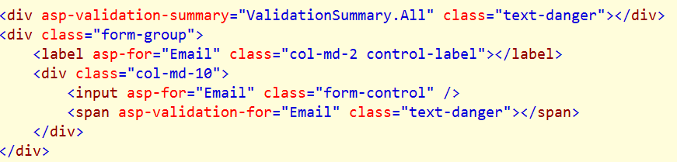
Validation Messages
ValidationMessage
Display property level validation errors
ValidationSummary
Display model level validation errors

Slide 23
Summary
Controller
Model
View

