Slide 1

Components and Directives
<custom-html>
</custom-html>

Slide 2
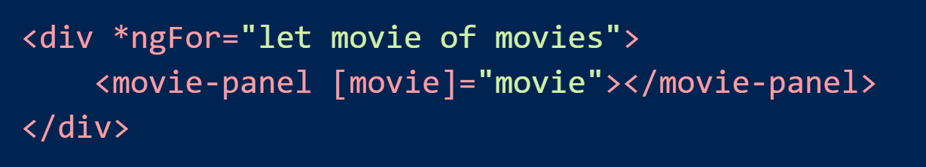
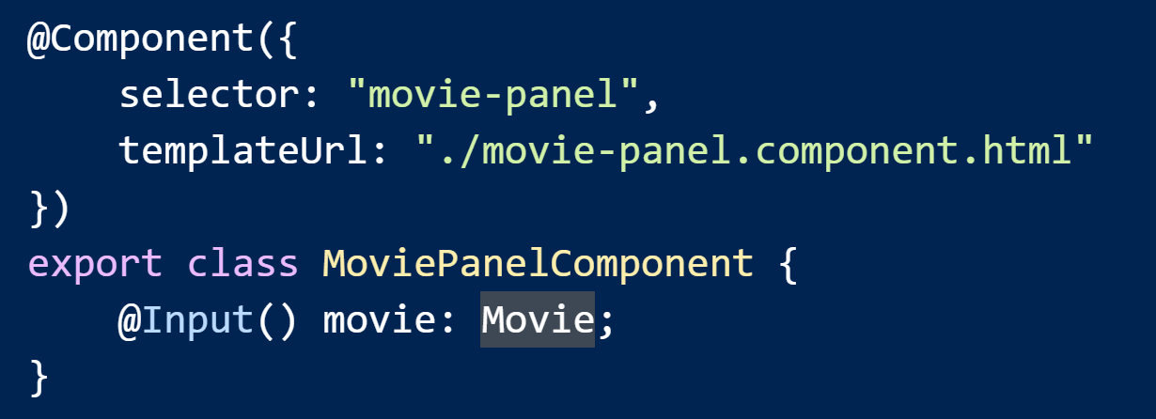
Components
Reusable, composable UI building blocks
A template is required

Slide 3
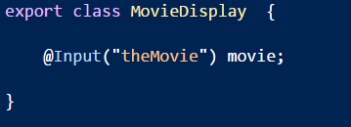

@Input
Declares a data-bound input property

Slide 4
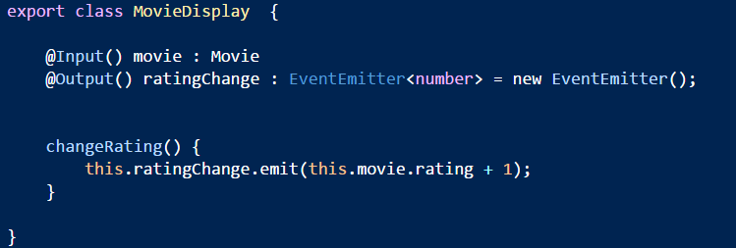
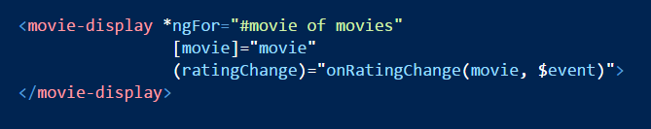
@Output
An event-bound output property

Slide 5
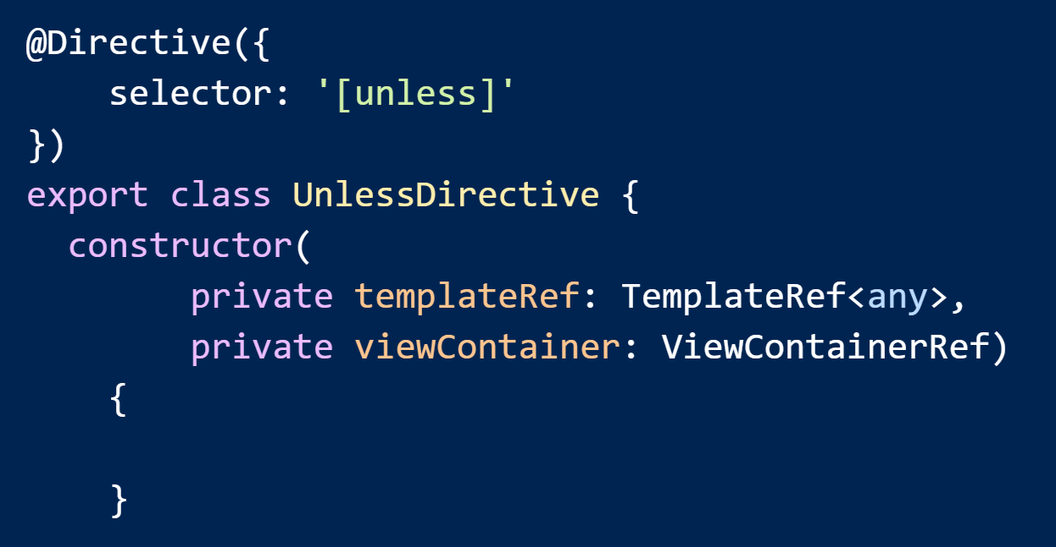
Components versus Directives
Directives require no template
But, can work with templates
Components are directives, but with a template

Slide 6
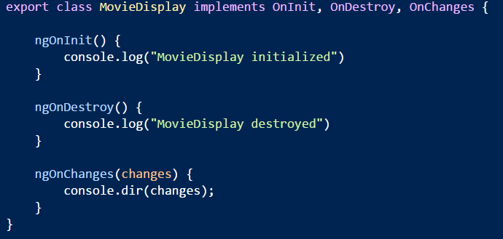
Lifecycle
Methods ngOnInit and ngOnDestroy invoked by framework
Optional interfaces are OnInit, OnDestroyAlso …
Also …
DoCheck, OnChanges, AfterContentInit, AfterContentChecked, AfterViewInit, AfterViewChecked

Slide 7
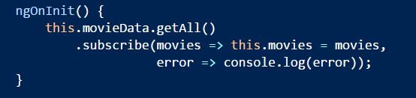
ngOnInit Note
Put work inside ngOnInit instead of constructor
Easier to test a component

Slide 8
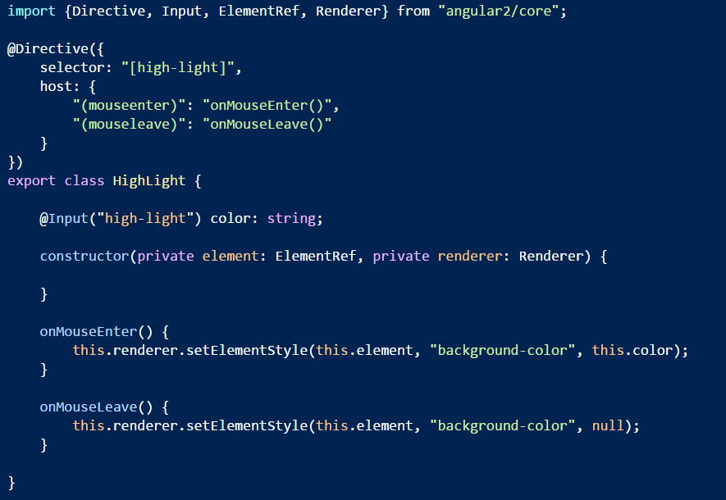
Decorator Directives
Attributes to add behavior to a DOM element

Slide 9
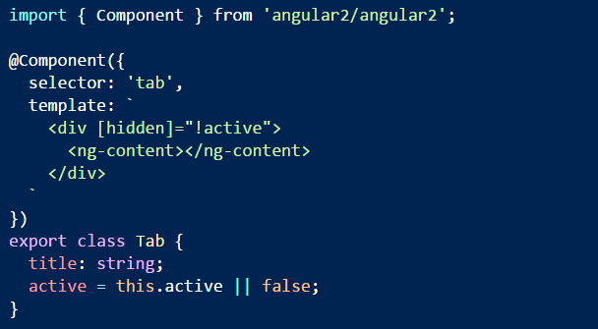
Directives with Content
Use ng-content to transclude content from client template

Slide 10
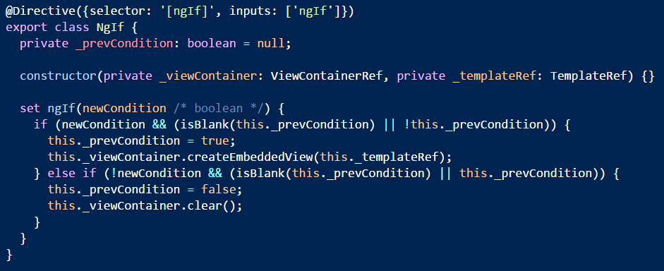
Directives and ViewContainers
Manage templates using a view container

Slide 11

Summary
Angular 2 encourages you to build components
Self describing UI building blocks
Extend HTML

