Slide 1

Routing
<router-outlet>

Slide 2
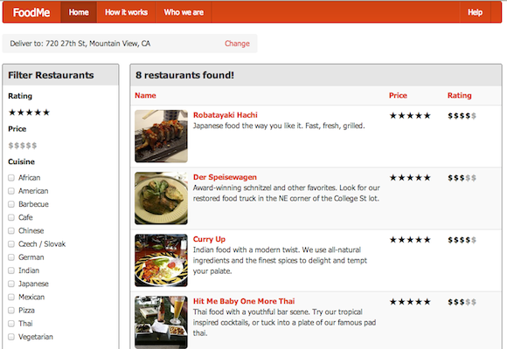
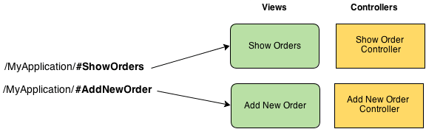
Why Routing?
Break large application into small components
Provide more features
Deep linking
Bookmarks
History

Slide 3
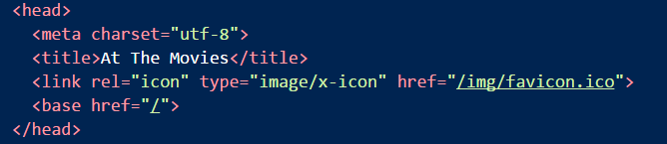
Prepare for Routing
Router features are in @angular2/router
Set a base href

Slide 4
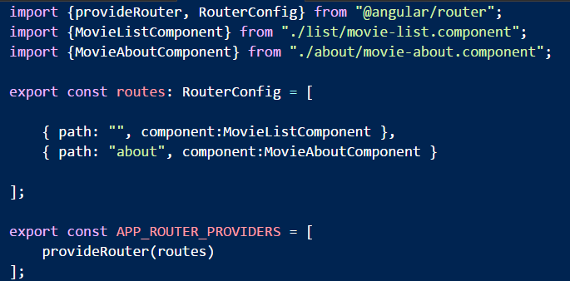
Bootstrap for Routing
Need a top level route configuration

Slide 5
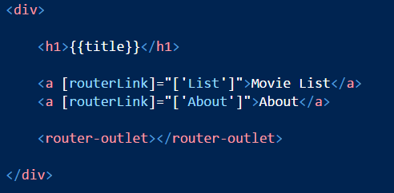
The Navigation Shell
Top level component becomes a shell
Use router-outlet directive to plugin routed components
Use routerLink to build anchor tags based on route config

Slide 6
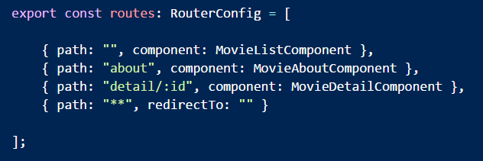
Working with Parameters
:tokens are placeholders
Can use multiple tokens

Slide 7
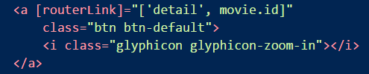
Passing Parameters
Pass an object for parameters in routerLink array

Slide 8
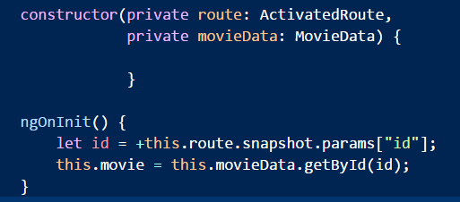
Receive Parameters
Use ActivatedRoute
Snapshot or subscribe

Slide 9


Programmatically Route
Inject a Router and use navigate

Slide 10
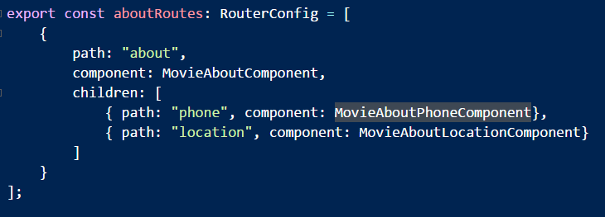
Child Routes
Useful for composite Uis
Dashboards, tree views, nested complexity

Slide 11
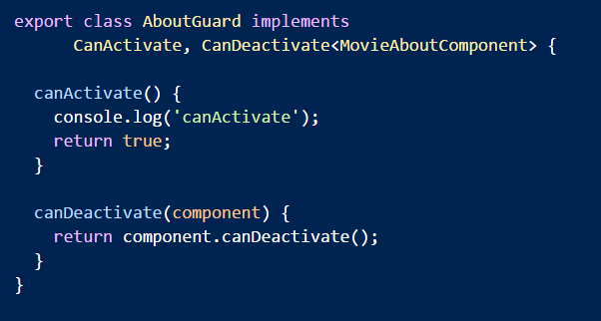
Route Guards
canActivate
canDeactivate

Slide 12
Summary
Routing builds big applications from small pieces
App
Orders
Customers
Reports
CustomerEdit
CustomerDetail

