Slide 1

Hello, Aurelia

Slide 2



Slide 3

Next Gen
Written with ES2016
Integration with Web Components

Slide 4
JavaScript Framework
Aurelia Framework
Application Code
Polyfills

Slide 5




Mobile Desktop and Web

Slide 6
Simple conventions
ViewModel
View
+

Slide 7


Getting Started
Install Node
Install a Git CLI
Getting Started

Slide 8

Install JSPM
More than a package manager
Also includes a runtime
System API polyfill
ES6 module loader
Runtime configuration

Slide 9
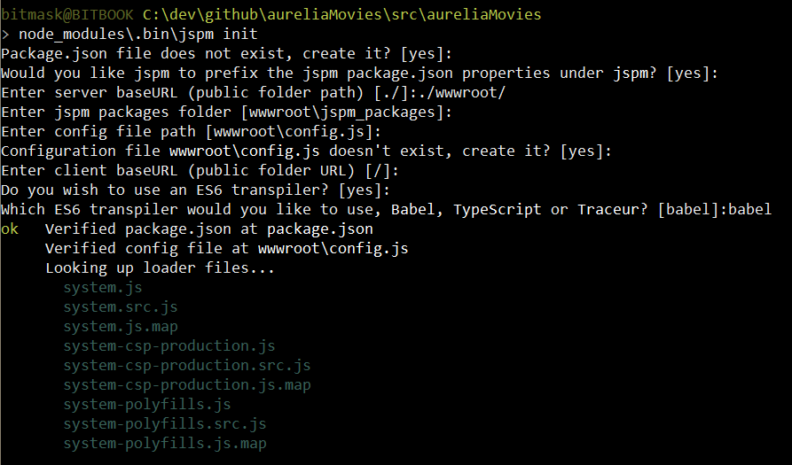
jspm init

Slide 10
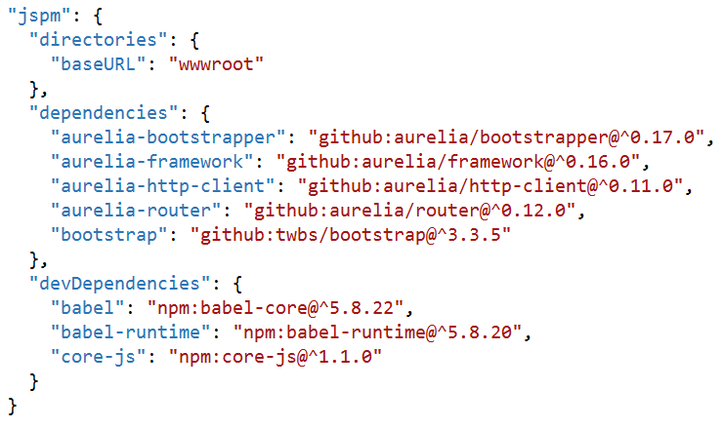
jspm install
Dependencies manages in package.json
You’ll probably want
aurelia-framework
aurelia-bootstrapper
Aurelia-router
aurelia-http-client

Slide 11
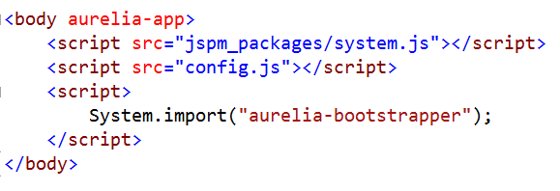
Bootstrap an App
Bring in
SystemJS
Runtime module configuration
Aurelia bootstrapper

Slide 12
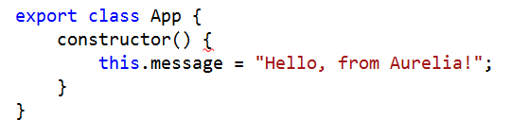
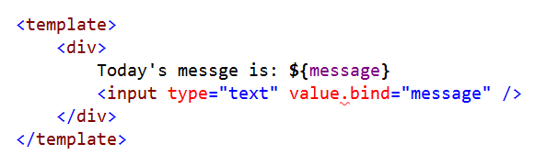
Aurelia Conventions
app.js
+
app.html

Slide 13
What’s Happening?
System loads aurelia-bootstrapper
(with help of config.js)
Aurelia asks System for app module
Module loader imports and transpiles app.js
(with help of Babel, Tracuer, or TypeScript)
Aurelia framework binds app VM to V

Slide 14
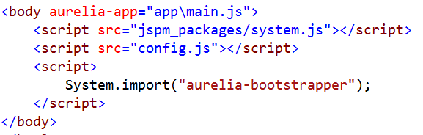
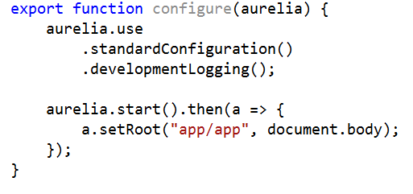
Taking Control
Specify a configure module for aurelia

Slide 15
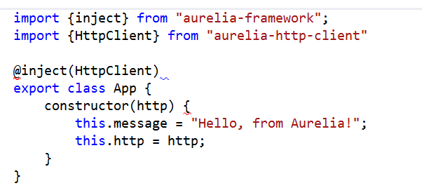
Dependency Injection
Container configured during startup
Can inject using decorators

Slide 16
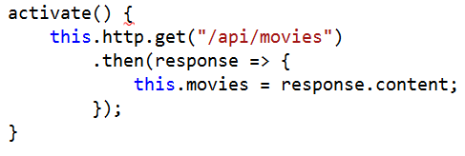
Working with Http Client
Like everything else, HttpClient not required
Supports basic GET, POST, PUT, DELETE with application/json

Slide 17
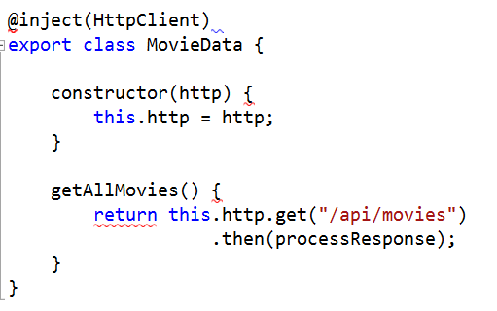
Creating “Services”
Write plain JavaScript and export
Import or inject where needed

Slide 18
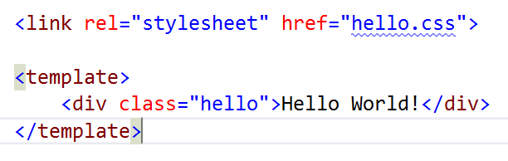
Templating
Uses HTML Import technology

Slide 19


Data Binding
Use .bind anywhere for sensible binding
Also can use .one-way, .two-way, and .one-time

Slide 20
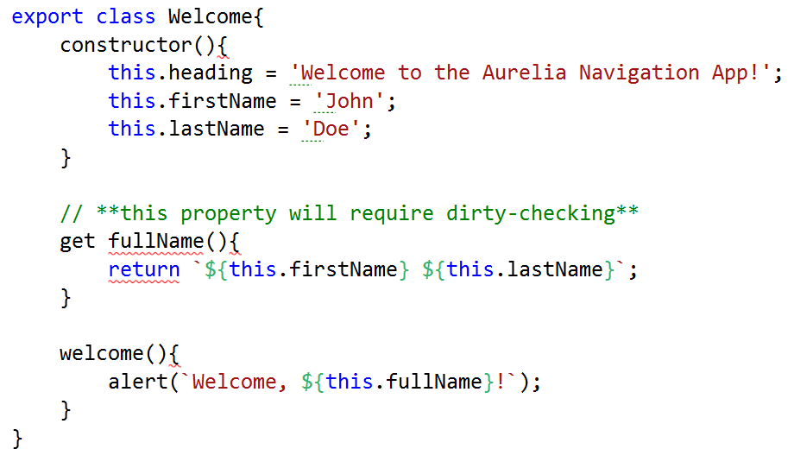
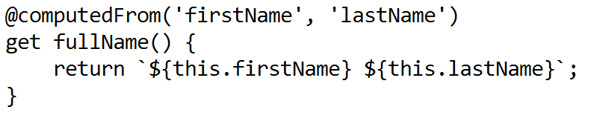
Adaptive Binding
ObserverLocator for data binding
DOM elements (SelectValueObserver, CheckedObserver)
Object.observe, Object.defineProperty

Slide 21
Delegate and Trigger

Slide 22
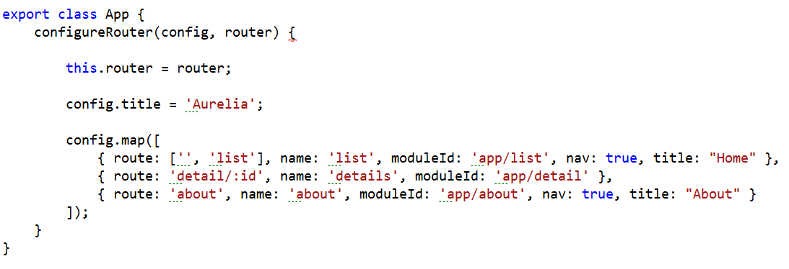
Routing
Router and router-view work together
Routing information is bindable

Slide 23
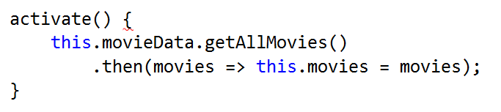
Screen Activation
Use activation lifecycle to control navigation
canActivate
activate
canDeactivate
Deactivate
Return promises to have the router wait…

Slide 24
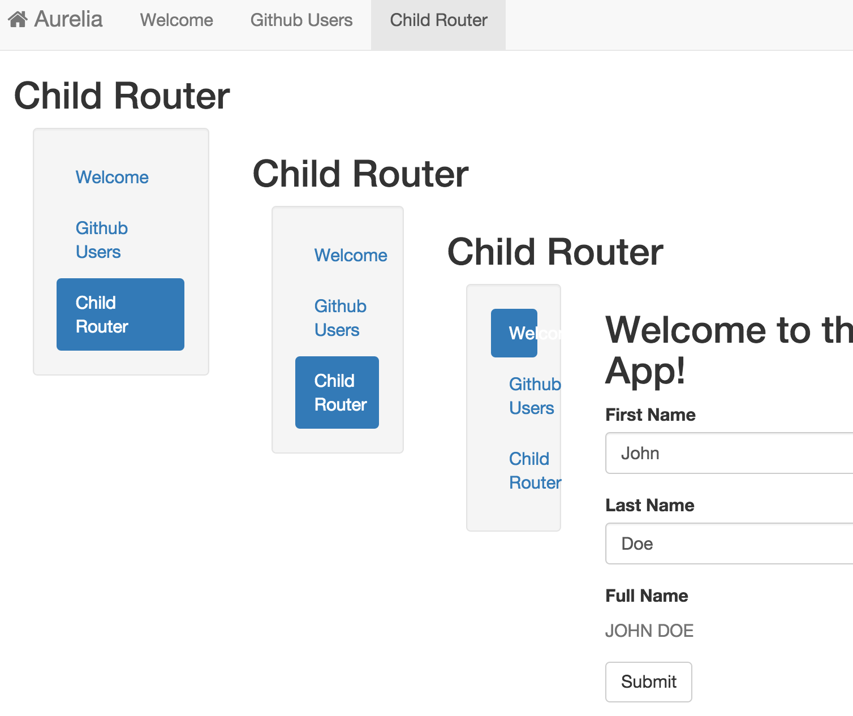
Child Routers
Independent route configuration
Navigate relative to parent

Slide 25
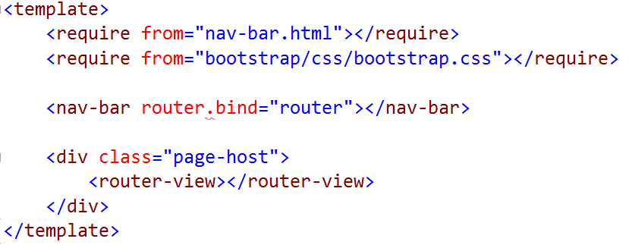
Custom Elements
Follow the View <-> View Model conventions

Slide 26
Summary
Aurelia – only weeks left till the beta starts!
http://aurelia.io
https://gitter.im/Aurelia/Discuss
Me: scott@OdeToCode.com or @OdeToCode

