Slide 1
ASP.NET 5 Overview
Old patterns on a new framework

Slide 2
ASP.NET 5 Workshop
Scott Allen (scott@OdeToCode.com)
Agenda
Overview
Middleware
Configuration and Services
Controllers
Models and Views
Security
NodeJS Tools
Deployment and DNU
Schedule
9:00-17:00 Workshop
12:00-13:00 Lunch
15:00-15:30 Coffee Break

Slide 3

The 15 Year Reboot
Major architectural changes
No more System.Web.dll
Cross Platform
Windows, OS/X, Linux
Unified programming model
One framework for UI and APIs
Faster, lighter, and pay as you go
Customize the processing pipeline

Slide 4
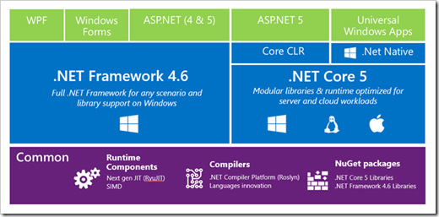
.NET 2015

Slide 5
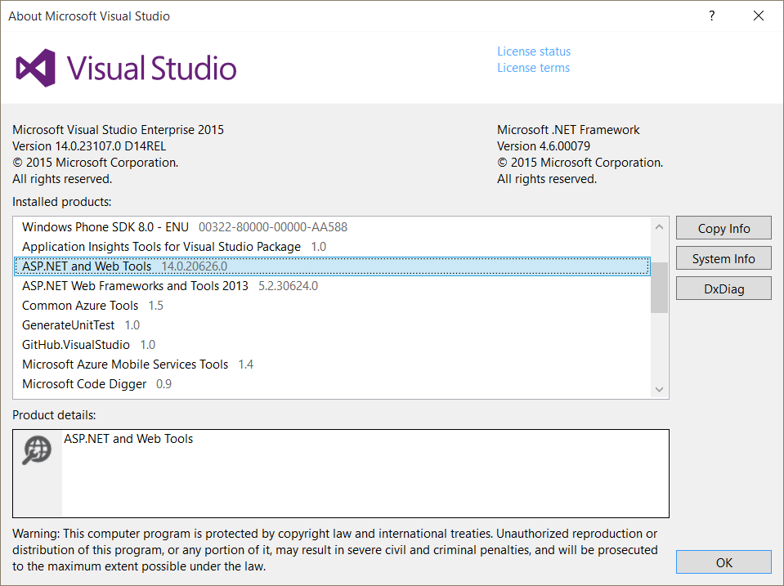
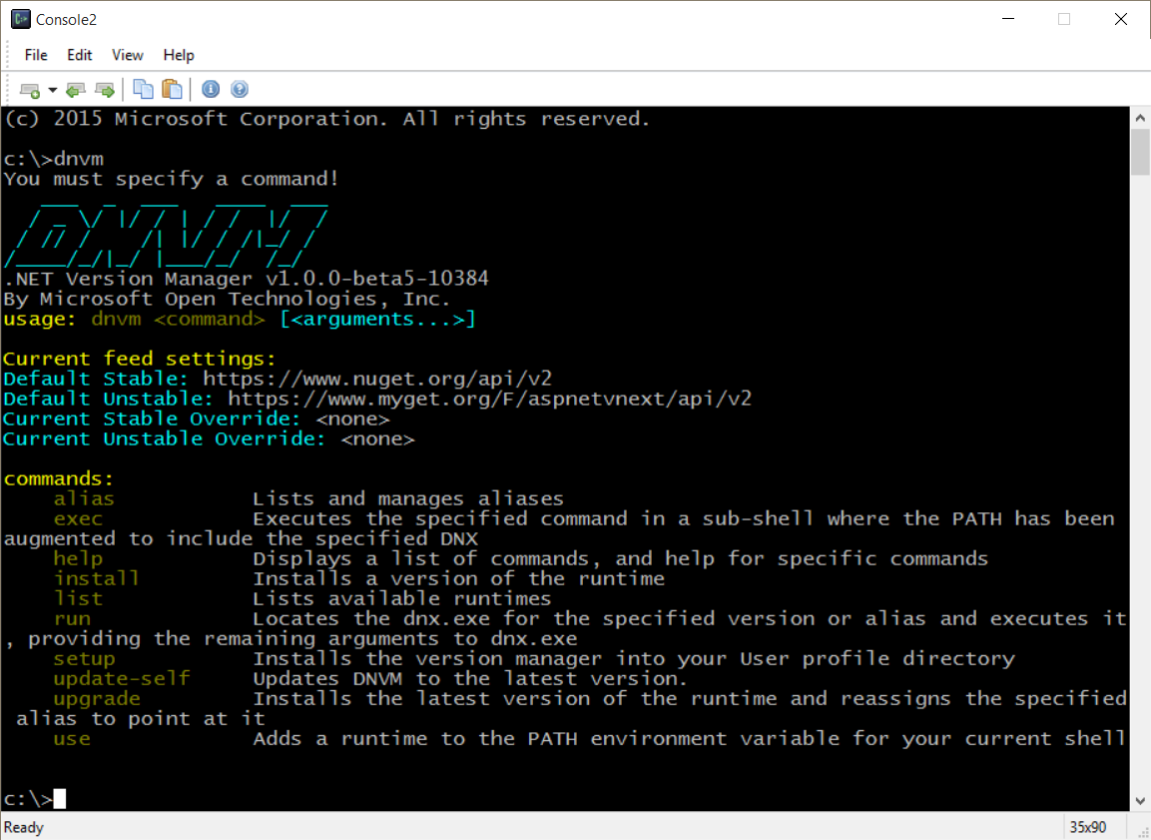
Getting Started
Install with Visual Studio 2015
Install using the .NET Version Manager (dnvm)

Slide 6
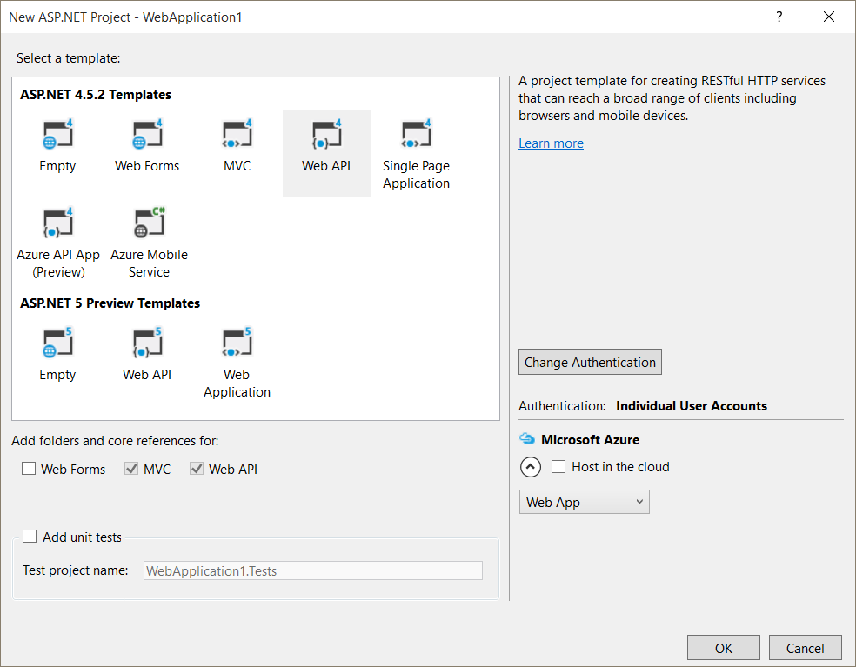
Creating a Web App
Visual Studio offers ASP.NET 5 templates

Slide 7
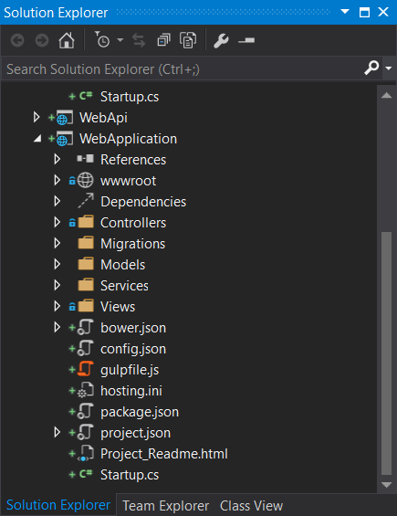
The .xproj file
.xproj file for Visual Studio
No individual files
No assembly references
Enabled tooling, building
File system dictates project contents

Slide 8
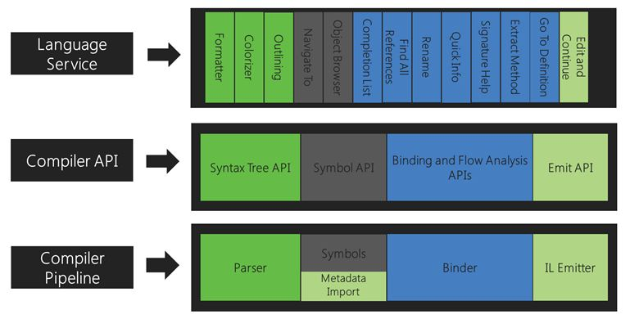
Dynamic Compilation
Roslyn builds assemblies in memory

Slide 9
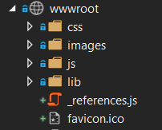
The wwwroot folder
Web site is rooted in wwwroot
Static assets must live in wwwroot
Name is configurable in project.json

Slide 10
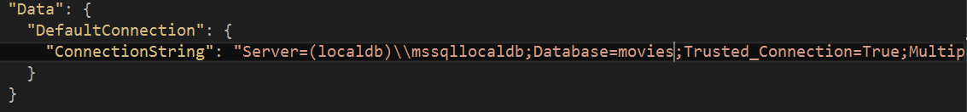
The config.json file
Runtime configuration options include:
JSON files
INI files
Environment variables

Slide 11
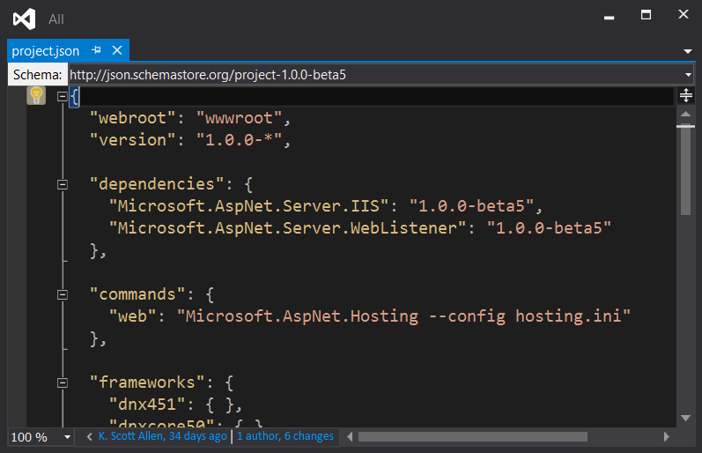
The project.json
project.json is the heart of the project
Defines dependencies (references)
Defines framework
Defines the “build”

Slide 12
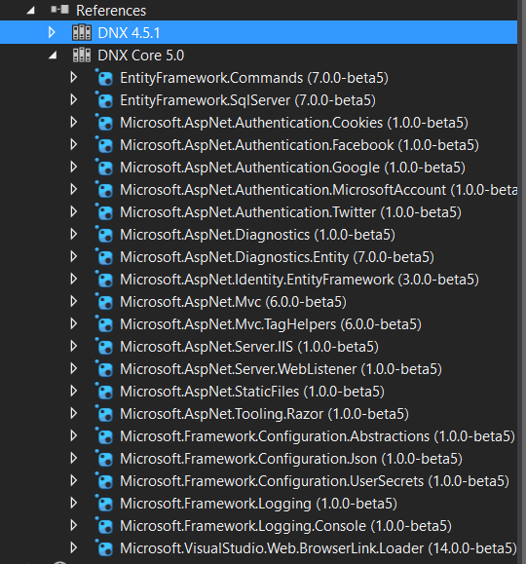
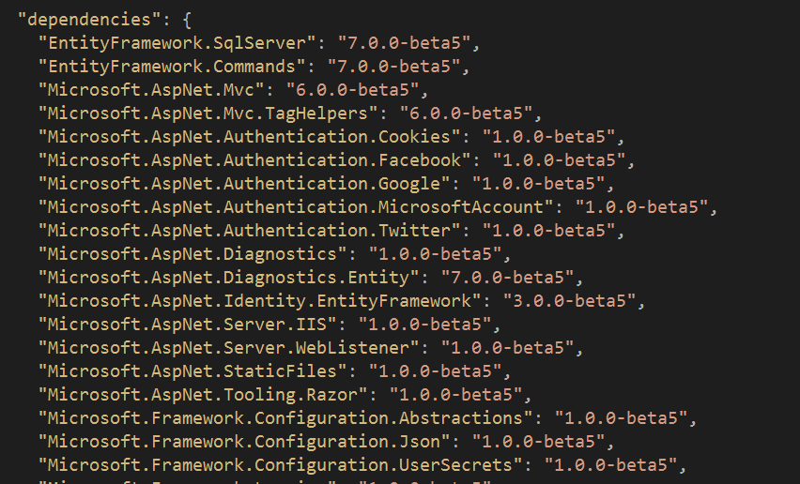
Dependencies
Everything in NuGet

Slide 13
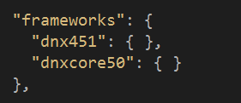

The Runtimes
Full CLR versus the Core CLR
Build against 2 frameworks

Slide 14
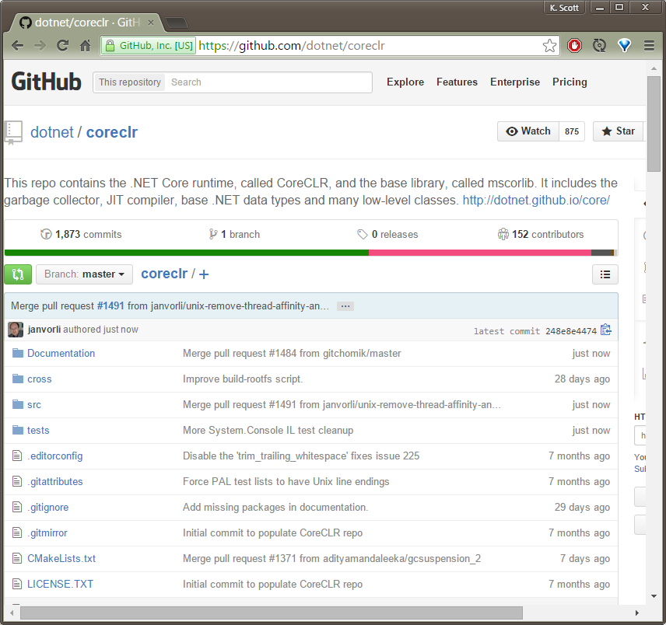
Core CLR
Cross platform
Subset of full CLR

Slide 15
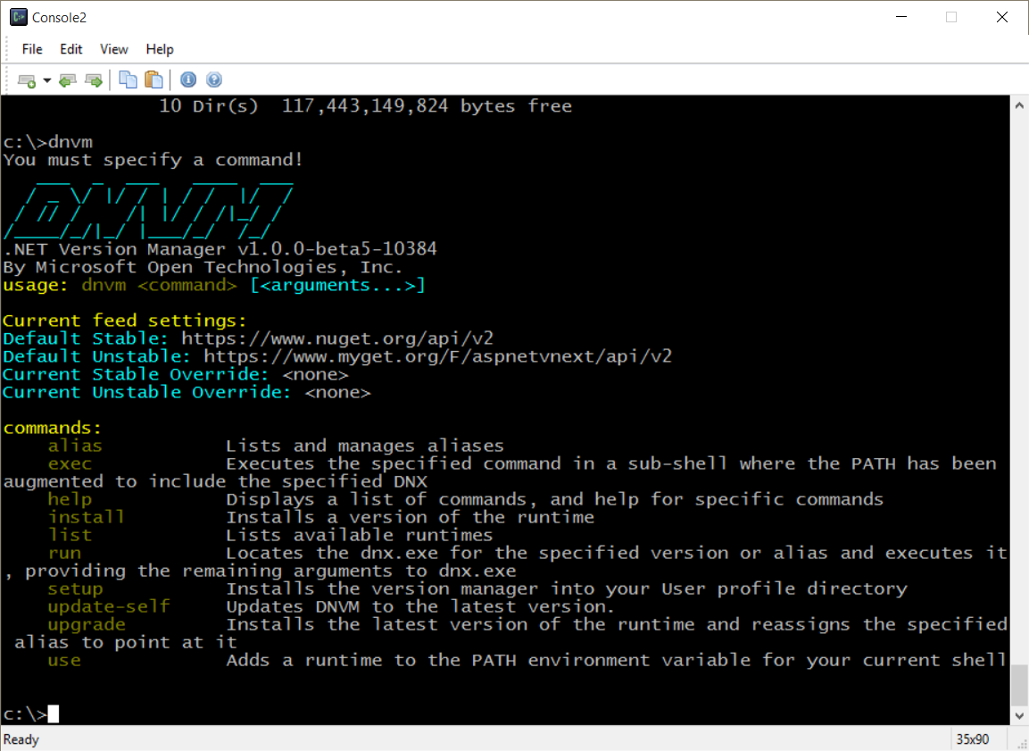
Managing .NET
DNVM - .NET Version Manager
Set default execution environment

Slide 16
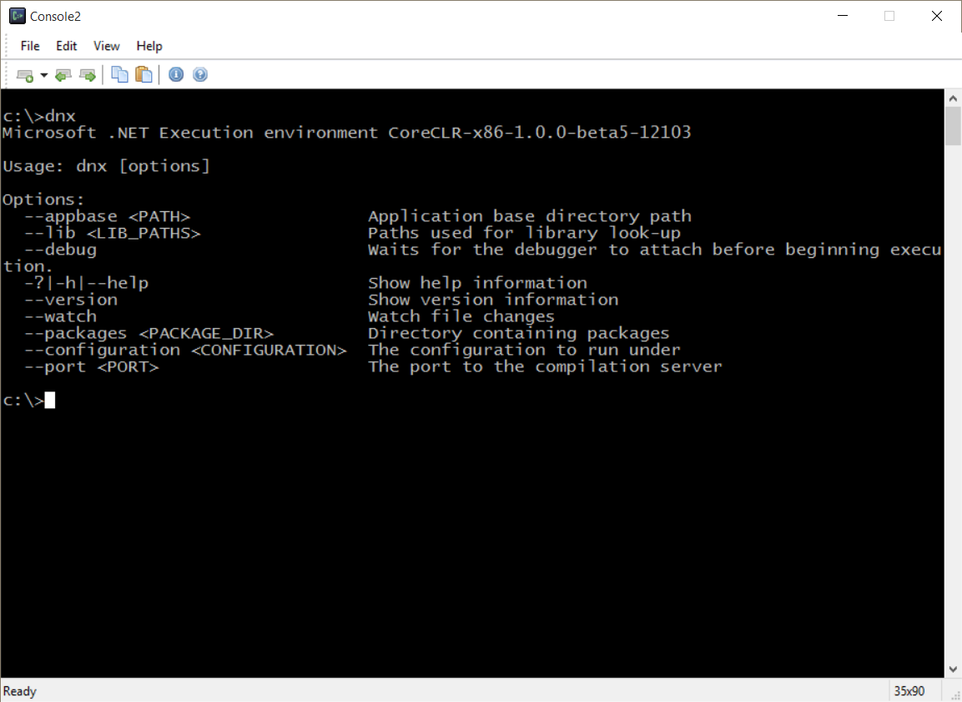
Executing .NET
DNX - .NET Execution Environment
Cross platform
Host for CLR and Core CLR

Slide 17
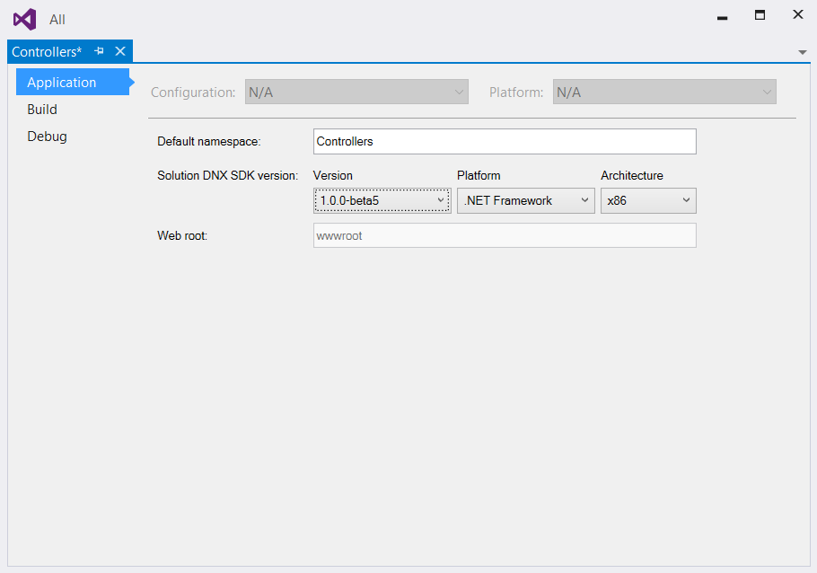
Managing Runtimes From VS

Slide 18
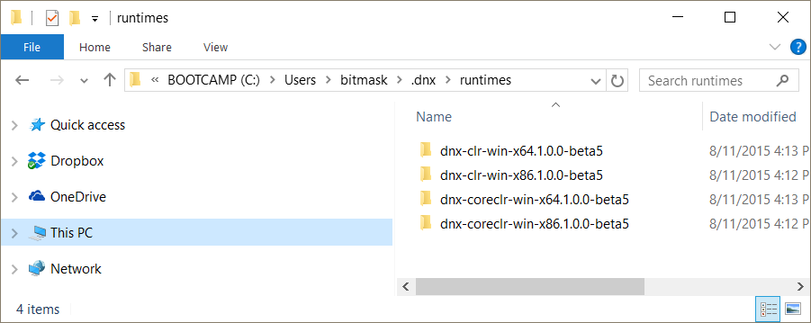
Locations
Look in ~/.dnx

Slide 19
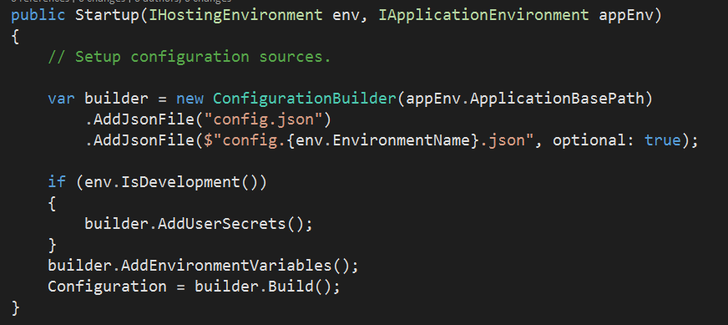
Startup
Entry point for web application
Configure the configuration
Configure the HTTP processing pipeline
Configure services and container

Slide 20
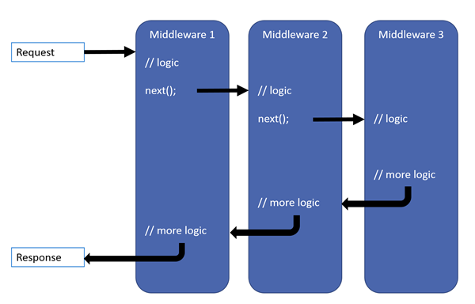
Middleware
Middleware is the HTTP processing pipeline
Based on OWIN

Slide 21
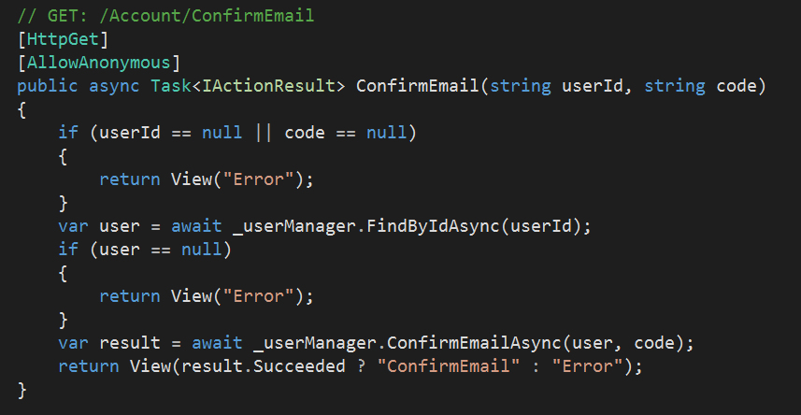
MVC Framework
Includes both HTML and API features

Slide 22
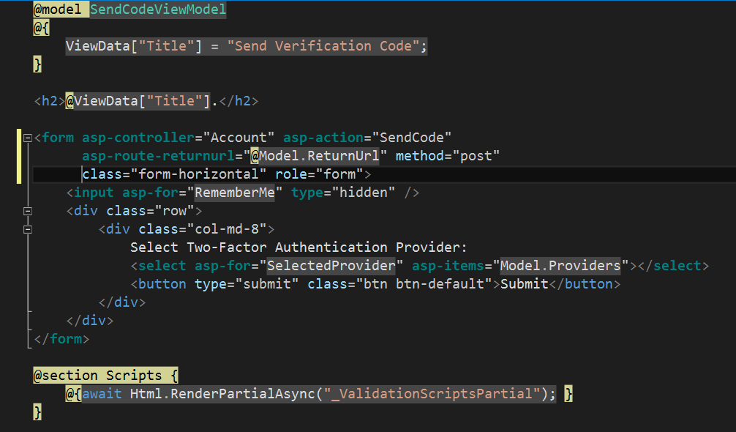
Razor Views

Slide 23
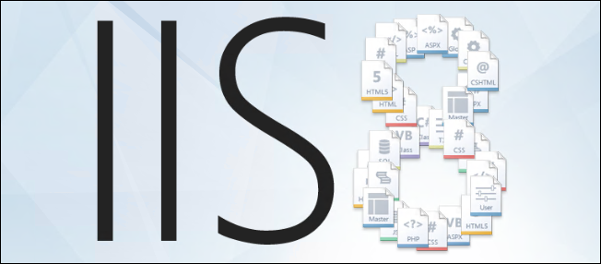
Hosting
IIS / IIS Express
http.sys
Kestrel

Slide 24
Summary
ASP.NET MVC
Middleware

