Slide 1
ABC:010:2
ABC:110:6
CBA:010:2
CBA:011:3
2
3
1
2
ABC:011:3
ABC:100:4
3
1
4
6
CBA:110:6
CBA:001:1
5
4
6
5
ABC:001:1
ABC:101:5
CBA:100:4
CBA:101:5

Slide 2



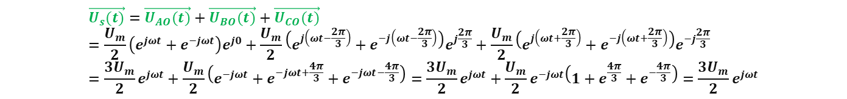
SVPWM Method 2
Vector Calculation Sector 1
$U_{AO}(t)=U_{m}cos\left(θ\right)=$ $U_{m}cos\left(ωt\right)=\frac{U_{m}}{2}(e^{jωt}+e^{−jωt})$
$$U_{BO}\left(t\right)=U_{m}cos\left(θ−\frac{2π}{3}\right)=U_{m}cos\left(ωt−\frac{2π}{3}\right)=\frac{U_{m}}{2}(e^{j(ωt−\frac{2π}{3})}+e^{−j(ωt−\frac{2π}{3})})$$
$$U_{CO}(t)=U_{m}cos\left(θ+\frac{2π}{3}\right)=U_{m}cos\left(ωt+\frac{2π}{3}\right)=\frac{U_{m}}{2}(e^{j(ωt+\frac{2π}{3})}+e^{−j(ωt+\frac{2π}{3})})$$
$$\vec{U_{AO}(t)}=U_{AO}(t)e^{j0}$$
$$\vec{U_{BO}(t)}=U_{BO}(t)e^{j\frac{2π}{3}}$$
$$\vec{U_{CO}(t)}=U_{CO}(t)e^{−j\frac{2π}{3}}$$
$$\vec{U_{s}(t)}=\vec{U_{AO}(t)}+\vec{U_{BO}(t)}+\vec{U_{CO}(t)}=\frac{U_{m}}{2}\left(e^{jωt}+e^{−jωt}\right)e^{j0}+\frac{U_{m}}{2}\left(e^{j\left(ωt−\frac{2π}{3}\right)}+e^{−j\left(ωt−\frac{2π}{3}\right)}\right)e^{j\frac{2π}{3}}+\frac{U_{m}}{2}\left(e^{j\left(ωt+\frac{2π}{3}\right)}+e^{−j\left(ωt+\frac{2π}{3}\right)}\right)e^{−j\frac{2π}{3}}=\frac{3U_{m}}{2}e^{jωt}+\frac{U_{m}}{2}\left(e^{−jωt}+e^{−jωt+\frac{4π}{3}}+e^{−jωt−\frac{4π}{3}}\right)=\frac{3U_{m}}{2}e^{jωt}+\frac{U_{m}}{2}e^{−jωt}\left(1+e^{\frac{4π}{3}}+e^{−\frac{4π}{3}}\right)=\frac{3U_{m}}{2}e^{jωt}$$

Slide 3


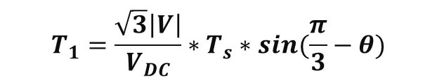


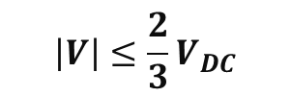
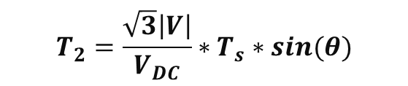

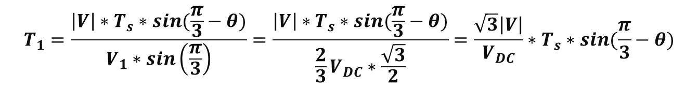



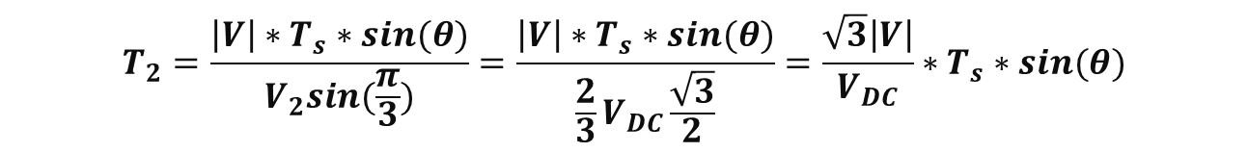



SVPWM Method 1
Vector Calculation Sector 1
$$\vec{V_{2}}$$
$$\left|V\right|≤\frac{2}{3}V_{DC}$$
$$|V|$$
$$\frac{T_{2}}{T_{s}}\vec{V_{2}}$$
$$θ$$
$${60}^{o}$$
$$Im$$
$$\vec{V_{1}}$$
$$\frac{T_{1}}{T_{s}}\vec{V_{1}}$$
$$Re$$
$$V_{1}∗T_{1}∗sin\left(\frac{π}{3}\right)=\left|V\right|∗T_{s}∗sin(\frac{π}{3}−θ)$$
$$T_{1}=\frac{\left|V\right|∗T_{s}∗sin(\frac{π}{3}−θ)}{V_{1}∗sin\left(\frac{π}{3}\right)}=\frac{\left|V\right|∗T_{s}∗sin(\frac{π}{3}−θ)}{\frac{2}{3}V_{DC}∗\frac{\sqrt{3}}{2}}=\frac{\sqrt{3}\left|V\right|}{V_{DC}}∗T_{s}∗sin(\frac{π}{3}−θ)$$
$$T_{1}=\frac{\sqrt{3}\left|V\right|}{V_{DC}}∗T_{s}∗sin(\frac{π}{3}−θ)$$
$$V_{2}∗T_{2}∗sin(\frac{π}{3}) =\left|V\right|∗T_{s}∗sin(θ)$$
$$T_{2}=\frac{\left|V\right|∗T_{s}∗sin(θ)}{V_{2}sin(\frac{π}{3})}=\frac{\left|V\right|∗T_{s}∗sin(θ)}{\frac{2}{3}V_{DC}\frac{\sqrt{3}}{2}}=\frac{\sqrt{3}\left|V\right|}{V_{DC}}∗T_{s}∗sin(θ)$$
$$T_{2}=\frac{\sqrt{3}\left|V\right|}{V_{DC}}∗T_{s}∗sin(θ)$$

Slide 4









Vector Calculation Sector 1
Vector Calculation Sector 2
$$T_{1}=\frac{\sqrt{3}\left|V\right|}{V_{DC}}∗T_{s}∗sin(\frac{π}{3}−θ)$$
$$T_{1}=\frac{\sqrt{3}\left|V\right|}{V_{DC}}∗T_{s}∗sin\left(\frac{π}{3}−\left(θ−\frac{π}{3}\right)\right)=\frac{\sqrt{3}\left|V\right|}{V_{DC}}∗T_{s}∗sin\left(\frac{2π}{3}−θ\right)=\frac{\sqrt{3}\left|V\right|}{V_{DC}}∗T_{s}∗sin\left(π−\frac{π}{3}+θ\right)=−\frac{\sqrt{3}\left|V\right|}{V_{DC}}∗T_{s}∗sin\left(θ−\frac{π}{3}\right)$$
$$T_{2}=\frac{\sqrt{3}\left|V\right|}{V_{DC}}∗T_{s}∗sin(θ−\frac{π}{3})$$
$$T_{2}=\frac{\sqrt{3}\left|V\right|}{V_{DC}}∗T_{s}∗sin(θ)$$
Vector Calculation Sector 3
Vector Calculation Sector 4
$$T_{1}=\frac{\sqrt{3}\left|V\right|}{V_{DC}}∗T_{s}∗sin\left(\frac{π}{3}−\left(θ−\frac{2π}{3}\right)\right)=\frac{\sqrt{3}\left|V\right|}{V_{DC}}∗T_{s}∗sin(π−θ)$$
$$T_{1}=\frac{\sqrt{3}\left|V\right|}{V_{DC}}∗T_{s}∗sin\left(\frac{π}{3}−\left(θ−π\right)\right)=\frac{\sqrt{3}\left|V\right|}{V_{DC}}∗T_{s}∗sin(\frac{4π}{3}−θ)$$
$$T_{2}=\frac{\sqrt{3}\left|V\right|}{V_{DC}}∗T_{s}∗sin(θ−\frac{2π}{3})$$
$$T_{2}=\frac{\sqrt{3}\left|V\right|}{V_{DC}}∗T_{s}∗sin(θ−π)$$
Vector Calculation Sector 5
Vector Calculation Sector 6
$$T_{1}=\frac{\sqrt{3}\left|V\right|}{V_{DC}}∗T_{s}∗sin\left(\frac{π}{3}−\left(θ−\frac{4π}{3}\right)\right)=\frac{\sqrt{3}\left|V\right|}{V_{DC}}∗T_{s}∗sin(\frac{5π}{3}−θ)$$
$$T_{1}=\frac{\sqrt{3}\left|V\right|}{V_{DC}}∗T_{s}∗sin\left(\frac{π}{3}−\left(θ−\frac{5π}{3}\right)\right)=\frac{\sqrt{3}\left|V\right|}{V_{DC}}∗T_{s}∗sin\left(2π−θ\right)=−\frac{\sqrt{3}\left|V\right|}{V_{DC}}∗T_{s}∗sin(θ)$$
$$T_{2}=\frac{\sqrt{3}\left|V\right|}{V_{DC}}∗T_{s}∗sin(θ−\frac{4π}{3})$$
$$T_{2}=\frac{\sqrt{3}\left|V\right|}{V_{DC}}∗T_{s}∗sin\left(θ−\frac{5π}{3}\right)=\frac{\sqrt{3}\left|V\right|}{V_{DC}}∗T_{s}∗sin\left(θ−2π+\frac{π}{3}\right)=\frac{\sqrt{3}\left|V\right|}{V_{DC}}∗T_{s}∗sin(θ+\frac{π}{3})$$

Slide 5





Vector Calculation Sector 1
Vector Calculation Sector 2
$$sin\left(π+θ\right)=−sin\left(θ\right)$$
$$sin\left(π−θ\right)=sin\left(θ\right)$$
$$T_{1}=\frac{\sqrt{3}\left|V\right|}{V_{DC}}∗T_{s}∗sin\left(\frac{π}{3}−θ\right)=−\frac{\sqrt{3}\left|V\right|}{V_{DC}}∗T_{s}∗sin(θ−\frac{π}{3})$$
$$T_{1}=\frac{\sqrt{3}\left|V\right|}{V_{DC}}∗T_{s}∗sin\left(\frac{π}{3}−\left(θ−\frac{π}{3}\right)\right)=\frac{\sqrt{3}\left|V\right|}{V_{DC}}∗T_{s}∗sin\left(\frac{2π}{3}−θ\right)=\frac{\sqrt{3}\left|V\right|}{V_{DC}}∗T_{s}∗sin\left(π−θ−\frac{π}{3}\right)=\frac{\sqrt{3}\left|V\right|}{V_{DC}}∗T_{s}∗sin\left(θ+\frac{π}{3}\right)$$
$$T_{2}=\frac{\sqrt{3}\left|V\right|}{V_{DC}}∗T_{s}∗sin(θ)$$
$$T_{2}=\frac{\sqrt{3}\left|V\right|}{V_{DC}}∗T_{s}∗sin(θ−\frac{π}{3})$$
Vector Calculation Sector 3
$$T_{1}=\frac{\sqrt{3}\left|V\right|}{V_{DC}}∗T_{s}∗sin\left(\frac{π}{3}−\left(θ−\frac{2π}{3}\right)\right)=\frac{\sqrt{3}\left|V\right|}{V_{DC}}∗T_{s}∗sin\left(π−θ\right)=\frac{\sqrt{3}\left|V\right|}{V_{DC}}∗T_{s}∗sin\left(θ\right)$$
$$T_{2}=\frac{\sqrt{3}\left|V\right|}{V_{DC}}∗T_{s}∗sin\left(θ−\frac{2π}{3}\right)=\frac{\sqrt{3}\left|V\right|}{V_{DC}}∗T_{s}∗sin\left(θ+\frac{π}{3}−π\right)=−\frac{\sqrt{3}\left|V\right|}{V_{DC}}∗T_{s}∗sin\left(π−θ−\frac{π}{3}\right)=−\frac{\sqrt{3}\left|V\right|}{V_{DC}}∗T_{s}∗sin\left(θ+\frac{π}{3}\right)$$
Vector Calculation Sector 4
$$T_{1}=\frac{\sqrt{3}\left|V\right|}{V_{DC}}∗T_{s}∗sin\left(\frac{π}{3}−\left(θ−π\right)\right)=\frac{\sqrt{3}\left|V\right|}{V_{DC}}∗T_{s}∗sin\left(\frac{π}{3}−θ+π\right)=−\frac{\sqrt{3}\left|V\right|}{V_{DC}}∗T_{s}∗sin\left(\frac{π}{3}−θ\right)=\frac{\sqrt{3}\left|V\right|}{V_{DC}}∗T_{s}∗sin(θ−\frac{π}{3})$$
$$T_{2}=\frac{\sqrt{3}\left|V\right|}{V_{DC}}∗T_{s}∗sin\left(θ−π\right)=−\frac{\sqrt{3}\left|V\right|}{V_{DC}}∗T_{s}∗sin\left(π−θ\right)=−\frac{\sqrt{3}\left|V\right|}{V_{DC}}∗T_{s}∗sin(θ)$$
Vector Calculation Sector 5
$$T_{1}=\frac{\sqrt{3}\left|V\right|}{V_{DC}}∗T_{s}∗sin\left(\frac{π}{3}−\left(θ−\frac{4π}{3}\right)\right)=\frac{\sqrt{3}\left|V\right|}{V_{DC}}∗T_{s}∗sin\left(\frac{5π}{3}−θ\right)=\frac{\sqrt{3}\left|V\right|}{V_{DC}}∗T_{s}∗sin\left(2π−\frac{π}{3}−θ\right)=−\frac{\sqrt{3}\left|V\right|}{V_{DC}}∗T_{s}∗sin(θ+\frac{π}{3})$$
$$T_{2}=\frac{\sqrt{3}\left|V\right|}{V_{DC}}∗T_{s}∗sin\left(θ−\frac{4π}{3}\right)=\frac{\sqrt{3}\left|V\right|}{V_{DC}}∗T_{s}∗sin\left(θ−\frac{π}{3}−π\right)=\frac{\sqrt{3}\left|V\right|}{V_{DC}}∗T_{s}∗sin\left(θ−\frac{π}{3}\right)$$
Vector Calculation Sector 6
$$T_{1}=\frac{\sqrt{3}\left|V\right|}{V_{DC}}∗T_{s}∗sin\left(\frac{π}{3}−\left(θ−\frac{5π}{3}\right)\right)=\frac{\sqrt{3}\left|V\right|}{V_{DC}}∗T_{s}∗sin\left(2π−θ\right)=−\frac{\sqrt{3}\left|V\right|}{V_{DC}}∗T_{s}∗sin(θ)$$
$$T_{2}=\frac{\sqrt{3}\left|V\right|}{V_{DC}}∗T_{s}∗sin\left(θ−\frac{5π}{3}\right)=\frac{\sqrt{3}\left|V\right|}{V_{DC}}∗T_{s}∗sin\left(θ−2π+\frac{π}{3}\right)=\frac{\sqrt{3}\left|V\right|}{V_{DC}}∗T_{s}∗sin(θ+\frac{π}{3})$$

Slide 6

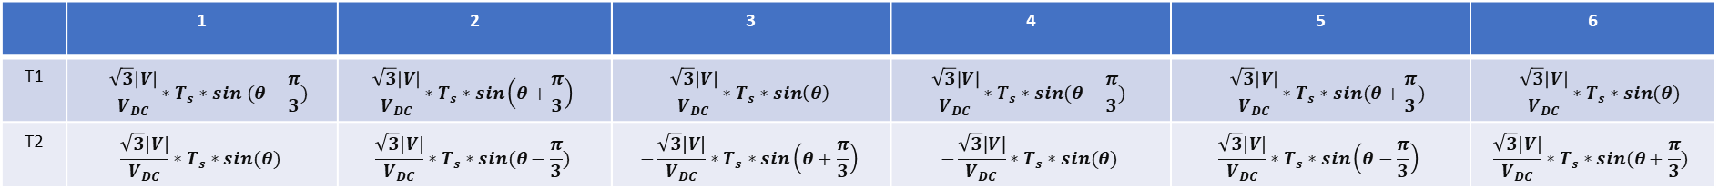
 | 1 | 2 | 3 | 4 | 5 | 6
T1 | $$−\frac{\sqrt{3}\left|V\right|}{V_{DC}}∗T_{s}∗sin (θ−\frac{π}{3})$$ | $$\frac{\sqrt{3}\left|V\right|}{V_{DC}}∗T_{s}∗sin\left(θ+\frac{π}{3}\right)$$ | $$\frac{\sqrt{3}\left|V\right|}{V_{DC}}∗T_{s}∗sin\left(θ\right)$$ | $$\frac{\sqrt{3}\left|V\right|}{V_{DC}}∗T_{s}∗sin(θ−\frac{π}{3})$$ | $$−\frac{\sqrt{3}\left|V\right|}{V_{DC}}∗T_{s}∗sin(θ+\frac{π}{3})$$ | $$−\frac{\sqrt{3}\left|V\right|}{V_{DC}}∗T_{s}∗sin(θ)$$
T2 | $$\frac{\sqrt{3}\left|V\right|}{V_{DC}}∗T_{s}∗sin(θ)$$ | $$\frac{\sqrt{3}\left|V\right|}{V_{DC}}∗T_{s}∗sin(θ−\frac{π}{3})$$ | $$−\frac{\sqrt{3}\left|V\right|}{V_{DC}}∗T_{s}∗sin\left(θ+\frac{π}{3}\right)$$ | $$−\frac{\sqrt{3}\left|V\right|}{V_{DC}}∗T_{s}∗sin(θ)$$ | $$\frac{\sqrt{3}\left|V\right|}{V_{DC}}∗T_{s}∗sin\left(θ−\frac{π}{3}\right)$$ | $$\frac{\sqrt{3}\left|V\right|}{V_{DC}}∗T_{s}∗sin(θ+\frac{π}{3})$$
ABC:010:2
ABC:110:6
$$M=\frac{\sqrt{3}\left|V\right|}{V_{DC}}≤\frac{\sqrt{3}\frac{2}{3}V_{DC}}{V_{DC}}=\frac{2}{\sqrt{3}}=1.154$$
 | 1 | 2 | 3 | 4 | 5 | 6
A | T1 | T0 | T2 | T1 | T0 | T2
B | T0 | T2 | T1 | T0 | T2 | T1
C | T2 | T1 | T0 | T2 | T1 | T0
2
3
1
ABC:011:3
ABC:100:4
4
6
5
ABC:001:1
ABC:101:5

Slide 7


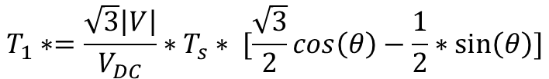



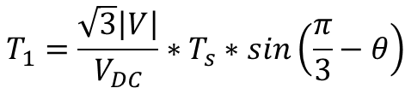

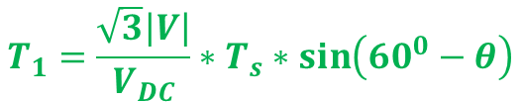





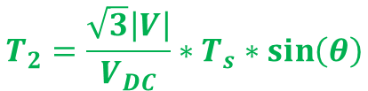

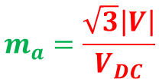
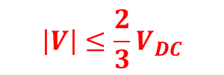
Vector Calculation Sector 1
$$Re:=\left|V\right|∗\cos\left(θ\right)∗T_{s}=T_{1}∗\frac{2}{3}V_{DC}+T_{2}∗\frac{2}{3}V_{DC}∗cos⁡(\frac{π}{3})$$
$$\vec{V_{2}}$$
$$\left|V\right|≤\frac{2}{3}V_{DC}$$
$$Re:=\left|V\right|∗\cos\left(θ\right)∗T_{s}=T_{1}∗\frac{2}{3}V_{DC}+T_{2}∗\frac{1}{3}V_{DC}=T_{1}∗\frac{2}{3}V_{DC}+\frac{Im}{\sqrt{3}}$$
$$Re:=\left|V\right|∗\cos\left(θ\right)∗T_{s}=T_{1}∗\frac{2}{3}V_{DC}+\frac{1}{\sqrt{3}}\left|V\right|∗\sin\left(θ\right)∗T_{s}$$
$$|V|$$
$$\frac{T_{2}}{T_{s}}\vec{V_{2}}$$
$$θ$$
$${60}^{o}$$
$$Im$$
$$T_{1}∗\frac{2}{3}V_{DC}=\left|V\right|∗T_{s}∗[\cos\left(θ\right)−\frac{1}{\sqrt{3}}∗\sin\left(θ\right)]$$
$$\vec{V_{1}}$$
$$\frac{T_{1}}{T_{s}}\vec{V_{1}}$$
$$Re$$
$$T_{1}∗=\frac{\sqrt{3}\left|V\right|}{V_{DC}}∗T_{s}∗ [\frac{\sqrt{3}}{2}cos\left(θ\right)−\frac{1}{2}∗\sin\left(θ\right)]$$
$$Re:=\left|V\right|∗\cos\left(θ\right)∗T_{s}=T_{1}∗V_{1}+T_{2}∗V_{2}∗cos⁡(\frac{π}{3})$$
$$T_{1}=\frac{\sqrt{3}\left|V\right|}{V_{DC}}∗T_{s}∗\sin\left(\frac{π}{3}−θ\right)$$
$$Im:=\left|V\right|∗\sin\left(θ\right)∗T_{s}=T_{2}∗V_{2}∗sin⁡(\frac{π}{3})$$
$$Re:=\left|V\right|∗\cos\left(θ\right)∗T_{s}=T_{1}∗\frac{2}{3}V_{DC}+T_{2}∗\frac{1}{3}V_{DC}$$
$$Im:=\left|V\right|∗\sin\left(θ\right)∗T_{s}=T_{2}∗\frac{2}{3}V_{DC}∗sin⁡(\frac{π}{3})$$
$$Im:=\left|V\right|∗\sin\left(θ\right)∗T_{s}=T_{2}∗\frac{1}{\sqrt{3}}V_{DC}$$
$$Im:=\left|V\right|∗\sin\left(θ\right)∗T_{s}=T_{2}∗\frac{1}{\sqrt{3}}V_{DC}$$
$$T_{1}=\frac{\sqrt{3}\left|V\right|}{V_{DC}}∗T_{s}∗\sin\left({60}^{0}−θ\right)$$
$$m_{a}=\frac{\sqrt{3}\left|V\right|}{V_{DC}}$$
$$T_{2}=\frac{\sqrt{3}\left|V\right|}{V_{DC}}∗T_{s}∗\sin\left(θ\right)$$
$$T_{0}=T_{s}−T_{1}−T_{2}$$

Slide 8







Vector Calculation Sector 2
$$\vec{V_{2}}$$
$$\left|V\right|≤\frac{2}{3}V_{DC}$$
$$\left|V\right|T_{s}∗\left(\sin\left(θ\right)∗\cos\left(\frac{π}{3}\right)+\cos\left(θ\right)∗\sin\left(\frac{π}{3}\right)\right)=2∗T_{1}∗V_{1}∗\sin\left(\frac{π}{3}\right)\cos\left(\frac{π}{3}\right)$$
$$\frac{T_{2}}{T_{s}}\vec{V_{2}}$$
$$|V|$$
$${60}^{o}$$
$$θ$$
$$Im$$
$$\vec{V_{1}}$$
$$Re$$
$$\frac{T_{1}}{T_{s}}\vec{V_{1}}$$
$$Re:=\left|V\right|∗\cos\left(θ\right)∗T_{s}=T_{1}∗V_{1}∗\cos\left(\frac{π}{3}\right)−T_{2}∗V_{2}∗cos⁡(\frac{π}{3})$$
$$Im:=\left|V\right|∗\sin\left(θ\right)∗T_{s}=T_{1}∗V_{1}∗\sin\left(\frac{π}{3}\right)+T_{2}∗V_{2}∗sin⁡(\frac{π}{3})$$
$$Re∗\sin\left(\frac{π}{3}\right):=\left|V\right|∗\cos\left(θ\right)∗T_{s}sin⁡(\frac{π}{3})=T_{1}∗V_{1}∗\cos\left(\frac{π}{3}\right)sin⁡(\frac{π}{3})−T_{2}∗V_{2}∗cos⁡(\frac{π}{3})sin⁡(\frac{π}{3})$$
$$Im∗\cos\left(\frac{π}{3}\right):=\left|V\right|∗\sin\left(θ\right)∗T_{s}\cos\left(\frac{π}{3}\right)=T_{1}∗V_{1}∗\sin\left(\frac{π}{3}\right)\cos\left(\frac{π}{3}\right)+T_{2}∗V_{2}∗sin⁡(\frac{π}{3})\cos\left(\frac{π}{3}\right)$$
$$\left|V\right|T_{s}∗\left(\sin\left(θ\right)∗\cos\left(\frac{π}{3}\right)+\cos\left(θ\right)∗\sin\left(\frac{π}{3}\right)\right)=2∗T_{1}∗V_{1}∗\sin\left(\frac{π}{3}\right)\cos\left(\frac{π}{3}\right)$$

Slide 9

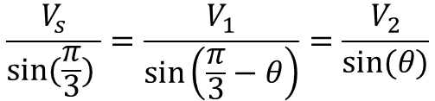

Task List
$$V_{s}\sin\left(θ\right)=V_{2}sin⁡(\frac{π}{3})$$
$$V_{2}\sin\left(\frac{π}{3}−θ\right)=V_{1}sin⁡(θ)$$
$$\frac{V_{s}}{sin⁡(\frac{π}{3}) }=\frac{V_{1}}{\sin\left(\frac{π}{3}−θ\right)}=\frac{V_{2}}{sin⁡(θ)}$$

Slide 10





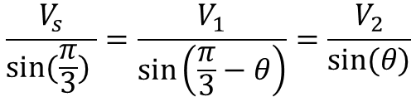






Task List
$$V_{s}\sin\left(θ\right)=V_{2}sin⁡(\frac{π}{3})$$
$$V_{2}\sin\left(\frac{π}{3}−θ\right)=V_{1}sin⁡(θ)$$
$$q$$
$$\frac{V_{s}}{sin⁡(\frac{π}{3}) }=\frac{V_{1}}{\sin\left(\frac{π}{3}−θ\right)}=\frac{V_{2}}{sin⁡(θ)}$$
$$β$$
$$I_{s}$$
$$I_{d}$$
$$φ_{pm}$$
$$d$$
$$ω_{m}$$
$$I_{q}$$
$$α$$

Slide 11






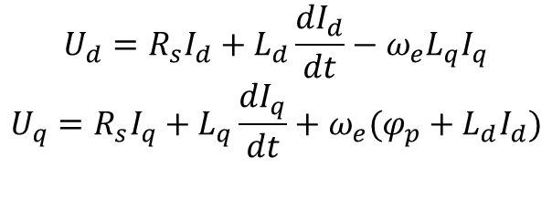





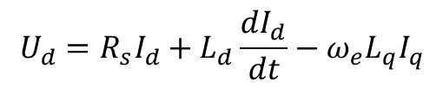


Task List
$$Voltage$$
$$Steady state$$
$$U_{d}=R_{s}I_{d}+L_{d}\frac{dI_{d}}{dt}−ω_{e}L_{q}I_{q}$$
$$U_{d}=R_{s}I_{d}−ω_{e}L_{q}I_{q}$$
$$U_{q}=R_{s}I_{q}+L_{q}\frac{dI_{q}}{dt}+ω_{e}(φ_{p}+L_{d}I_{d})$$
$$U_{q}=R_{s}I_{q}+ω_{e}(φ_{p}+L_{d}I_{d})$$
$$Power$$
$$P_{d}=R_{s}I_{d}−ω_{e}L_{q}I_{q}$$
$${{P_{t}=R_{s}I_{s}^{2}+ω_{e}(φ}_{e}I}_{q}+\left(L_{d}−L_{q}\right)I_{d}I_{q}$$
$$U_{q}=R_{s}I_{q}+ω_{e}(φ_{p}+L_{d}I_{d})$$
${{Q_{t}=\frac{3}{2}ω_{e}(φ}_{e}I}_{d}+L_{q}I_{d}^{2}+L_{d}I_{q}^{2}$)
$$Torque$$
$$U_{d}=R_{s}I_{d}+L_{d}\frac{{dI}_{d}}{dt}−ω_{e}L_{q}I_{q}$$
$$U_{q}=R_{s}I_{q}+L_{q}\frac{{dI}_{q}}{dt}+ω_{e}(φ_{p}+L_{d}I_{d})$$
$T_{e}={\frac{3}{2}p[φ_{p}I}_{q}+(L_{d}−L_{q}){ I}_{d}{ I}_{q}$]
$$MTPA$$
$${{\left(L_{d}−L_{q}\right)I_{d}^{2}+φ}_{p}I}_{d}−\left(L_{d}−L_{q}\right)I_{q}^{2}=0$$

Slide 12



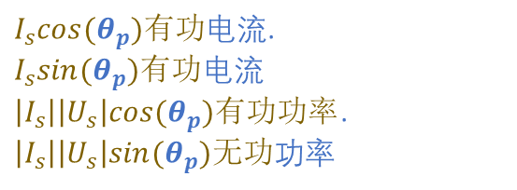





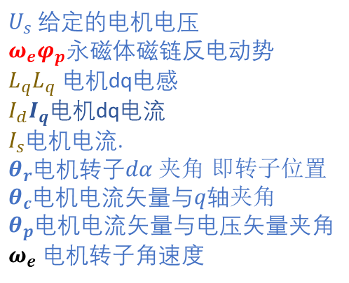






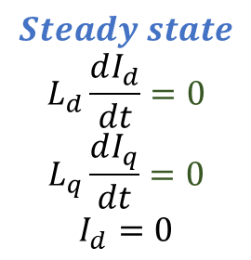




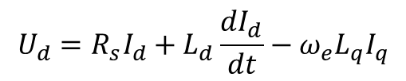



Current Direction $I_{d}=0 I_{q}>0$
$$U_{d}=R_{s}I_{d}+L_{d}\frac{dI_{d}}{dt}−ω_{e}L_{q}I_{q}$$
$$U_{q}=R_{s}I_{q}+L_{q}\frac{dI_{q}}{dt}+ω_{e}(φ_{p}+L_{d}I_{d})$$
$$ω_{e}L_{q}I_{q}$$
$$q$$
$U_{s}$ 给定的电机电压
$ω_{e}φ_{p}$永磁体磁链反电动势
$L_{q}L_{q}$ 电机dq电感
$I_{d}I_{q}$电机dq电流
$I_{s}$电机电流.
$θ_{r}$电机转子$dα 夹角$ 即转子位置
$θ_{c}$电机电流矢量与$q轴夹角$
$θ_{p}$电机电流矢量与电压矢量夹角
$ω_{e}$ 电机转子角速度
$$Steady state$$
$$L_{d}\frac{dI_{d}}{dt}=0$$
$$L_{q}\frac{dI_{q}}{dt}=0$$
$$I_{d}=0$$
$$U_{s}$$
$$ω_{e}φ_{p}$$
$$U_{q}$$
$$U_{d}=ω_{e}L_{q}I_{q}$$
$$β$$
$$R_{s}I_{q}$$
$$U_{q}=R_{s}I_{q}+ω_{e}φ_{p}$$
$$θ_{p}$$
$$I_{q}$$
$$I_{s}$$
$I_{s}cos⁡(θ_{p})有功$电流.
$I_{s}sin⁡(θ_{p})有功$电流
$\left|I_{s}\right|\left|U_{s}\right|cos⁡(θ_{p})有功功率$.
$\left|I_{s}\right|\left|U_{s}\right|sin⁡(θ_{p})无功$功率
$$φ_{p}$$
$$d$$
$$ω_{e}$$
$$U_{d}$$
$$O$$
$$θ_{r}$$
$$α$$

Slide 13























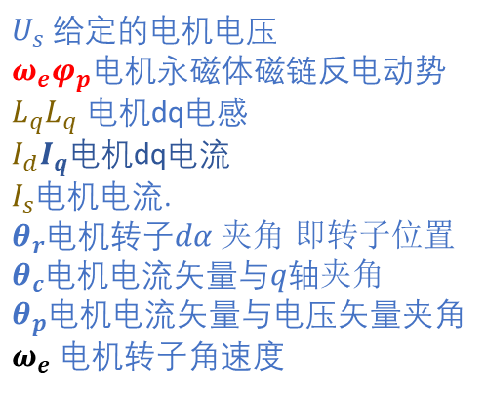
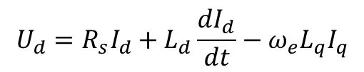





Current Direction $I_{d}≠0I_{q}>0$
$$U_{d}=R_{s}I_{d}+L_{d}\frac{dI_{d}}{dt}−ω_{e}L_{q}I_{q}$$
$$U_{q}=R_{s}I_{q}+L_{q}\frac{dI_{q}}{dt}+ω_{e}(φ_{p}+L_{d}I_{d})$$
$$ω_{e}L_{q}I_{q}$$
$$q$$
$$Steady state$$
$$L_{d}\frac{dI_{d}}{dt}=0$$
$$L_{q}\frac{dI_{q}}{dt}=0$$
$$I_{d}≠0$$
$U_{s}$ 给定的电机电压
$ω_{e}φ_{p}$电机永磁体磁链反电动势
$L_{q}L_{q}$ 电机dq电感
$I_{d}I_{q}$电机dq电流
$I_{s}$电机电流.
$θ_{r}$电机转子$dα 夹角$ 即转子位置
$θ_{c}$电机电流矢量与$q轴夹角$
$θ_{p}$电机电流矢量与电压矢量夹角
$ω_{e}$ 电机转子角速度
$$U_{s}$$
$$ω_{e}φ_{p}$$
$$B$$
$$ω_{e}L_{d}I_{d}$$
$$R_{s}I_{s}$$
$$C$$
$$U_{q}$$
$$β$$
$$U_{d}=R_{s}I_{d}−ω_{e}L_{q}I_{q}$$
$$A$$
$$θ_{p}$$
$$θ_{c}$$
$$U_{q}=R_{s}I_{q}+ω_{e}L_{d}I_{d}+ω_{e}φ_{p}$$
$$I_{s}$$
$$I_{q}$$
$I_{s}cos⁡(θ_{p})有功$电流.
$I_{s}sin⁡(θ_{p})有功$电流
$\left|I_{s}\right|\left|U_{s}\right|cos⁡(θ_{p})有功功率$.
$\left|I_{s}\right|\left|U_{s}\right|sin⁡(θ_{p})无功$功率
$$φ_{p}$$
$$d$$
$$ω_{e}$$
$$U_{d}$$
$$I_{d}$$
$$O$$
$$θ_{r}$$
$$α$$

Slide 14
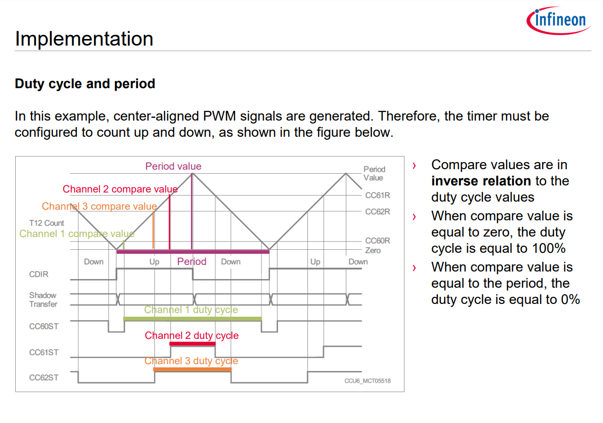

Slide 15
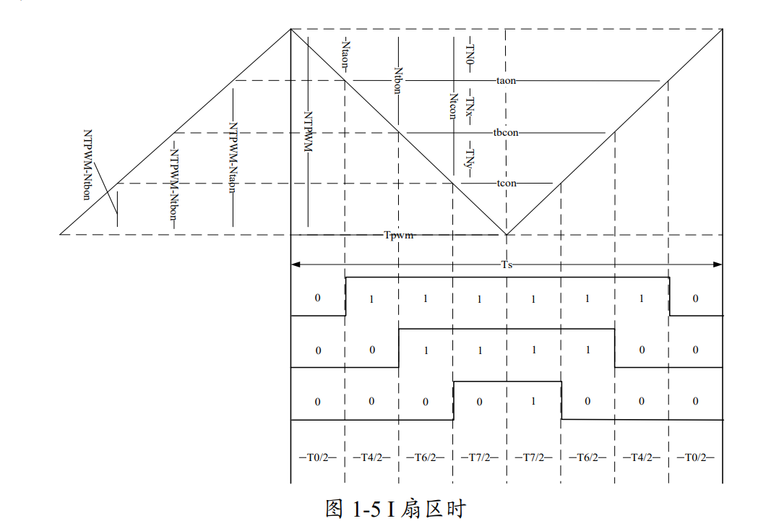

Slide 16





Task List
$$U_{AN}=\frac{2}{3}U_{DC}∗cos⁡(ωt)$$
R=3
sin(60)=sqrt(3)/2
$$U_{BN}=\frac{2}{3}U_{DC}∗cos⁡(ωt−\frac{2}{3}π)$$
Vdc=3
$$U_{CN}=\frac{2}{3}U_{DC}∗cos⁡(ωt+\frac{2}{3}π)$$
$$\vec{U_{S}}=U_{DC}∗e^{j(ωt−\frac{π}{2})}$$
1.299
$$\frac{3}{2}\frac{\sqrt{3}}{2}$$

