Slide 1
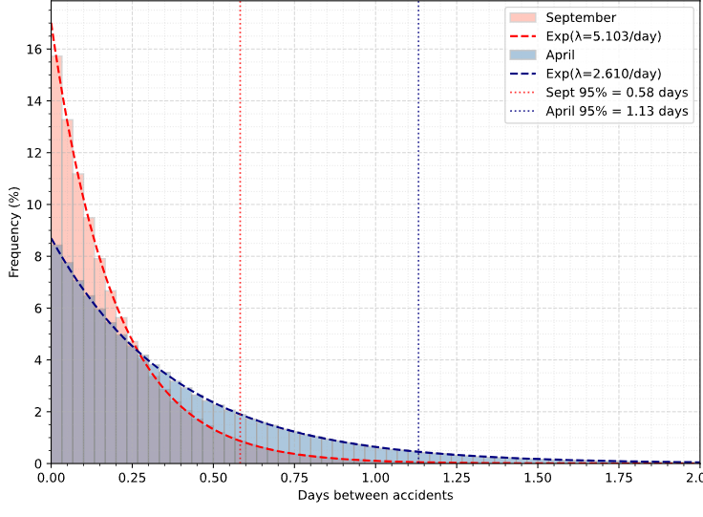
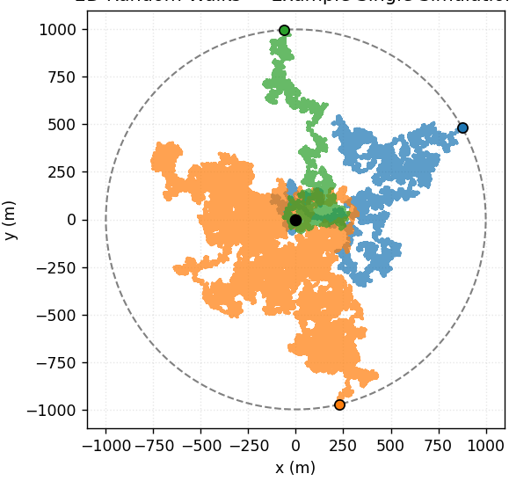
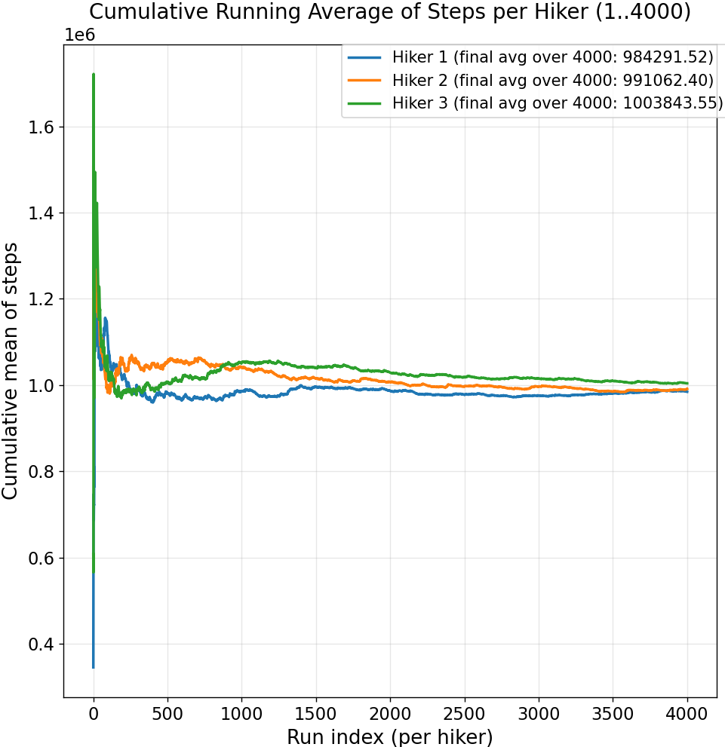
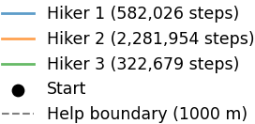
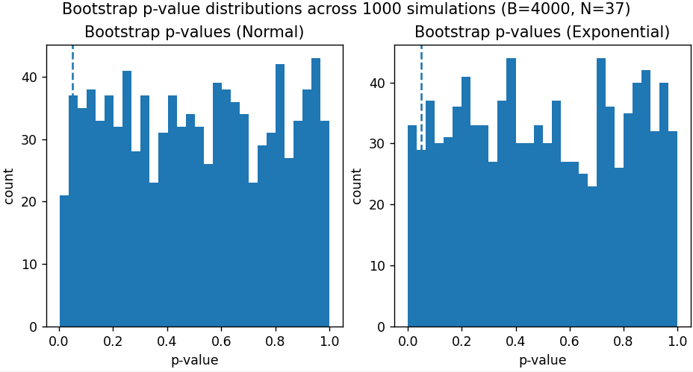
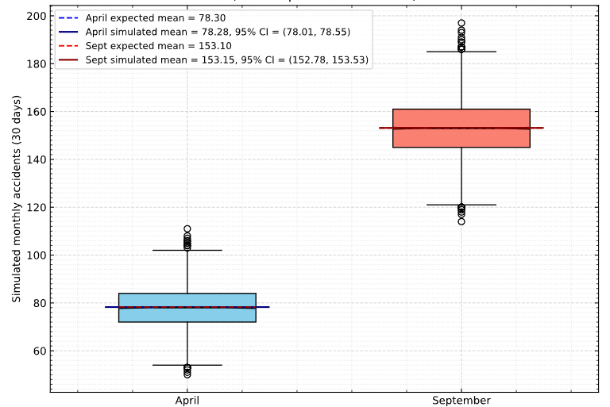
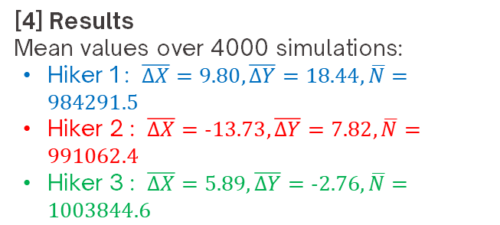

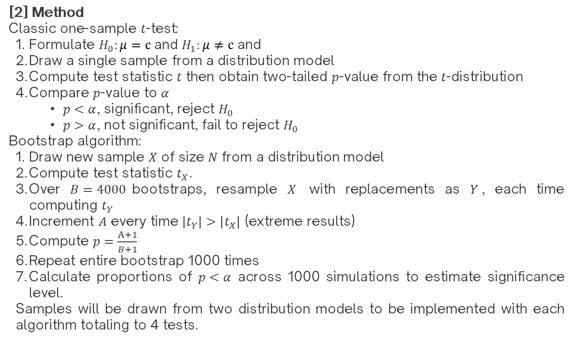
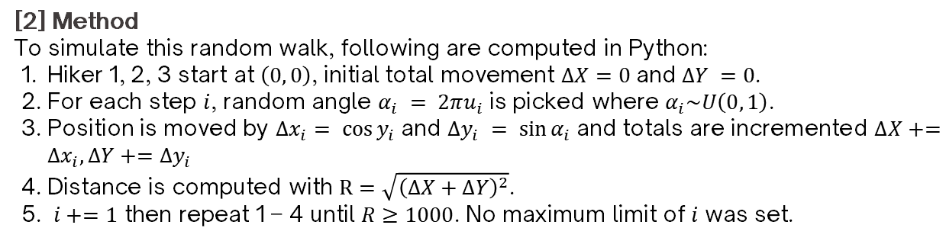
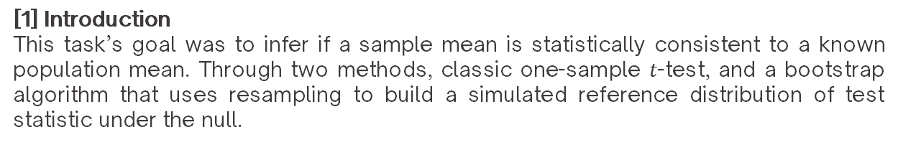

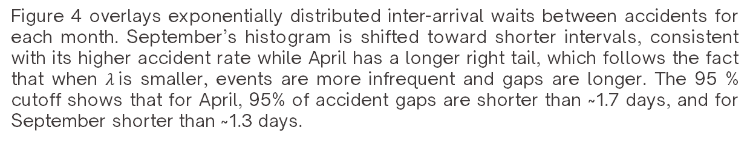
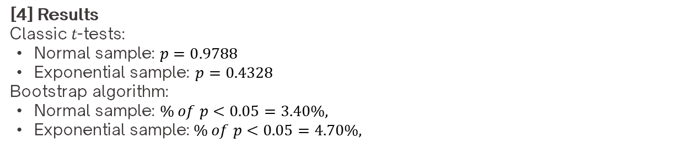
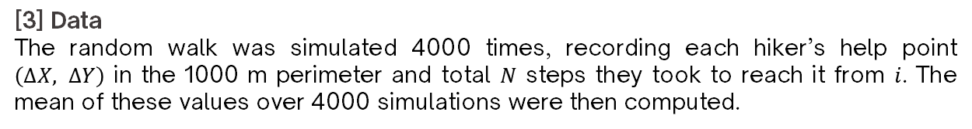
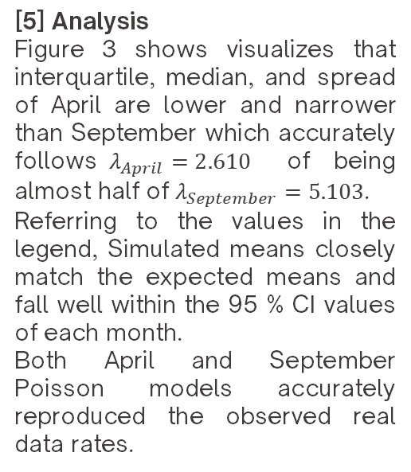
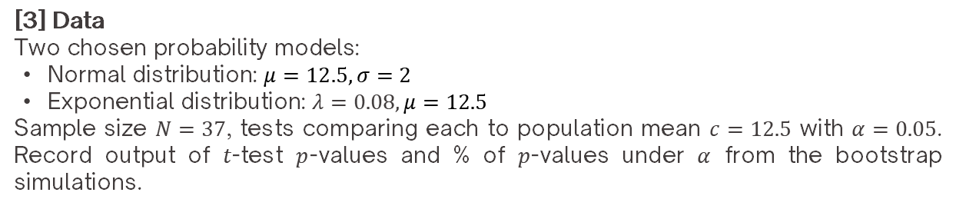
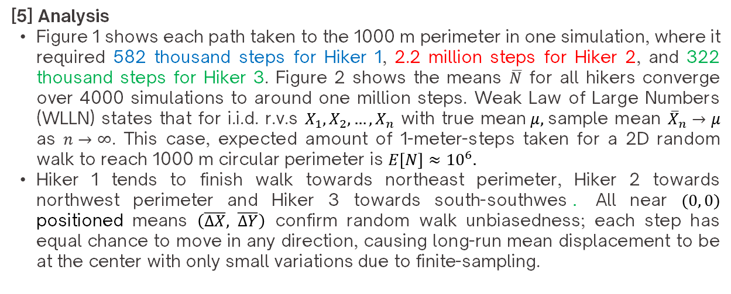
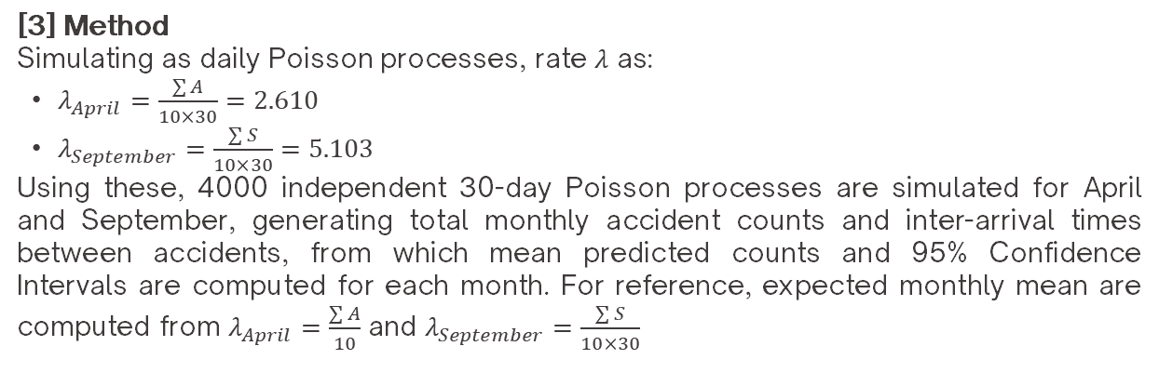
Stochastic Processes and Statistical Inference Simulation & Analysis
Andifallih Noor Malela
  26002304448
I
Lost Hikers Walk Simulation
Figure 4. April vs September Inter-arrival Times Distribution with 95% Cutoff
[5] Analysis
Figure 3 shows visualizes that interquartile, median, and spread of April are lower and narrower than September which accurately follows$λ_{April}=2.610$ of being almost half of $λ_{September}=5.103$.
Referring to the values in the legend, Simulated means closely match the expected means and fall well within the 95 % CI values of each month.
Both April and September Poisson models accurately reproduced the observed real data rates.
[1] Introduction
Three lost hikers are moving in random walk in a 2-dimensional flat terrain forest. Any hiker can get help if they reach the boundary that’s 1000-meter distance away from the same, single starting point in any direction. Each hiker’s walk are independent of one another with each step taken equivalent of 1 meter.
[2] Method
To simulate this random walk, following are computed in Python:
  Hiker 1, 2, 3 start at $\left(0, 0\right)$, initial total movement $ΔX=0$and $ΔY =0$.
  For each step $i$, random angle $α_{i} = 2πu_{i}$ is picked where $α_{i}\sim U\left(0, 1\right)$.
  Position is moved by $∆x_{i}= cos⁡y_{i}$and $∆y_{i} = sin⁡α_{i}$and totals are incremented $∆X+=∆x_{i},∆Y+=∆y_{i}$
  Distance is computed with $R=\sqrt{{\left(∆X+∆Y\right)}^{2}}$.
  $i+=1$ then repeat 1 – 4 until $R≥1000$. No maximum limit of $i$ was set.
[3] Data
The random walk was simulated 4000 times, recording each hiker’s help point $\left(∆X, ∆Y\right)$ in the 1000 m perimeter and total $N$ steps they took to reach it from $i$. The mean of these values over 4000 simulations were then computed.
Figure 4 overlays exponentially distributed inter-arrival waits between accidents for each month. September’s histogram is shifted toward shorter intervals, consistent with its higher accident rate while April has a longer right tail, which follows the fact that when $λ$is smaller, events are more infrequent and gaps are longer. The 95 % cutoff shows that for April, 95% of accident gaps are shorter than ~1.7 days, and for September shorter than ~1.3 days.
[4] Results
Mean values over 4000 simulations:
Hiker 1 : $\overline{ΔX}=9.80,\overline{ΔY}=18.44,\overline{N}=984291.5$
Hiker 2 : $\overline{ΔX}=-13.73,\overline{ΔY}=7.82,\overline{N}=991062.4$
Hiker 3 : $\overline{ΔX}=5.89,\overline{ΔY}=-2.76,\overline{N}=1003844.6$
III
Statistical Inferencing Testing
[1] Introduction
This task’s goal was to infer if a sample mean is statistically consistent to a known population mean. Through two methods, classic one-sample $t$-test, and a bootstrap algorithm that uses resampling to build a simulated reference distribution of test statistic under the null.
[2] Method
Classic one-sample $t$-test:
Formulate $H_{0}:μ=c$and $H_{1}:μ≠c$ and
Draw a single sample from a distribution model
Compute test statistic $t$ then obtain two-tailed $p$-value from the $t$-distribution
Compare $p$-value to $α$
  $p<α$, significant, reject $H_{0}$
  $p>α$, not significant, fail to reject $H_{0}$
Bootstrap algorithm:
Draw new sample $X$ of size $N$ from a distribution model
Compute test statistic $t_{X}$.
Over $B=4000$bootstraps, resample $X$ with replacements as $Y$, each time computing $t_{Y}$
Increment $A$ every time $\left|t_{Y}\right|>\left|t_{X}\right|$ (extreme results)
Compute $p=\frac{A+1}{B+1}$
Repeat entire bootstrap 1000 times
Calculate proportions of $p<α$ across 1000 simulations to estimate significance level.
Samples will be drawn from two distribution models to be implemented with each algorithm totaling to 4 tests.
Figure 1. 3 Hiker’s Simulated Path
Figure 2. Cumulative Running Mean of Steps N
[5] Analysis
Figure 1 shows each path taken to the 1000 m perimeter in one simulation, where it required 582 thousand steps for Hiker 1, 2.2 million steps for Hiker 2, and 322 thousand steps for Hiker 3. Figure 2 shows the means $\overline{N}$ for all hikers converge over 4000 simulations to around one million steps. Weak Law of Large Numbers (WLLN) states that for i.i.d. r.v.s $X_{1},X_{2},…,X_{n}$ with true mean$μ,$sample mean ${\overline{X}}_{n}→μ$ as $n→∞$. This case, expected amount of 1-meter-steps taken for a 2D random walk to reach 1000 m circular perimeter is $E\left[N\right]≈{10}^{6}.$
Hiker 1 tends to finish walk towards northeast perimeter, Hiker 2 towards northwest perimeter and Hiker 3 towards south-southwes$.$ All near $(0, 0)$ positioned means $\left(\overline{ΔX}, \overline{ΔY}\right)$ confirm random walk unbiasedness; each step has equal chance to move in any direction, causing long-run mean displacement to be at the center with only small variations due to finite-sampling.
[3] Data
Two chosen probability models:
Normal distribution: $μ=12.5, σ=2$
Exponential distribution: $λ=0.08,μ=12.5$
Sample size $N=37$, tests comparing each to population mean $c=12.5$ with $α=0.05$. Record output of $t$-test $p$-values and % of $p$-values under $α$ from the bootstrap simulations.
II
Fatal Pedestrian Accidents Occurence Simulation
[4] Results
Classic $t$-tests:
Normal sample: $p=0.9788$
Exponential sample: $p=0.4328$
Bootstrap algorithm:
Normal sample: $\% of p<0.05=3.40\%,$
Exponential sample:$\% of p<0.05=4.70\%,$
[1] Introduction
Real-world data of fatal pedestrian accidents in April and September over 2016 – 2025 in Japan were obtained. The goal is to construct Poisson process that model the accidents accurately utilizing said data.
[2] Data
The 10-year accidents data:
April, $A = [100, 83, 97, 71, 95, 63, 72, 65, 67, 70]$
September, $S = \left[191, 178, 176, 135, 157, 135, 147, 130, 143, 139\right]$
[5] Analysis
For classic $t$-tests, both Normal and Exponential distribution samples show $p<0.05$ meaning we fail to reject $H_{0}$.
For bootstrap algorithm, around 3-5% of 1000 simulations showed $p<0.05$ which is near the expected 5% Type I error under true $H_{0}$. The test using bootstrap algorithm behaves correctly, only rarely rejecting $H_{0}$. The bootstrap attempts to verify the classic $t$-test’s assumptions by showing that repeated random sampling and resampling lead to the same conclusion as the $t$-test.
Figure 5. visualizes $p$-values distribution for samples across 1000 simulations. The dotted vertical lines denote $α=0.05$. Theoretically the histograms should follow $\sim U(0,1)$ to indicate that $p$-values occur equally likely across the range but seems like there is not enough data points that there is a lot of noises and I can’t say surely it followed $\sim U(0,1)$ just from looking. Therefore, I will not draw any conclusion from this graph. From the two methods of t-test and bootstrap algorithm however, it can be safely inferred that for both distributions, we fail to reject $H_{0}$.
[3] Method
Simulating as daily Poisson processes, rate $λ$ as:
$λ_{April}=\frac{\sum{A}}{10×30}=2.610$
$λ_{September}=\frac{\sum{S}}{10×30}=5.103$
Using these, 4000 independent 30-day Poisson processes are simulated for April and September, generating total monthly accident counts and inter-arrival times between accidents, from which mean predicted counts and 95% Confidence Intervals are computed for each month. For reference, expected monthly mean are computed from $λ_{April}=\frac{\sum{A}}{10}$ and $λ_{September}=\frac{\sum{S}}{10×30}$
Figure 5. Frequency of Bootstrap p-values over 1000 simulations
Figure 3. Simulated Total Monthly Accidents with 95% CI and Expected Mean
[4] Results

