Slide 1
Cyclistic Pricing Analysis: Bayesian Analysis
Understanding Rider Behaviour, Revenue Risk, and the Case for a Price Experiment
Notes:
This analysis extends the main Cyclistic analysis by using Bayesian models to quantify uncertainty in rider behaviour and revenue. The goal is to understand how members and casual riders differ, how much revenue casual riders generate, and what happens financially if Cyclistic converts casual riders to members. The key message is that Cyclistic’s pricing challenge lies in the member plan, not the casual rate, and that a controlled price experiment is needed to guide future pricing decisions.

Slide 2
Why This Analysis Exists
This Analysis:
Clarifies uncertainty in rider behaviour
Quantifies revenue risk from membership conversion
Tests pricing assumptions under a Bayesian framework
Highlights the limits of the current dataset
Notes:
The main analysis showed strong behavioural differences between members and casual riders. This addendum goes deeper by quantifying uncertainty. Bayesian modelling lets us express results as probabilities, not just averages. This matters because trip durations and revenues are skewed. The addendum also highlights a key limitation: Cyclistic has no variation in price, so we cannot estimate price elasticity. That limitation shapes the strategic recommendation.

Slide 3
Why Bayesian?
Why Bayesian:
Handles skewed, variable data
Produces full probability distributions
Answers “How certain are we?”
Supports decision‑ready insights
Notes:
Bayesian modelling is ideal for bike‑share data. Trip durations and revenues are not normally distributed; they’re skewed with long tails. A Bayesian approach models the full distribution and gives us credible intervals, not just point estimates. This helps Cyclistic understand the range of plausible outcomes and make decisions with a clearer sense of uncertainty.

Slide 4
Data Preparation
Data Preparation:
Cleaned dataset from main workflow
Recreated engineered features
Built subsets for duration and revenue
Prepared features for future logistic modelling
Notes:
The analysis uses the cleaned dataset from the main workflow. I recreated the engineered features needed for modelling, including trip duration, weekend indicators, and peak‑hour flags. I also built subsets for members and casual riders. The logistic regression features are prepared for future work but not used in this addendum.

Slide 5
Model 1: Trip Duration Differences
Trip Duration Differences:
Log‑normal model for trip durations
Separate means for members and casual riders
Key parameter: difference in log‑means
Notes:
Trip durations are positive and skewed, so I modelled the log of each duration. The model estimates separate mean log‑durations for members and casual riders. The difference between these means tells us how much longer casual riders ride. This is a clean, interpretable way to quantify behavioural differences.

Slide 6
Duration Results
Duration Results:
100% posterior probability casual riders ride longer
Casual trips are 1.42× longer
Typical member trip: 8.7 minutes
Typical casual trip: 12.4 minutes
Notes:
The results are decisive. Every posterior sample shows casual riders taking longer trips. The multiplier is 1.42, with a very tight credible interval. This means casual riders ride about 42% longer. A typical member trip lasts 8.7 minutes; a typical casual trip lasts 12.4 minutes. This aligns with the behavioural story: members ride for commuting; casual riders ride for leisure.

Slide 7
Posterior Predictive Check
Posterior Predictive Check:
Model predictions match observed data
Confirms the log‑normal model fits well
Supports confidence in duration estimates
Notes:
The posterior predictive check compares the model’s predictions with the actual data. The curves align closely, which shows the model captures real behaviour. This gives us confidence that the duration estimates are reliable and grounded in the data.

Slide 8
Model 2: Revenue Modelling
Revenue Modelling:
Log‑normal model for trip revenue
Estimates average revenue per casual trip
Forms basis for conversion analysis
Notes:
Casual revenue is also skewed, so I used a log‑normal model. The goal is to estimate the average revenue Cyclistic earns from a casual trip. This sets the baseline for comparing casual and member revenue and evaluating the financial impact of converting casual riders to members.

Slide 9
Revenue Results
Revenue Results:
Average casual trip revenue: $2.37
Total casual revenue: $7.28M
Under member plan: $1.36M
Revenue loss: $5.9M
Notes:
The model estimates that Cyclistic earns $2.37 per casual trip. Across the dataset, that totals $7.28 million. If those same riders were members, Cyclistic would earn only $1.36 million because most casual trips are under 45 minutes and would be free. The revenue loss would be $5.9 million. This shows that converting casual riders to members under the current plan is financially damaging.

Slide 10
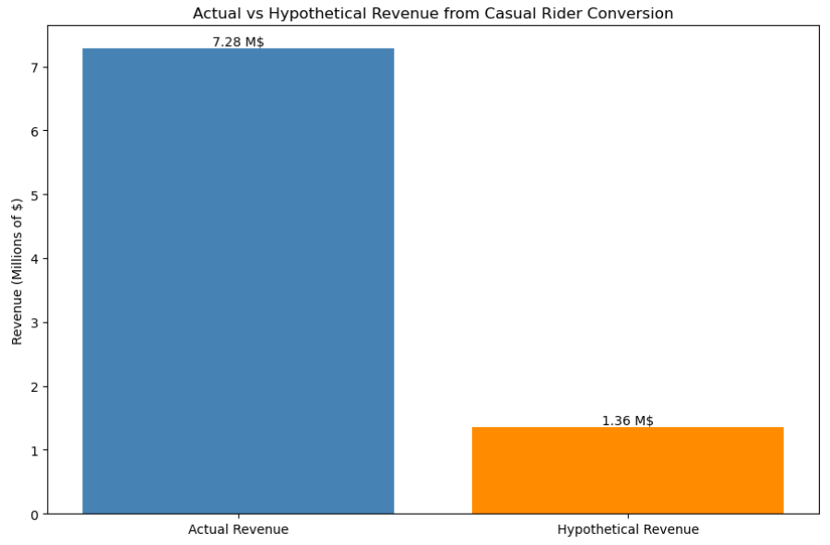
Revenue Comparison Chart
Revenue Comparison Chart:
Visual gap between actual and
hypothetical revenue
Highlights dependence on casual
riders
Shows member plan is underpriced
Notes:
The bar chart makes the revenue gap clear. Cyclistic relies heavily on casual riders for revenue. The member plan is underpriced relative to casual behaviour. This reinforces the conclusion that the pricing challenge lies in the member plan, not the casual rate.

Slide 11
Key Limitation
Key Limitation:
No variation in price in the dataset
Cannot estimate price elasticity
Pricing corridor assumes fixed behaviour
Real riders respond to price changes
Notes:
This is the most important limitation. Cyclistic’s dataset contains no variation in price. Because of that, we cannot estimate elasticity — how riders change their behaviour when prices change. The pricing corridor shows only mechanical revenue under fixed behaviour. Real riders do not behave this way. This limits what we can conclude about optimal pricing.

Slide 12
Future Work: Elasticity Modelling
Price Elasticity:
Need data with price variation
Historical changes, cross‑market data, or experiments
Bayesian elasticity model is the natural next step
Notes:
To understand how riders respond to price changes, Cyclistic needs data that varies in price. This could come from historical changes, comparisons with other markets, or controlled experiments. With such data, we can build a Bayesian elasticity model that estimates how trip frequency, duration, and membership conversion respond to price. This would allow Cyclistic to simulate behavioural responses to new pricing.

Slide 13
Strategic Recommendation
Strategic Recommendation:
Run a controlled price experiment
Test different per‑minute rates
Measure behavioural response
Use results to design optimal pricing
Notes:
The most actionable recommendation is to run a controlled price experiment. Cyclistic could vary prices at selected stations or during specific time windows. Even a small experiment would generate the variation needed to estimate elasticity. This would give Cyclistic the behavioural evidence needed to design a pricing strategy that balances revenue, ridership, and membership growth.

Slide 14
Conclusion
Conclusion:
Members are underpriced
Casual riders generate most revenue
Converting casuals to members reduces revenue
Behavioural uncertainty is the key gap
A price experiment is the next step
Notes:
The Bayesian models clarify Cyclistic’s pricing structure. Members receive far more value than they pay for. Casual riders generate most of the company’s revenue. Converting casual riders to members under the current plan would sharply reduce revenue. The missing piece is behavioural data. A controlled price experiment is the most direct way to gather that data and design a pricing strategy that reflects both financial goals and real‑world behaviour.

