Slide 1
Bellabeat Case Study
Movement Patterns Personas, and Product Opportunities
Exploratory Data Analysis & Behavioral Insights
Notes:
This project looks at how Bellabeat users move throughout the day. I focus on simple questions, clear methods, and evidence‑based insights. The goal is to understand daily and hourly movement patterns, build personas from real behavior, and show how these patterns can guide product ideas

Slide 2
Executive Summary
Daily and hourly movement show clear, repeatable patterns
Four personas emerge with distinct activity rhythms
Hourly profiles reveal morning, midday, and evening tendencies
Sleep data is limited but adds helpful context
Findings support features aligned with routines and time of day
Notes:
The data shows strong, repeatable movement patterns. When we cluster users, four clear personas emerge. Each persona has its own rhythm across the day — morning peaks, midday peaks, or evening peaks. Sleep data is limited, so I use it only for context. The main takeaway is that movement patterns are stable enough to support features tied to time of day and daily routines.

Slide 3
Problem Statement
Bellabeat wants to understand:
How users move throughout the day
What patterns define different types of movers
How these patterns can guide product design
What insights remain reliable despite limited sleep data
Notes:
Bellabeat wants to know how people actually use their devices. When do they move? How much? What patterns separate one type of user from another? And how can these patterns help shape product strategy? Even with limited sleep data, we can still learn a lot about daily habits and movement rhythms.

Slide 4
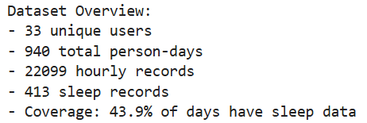
Data Sources
Daily activity summaries
Hourly step data
Sleep logs (limited coverage)
31 users, one month of data (2016)
Notes:
The dataset includes daily activity summaries, hourly step counts, and a small amount of sleep data. It covers 31 users over one month. The sample is small and not representative, but it’s enough to study patterns and build personas. The sleep data is especially thin, so I treat it as context rather than a core part of the analysis.

Slide 5
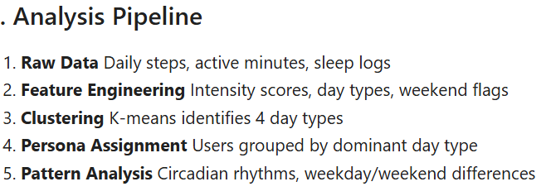
Methodology Overview
Clean and standardize data
Run statistical checks on distributions and outliers
Build features for movement intensity
Cluster users with K‑Means
Study daily, hourly, and weekday/weekend patterns
Use sleep data for context, not conclusions
Notes:
I start by cleaning and standardizing the data. Then I check distributions, outliers, and correlations. I build features that capture movement intensity. I use K‑Means to cluster users into personas. After that, I study daily patterns, hourly rhythms, and weekday/weekend differences. Sleep data is used only to add context. The goal is a simple, transparent workflow.

Slide 6
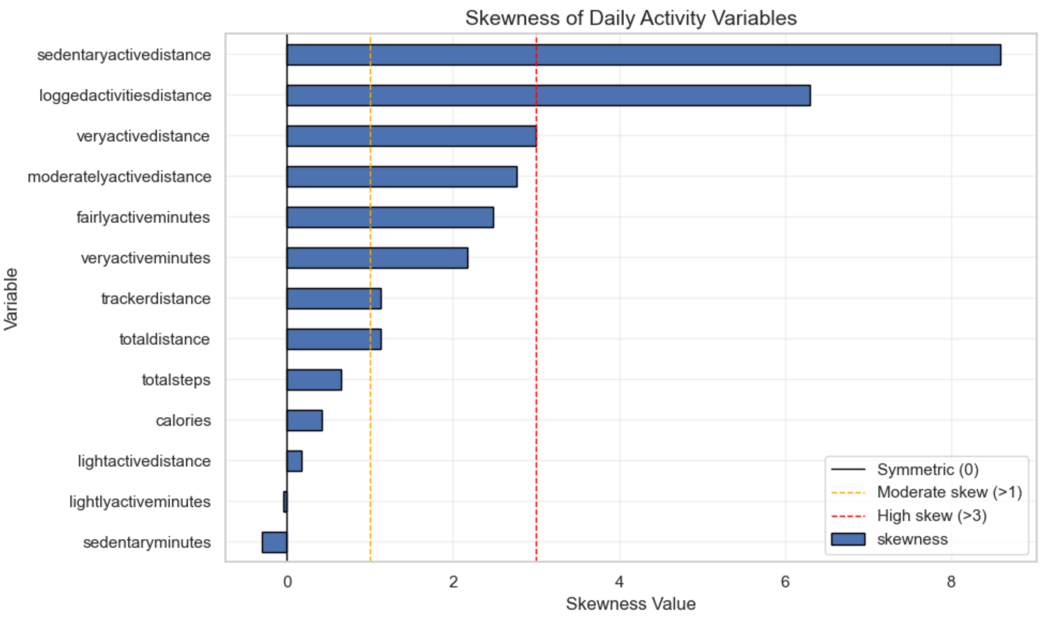
Statistical Diagnostics
Vigorous activity is strongly right‑skewed
Steps and calories show moderate skew
Light activity and sedentary time are stable
High‑activity days are real, not errors
Notes:
Vigorous activity is rare and heavily skewed. Steps and calories also show skew, but less extreme. Light activity and sedentary time are stable and predictable. Outliers are not errors — they represent real high‑activity days. These diagnostics help shape the clustering and prevent misinterpretation.

Slide 7
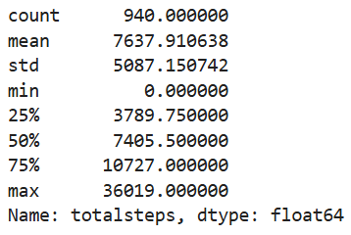
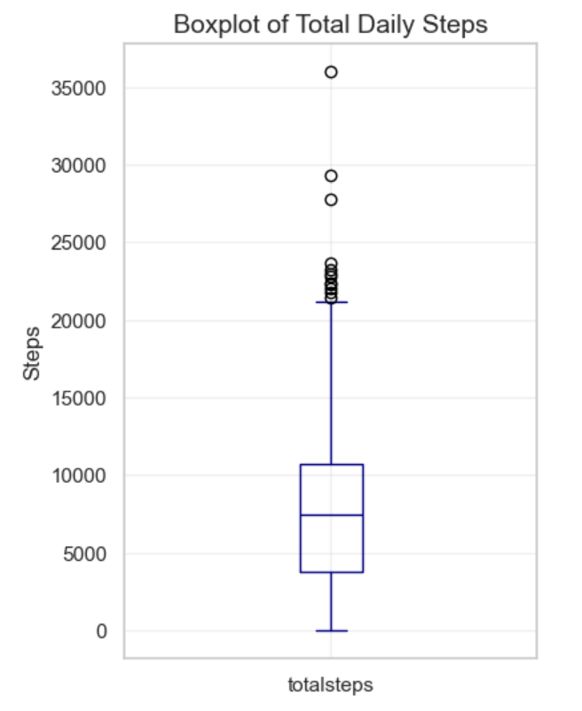
Daily Activity Patterns
Median ~7,400 steps
Light activity dominates most days
Vigorous activity is rare
Sedentary time dominates daily routines
Notes:
The median user takes about 7,400 steps per day. Light activity makes up most of the day. Vigorous activity is uncommon. Sedentary time dominates daily routines. These patterns set the stage for understanding how personas differ.

Slide 8
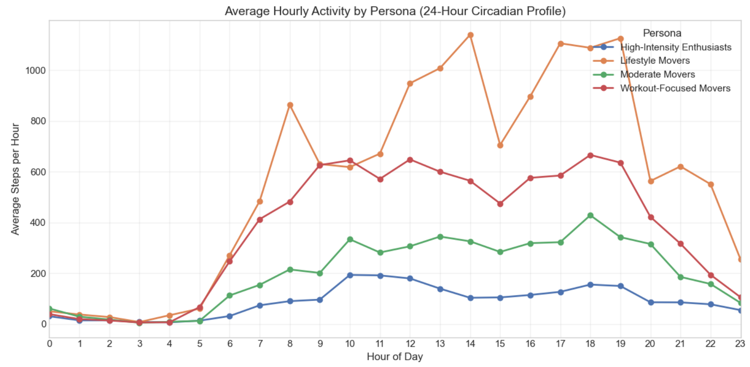
Hourly Movement Patterns
Clear daily rhythms emerge across personas
Morning, midday, and evening peaks differ by group
Hourly profiles reveal chronotype-like tendencies
Notes:
Hourly data reveals clear daily rhythms. Some users move early, some move late, and some spread activity across the day. These rhythms resemble chronotypes — morning‑leaning, midday‑leaning, or evening‑leaning patterns. This adds depth to the personas and helps identify when users are most receptive to guidance.

Slide 9
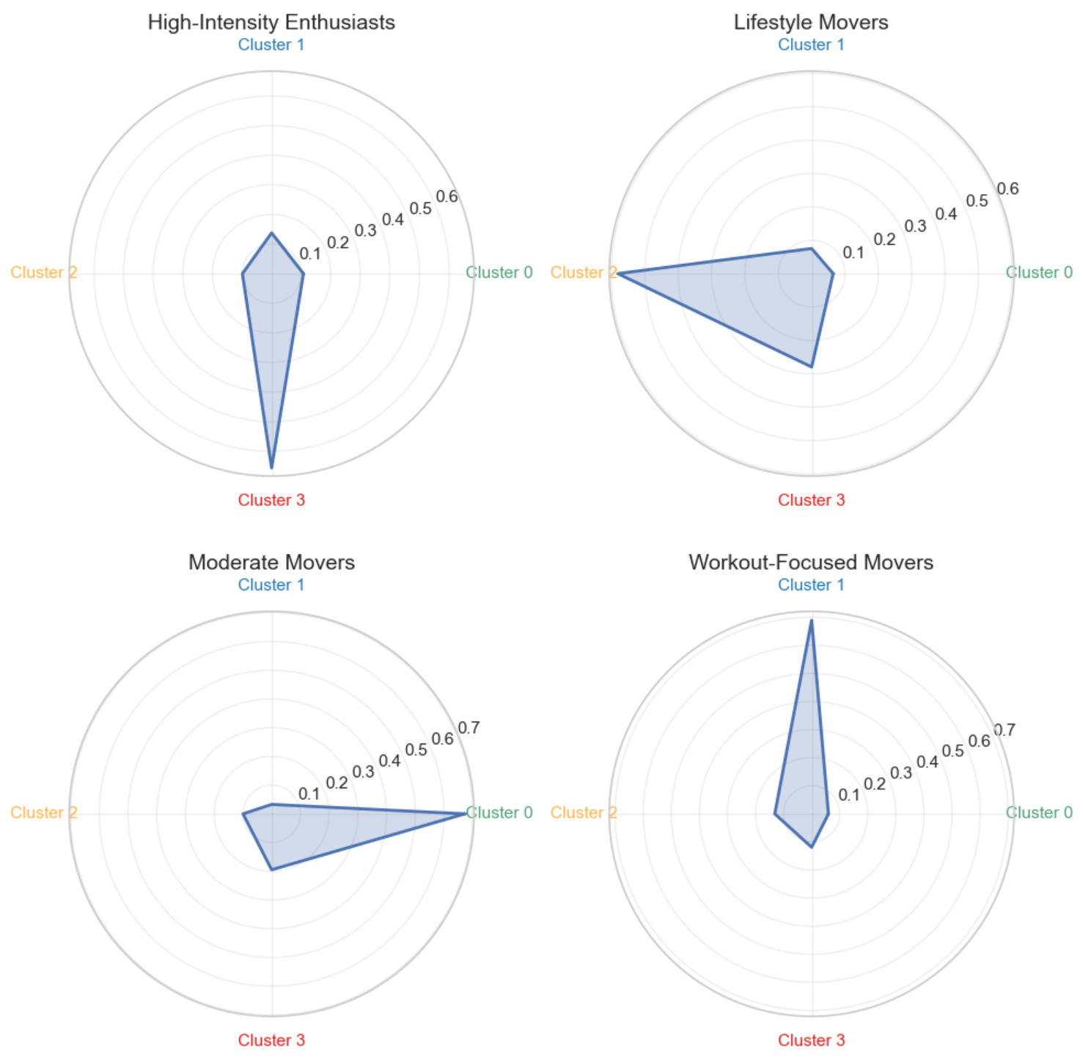
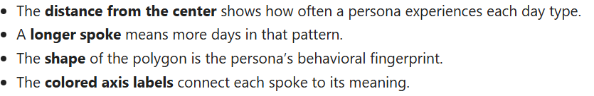
Persona Overview
Four personas identified:
High‑Intensity Enthusiasts
Lifestyle Movers
Moderate Movers
Workout‑Focused Movers
Notes:
The clustering produces four personas. High‑Intensity Enthusiasts move a lot and often. Lifestyle Movers stay active at a steady, moderate level. Moderate Movers are quieter overall. Workout‑Focused Movers show concentrated bursts of activity. These personas are grounded in real behavior, not assumptions.

Slide 10
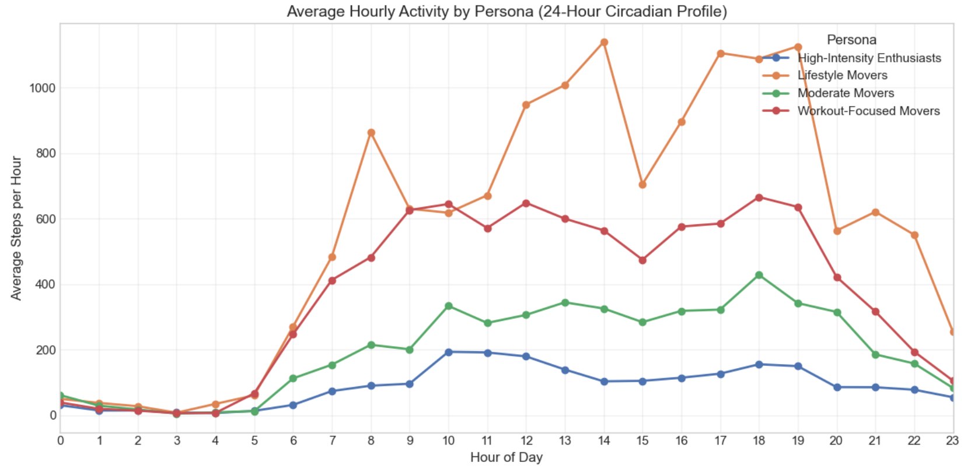
Persona Profiles
Notes:
Each persona has a distinct pattern. The profiles show differences in total steps, intensity minutes, sedentary time, and hourly rhythms. These differences are consistent across multiple metrics, which gives confidence in the segmentation.
High‑Intensity Enthusiasts show structured, vigorous activity with clear morning and evening peaks.
Lifestyle Movers maintain steady, low‑to‑moderate movement throughout the day — they’re consistent and balanced.
Moderate Movers peak around midday, suggesting routine‑driven movement patterns.
Workout‑Focused Movers concentrate their activity into late‑evening workouts, often after 9pm

Slide 11
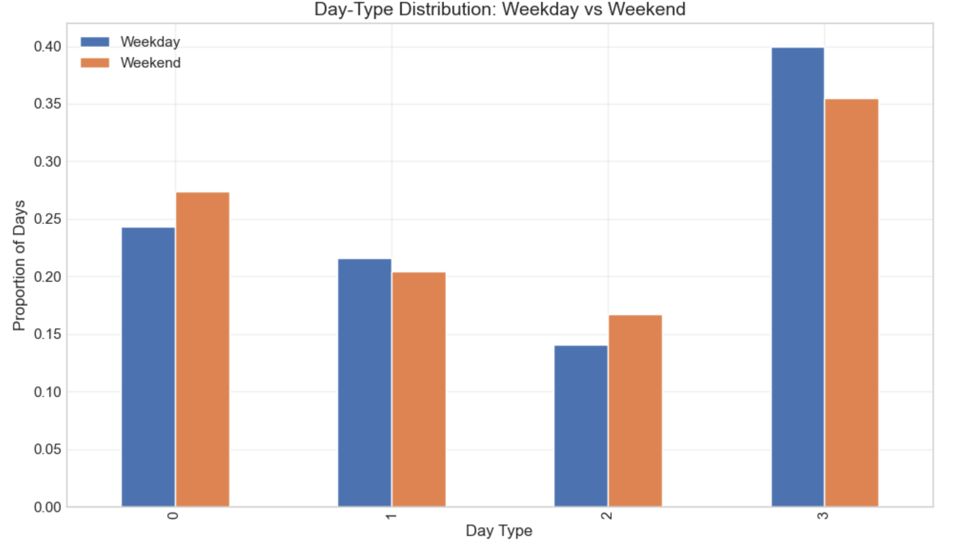
Weekday vs Weekend Behavior
High‑Intensity Enthusiasts: intense weekdays, lighter weekends
Lifestyle Movers: steady across the week
Moderate Movers: quieter weekends
Workout‑Focused Movers: more workouts
on weekends
Notes:
Weekday and weekend patterns add another layer. High‑Intensity Enthusiasts are busiest during the week. Lifestyle Movers stay steady. Moderate Movers slow down on weekends. Workout‑Focused Movers do more structured activity on weekends. These patterns help identify when each persona is most engaged.

Slide 12
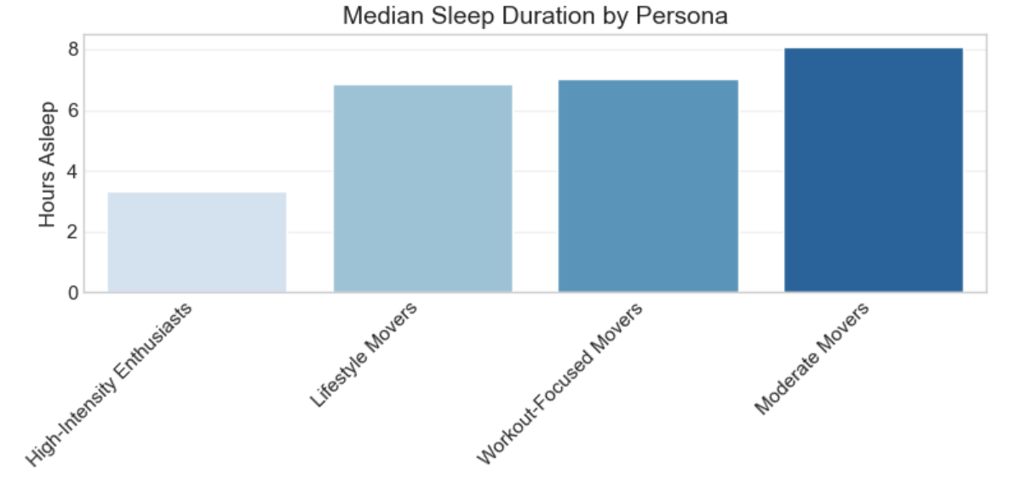
Sleep Patterns (Context Only)
Coverage is Limited
Typical sleep duration 6–8 hours
Efficiency varies
Not enough data for persona‑level conclusions
Notes:
Sleep data is too limited for strong conclusions. Most users sleep between six and eight hours. Efficiency varies. Because the sample is small and inconsistent, I use sleep only to add context, not to shape the personas.

Slide 13
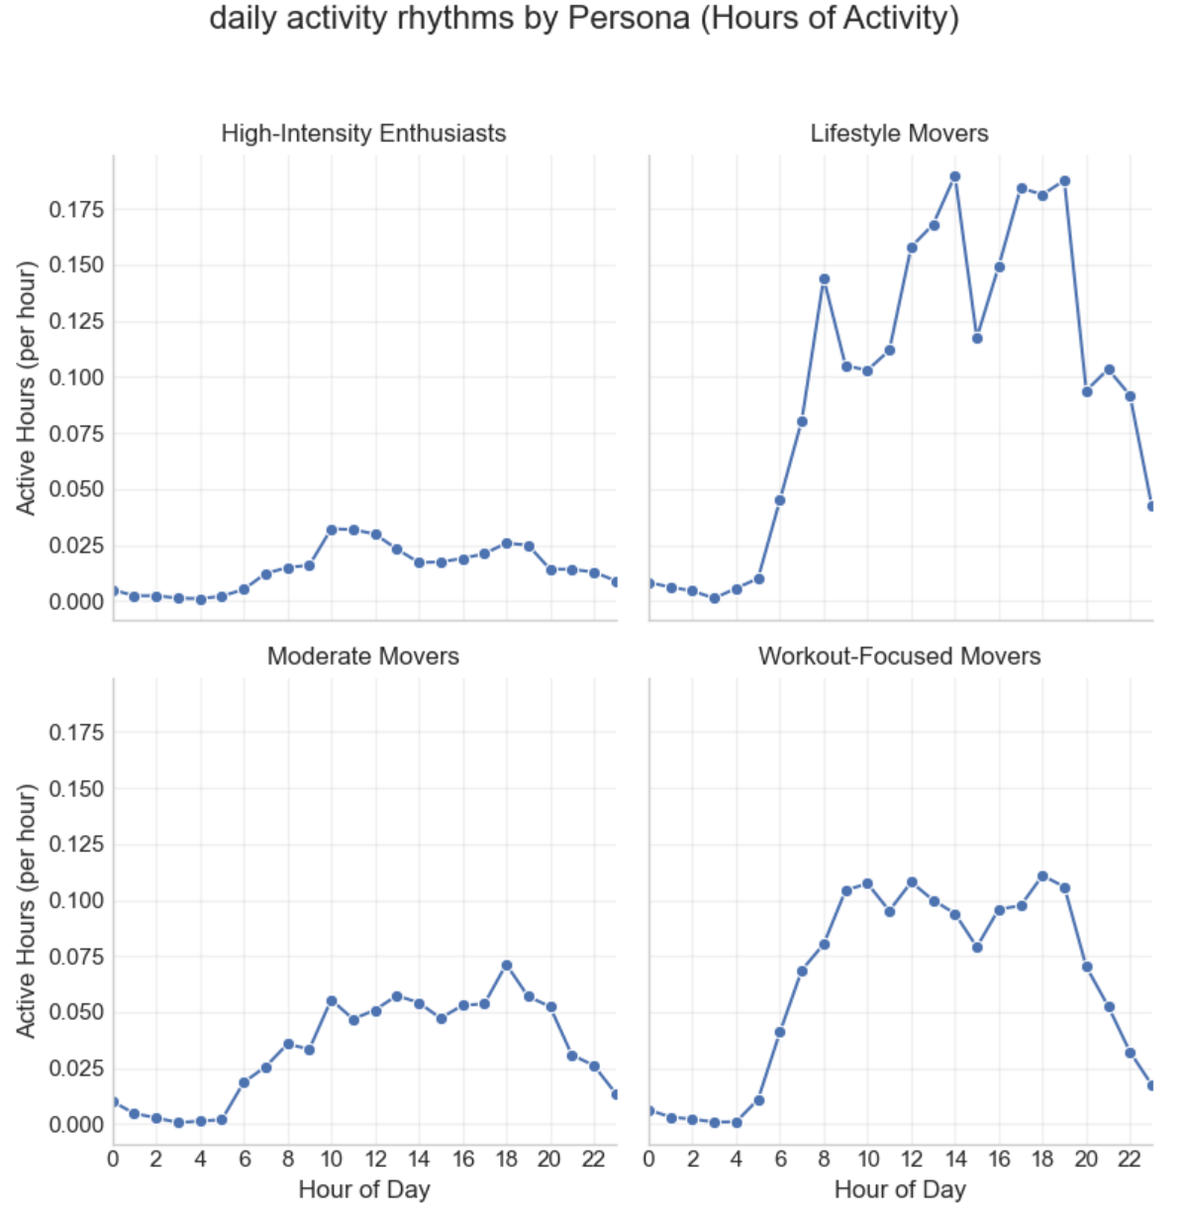
Key Insights
Movement patterns are strong and consistent
Personas reflect real behavioral differences
Hourly rhythms add depth and reveal rourines
Light activity shapes most days
High‑intensity activity is rare but meaningful
Notes:
Movement patterns are strong and consistent. Personas reflect real differences in behavior. Hourly rhythms add depth and reveal routines. Light activity shapes most days. High‑intensity activity is rare but meaningful. These insights give Bellabeat a solid foundation for product ideas.

Slide 14
Opportunities for Bellabeat
Time‑of‑day‑aware guidance
Features that reinforce daily routines
Support for irregular movers
Wellness insights focused on lifestyle patterns
Notes:
The data suggests several opportunities. First, time‑of‑day‑aware guidance — nudges that match each persona’s natural rhythm. Second, features that reinforce daily routines. Third, support for users with irregular patterns. And finally, wellness guidance focused on lifestyle rather than high‑intensity workouts.

Slide 15
Conclusion
Movement data provides a strong behavioral foundation
Personas and hourly rhythyms offer actionable segmentation
Sleep adds context but not depth
Findings support further work in the Share & Act phases
Notes:
Movement data gives a clear view of user behavior. Personas and hourly rhythms offer actionable segmentation. Sleep adds context but not depth. The findings support further work in the Share and Act phases, where insights can be turned into product ideas and user‑facing features.

Slide 16
Data Caveat
Small sample (31 users)
One month of data
No demographic information
Sleep data incomplete
Findings are directional, not generalizable
Notes:
The dataset is small and limited. It covers only one month and includes no demographic information. Sleep data is incomplete. Because of this, the findings are directional, not generalizable. They show patterns worth exploring, not conclusions about the wider population.

