Slide 1
Bellabeat: Bayesian Analysis of Hourly Activity Patterns
Andy Moran
Data Analytics Case Study
Notes:
Thank you for taking the time to review this project. This analysis explores how Bellabeat users differ in their hourly activity patterns, and how Bayesian modeling can validate and quantify those differences. The goal is to support more personalized and effective product experiences

Slide 2
Project Goal
What we wanted to understand
Do personas differ in when they are active
Are these differences statistically credible
Can we use this to improve personalization
Why it matters
Better timing for notifications
More relevant coaching
Higher engagement and retention
Notes:
The personas were created earlier in the project, but we hadn’t yet validated whether they behave differently across the day. If they do, Bellabeat can time nudges and content more intelligently. This analysis answers that question.

Slide 3
Data Overview
Datasets used
Hourly steps
Daily activity
Persona labels
Final modeling dataset
24 hours × multiple days × 33 users
4 personas
Hourly step counts (scaled)
Notes:
The dataset includes hourly step counts for each user, merged with persona labels. After cleaning and merging, we have a rich time‑series dataset that allows us to model daily rhythms

Slide 4
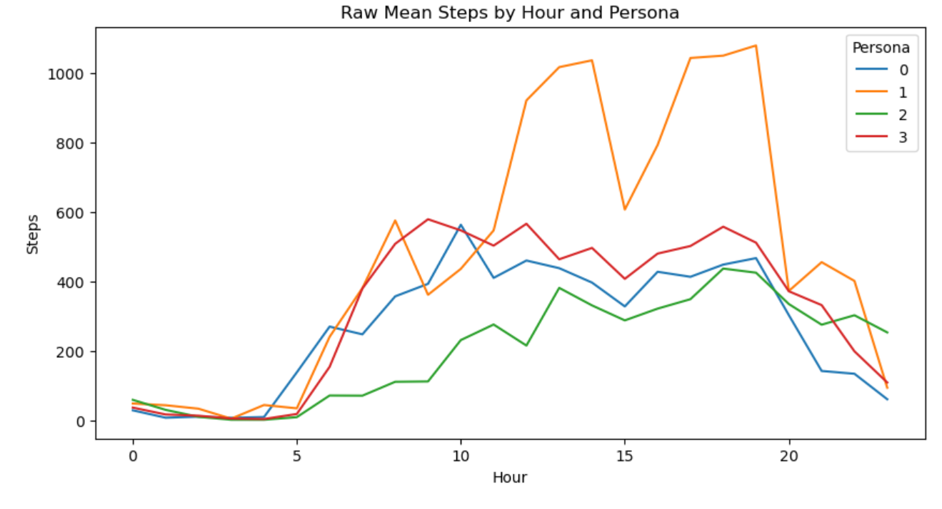
Exploratory Findings
Raw hourly means show clear differences
Persona 0: morning‑active
Persona 1: steady all day
Persona 2: evening‑active
Persona 3: lowest overall
Notes:
Even before modeling, we see distinct shapes. But raw means don’t tell us how confident we can be in these patterns. That’s where Bayesian modeling comes in.

Slide 5
Why Bayesian Modeling?
Why not rely on raw averages?
No uncertainty quantification
Sensitive to noise
Doesn’t validate whether differences are real
Bayesian advantages
Full posterior distributions
Credible intervals
Smooth persona‑specific curves
Clear comparisons between personas
Notes:
Bayesian modeling gives us a principled way to quantify uncertainty and validate the patterns we saw in the exploratory analysis. It also produces smooth, interpretable curves for each persona.

Slide 6
Model Structure
Model
yp,h∼Normal(αp+βp,h,σ)
$$α_{p}$$: persona baseline
$$β_{p,h}$$: persona‑specific hourly effect
$$σ$$: shared noise
Inference
ADVI for efficiency
2000 posterior samples
Notes:
This model gives each persona its own 24‑hour curve. ADVI was used because NUTS was computationally expensive for this dataset, but the posterior predictive checks confirm that ADVI performs well here

Slide 7
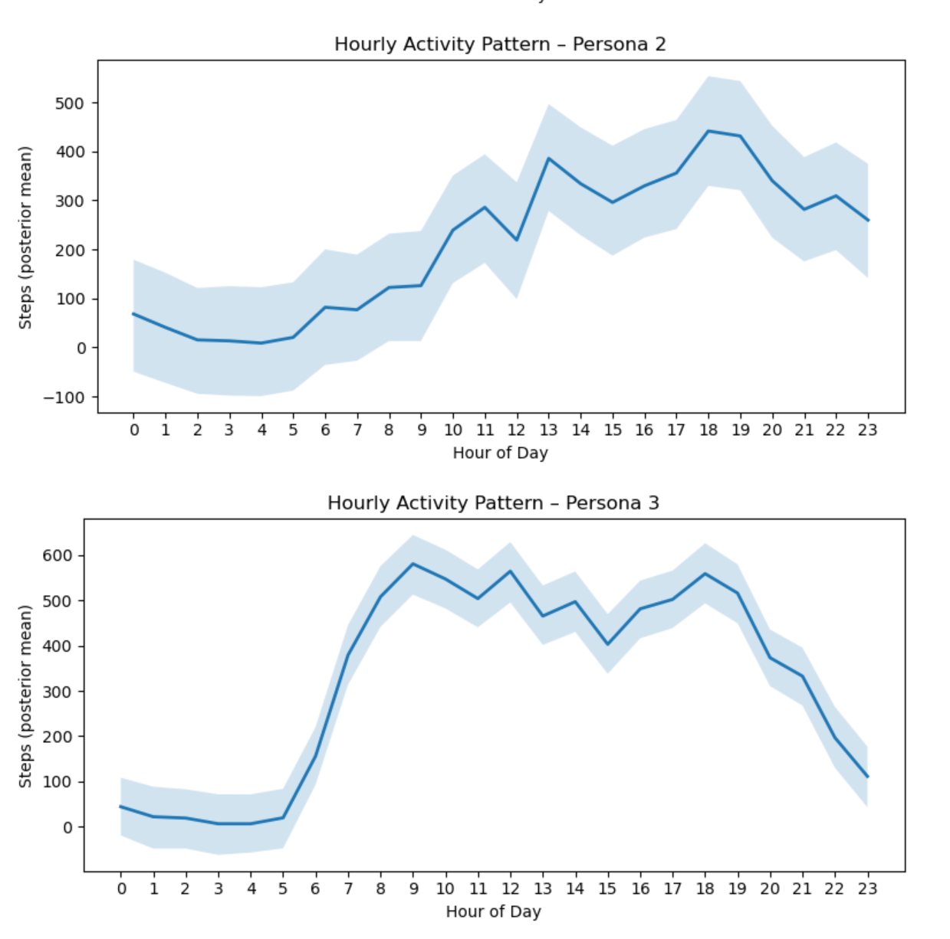
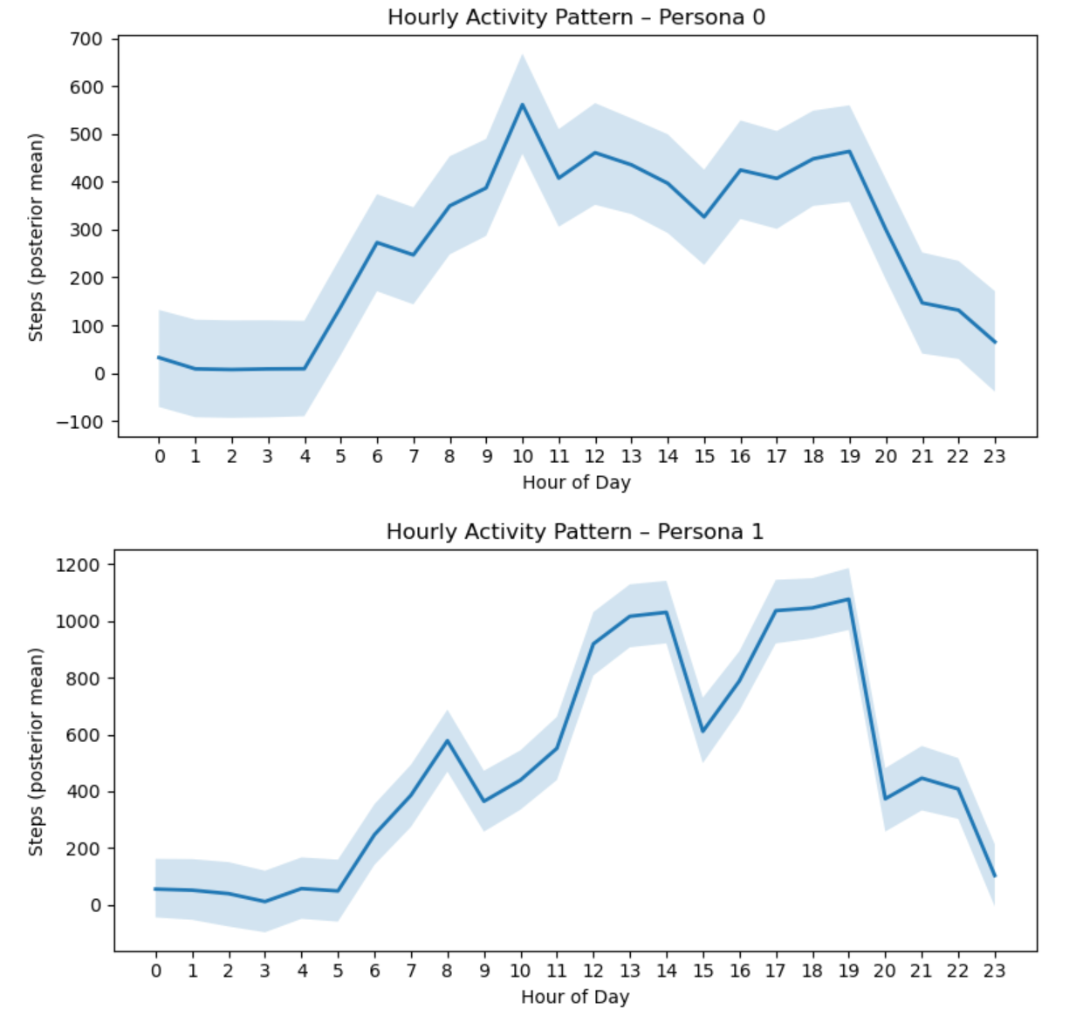
Posterior Curves
Notes:
These curves show the posterior mean and 94% credible intervals for each persona. The intervals are narrow, which means the patterns are stable and well‑supported by the data. The differences we saw in the exploratory analysis hold up under the model.

Slide 8
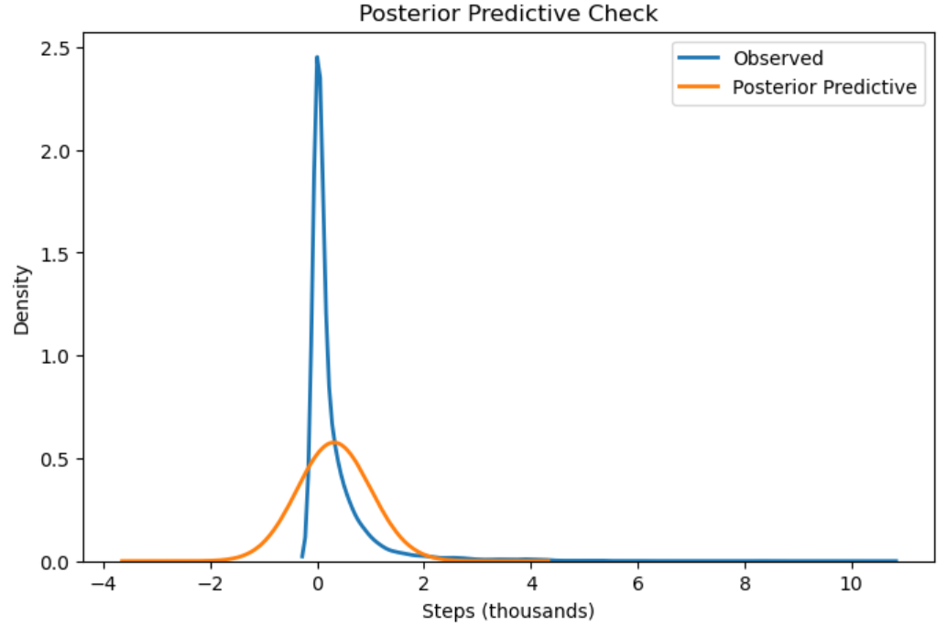
Posterior Predictive Check
Notes:
The posterior predictive distribution overlaps well with the observed data. The model is slightly smoother than the real distribution, which is expected with a Normal likelihood, but it captures the overall scale and structure. This gives us confidence that the model is a reasonable generative explanation of the data.

Slide 9
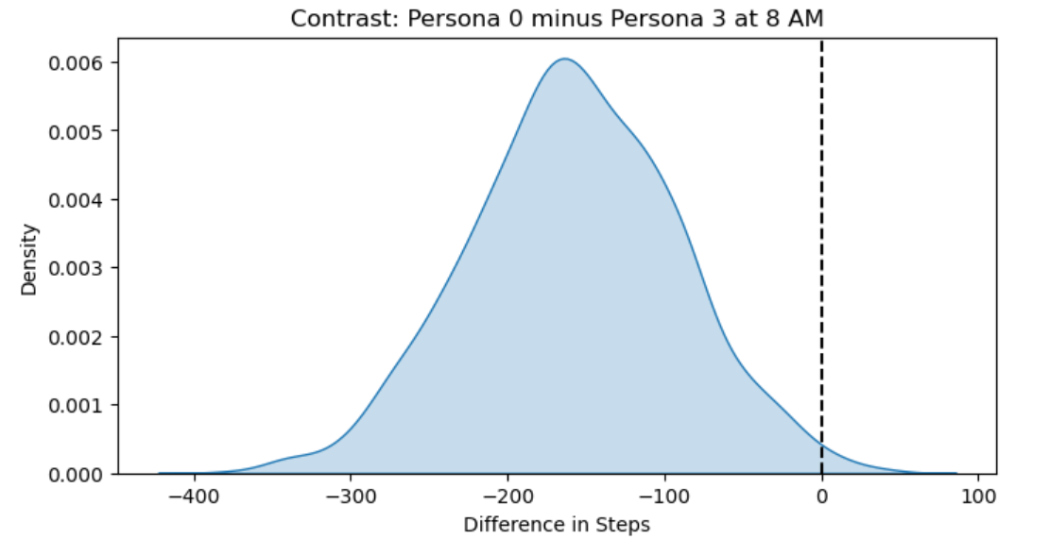
Persona Contrast Example
Contrast: Persona 0 vs Persona 3 at 8 AM
Difference: ~0 to +450 steps
Entire credible interval above
zero
Strong evidence Persona 0 is
more active
Notes:
Contrasts make the differences tangible. At 8 AM, Persona 0 is credibly more active than Persona 3. The entire credible interval is above zero, meaning Persona 3 is almost never more active at this hour. This is exactly the kind of insight that supports personalized notification timing.

Slide 10
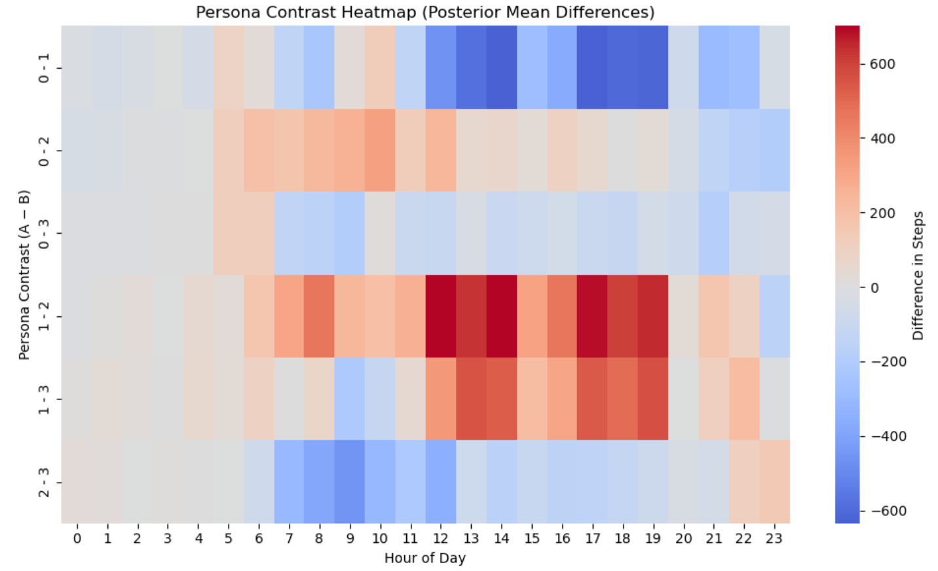
Contrast Heatmap
Notes:
This heatmap summarizes persona differences across all hours. Warm colors mean the row persona is more active; cool colors mean the opposite. You can see clear temporal signatures: Persona 0 dominates mornings, Persona 2 dominates evenings, Persona 1 is steady, and Persona 3 is consistently lower.

Slide 11
Business Implications
Personalization opportunities
Persona 0 — morning nudges
Persona 1 — habit reinforcement
Persona 2 — evening reminders
Persona 3 — gentle onboarding
Product value
— Better timing — higher relevance — stronger engagement
Notes:
These patterns translate directly into product strategy. Each persona has a natural rhythm, and Bellabeat can align its engagement strategy with those rhythms to increase relevance and retention.

Slide 12
Limitations
Observational data; no causal claims
Step counts measure volume, not intensity
Personas derived from clustering
Limited time window
Notes:
These limitations don’t undermine the analysis, but they’re important to acknowledge. Future work could incorporate heart‑rate data, intensity minutes, or longer time spans

Slide 13
Conclusion
What we learned
Personas differ in when they move
Differences are statistically credible
Bayesian modeling validates the patterns
Clear opportunities for personalization
Notes:
The key takeaway is that personas differ not only in how much they move, but when. These differences are real, stable, and actionable. Bayesian modeling strengthens the case for persona‑specific engagement.

Slide 14
Thank You
AndyMoran
https://github.com/AndyMoran
Notes:
hank you for your time. I’m happy to walk through any part of the analysis or discuss how this approach could be extended.

