Slide 1
Cyclistic Case Study
Understanding Rider Behaviour and Membership Strategy
Insights from 5.4 million trips (Dec 2024–Nov 2025)
Notes:
Welcome everyone. Today I’ll walk through a full analysis of Cyclistic’s rider behaviour, based on 5.4 million trips taken between December 2024 and November 2025.
The goal is simple: understand how members and casual riders differ, and whether those differences support Cyclistic’s aim to grow annual membership while keeping the system financially sustainable.
This analysis combines descriptive analytics, revenue modelling, station patterns, and predictive modelling to give a clear, evidence‑based view of how the system works.

Slide 2
Executive Summary
Members and casual riders behave very differently
Members take short, predictable weekday trips
Casual riders take longer, variable trips with weekend and summer peaks
Revenue modelling shows conversion reduces revenue under current pricing
Two station ecosystems: commuter vs leisure
Predictive models confirm the behavioural divide
Cyclistic should review pricing and tailor operations to both groups
Notes:
The headline is that members and casual riders behave in sharply different ways. Members ride like commuters: short trips, predictable timing, strong weekday patterns. Casual riders behave like leisure users: longer trips, more variability, and strong weekend and summer peaks.
But the most important finding is financial. Many casual riders pay more than the membership fee, but only by a small margin. When they convert, Cyclistic loses more casual revenue than it gains in membership fees.
This means membership is underpriced relative to heavy casual usage.
The station analysis shows two distinct ecosystems — downtown commuter corridors and lakefront leisure zones.
The predictive model confirms the behavioural divide.
Together, these findings point to a need for pricing review and targeted operational planning.

Slide 3
Business Context
Cyclistic aims to grow annual membership
Needs a clear view of rider behaviour
Must understand financial impact of conversion
Analysis supports marketing, pricing, and operations
Notes:
Cyclistic’s stated goal is to grow its base of annual members. Membership provides predictable revenue and supports long‑term planning.
But converting casual riders only makes sense if it improves Cyclistic’s financial position.
This analysis gives Cyclistic the behavioural and financial evidence needed to make informed decisions about pricing, marketing, and operations.

Slide 4
Dataset Overview
5.4 million trips
Dec 2024–Nov 2025
Cleaned and validated in a separate pipeline
Engineered fields: duration, weekend flag, peak hours, month, hour
Notes:
The dataset spans a full seasonal cycle, which is important because casual ridership is highly seasonal.
The cleaning pipeline standardised timestamps, removed duplicates, validated categories, and created engineered fields like trip duration, weekend indicators, peak‑hour flags, and month.
These engineered fields are essential for behavioural and revenue analysis.

Slide 5
Key Question
How do members and casual riders differ, and do those differences support membership growth?
Notes:
This is the core question. Everything else — revenue modelling, station analysis, predictive modelling — supports this.
We want to understand not just how riders behave, but whether those behaviours translate into profitable membership conversion.

Slide 6
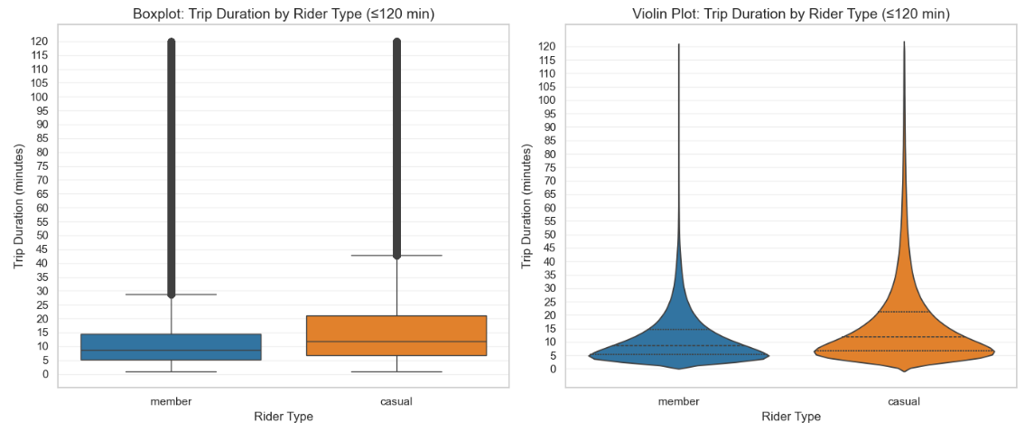
Trip Duration Differences
Members: short, consistent trips (5–15 min)
Casual riders: longer, variable trips
Casual distribution has a
long right tail
Notes:
Trip duration is one of the clearest behavioural signals.
Members take short, practical trips that match commuting patterns.
Casual riders take longer trips, often 20–30 minutes or more, with a long tail of very long rides.
This suggests that members use Cyclistic for transport, while casual riders use it for leisure or tourism.
This difference becomes important later when we analyse revenue.

Slide 7
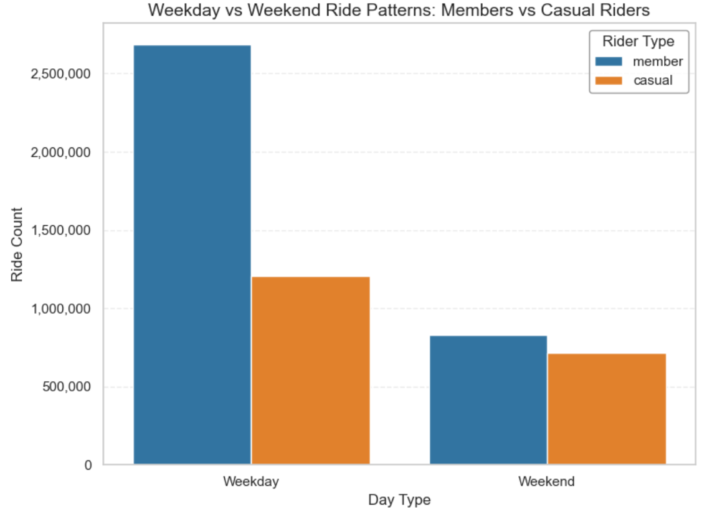
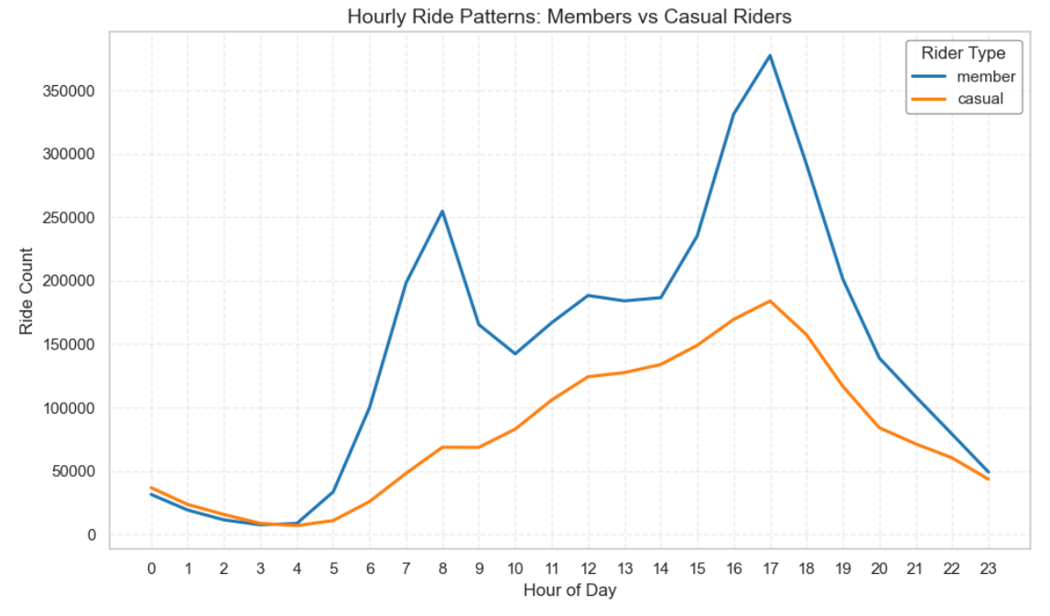
Temporal Patterns
Members ride on weekdays
Casual riders ride on weekends
Members show strong AM/PM peaks
Casual riders ride more midday and
afternoon
Notes:
Temporal patterns reinforce the commuter vs leisure divide.
Members ride heavily during weekday peak hours — 7–9 AM and 4–6 PM — which aligns with work commutes.
Casual riders show a flatter distribution, with more activity in the middle of the day and on weekends.
This difference is consistent across the entire year.

Slide 8
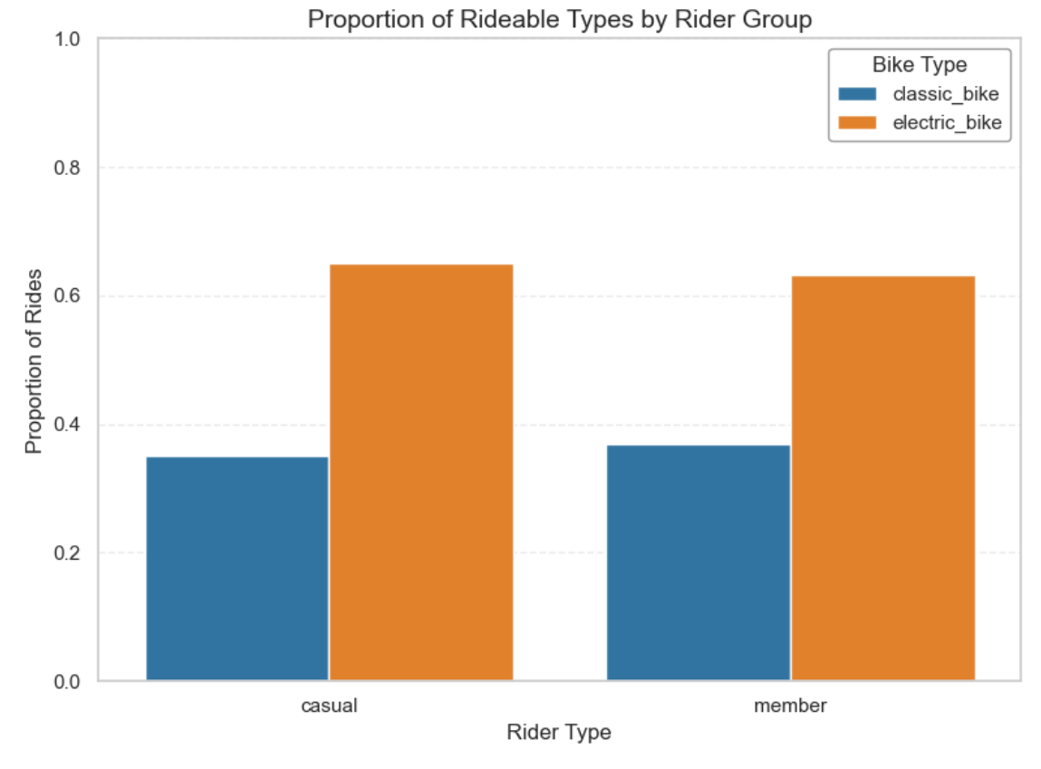
Rideable Type Usage
Electric bikes dominate both groups (≈63–65%)
No meaningful difference between members and casuals
E‑bike demand is system‑wide
Notes:
Electric bikes now account for nearly two‑thirds of all rides for both groups.
This is a system‑wide shift, not a rider‑type preference.
It means Cyclistic must treat e‑bike charging, maintenance, and distribution as core operational priorities.
This also affects pricing strategy, because e‑bikes cost more to operate.

Slide 9
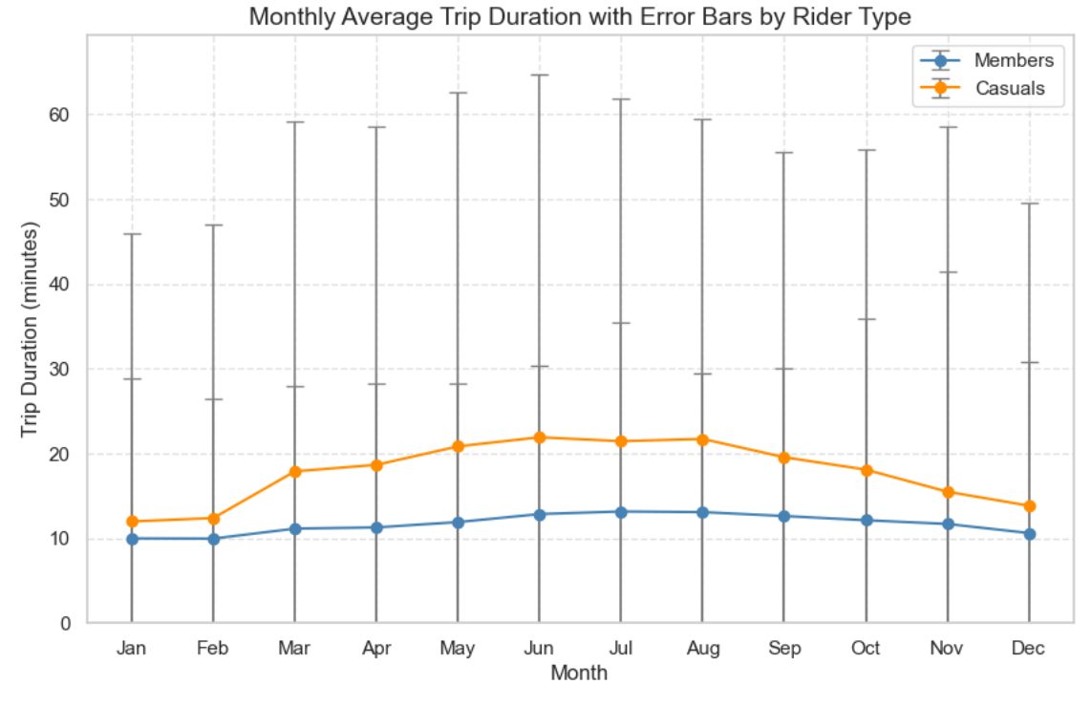
Seasonal Patterns
Casual ridership peaks sharply in summer
Member ridership is steadier
Winter drop affects both groups
Notes:
Seasonality is one of the strongest drivers of casual demand.
Casual ridership surges in summer, especially near lakefront stations.
Members show a smaller summer increase but remain more stable across the year.
This has implications for fleet allocation, staffing, and maintenance cycles.

Slide 10
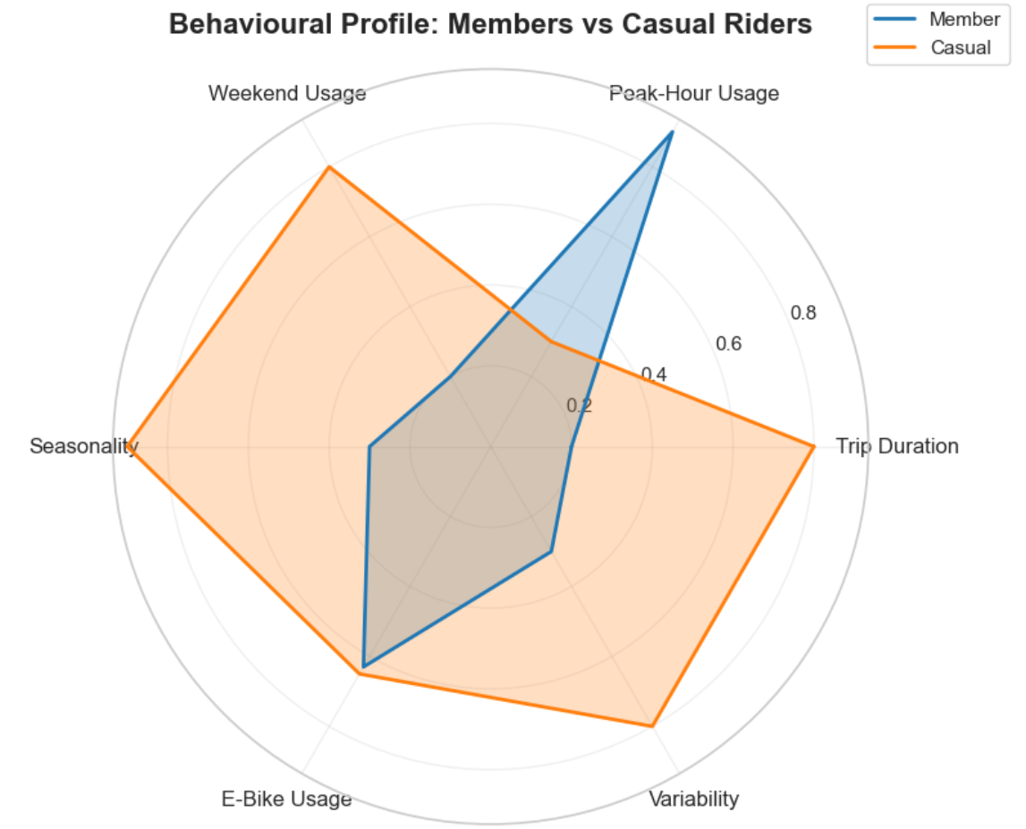
Behavioural Summary
Members = short, predictable,
commuter‑style
Casual riders = long, variable,
leisure‑oriented
Electric bike usage similar
Members ride weekdays; casuals ride weekends
Casual riders show strong summer peaks
Notes:
Across all descriptive metrics, the behavioural divide is consistent.
Members behave like commuters. Casual riders behave like leisure users.
Electric bike usage is similar, which means e‑bike demand is universal.
These patterns set the stage for the revenue analysis.

Slide 11
Revenue Proxy Model (Trip‑Level)
Dataset has no rider IDs → rider‑level revenue impossible
Revenue model uses trip duration × per‑minute price
Member model uses 45
free minutes + overage
Provides a consistent,
defensible estimate
Notes:
Cyclistic’s dataset does not include rider‑level identifiers, so we cannot calculate annual spending per rider.
Instead, we use a trip‑level proxy: trip duration multiplied by the per‑minute casual price.
For the membership model, we apply the 45‑minute free allowance and calculate overage minutes.
This method respects the limits of the dataset and provides a consistent basis for comparing casual and member revenue.

Slide 12
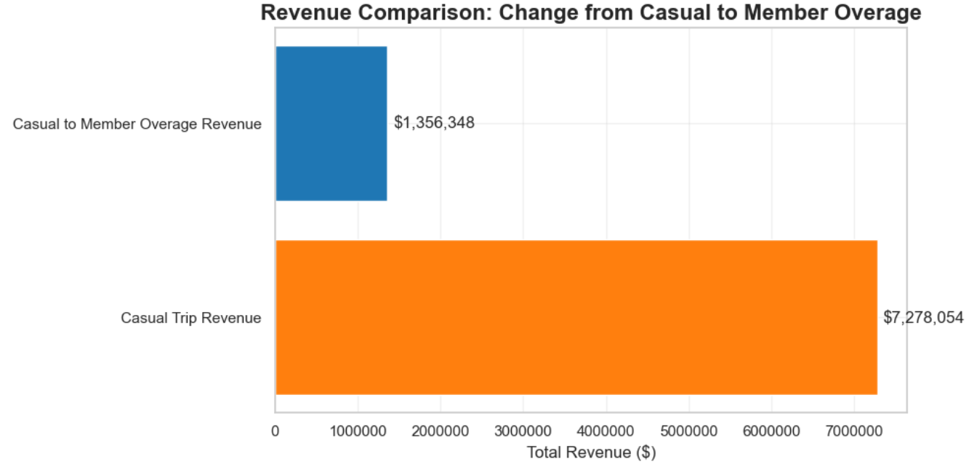
Revenue Findings
Many casual riders pay more than the membership fee
Most exceed it by only a
small amount
Converting them reduces
revenue
Membership is underpriced
relative to heavy casual usage
Notes:
The key insight is that many casual riders pay more than the membership fee — but only slightly more.
When they convert, Cyclistic loses the higher casual revenue and replaces it with a lower membership fee.
This means membership is underpriced relative to the value heavy casual riders generate.
Membership builds loyalty and stability, but it does not increase revenue under current pricing.

Slide 13
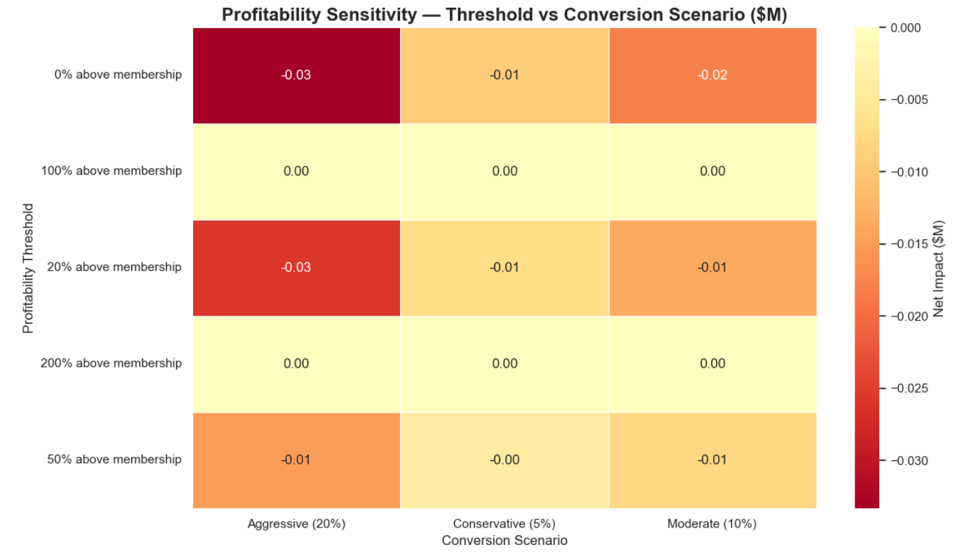
Profitability Thresholds
Exceeding the membership fee is not
enough to increase revenue
Most casual riders exceed the fee by
a small margin.
How far above the fee must a rider be to make conversion profitable? Test thresholds: 20%, 50%, 100%, 200%
Even at high thresholds, conversion still leads to net revenue loss because the membership fee is priced below the economic value of heavy casual usage.
Notes:
The net revenue impact of converting a rider is:$$Net Revenue Change=Membership Fee−Casual Revenue$$
A rider who generates £200 in casual revenue and a rider who generates £180 both “exceed the fee,” but converting them replaces higher casual revenue with a lower membership fee:$$£100−£200=−£100$$$$£100−£180=−£80$$
Both conversions lose revenue. Exceeding the membership fee is not enough.
To understand how much overage is needed to break even, we test several profitability thresholds: 20%, 50%, 100%, and 200% above the membership fee. The heatmap shows that even at very high thresholds, conversion still produces a net revenue loss. The membership fee is priced far below the economic value of heavy casual usage.
The conclusion is clear: under the current pricing model, converting high‑usage casual riders is financially disadvantageous. Cyclistic should not pursue conversion as a revenue strategy until the membership price is reviewed.

Slide 14
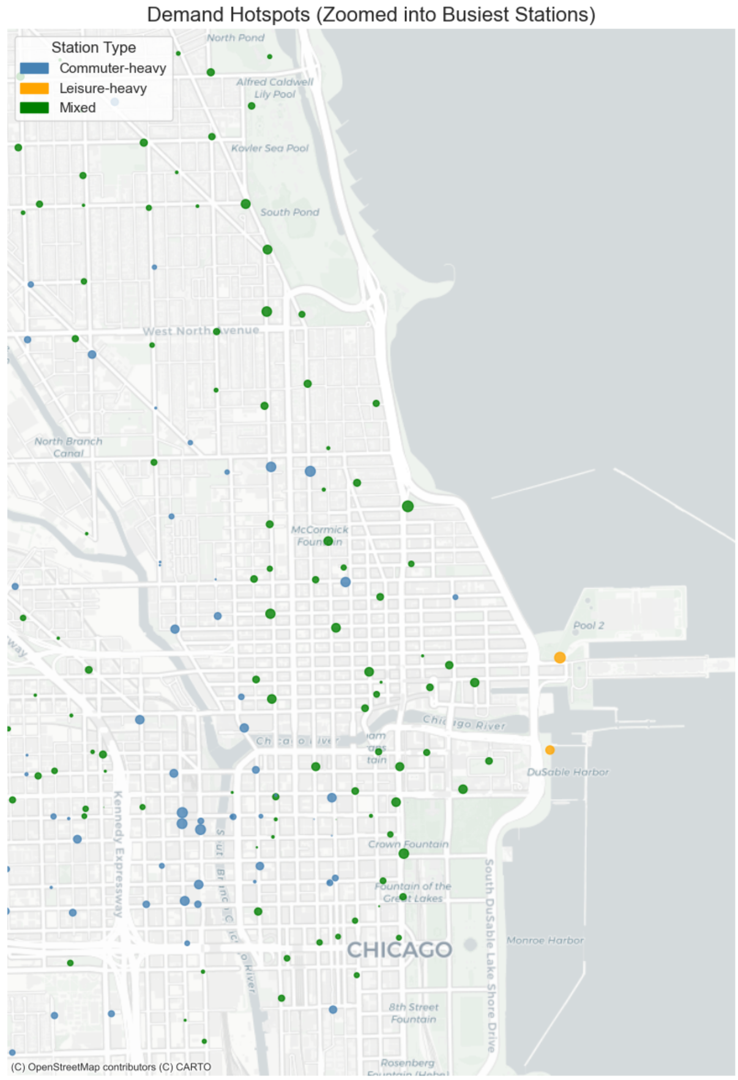
Station Ecosystems
Downtown = commuter network
(members)
Lakefront = leisure network (casuals)
Different operational needs
Notes:
The station analysis reveals two distinct ecosystems.
Downtown stations serve commuters and show strong weekday peaks.
Lakefront stations serve leisure riders and show strong weekend and summer peaks.
These zones require different operational strategies — more dock capacity downtown, more weekend rebalancing along the lakefront.

Slide 15
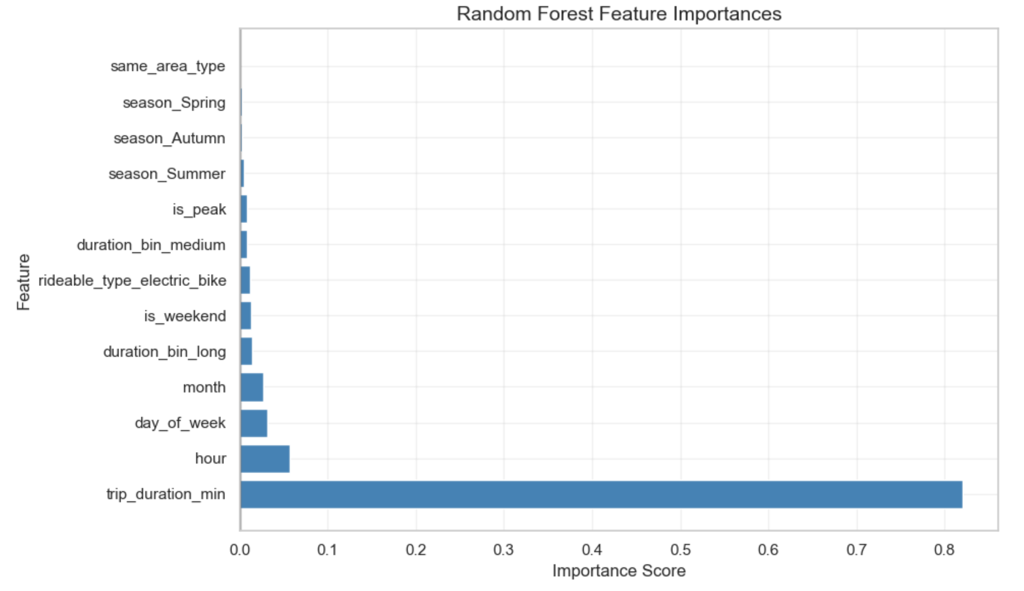
Predictive Model Insights
Trip duration is a strong behavioural signal
Time‑based features (hour, peak, weekend, season) also matter
Models achieve moderate accuracy
The value lies in interpretation,
not prediction
Notes:
The models confirm what the descriptive analysis showed. Trip duration separates members from casual riders. Time‑based features—hour, peak periods, weekends, and seasons—also play major roles.
The Random Forest highlights duration because it captures non‑linear patterns. Logistic Regression lifts seasonal and categorical features because it responds to how variables are encoded.
The models differ in emphasis but point to the same truth: members and casual riders behave in distinct ways. The goal is not perfect prediction. The goal is to understand which behaviours matter and use them to guide marketing and operations.

Slide 16
Strategic Recommendations
Review membership pricing
Strengthen operations in commuter and leisure zones
Target member‑like casual riders
Use pricing tests and seasonal campaigns
Treat e‑bike demand as a core priority
Notes:
Cyclistic should review its membership price, which is currently too low relative to heavy casual usage.
Operational planning should recognise the two‑network structure — commuter downtown, leisure lakefront.
Marketing should target casual riders who already behave like members.
Seasonal campaigns can capture riders active in late summer.
E‑bike demand must be treated as a core operational priority.

Slide 17
Closing Note
Cyclistic aims to grow annual membership while keeping the system financially sustainable. This analysis shows how members and casual riders differ and whether those differences support that goal.
Notes:
This analysis gives Cyclistic a clear, evidence‑based view of rider behaviour and the financial impact of conversion.
It shows that behavioural differences are strong, but they do not translate into profitable membership growth under current pricing.
Cyclistic can use these insights to refine pricing, improve operations, and plan for long‑term sustainability.

Slide 18
Thank You
Questions & Discussion

