Slide 1

– Proof of Concept
Team Name: Asteroid Destroyers
Contributors: Emilia Mahmoodi, Andy Moughalian, Roee Palmon, Christian Rusanovsky, Novali Plascencia
May 14, 2026
Notes:
AI-generated content may be incorrect. ---

Slide 2

FINAL YEAR CS PROJECT – POC PRESENTATION
Notes:
Cover Slide, Problem Statement, Objective / Goals, Key Features / Functionality, Architecture Overview, Design & Mockups, Legal, Security & Compliance Considerations, Testing & Validation, Demo Flow, Feedback & Iteration, Metrics & Achievements, Next Steps / Future Work, References / Acknowledgements

Slide 3

What is summArIze?
Our app uses AI to summarize text, videos, and lectures, create quick study guides, and generate quizzes so students can learn faster, understand better, and study more efficiently.
Emilia Mahmoodi
Andy Moughalian
Roee Palmon
Christian Rusanovsky
Novali Plascencia
Instructor: Savita Mittal
Notes:
The cover slide introduces the project titled '[Project Name] – Proof of Concept' as part of a final year Computer Science presentation. It includes essential details such as the project name, team members involved, the instructor or course name, and the date of presentation. Optionally, a project logo or graphic can be added to enhance visual appeal and branding. This slide sets the tone for the presentation and provides the audience with a clear understanding of the context and contributors.

Slide 4
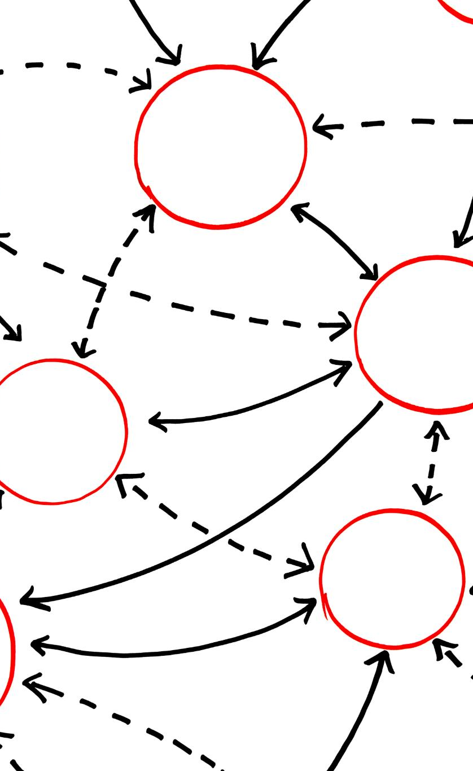
Problem Statement
Main Problem
Many students struggle to keep up with lectures, long readings, and study materials. College and high school students often feel overwhelmed and don’t have enough time to review everything before exams. Notes can be confusing, videos are long, and studying is not always effective. Our app solves this problem by using AI to summarize text, videos, and lectures, create quick study guides, and generate quizzes so students can learn faster, understand better, and study more efficiently.
Pain Points
Time consuming studying
Information overload
Difficulty creating practice quizzes
No centralized study platform
Limited personalized feedback
Stakeholders
College students
Online learners
Students studying for exams
Visual Idea
Flow: Lecture/PDF/Video → Too Much Information → Student Stress → summArIze Solution
Notes:
This slide outlines the core problem that the proof of concept (POC) aims to address. It begins with a brief description of the issue, followed by contextual background explaining who is affected and under what circumstances. The slide highlights key pain points or gaps in existing solutions, emphasizing the need for innovation. A visual diagram illustrates the transition from the current state to the identified pain points, helping the audience grasp the problem's significance and the motivation behind the project.

Slide 5
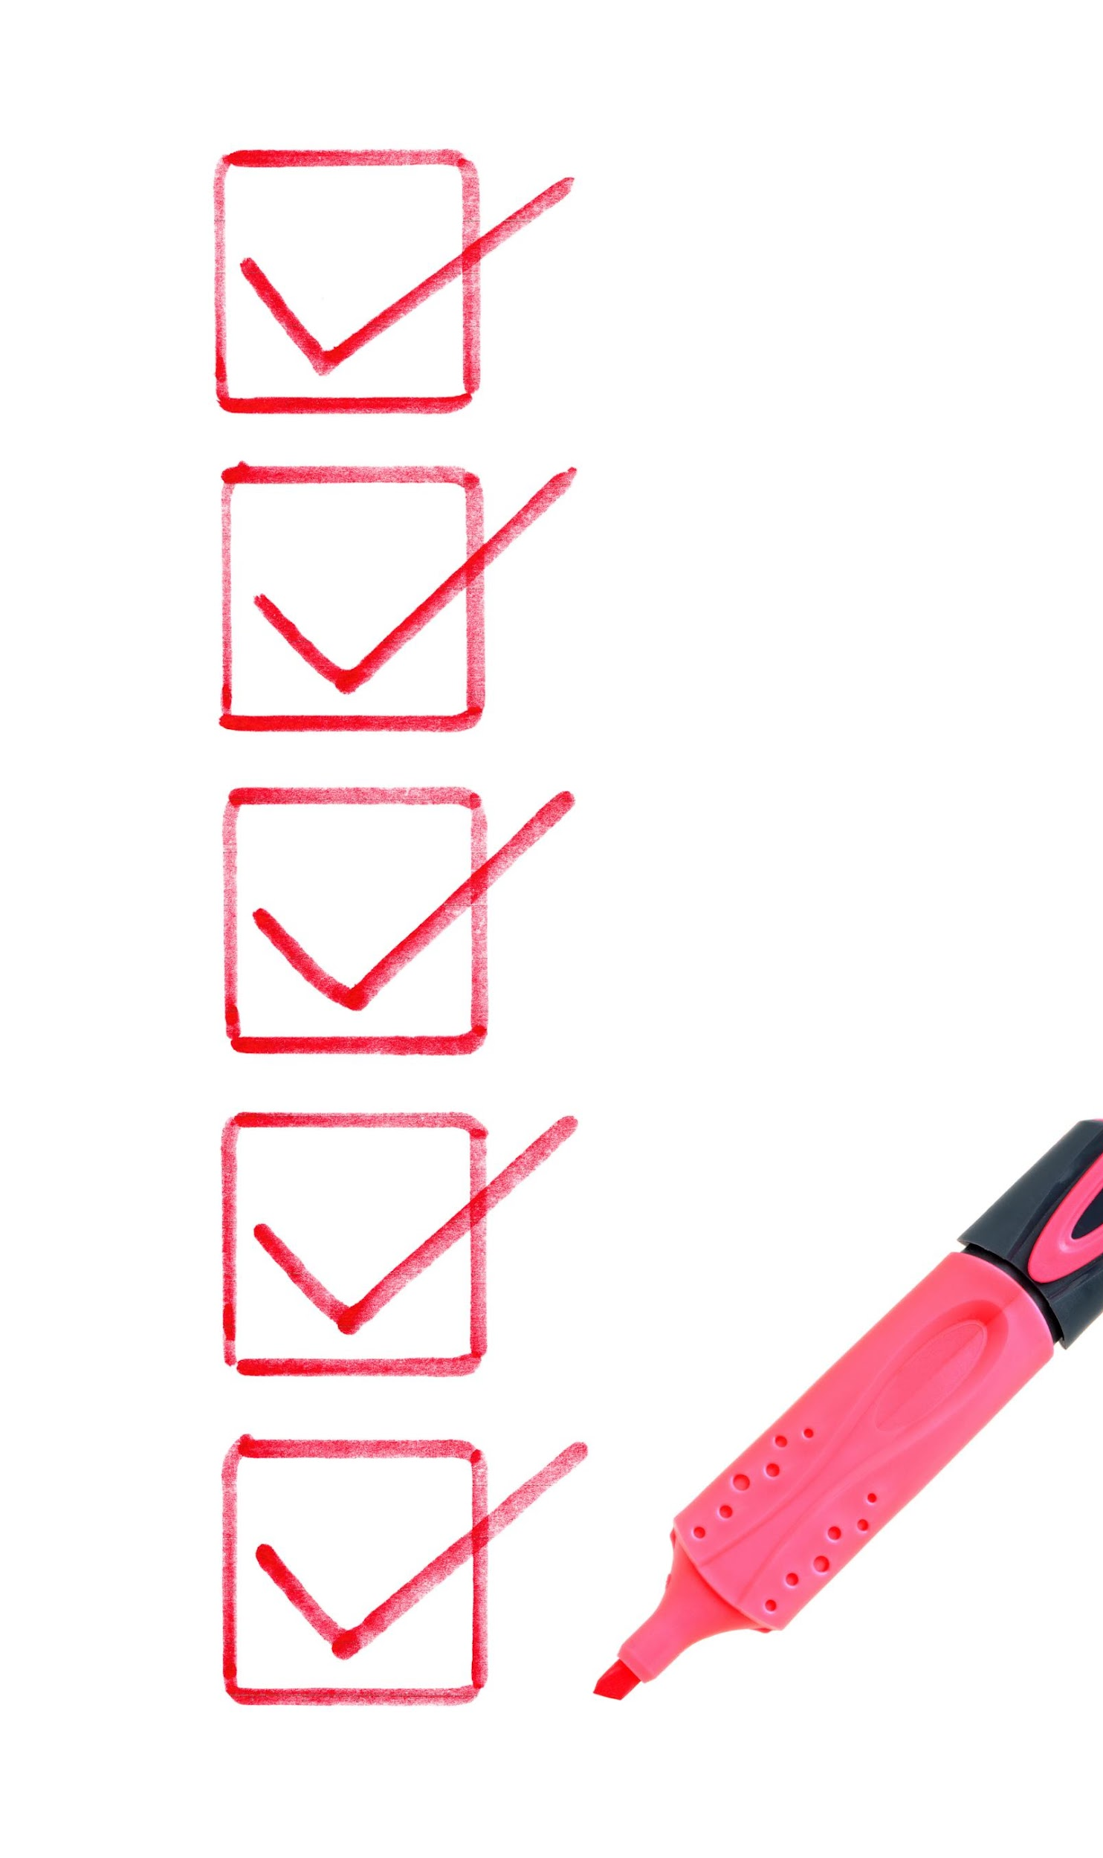
Objective / Goals
Goals
Demonstrate AI-powered summarization Generate quizzes automatically Provide AI-based feedback Support multiple content types Create a centralized study workflow
Success Criteria
Successful AI summaries
Quiz generation works
Users can upload content
APIs respond correctly
Data stored successfully
Notes:
The objectives and goals slide communicates the primary aims of the POC. It emphasizes demonstrating the feasibility of the proposed solution, implementing core functionalities, and validating critical user flows or architectural components. Additionally, it may include a checklist of success criteria to measure the effectiveness of the POC. Visual elements such as labeled boxes with checkmarks reinforce the achievement of key milestones, providing a clear roadmap of what the project intends to accomplish.

Slide 6

Key Features / Functionality
Must-Have Features
User authentication
Upload notes/PDFs/videos
AI text summarization
Video summarization
Quiz generation
AI evaluation/feedback
Progress tracking
Nice-to-Have Features
Dark mode
Study analytics
Personalized recommendations
4 AI Agents
Text Summarization Agent
Video/Lecture Agent
Quiz Generation Agent
Feedback/Evaluation Agent
Notes:
This slide presents the main features implemented in the POC, categorized into 'Must-have' and 'Nice-to-have' functionalities. Must-have features include essential components like user authentication and core workflows, while nice-to-have features enhance user experience, such as dark mode and notifications. A feature flow diagram visually represents how these features interact within the system, helping stakeholders understand the scope and priorities of the implementation.

Slide 7

Architecture Overview
UI (Next.js Frontend) ↓ API Routes / Cloud APIs ↓ AI Services (OpenAI + Anthropic APIs) ↓ Firebase Firestore / Storage
Technologies
Next.js
Firebase
OpenAI API
Anthropic API
Vercel
Notes:
The architecture overview slide provides a high-level depiction of the system's structure. It includes components such as the client/UI, API gateway, service layer, and database/storage. Arrows indicate data flow between these modules, illustrating how requests are processed and persisted. A legend explains the technologies used, such as React, FastAPI, and PostgreSQL, offering insight into the technical stack. This slide helps technical audiences understand the system's design and integration points.

Slide 8
API Design Slide
API 1 — Text Summarization API
Purpose:
This API summarizes uploaded notes or text into shorter and easier-to-understand study material for students.
Method: POST
Endpoint:
/api/summarize
Cloud Service:
Claude API + Vercel Deployment
Input (JSON Request):
{
"text": "Artificial Intelligence is transforming education...",
"mode": "summary"
}
Output (JSON Response):
{
"result": "Artificial Intelligence is improving personalized learning and automation in education."
}
Related Module:
Text Summarization Agent
Related Database Tables:
Content, Summary

Slide 9
API 2 — Video Summarization API
Purpose:
This API extracts and summarizes important information from YouTube videos or uploaded lecture videos to help students study more efficiently.
Method: POST
Endpoint:
/api/video-summarize
Cloud Service:
OpenAI API + RapidAPI + Vercel Deployment
Input (JSON Request):
{
"url": "https://www.youtube.com/watch?v=example"
}
Output (JSON Response):
{
"summary": "This lecture discusses machine learning fundamentals and neural networks."
}
Related Module:
Video/Lecture Summarization Agent
Related Database Tables:
Content, Summary, Video

Slide 10
API 3 — Quiz Generation API
Purpose:
This API generates quiz questions from uploaded notes or summarized content to help students test their understanding.
Method: POST
Endpoint:
/api/quiz-generate
Cloud Service:
Cluade API + Vercel Deployment
Input (JSON Request):
{
"content": "Machine learning uses data to train models."
}
Output (JSON Response):
{
"questions": [
{
"question": "What does machine learning use to train models?",
"answer": "Data"
}
]
}
Related Module:
Quiz Generation Agent
Related Database Tables:
Quiz, Questions, Content

Slide 11
API 4 — Flashcard Generation API
Purpose:
This API automatically converts study material into flashcards for active recall and faster studying.
Method: POST
Endpoint:
/api/flashcards
Cloud Service:
CaludeAI API + Vercel Deployment
Input (JSON Request):
{
"content": "Photosynthesis converts sunlight into energy."
}
Output (JSON Response):
{
"flashcards": [
{
"front": "What is photosynthesis?",
"back": "The process plants use to convert sunlight into energy."
}
]
}
Related Module:
Flashcard Generation Agent
Related Database Tables:
Flashcards, Content

Slide 12

Legal, Security & Compliance Considerations
Security
Firebase Authentication
Protected user accounts
Firestore security rules
Privacy
User study materials stored securely
No sharing of personal data
Ethical Considerations
AI hallucination awareness
Encouraging students to verify outputs
Academic integrity considerations
Notes:
This slide addresses critical legal, security, and compliance aspects of the POC. Topics include data privacy measures for handling personally identifiable information (PII), authentication and authorization mechanisms like multi-factor authentication, and licensing or intellectual property concerns related to third-party libraries and datasets. Visual elements such as labeled boxes for privacy checklist, security controls, and licensing review reinforce the importance of these considerations in building a responsible and secure application.

Slide 13
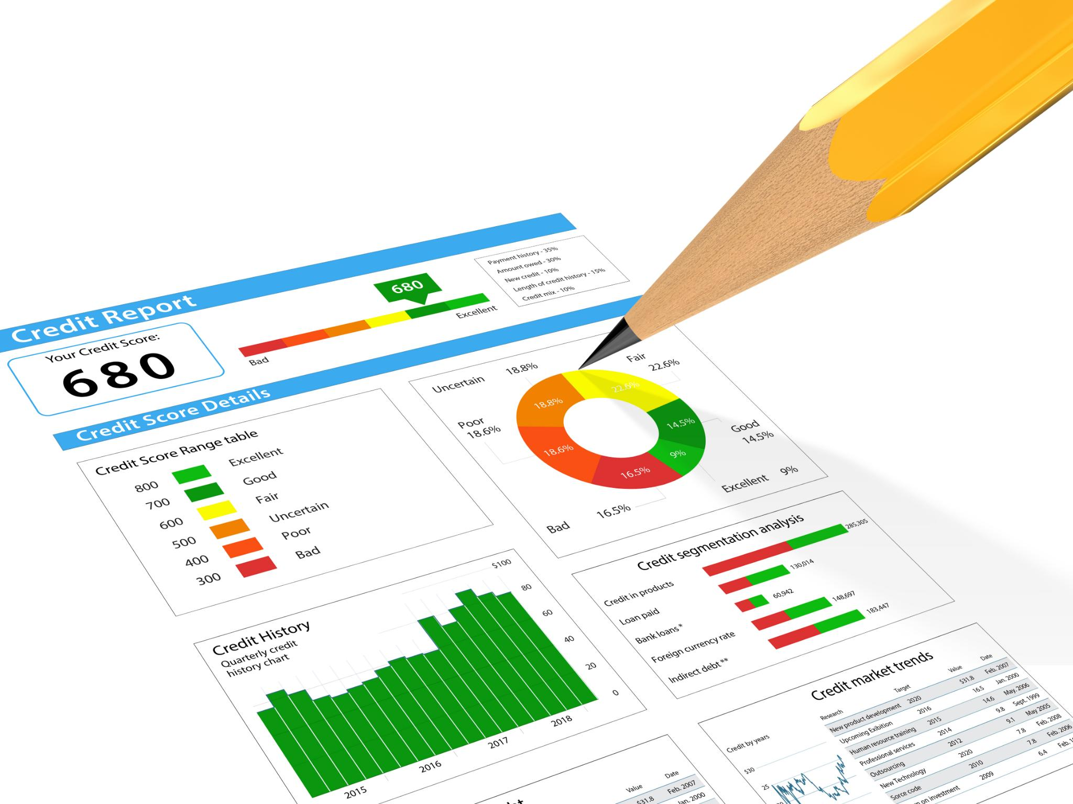
Testing & Validation
Comprehensive Test Cases
Tested Firebase Authentication login/logout flows
Tested AI summarization, quiz generation, and flashcards
Validated file uploads, error handling, and unsupported file types
Confirmed responsive UI behavior
Issue Tracking and Limitations
Known bugs and limitations are documented, highlighting the commitment to continuous improvement and quality.
Notes:
This slide summarizes the testing and validation efforts undertaken during the POC. It includes a table of key test cases, expected outcomes, actual results, and notes on any issues encountered. Sample entries cover scenarios like login functionality, unauthorized access, and responsive design. A visual placeholder is provided for screenshots or logs, offering evidence of testing rigor. This slide demonstrates the project's commitment to quality assurance and highlights known limitations or bugs.

Slide 14
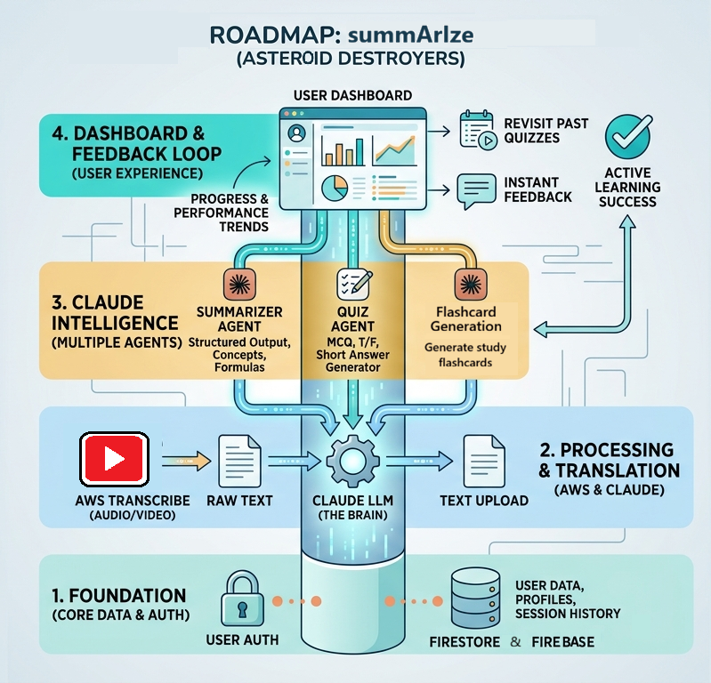
ROADMAP
Notes:
The demo flow slide outlines the step-by-step process for presenting the POC. It includes labeled boxes for each stage—setup, action, and result—connected by arrows to illustrate progression. This structured approach ensures clarity during the live demonstration and helps the audience follow the workflow. A note suggests preparing a short video backup in case of technical issues, emphasizing the importance of readiness and contingency planning.

Slide 15


Feedback & Iteration
Feedback Collection
Gathered constructive feedback from peers and instructors to identify key improvement areas.
Addressing UI Clutter
Implemented design changes to reduce UI clutter, enhancing user experience and clarity.
Optimizing API Performance
Improved API response times to ensure smoother and faster system performance.
Visual Before-and-After
Showcased before-and-after comparisons to highlight enhancements from feedback integration.
Notes:
This slide captures feedback received from peers and instructors and the corresponding changes implemented. A table lists specific feedback items, such as UI clutter and slow API response, alongside the actions taken to address them. A visual placeholder allows for before-and-after comparisons, showcasing improvements. This iterative process highlights the team's responsiveness and commitment to refining the solution based on constructive input.

Slide 16

Metrics & Achievements
Performance Comparison
Column chart contrasts baseline and POC performance across speed, coverage, UX, and stability metrics.
Response Time Improvement
Significant reduction in response time highlights enhanced efficiency of the POC implementation.
Feature Implementation Rate
High rate of feature implementation demonstrates successful project development progress.
Positive Usability Feedback
User feedback indicates strong satisfaction and acceptance of the POC’s usability and design.
Notes:
This slide presents quantitative and qualitative indicators of the POC's success. A column chart compares baseline and POC performance across metrics like speed, coverage, UX, and stability. Additional achievements include reduced response time, high feature implementation rate, and positive usability feedback. These metrics validate the effectiveness of the POC and provide a compelling case for further development.

Slide 17
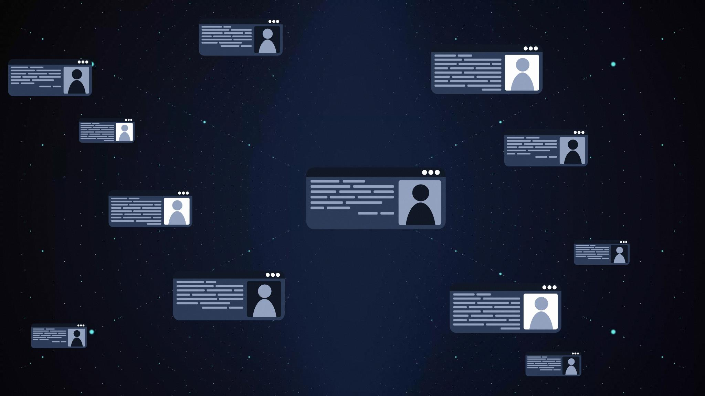
Next Steps / Future Work
Planned Enhancements
Our next step is to continue on with the project to add more features and functions to make the website even better. For example fix the flappy bird game to be more into learning then just a game. Or perhaps add more features for each tab to make it more engaging.
We probably will like to create it into a mobile app for more opportunities in helping others study properly and more efficiently.
Notes:
This slide outlines the roadmap for future development beyond the POC. It includes planned enhancements such as UI polish and extended admin tools, strategies for full-scale implementation like architecture hardening, and risk mitigation efforts including load testing and security reviews. A visual roadmap illustrates the progression from MVP to general availability (GA), helping stakeholders understand the project's long-term vision.

Slide 18
Thank you
Made by:
Emilia Mahmoodi
Andy Moughalian
Roee Palmon
Christian Rusanovsky
Novali Plascencia
Notes:
The final slide lists resources, libraries, frameworks, and datasets used in the POC. It also includes acknowledgements to instructors, mentors, and team members who contributed to the project's success. This slide serves to recognize support and provide transparency regarding the tools and data leveraged during development.

