Slide 1
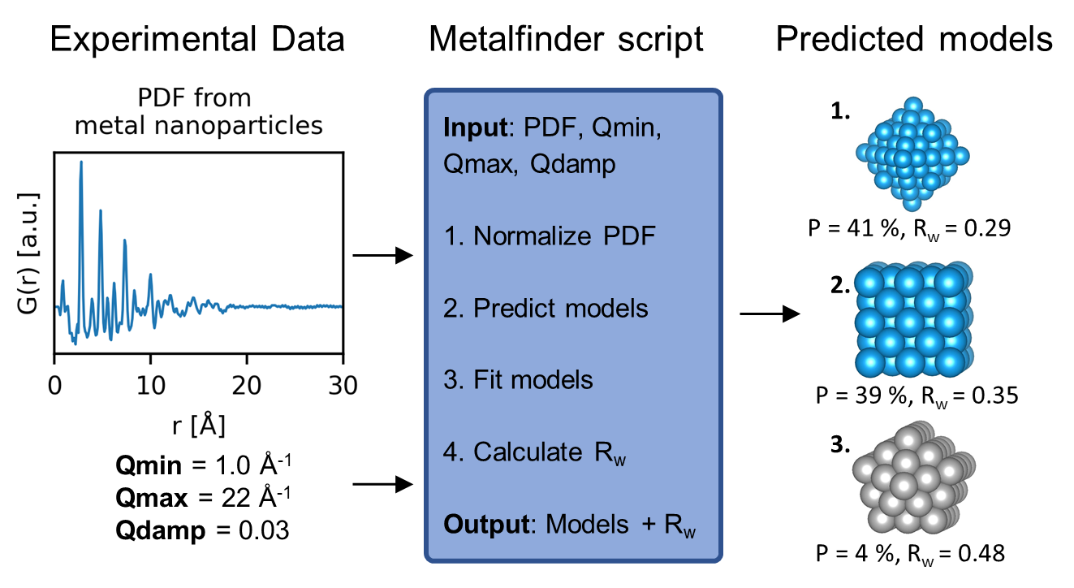
Brute-force PDF modelling
Input: PDF, Qmin, Qmax, Qdamp
Generate a database of structural candidates.
Fit the structures in the database to the experimental PDF and retrieve R_{wp} value.
Output: The structure with the lowest R_{wp} value
R_{wp} = 29 %
R_{wp} = 35 %
Å⁻¹
R_{wp} = 48 %

